Slide 1
Python introduction

Slide 2
Programming language
A computer language is a formal language used to communicate with a computer.
Computers can only understand zeros and ones.
Compile or interpret the source code.

Slide 3
Programming language
Compiler
Entire program
Faster
More preparation
Compiled once
Executable program
Example: C++, Java
Interpreter
Single instruction
Slower
Less preparation
Interpreted every run
Needs the interpreter
Example: Python; JavaScript

Slide 4
Programming language
Low level
Close to machine language
High performance
Requires deep understanding of computer architecture
High level
Close to human language
Performance sacrifice
Abstracts hardware

Slide 5
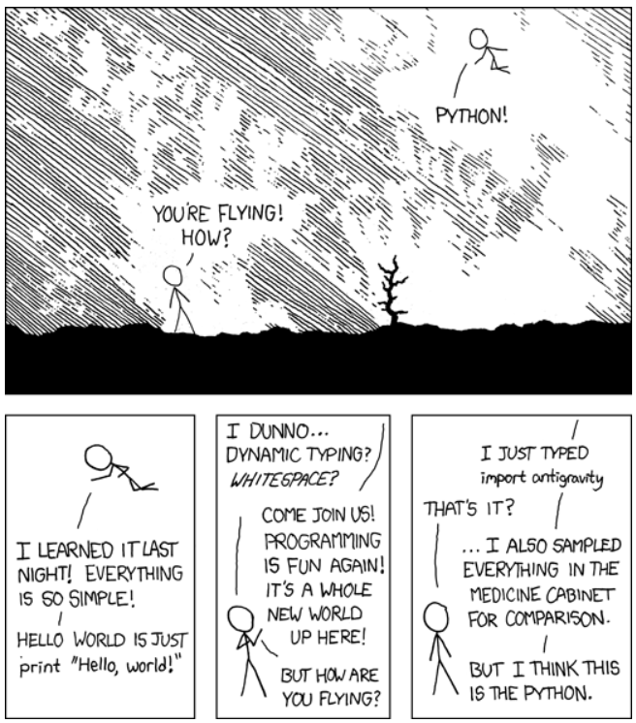
Why Python?
Ease to learn, read and write.
Versatility.
Large community.

Slide 6
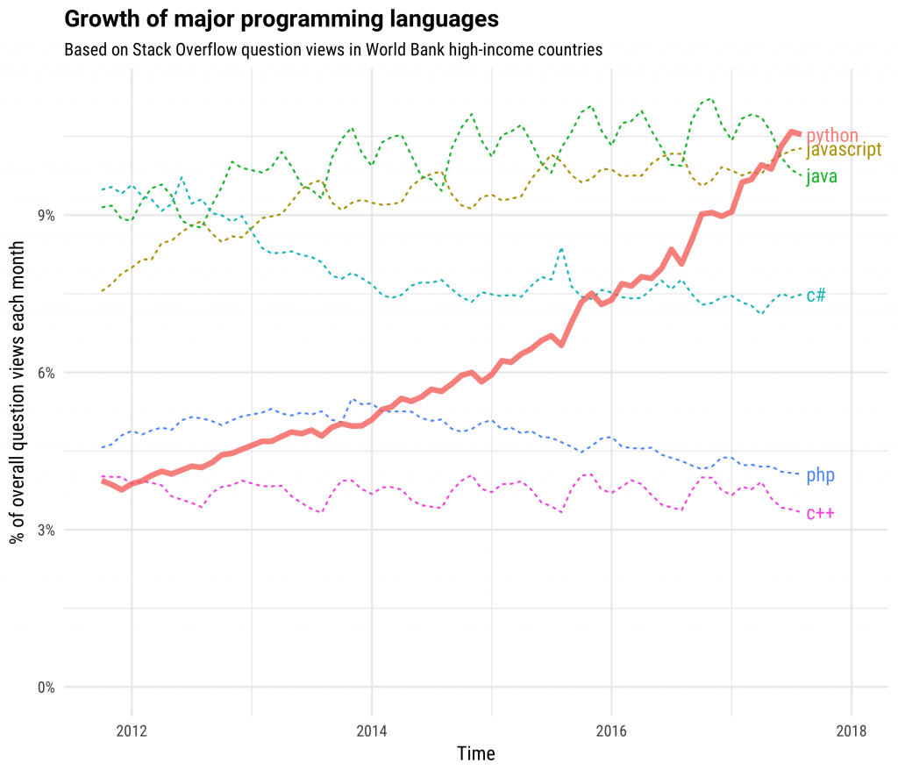
Why Python?

Slide 7
Installing
www.python.org
Interpreter only
www.anaconda.com
Tools and packages for scientific computing

Slide 8
Running
Write your code directly to the interpreter.
Execute a .py file.
Use a Jupyter notebook.

Slide 9
Installing packages
pip/conda install <package>
pip/conda uninstall <package>

