Slide 1
Deprecating the state machine: building conversational AI with Rasa stack
Justina Petraityte, Developer Advocate

Slide 2


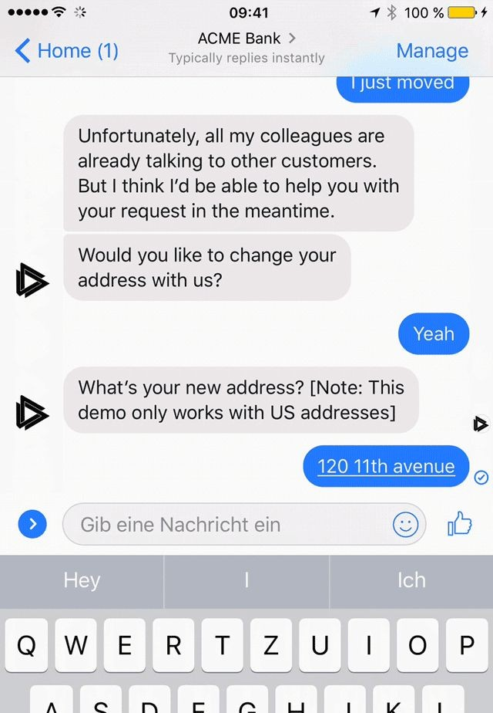

Conversational AI will dramatically change how your customers interact with you.
Example of a live Skill: A customer can change her address via Facebook Messenger

Slide 3
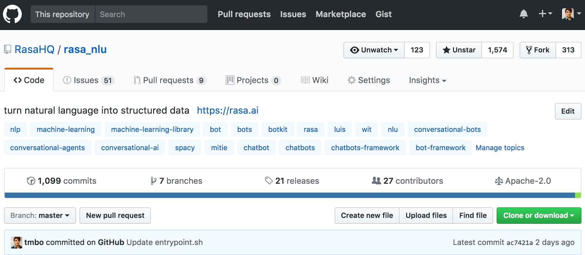
An open source, highly scalable ML framework to build
conversational software

Slide 4
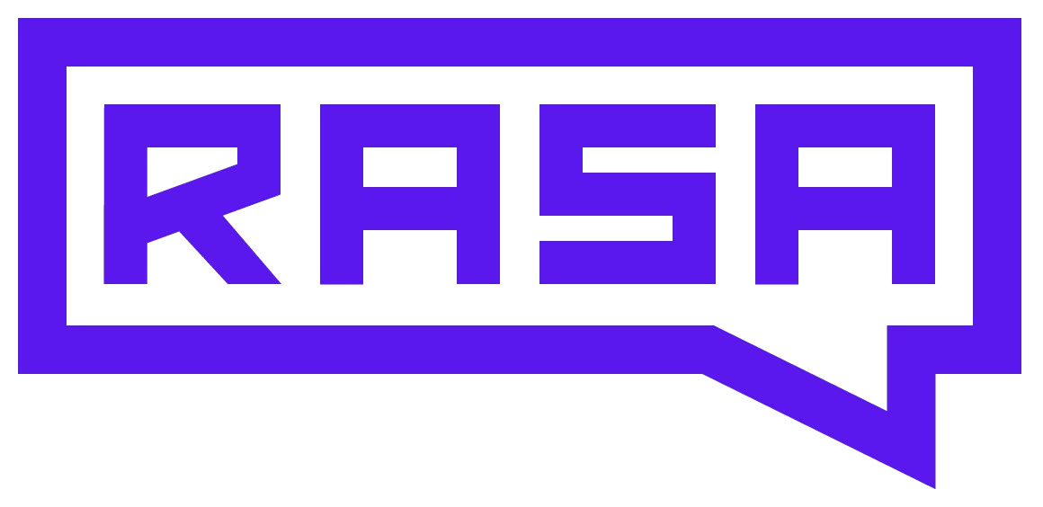












Rasa the OSS to build conversational software with ML
Introduction
Input Modules
“Ears”
NLU, GUI elements, context, personal info
“What’s the weather like tomorrow?”
(User Request via text or voice)
Connector Modules
Backend, database, API, etc.
Dialogue Management “Brain”
“It will be sunny and 20°C.”
(AI response via text or voice)
Connector to any conversational platforms
Output Modules “Mouth”
NLG, GUI elements
Alternatives:

Slide 5



Why Rasa?
Introduction
Runs Locally
Own Your Data
Hackable
No Network Overhead
Control QoS
Deploy anywhere
Don’t hand data over to big tech co’s
Avoid vendor lock-in
Tune models for your use case

Slide 6
What we are focusing on today
Introduction
Goal:
build & understand a bot based on machine learning
Roadmap:
Natural Language Understanding
Theory
Let’s Code
Dialogue Handling
i.
ii.
Research
Questions
Theory Let’s Code

Slide 7
Setup
Introduction
Jupyter notebook in python 3.6 (2.7 should work as well)
Download:
Repository: https://github.com/RasaHQ/rasa-workshop-pydata-berlin

Slide 8
Under the hood
Natural Language Understanding

Slide 9
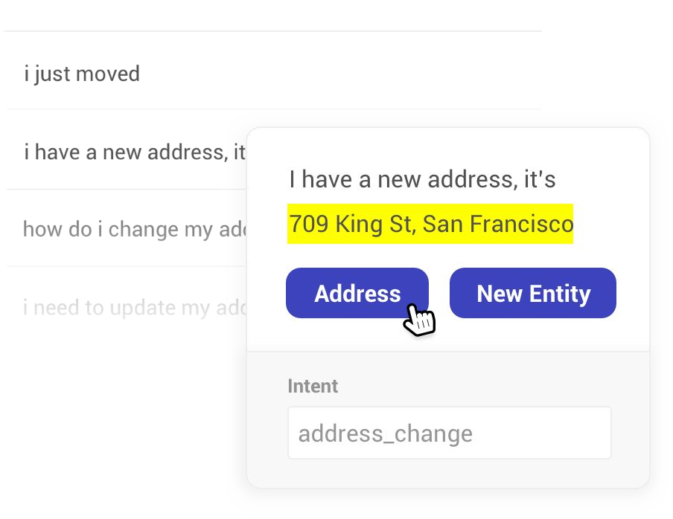

Rasa NLU: Natural Language Understanding
Under the Hood
Goal: create structured data
I have a new address, it’s 709 King St, San Francisco
https://github.com/RasaHQ/rasa-workshop-pydata-berlin

Slide 10
Natural Language Understanding
Under The Hood
Example Intent Classification Pipeline
”What’s the weather like tomorrow?” { “intent”: “request_weather” }
Vectorization
Intent Classification
Natural Language Understanding
What’s the weather like tomorrow?
https://github.com/RasaHQ/rasa-workshop-pydata-berlin

Slide 11
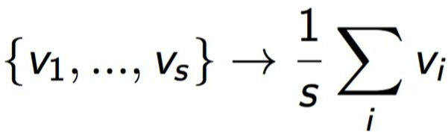





Rasa NLU: Natural Language Understanding
Under the Hood
Bags are your friend
greet goodbye thank_you
request_weather confirm
What’s the weather like tomorrow?
Bag of words
SVM
https://github.com/RasaHQ/rasa-workshop-pydata-berlin

Slide 12
Rasa NLU: Natural Language Understanding
Under the Hood
Example Intent Classification Pipeline
”What’s the weather like tomorrow?” { “intent”: “request_weather” }
Vectorization
Intent Classification
Natural Language Understanding
What’s the weather like tomorrow?
Example Entity Extraction Pipeline
”What’s the weather like tomorrow?”
{ “date”: “tomorrow” }
Tokenizer
Entity Extraction
Part of Speech Tagger
Chunker
Named Entity Recognition
https://github.com/RasaHQ/rasa-workshop-pydata-berlin

Slide 13


Rasa NLU: Entity Extraction
Under the Hood
Where can I get a
burrito
in the
2nd arrondissement
?
averaged perceptron
cuisine
location
Binary classifier is_entity & then entity_classifier
Direct structured prediction
https://github.com/RasaHQ/rasa-workshop-pydata-berlin

Slide 14
Let’s code!

Slide 15
Under the hood Dialogue Management

Slide 16
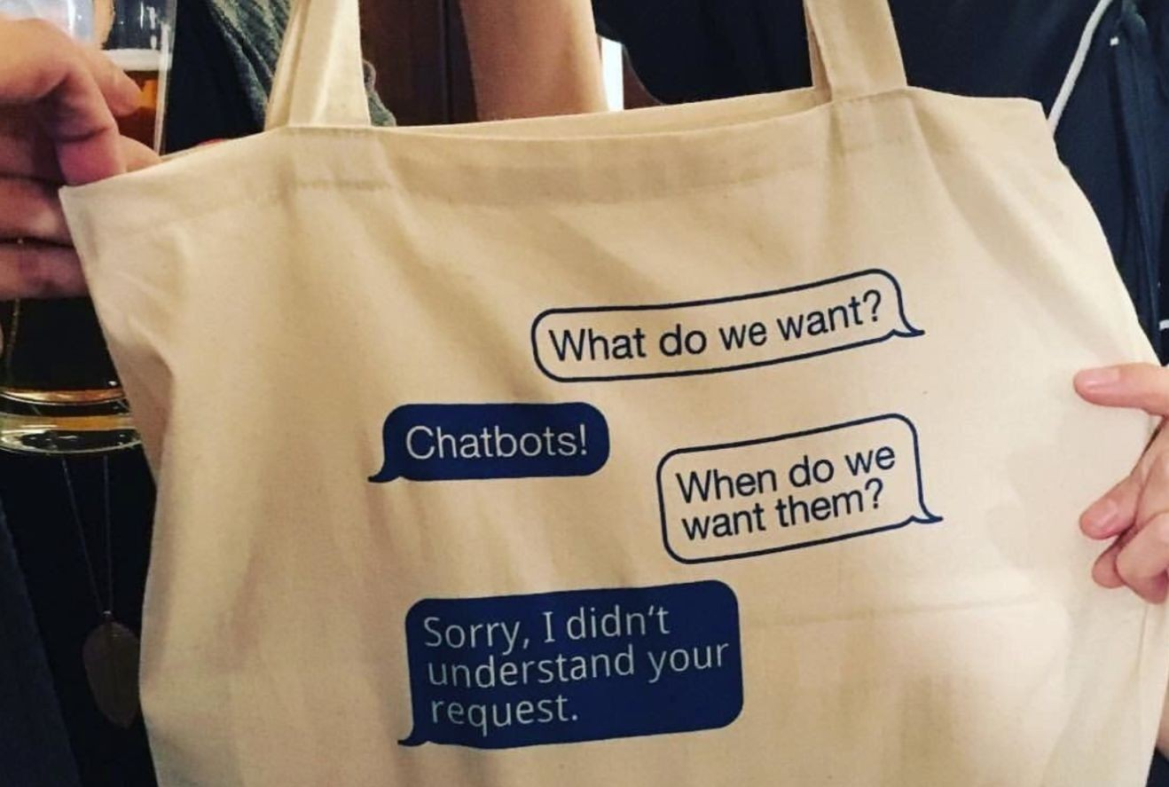
Why Dialogue Handling with Rasa Core?
Under The Hood
No more state machines!
Reinforcement Learning: too much data, reward functions...
Need a simple solution for everyone

Slide 17
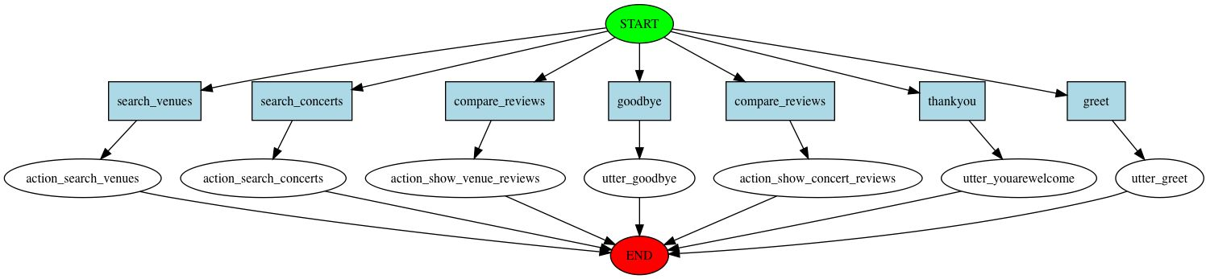
Under The Hood
Why Machine Learning?

Slide 18
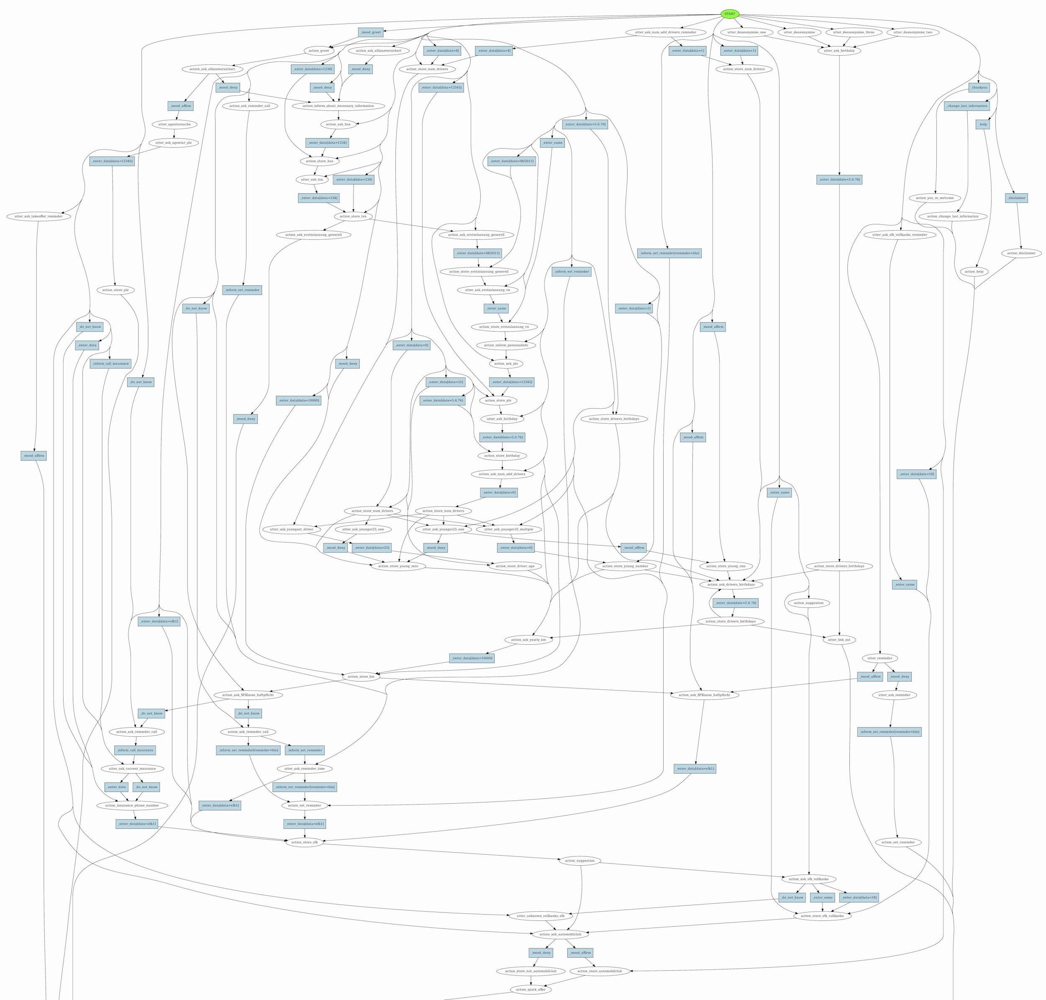
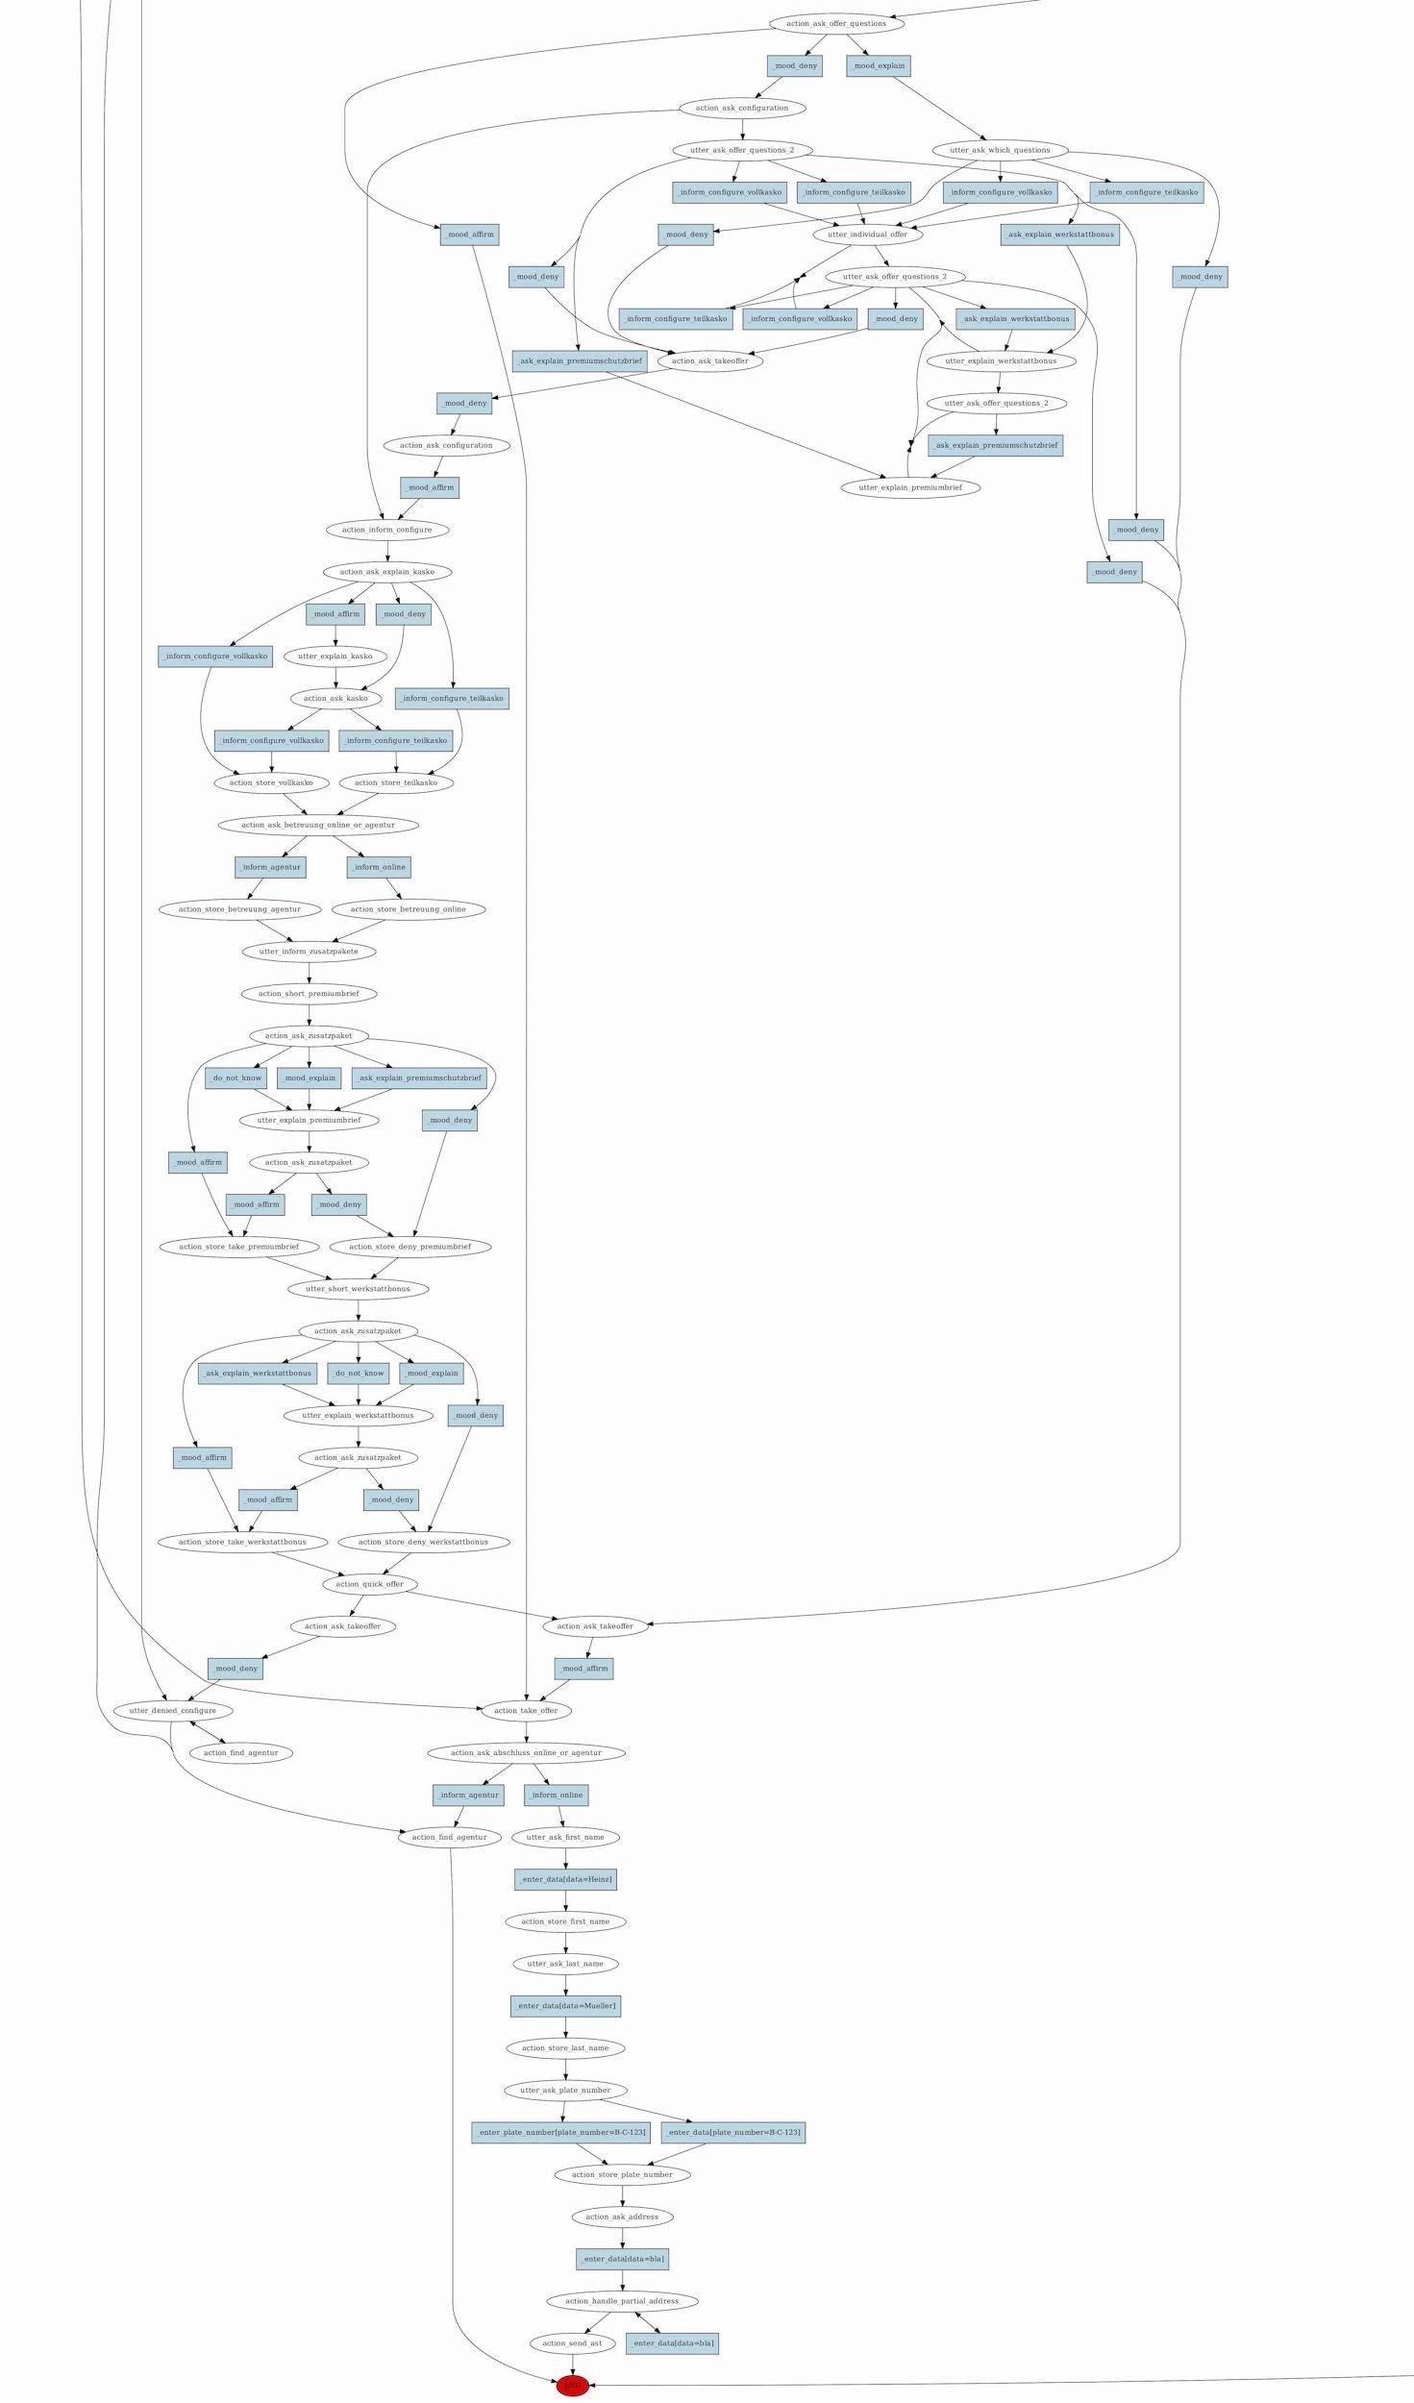
Under The Hood
State Machines are infeasible

Slide 19
previous
Action
Under The Hood
Rasa Core: Dialogue Handling
State
next
Action
“What’s the weather like tomorrow?”
Intent
SVM
Recurrent NN
...
Entities
“It will be sunny and 20°C.”
updated
State
after next
Action
“Thanks.”

Slide 20
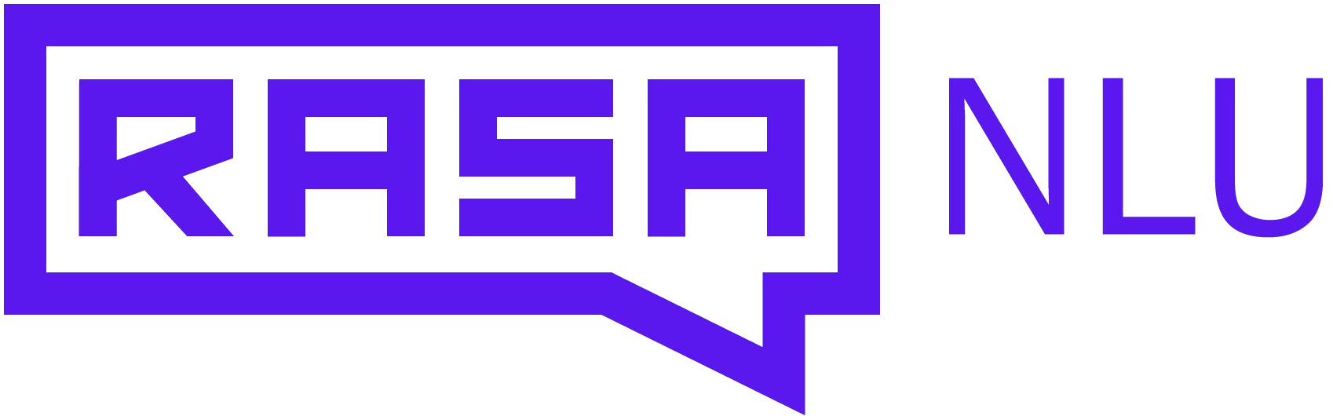

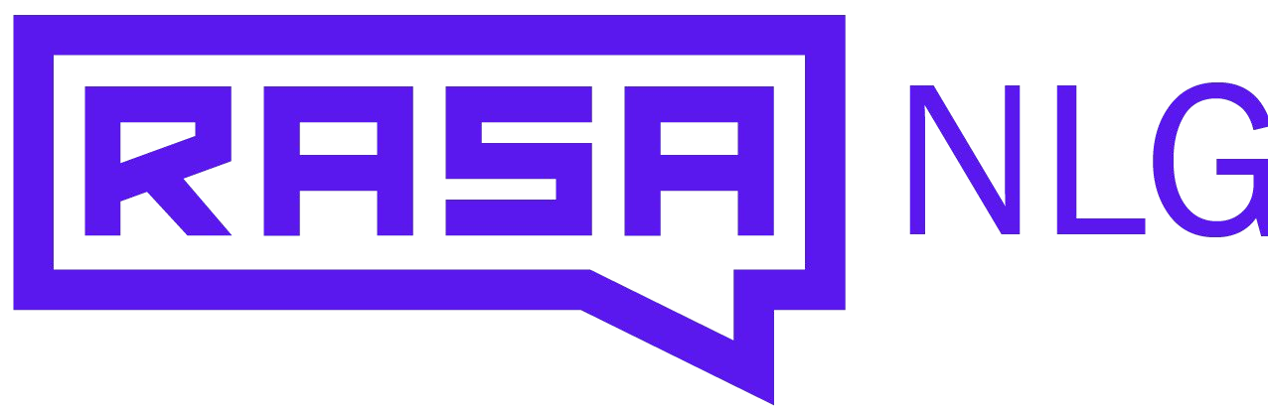
Rasa Core: Dialogue Handling
Under The Hood
Similar to LSTM-dialogue prediction paper: https://arxiv.org/abs/1606.01269
Intent Classification
Action Mask
“What’s the weather like tomorrow?”
Entity Extraction
Entity Input
Recurrent NN
Renormal- ization
Sample action
API Call
API Call
“It will be sunny and 20°C.”
Response
Action type?
Entity Output

Slide 21
Let’s code!

Slide 22

Rasa Core: Dialogue Training
Under The Hood
Issue: How to get started?
→
Online Learning
What’s the weather like tomorrow?
How did you like it?
Correct wrong behaviour
It will be sunny and 20°C.
Retrain model

Slide 23
Let’s Code
Interactive Learning

Slide 24
Research

Slide 25
Training NLU models without initial word vectors
Research
Goal: Learn an embedding for the intent labels based on the user messages
Learns joined embeddings for intents & words at the same time
Allows multi-intent labels
Knows about similarity between intent labels
Based on Starspace Paper
https://medium.com/rasa-blog/supervised-word-vectors-from-scratch-in-rasa-nlu-6daf794efcd8 https://medium.com/rasa-blog/how-to-handle-multiple-intents-per-input-using-rasa-nlu-tensorflow-pipeline
-75698b49c383

Slide 26
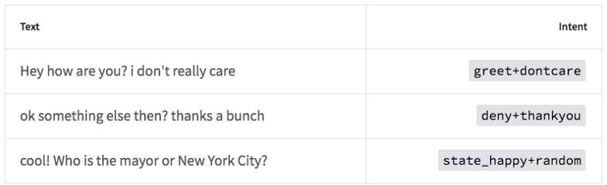
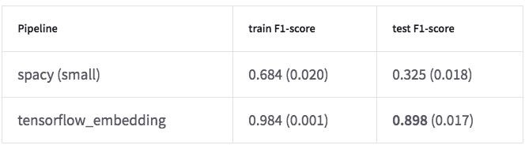
Training NLU models without initial word vectors
Research
Goal: Learn an embedding for the intent labels based on the user messages
Multi-Intent:
Evaluation:

Slide 27
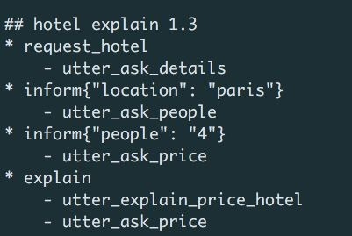
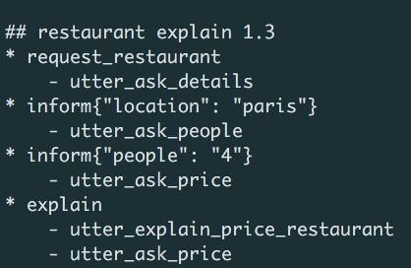

Generalisation across dialogue tasks
Research
Why do we need this complex architecture? For generalisation between domains!

Slide 28
Final Thoughts

Slide 29
Closing The Loop
Final Thoughts
New Training Data
Correct Training Data
“What’s the weather like tomorrow?”
(User Request via text or voice)
Use Improved Model
Retrain ML Models
Relabel Collected Data

Slide 30
Open challenges
Final Thoughts
For those that are curious:
Handling OOV words
Multi language entity recognition
Combination of dialogue models
We’re constantly working on improving our models!

Slide 31
Current Research
Final Thoughts
Good reads for a rainy day:
Last Words: Computational Linguistics and Deep Learning (blog)
https://goo.gl/lGSRuj
Starspace Embeddings (paper)
https://arxiv.org/abs/1709.03856
End-to-End dialogue system using RNN (paper)
https://arxiv.org/pdf/1604.04562.pdf
MemN2N in python (github)
https://github.com/vinhkhuc/MemN2N-babi-python
Sentence Embeddings (blog)
https://medium.com/huggingface/universal-word-sentence-embeddings-ce48ddc8fc3a

Slide 32
Summary
Final Thoughts
4 take home thoughts:
Techniques to handle small data sets are key to get started with conversational AI
Deep ML techniques help advance state of the art NLU and conversational AI
Combine ML with traditional Programming and Rules where appropriate
Abandon flow charts

Slide 33


Get in touch!
We are hiring!
ML Product Success Engineer
ML Engineer
Help the teams who are using Rasa Platform succeed.
Help us push the limits of the conversational AI software.
Justina Petraityte
Developer Advocate
juste@rasa.ai @juste_petr

