Slide 1
Title: Realistic Snake Game Development using Python and Pygame
Name: Garima Verma
Enrollment no.: A25ARI0056

Slide 2
Introduction:
Snake Game is a classic arcade game.
The objective is to control the snake and eat food.
The snake grows after eating food. Game ends when snake hits wall or itself.
Developed using Python and Pygame.

Slide 3

Objectives:
Develop
Develop a smooth and realistic snake game.
Implement
Implement vector-based movement.
Add
Add collision detection.
Display
Display real-time score.
Create
Create interactive gameplay.

Slide 4
Tools & Technologies Used:
Python 3.x
Pygame Library
VS Code
GitHub

Slide 5
Methodology:
Initialize
Initialize Pygame and create game window.
Implement
Implement snake movement using Vector2.
Generate
Generate food randomly.
Detect
Detect collisions (wall & self).
Update
Update score.
Add
Add tongue animation and visual effects.

Slide 6
Key Features:
Smooth movement (not grid-based)
Dynamic body growth
Animated tongue effect 👅
Eye direction changes
Real-time score display
60 FPS smooth gameplay

Slide 7
Code Structure:
Game loop using while running
Direction control using arrow keys
Collision detection using distance formula
Rendering using:
pygame.draw.circle
pygame.draw.lines

Slide 8
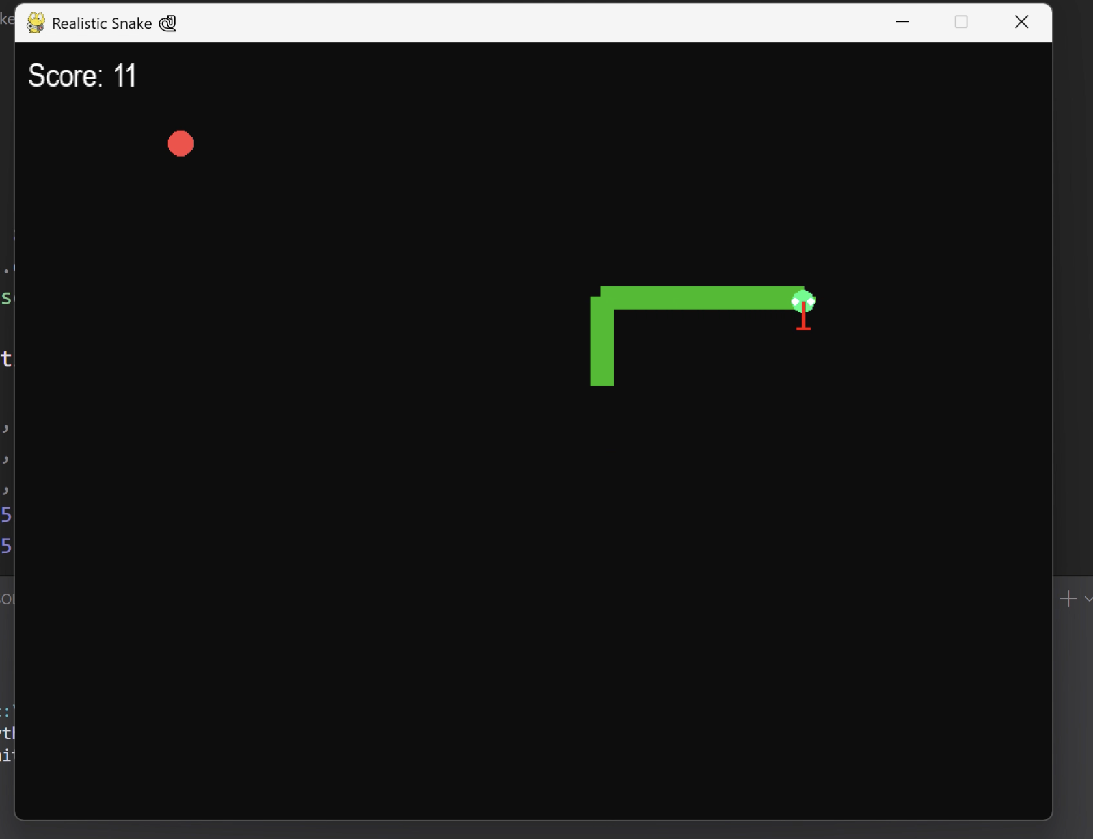
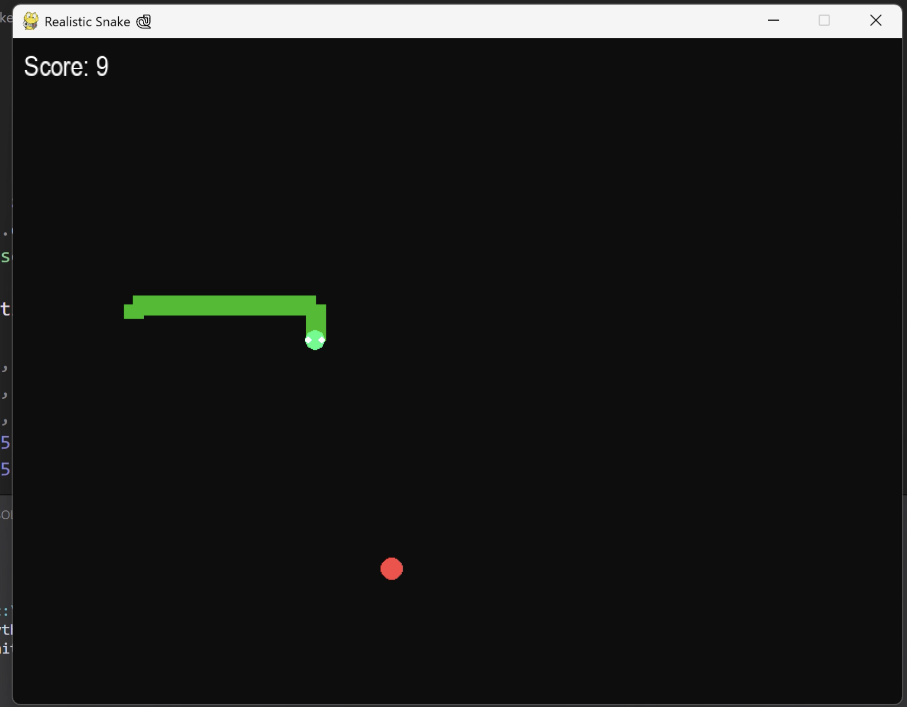
Output Screenshots:

Slide 9
Conclusion:
Successfully developed a realistic snake game.
Implemented smooth animation and collision logic.
Demonstrated game loop and event handling.
Improved understanding of Python graphics programming.

Slide 10
Future Scope:
Add background music
Add restart button
Add difficulty levels
Add high score saving system
Multiplayer mode

Slide 11

GitHub Repository:
https://github.com/gv545312-glitch/Realistic-Snake-Game-using-Python/tree/main

