Slide 1

Generative AI,
LangChain / LangGraph & Agentic AI
20 Jul to 22 Jul 2026
Trainer : Anil Kumar S

Slide 2


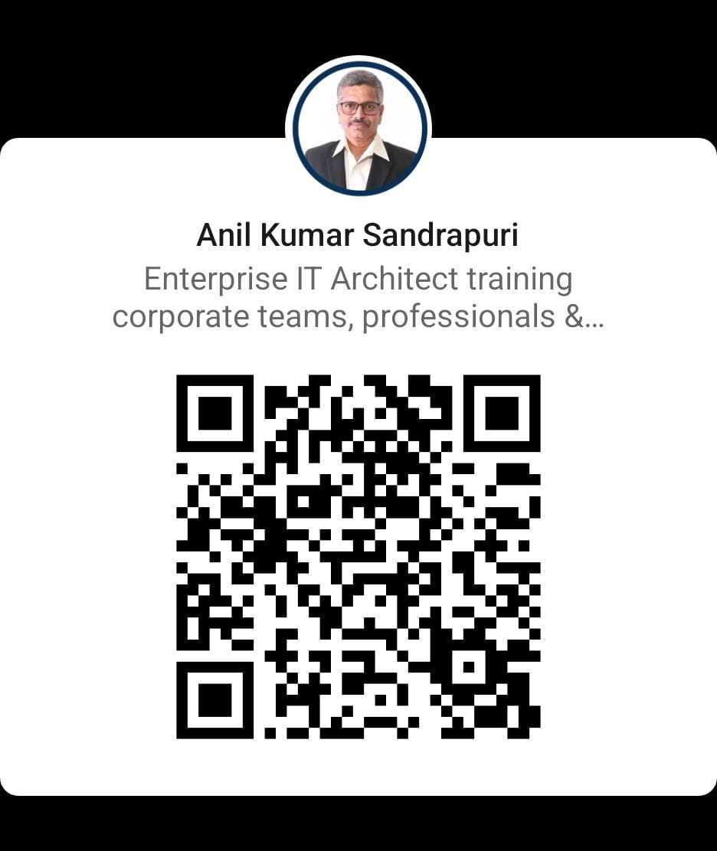
PROFILE
EXPERIENCE
25+ YEARS OF EXPERIENCE IN GLOBAL MNC IN Solutioning, Designing, Architecting, Implementing and Maintaining IT Systems on Multi Cloud, Data & Gen AI.
5000+ HOURS OF TRAINING EXPERIENCE
ANIL KUMAR S
TRAINING & TEACHING
Mentor & Instructor @ GREAT LEARNING - PG Program in Cloud Computing & DevOps
Designed & Delivering Cloud and DevOps with Gen AI Training Program Certified by IITM P
Professor of Practice - VIT Vellore, Veltech Chennai & GRT Institute of Engineering & Technology
Evaluator and Jury Member - Smart India Hackathon
Corporate Trainer in Cloud, Data & Gen AI
Ex-Associate Director, Kyndryl/IBM
Enterprise Architect –
FinOps, Multi Cloud, Data & Gen AI
TEDx Speaker
linkedin.com/in/askanilkumar/
EDUCATION & CERTIFICATIONS
MBA & EXEC ALUMNI IIM –C
Certified in AWS, Azure, Google Public cloud
PMP Certified (Project Management Professional
Finops Certified Practitioner & Certified in FinOps for AI
2

Slide 3
KYP
https://forms.gle/zYHxwPDc5M38Q98m6

Slide 4
Business Problem
Companies don't want ChatGPT/Claude users.
They want engineers who can BUILD
Scalable, Secure, Cost Effective AI systems.

Slide 5
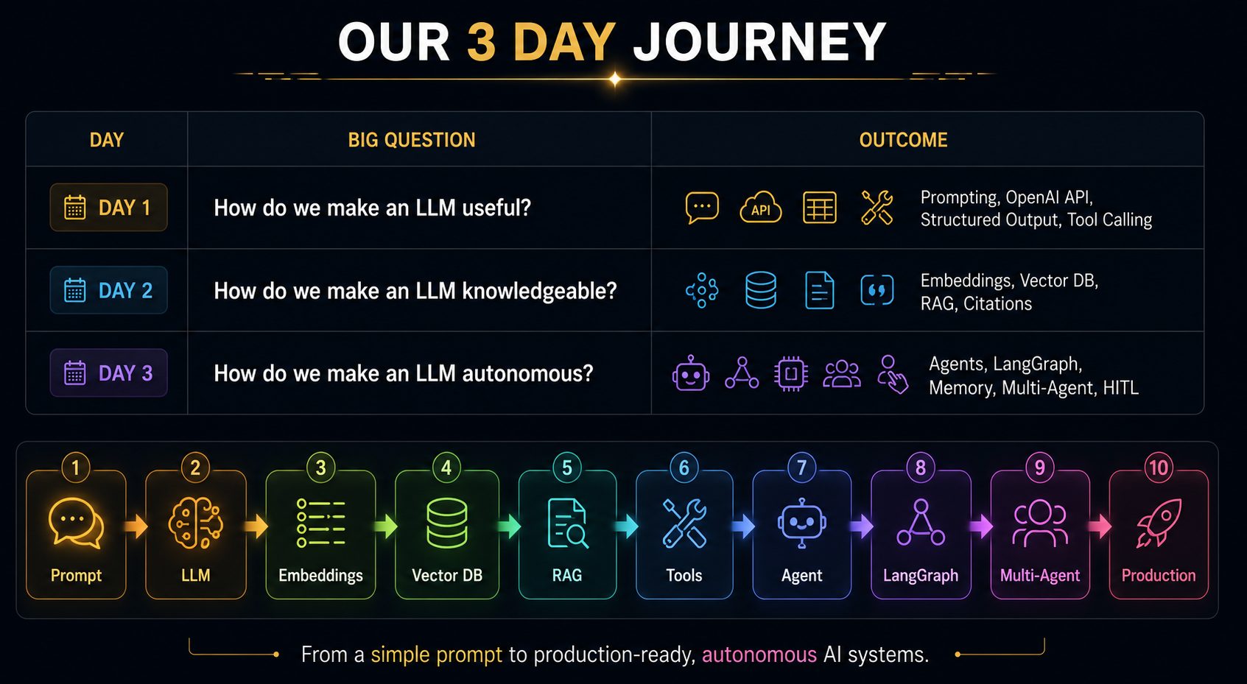

Slide 6
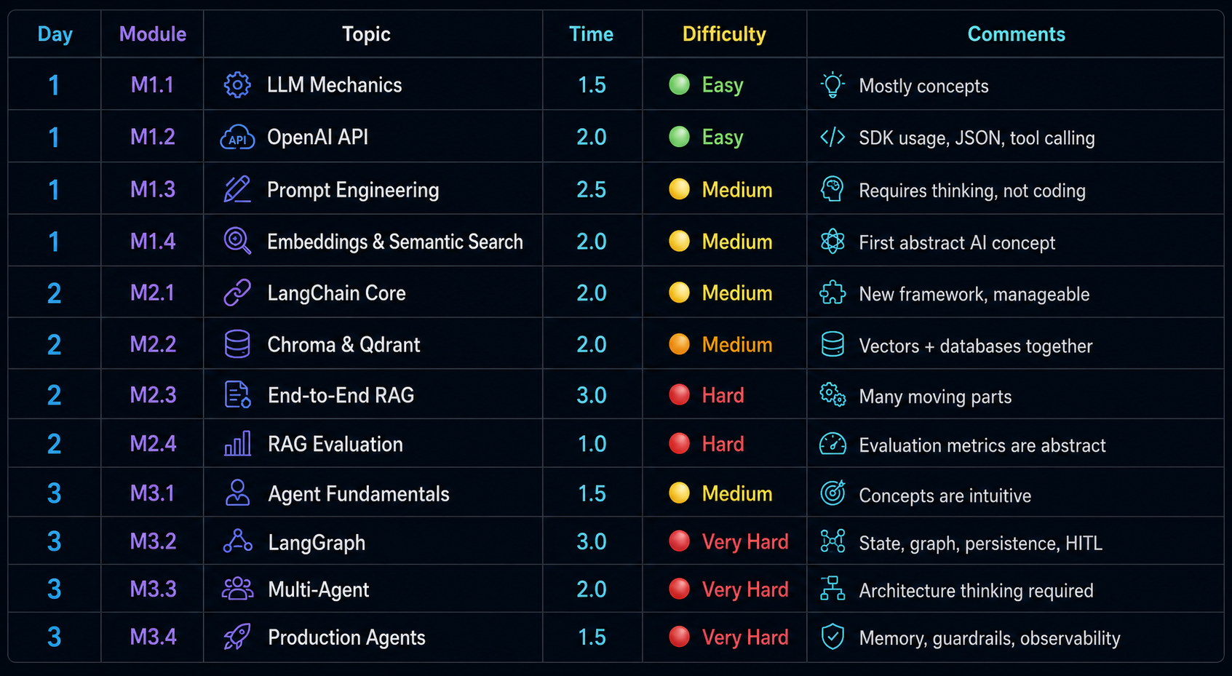

Slide 7
Format
What's different about this training ?
No PPT lectures — every concept is a hands-on interactive HTML page you click through yourself
Concept → Lab → Concept → Lab, all day — theory in small bites, immediately applied
One real system gets built, not 12 disconnected exercises
Labs auto-grade themselves — push your work to GitHub, get instant pass/fail
Silver → Gold → Diamond badges, tracked live on your own dashboard
Module end Quiz on concept and code Gamified – AHASlides)
Day End MCQ Quiz

Slide 8
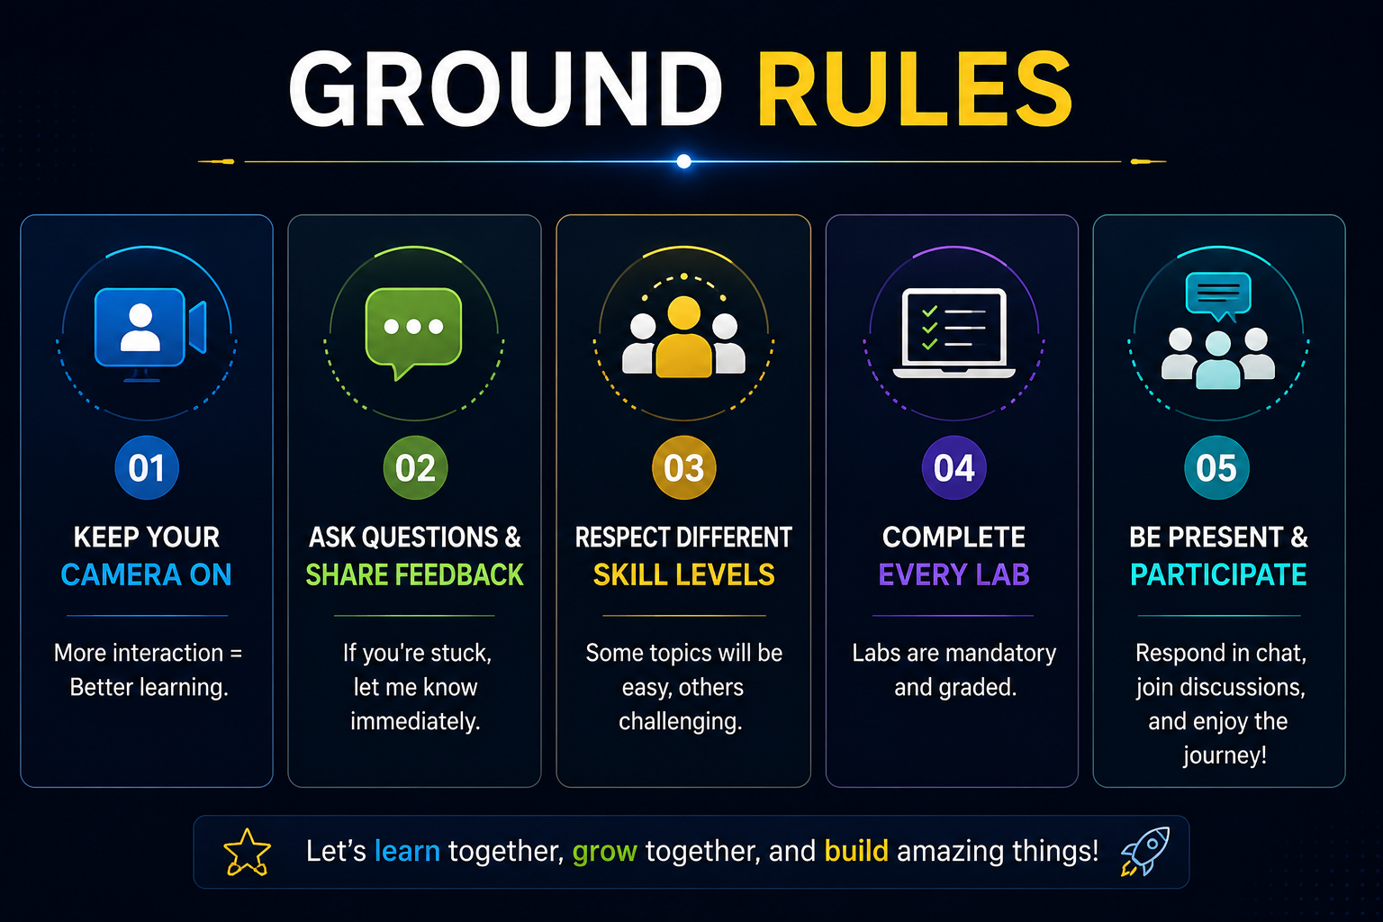

Slide 9
First Steps
Connect to your Azure VM — login details in your email
Fork my GitHub repo — this becomes your personal workspace
https://github.com/Anilmidna/EY_GenAI_3D
On the VM CMD prompt: git clone → git pull — pulls down all Day 1 files
Open in VS Code in VM → sign in to GitHub
Add your OpenAI key to .env → create .gitignore (never commit your key)
After Every lab – git push to see your results on dashboard

Slide 10
Next Steps (After Every Lab)
Finish the lab in every module (Refer Dayx/labs folder)— Understand/write/complete the code
Look for autograder folder - Dayx/autograder
Run the autograder script for the respective module— python autograder/....py (this checks your work, tells you pass/fail)
Example - D1_M1.1_LLM_Mechanics_Autograder.py for Module 1
On pass: it writes a submission file for you automatically
Push it — git add → git commit → git push
Dashboard updates automatically — from your GitHub

Slide 11

https://www.linkedin.com/in/askanilkumar/

Slide 12
Model | Input 1M | Output 1M
GPT-5.5 | $5.00 | $30.00
Claude Sonnet 4.6 | $3.00 | $15.00
Claude Opus 4.7 | $5.00 | $25.00
Gemini 2.5 Pro | $1.25 | $10.00
Gemini 3.5 Flash | $1.50 | $9.00
Grok 4.3 | $1.25 | $2.50
DeepSeek V4 Pro | $0.435 | $0.87
DeepSeek V4 Flash | $0.14 | $0.28
Mistral Medium 3.5 | $1.50 | $7.50
Cohere Command R+ | $2.50 | $10.00

Slide 13
Setting up openai API Keys
Open the new key email inside the VM's browser -May be Google Sheets (not personal laptop — copy-paste across machines won't work).
Copy the key.
In VS Code, open the Day1/labs/starter/ folder. Look for a file called .env.
Already exists from before? Open it, select the old key value, paste the new one in its place, keep the OPENAI_API_KEY= part unchanged. Save (Ctrl+S).
Doesn't exist? Right-click the folder → New File → type .env exactly → paste in one line: OPENAI_API_KEY=sk-... → Save.
VM VSCODE ->Terminal → New Terminal, paste and run once: pip install python-dotenv (If it says "already satisfied," that's fine — nothing to do.)
Open D1_M1.1_LLM_Mechanics_Starter.ipynb. If VS Code asks to select a kernel, choose Python Environments → the version shown.
At the very top of the notebook, before the Setup cell, add a new code cell (+ Code) with exactly this, then run it (▷):

Slide 14
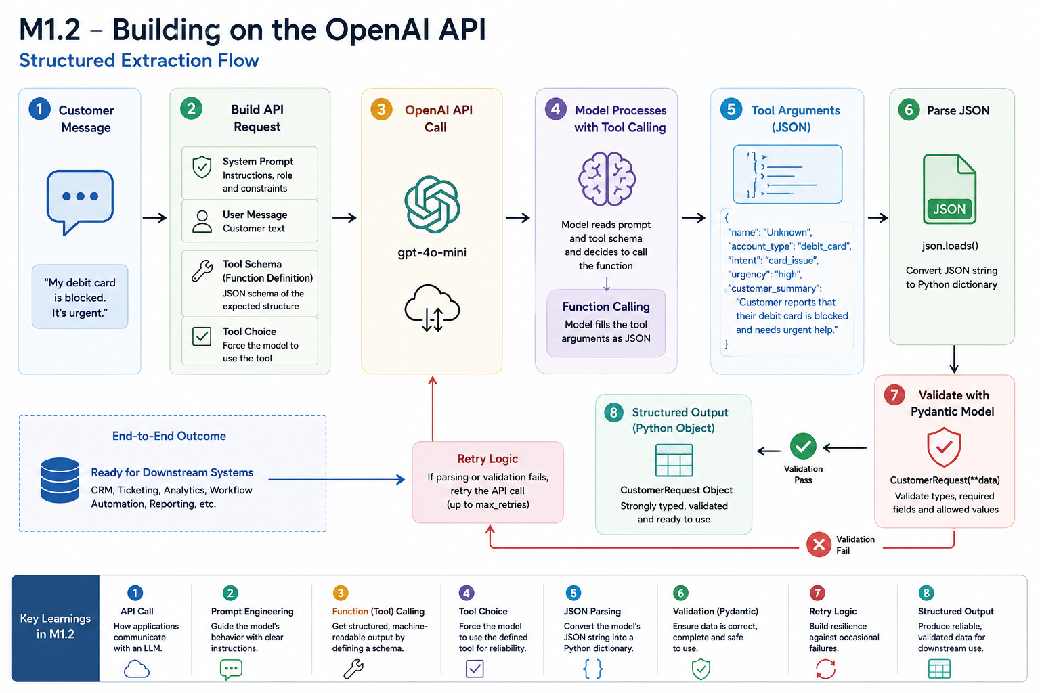

Slide 15
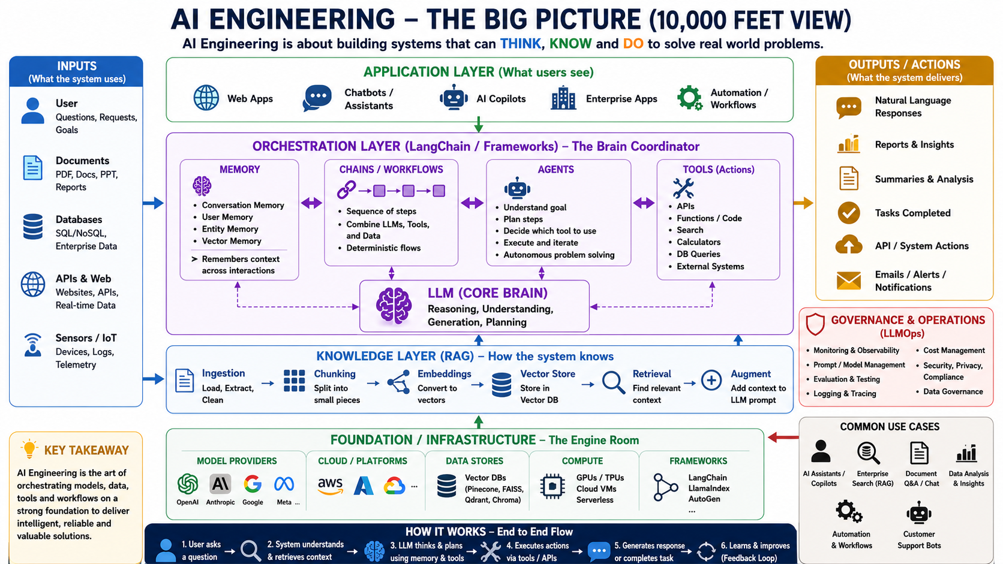

Slide 16
Layer / Topic | Purpose | Popular Tools / Frameworks
Application Layer | User Interface | Streamlit, React, Copilot Studio, Gradio
LLM (Core Brain) | Think & Generate | GPT-5, Claude, Gemini, Llama
Orchestration | Connect everything | LangChain, LlamaIndex, Semantic Kernel
Memory | Remember context | LangChain Memory, Mem0, Zep
Agents | Plan & Execute | LangGraph, CrewAI, AutoGen, OpenAI Agents SDK
Tools | Take Actions | MCP, Function Calling, REST APIs
Knowledge (RAG) | Search enterprise data | FAISS, Pinecone, Qdrant, Chroma
Embeddings | Convert text to vectors | OpenAI, BGE, E5, Voyage AI
Foundation | Build & Deploy | Python, FastAPI, Docker, Kubernetes
Cloud AI Platforms | Host AI services | Azure AI Foundry, AWS Bedrock, Google Vertex AI
Observability / LLMOps | Monitor & Improve | Langfuse, LangSmith, Helicone, Weights & Biases
Evaluation & Guardrails | Quality & Safety | DeepEval, Ragas, Guardrails AI, TruLens

