Slide 1
Tide-a-thon 2023
Classify
Automated document classification system
Sai Kumar Bhupathi
Vamshi Krishna Guntuku

Slide 2
Problem Statement
Document Classification – As industry adopting new technologies everyday most of the organisations choosing digital first approach. In Banking and Insurance domain this trend increased significently. Most of the queries from end users are being solved by back-office employees.
For any request with bank, customer need to fill a form and submit to the bank. Later those queries will be processed by back office employees. For most of the cases a scanned copy of the request shared digitally to back-office employees and they take action them.
Banks work with wide range of products and requests. Every time a new request submitted the major challenge arise that to whoom this request to be routed. Only few people can serve that particular request. So classifying the request type and routing this to appropriate queue is a major challenge.
In market there are multiple products available to perform this task and they capable to run only on windows environment. These products involve much complex configuration and setting. They also have multiple feature which are not required for classification and these features require heavy system resources.
Classify

Slide 3
Proposed Solution
The fundamental capability of system is to perform optical character recognition. For this many character recognition engines available.
As Java can be run on multiple operating system we can choose Java for developing this software.
Additional features like extracting fields from request can be added as an additional functionality.
Software creates classification results in text file or can be directly store to DB or can be save to any other rest service.
Software also includes a tool which allow user to perform manual classification for the requests not able to identified by system.
Classify

Slide 4


Application
Fill & Scan
Documents
Classify

Slide 5

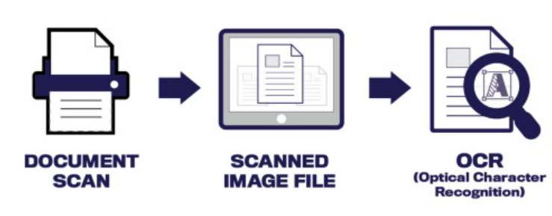
OCR to automatically classify documents
Identify work type
Classify

Slide 6

Automatic workflow assignment
Classify

