Slide 1

What’s New in Training & Certification
Check out the PartnerCast Webinar page (filter by live, on demand, series, language, location, and more)
Get AWS Trained, Accredited, and Certified from any location (Partner Virtual & Online Learning Hub)
All AWS Certification exams now offer online proctoring
Please Welcome
Stephen Johnson, Mobile/Web Specialist SA
Build Mobile and Web Apps
with the new AWS Amplify Admin
26 January 2021

Slide 2
Build Mobile and Web Apps with the new AWS Amplify Admin
Stephen Johnson, Mobile/Web Specialist SA
26 January, 2021

Slide 3
PartnerCast Agenda
AWS Amplify
Develop
Deliver
Manage
Wrap Up

Slide 4
AWS Amplify
Efficient Development and Deployment for apps that scale

Slide 5





Users are accomplishing more virtually. How will your application stand out?
5B (+1.2B)
Mobile internet users by 2025
3.6 hours
Daily time on mobile per user
24 GB (+17 GB)
Monthly mobile data usage per subscriber by 2024
25%
Apps abandoned after first use
4M+
Apps published to global app stores you need to compete with for mindshare
Source: GSMA
Source: Mary Meeker’s Internet Trends 2019
Source: GSMA
Notes:
TODO:
End-user expectations, supported by data (left)
Demand is there: Users and business want to accomplish more virtually.
But, the bar is increasing. Users expect great experience (features, UI, performance, personalization)
Consequence (Right)
There is lots of competition for mindshare, and great experience can make the difference
Front-end developers (i.e., not backend developers) are the most common type of developer

Slide 6





To meet & exceed user expectations, the front-end developer assumes broad responsibility
Platform(s)
Native mobile and web app?
Differentiation
Innovative & new ways to interact
How can your app stand out?
Screen & mobility
Responsive & progressive
Always available, even offline
Security
AuthN and AuthZ by default
Data layer
Instantaneous, with real-time feedback
Network friendly (less calls / more data / just right)
Time to market
Iterative, full stack development
Developer productivity & team workflows
Ability for non-developers to manage the app

Slide 7




AWS Amplify provides tools for front-end developers across the app lifecycle
DEVELOP
DELIVER
MANAGE
Configure AWS backends fast
Seamlessly connect frontends
Deploy your app frontend and backend
Easily manage users & content
Notes:
Job-to-be-done

Slide 8
Developing with AWS Amplify
Featuring the new Admin UI

Slide 9









Amplify provides a full-stack developer experience across ten feature categories
DEVELOP
Feature Categories
Authentication
DataStore
Storage
API (GraphQL & REST)
Functions
Analytics
PubSub
Predictions
Interactions
Notifications
Configure AWS backends fast
Seamlessly connect frontends
NEW!
CLI
Admin UI
Libraries &
UI Components
Powered by AWS services such as AWS AppSync (GraphQL API) and Amazon Cognito (Authentication)
Notes:
Job-to-be-done

Slide 10
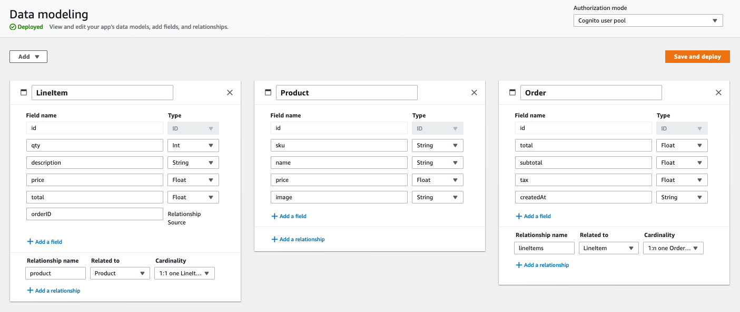
Example: Create backend for a field service app in the admin UI
Customer
Create Orders with associated line items
Create and access only their orders
Barista
Get immediate notification of incoming orders

Slide 11







Connect to your backend with UI components & libraries for popular mobile/web frameworks
Android
iOS
React Native
Ionic
Flutter
JavaScript
React
Angular
Vue

Slide 12
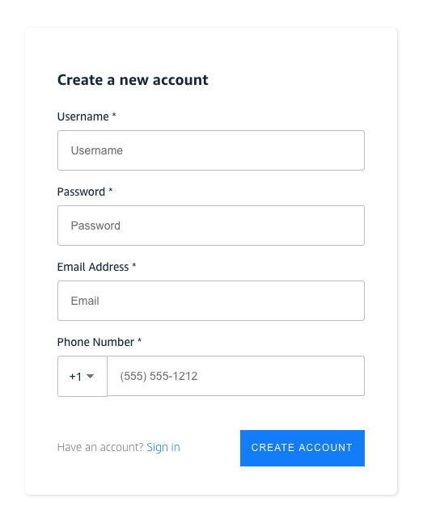
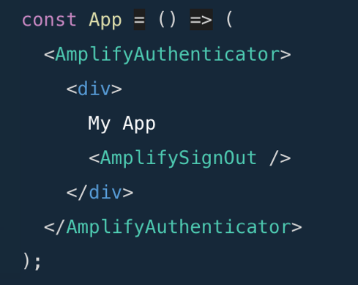
Example: Add sign-up/sign-in flows using the React UI component

Slide 13
Example: Synchronize app data with DataStore
New! Use Selective Sync to apply predicates to the base and delta sync queries, as well as to incoming subscriptions.
const subscription = DataStore.observe(Appointment).subscribe(msg => {
console.log(msg.model, msg.opType, msg.element);
if (msg.opType === "INSERT") {
…
} else if (msg.opType === "DELETE") {
…
}
});
await DataStore.save(new Appointment(
{
description: formState.description,
serviceRegion: formState.serviceRegion,
scheduledTime: formState.startDate
}
));
Subscribe to changes
DataStore.configure({
syncExpressions: [
syncExpression(Appointment, () => {
return (c) => c.serviceRegion('contains', ', WA');
}),
syncExpression(WorkOrder, () => {
return (c) => c.serviceRegion('contains', ', WA');
}),
]
});
await DataStore.query(
WorkOrder,
item => item.appointmentID("eq", appointment.id));
Save and retrieve
New! Only sync a subset of data

Slide 14
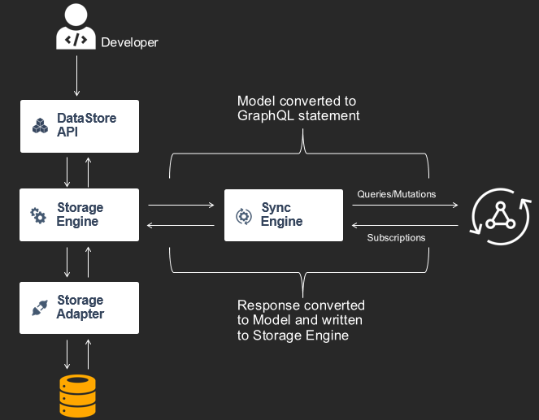


Amplify DataStore: Developer experience
Model app data & relationships
(locally or in admin UI)
Set up authentication & authorization
Work with app data using an ‘offline-first’ programming model. Receive updates to shared data in real-time.

Slide 15
Amplify DataStore: How it works

Slide 16
Deploying with AWS Amplify
Using the Amplify Console

Slide 17
Deliver your app: Managed hosting and full-stack deployment with CI/CD
DELIVER
Services & Features
Static web hosting
Fully managed hosting service for static web apps
Easy custom domain setup
Full-stack continuous deployments
Both Amplify CLI and admin UI generate infrastructure as code (IAC)
Deploy via the CLI or console
Deploy your app frontend and backend
CLI
Console

Slide 18
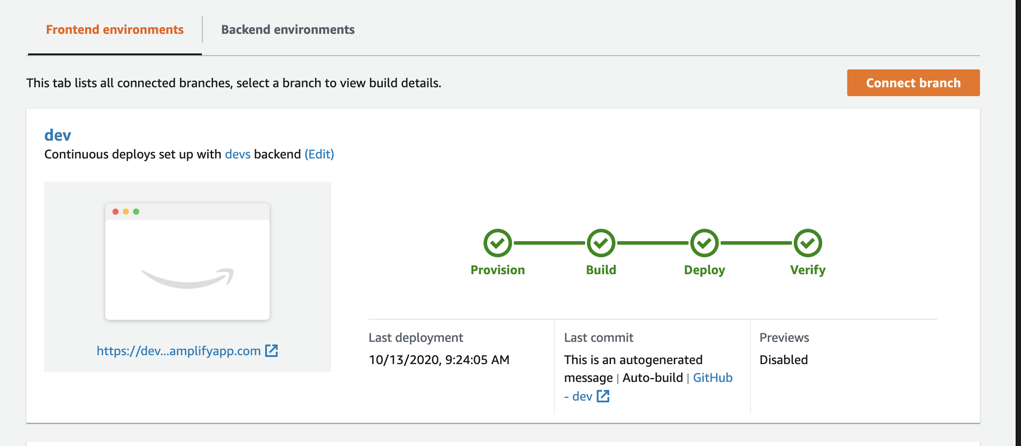
Deliver your app: Managed hosting and full-stack deployment with CI/CD

Slide 19
Manage your App and Content with AWS Amplify

Slide 20
Manage app content and users with the admin UI
NEW!
MANAGE
Features
Accessible outside AWS console
Share access with non-developers (QA testers, Product Managers)
Content management functionality with rich text support
User and group management
Easily manage users & content
Admin UI
Notes:
Easily manage content Use the Amplify admin UI to provide non-developers with administrative access to manage app users and app content without an AWS account.
Admin UI
Once your app is launched, you can use the Amplify admin UI to invite app operators to access the user and content management view to manage users and app content without relying on developers to push updates.

Slide 21
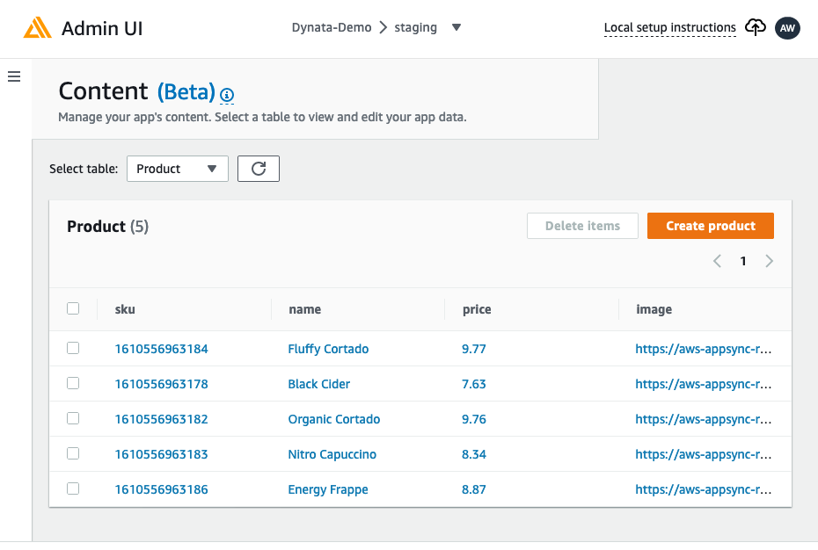
Manage app content and users with the admin UI
NEW!

Slide 22
3 Key Takeaways
Building Apps using Amplify is easier than ever with the Admin UI
Backends are easy to import and use for Web and Mobile with the CLI
Supports Native, React Native, Flutter, React and other JS platforms

Slide 23
Amplify Resources
Website: aws.amazon.com/amplify
Docs: docs.amplify.aws
Tutorials: docs.amplify.aws/start
Community: amplify.aws/community
Github: github.com/aws-amplify
Discord: www.discord.gg/amplify

Slide 24
Thank You!
Please join us again for another PartnerCast session
https://aws.amazon.com/partners/training/partnercast/

Slide 25

Shape the future of AWS Partner learning! AWS Partner Training Feedback Contributor
Notes:
At AWS we love to get feedback on how we can improve the learning experience for AWS Partners. If you’re interested in sharing your opinion and shaping the future of AWS Partner learning, you can become an AWS Partner Training Feedback Contributor. To learn more about this opportunity to give us direct feedback and to sign up, go ahead and take a moment right now to open your phone camera app, hold it up to the QR code and click the “Website QR Code” that pops up on the top of your screen. Alternatively, if you can click the link that I’ll share in the chat window right now.
(Copy/paste this into vILT chat window):
Shape the future of AWS Partner training! Become an AWS Partner Training Feedback Contributor. Learn more about this opportunity to share your voice: https://amazonmr.au1.qualtrics.com/jfe/form/SV_0f8NPPCzJEHcv5z

