Slide 1
EuroPython Keynote
June 26, 2002
Guido van Rossum
Director of PythonLabs at Zope Corporation
guido@zope.com
guido@python.org

Slide 2
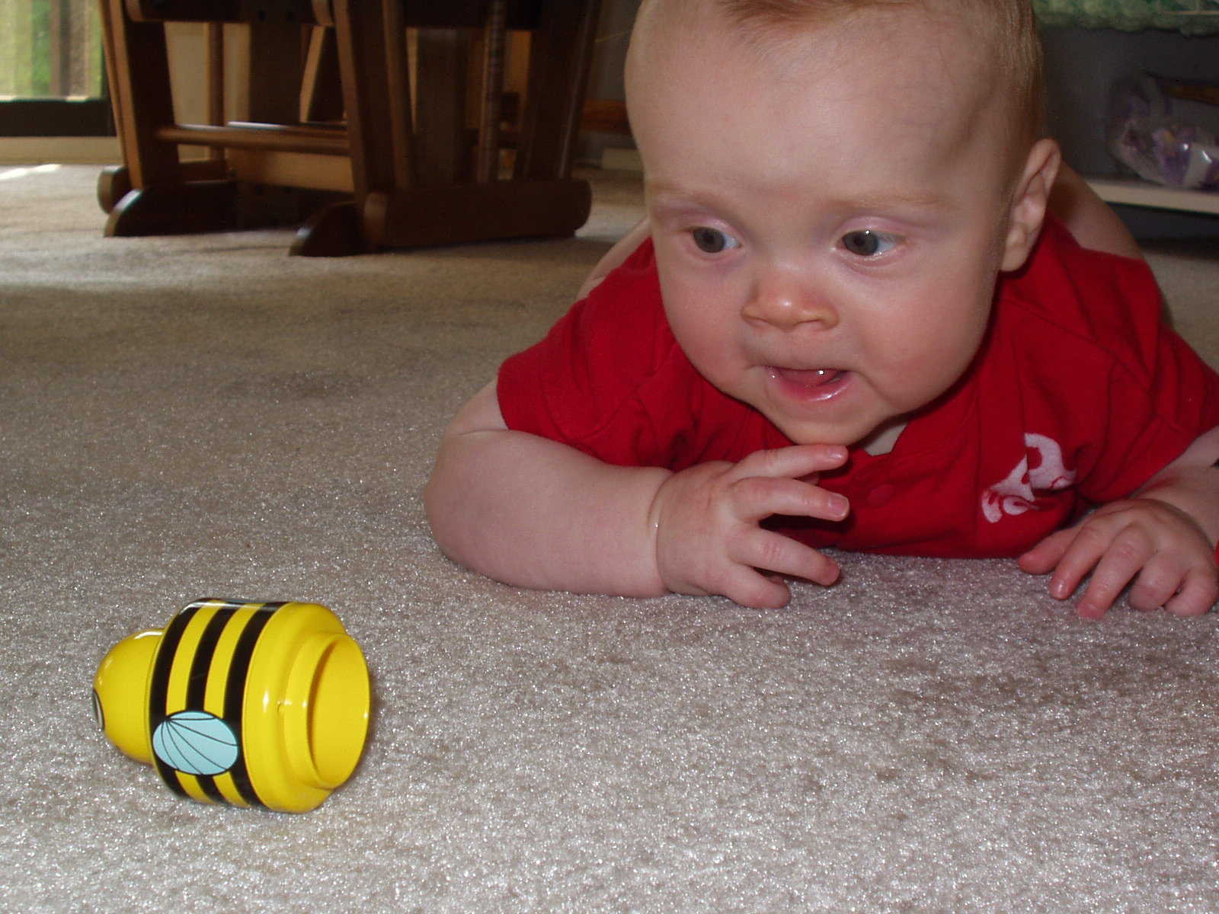

Slide 3
Recent Releases
Python 2.2
  iterators!
  generators!!
  new-style classes!!!
  and too much to summarize here...
Python 2.1.3
  bug fix release for 2.1; focus on stability
Python 2.2.1
  bug fix release for 2.2; ditto
What's with this stability focus...? (see later)

Slide 4
Python Organizations
Python Software Foundation
  www.python.org/psf
  US non-profit for research and education
  owns the current Python copyright
  looking for donations and sponsors
Python Business Forum
  www.python-in-business.org
  EU non-profit for businesses based on Python
  plans:
    Python in a tie
    Compile farm

Slide 5
Python in a Tie
Result of stability discussion on c.l.py
Plan:
  pick a release and maintain it for 18+ months
  bleeding edge development releases continue
Purpose:
  have a reliable target for commercial users
  stability more important than latest features
Which release????
  Python 2.2.x most likely candidate
See BOF on Friday

Slide 6
Compile Farm
Joint venture of PBF and Lysator
    Lysator: oldest Swedish computer society
  Lysator owns a very diverse hardware farm
  PBF provides motivation, funding
Goals:
  testing on many platforms
    Python-in-a-tie as well as bleeding edge code
    core Python as well as 3rd party extensions
  build binary releases for Python-in-a-tie
    hopefully "sumo releases"
See BOF on Friday

Slide 7
Python.Org HTTP Statistics
May 2002
  7.9M HTTP requests from 257K hosts
    291K hits for "/"
  52K downloads of Python 2.2.1
    about 70% Windows installer
Feb 2001
  5.5M HTTP requests from 164K hosts
    212K hits for "/"
  23K downloads of Python 2.0
    over 70% Windows installer

Slide 8
What's With SourceForge?
Sad to say, unhappy with many services
  main problem: SF no longer listens
CVS still fine
Mailing lists: Geocrawler archives stink
Moved dev guide to www.python.org/dev
Moved file downloads to www.python.org
  (too much work to upload, less used)
Issue trackers: lots of issues...
  watch this space

Slide 9
"No Uncontroversial Topics"
The yearly recap of a recent flame war
It's a growth opportunity!
QOTY:
  "When a group becomes large enough there are no uncontroversial topics any more."
      Erik van Blokland (in personal email)
This year's topic:
  to bool or not to bool

Slide 10
Why bool()?
I always regretted having left it out
If it's not built-in, people define their own
Explicit is better than implicit: "return True"
A bool result is distinguished in output
  >>> x == y
  True
  >>>
"bool(x)" normalizes Booleans
  was "not not x"
RPC tools can special-case Booleans

Slide 11
Why not bool()?
All misunderstandings (in my opinion)
Will "if x:" require x to be a bool? (Never!)
Some people write "if x == True:" (Yuck)
"No function should return a bool" (Huh?)
It's confusing to teach
  I don't buy this:
    You need to explain the Boolean concept anyway
    You need to pick representatives anyway
    You need to explain that (almost) all types have a Boolean interpretation anyway

Slide 12
How to bool()?
bool is a new built-in type
True and False are the only values
  singletons like None ("dualtons"?)
Cannot be subtyped
Subtype of int, for compatibility
  True + 1 == 2
  True == 1
  str(True) == 'True' # The only incompatibility
  will stay this way in Python 3.0
    it's useful and harmless

Slide 13
Lessons Learned
Everything is controversial
Anticipate potential misunderstandings
  explain in advance
  I thought the PEP was clear - not so :-(
In the end, do what's right

Slide 14
The Future: Python 2.3
No new syntax, except yield w/o __future__
Library focus, e.g.:
    support extended slices, e.g. "dlrow olleh"[::-1]
    bool() and enumerate()
    more callable types; basestring
    import from zip files
    timeouts for sockets
    logging module
    gnu_getopt and option parser modules
    new compiler package
    berkeleydb module
Fixing bugs
  e.g. disappearing unwise.exe

Slide 15
PendingDeprecationWarning
Discourage certain things in new code
  But don't warn about them normally
    Because they are too common
Potential examples:
  string module (use string methods)
  types module (use built-in type names)
  has_key (use 'in' operator)
To get the warning:
  python -Wall # also warns about overflows
  python -Wall::PendingDeprecationWarning

Slide 16
Python 2.3 Miscellanea
Make None a keyword?
  can't do this at once
    it's surprising how much code would break
      typical idiom: def func(x, y, None=None): ...
        (trying to save repeated lookup time of built-in None)
Stage 2 of int/long integration
  add warning for hex/octal of negative short ints
  add warning for certain left-shifts of short ints

Slide 17
2.3 Release Schedule
Surprise: we have none!
Focus on feature completeness, not dates
Hope: alpha before OSCON, final in 2002
See PEP 283 for details

Slide 18
Pace of Change
Users demand a stop to all new features except for their personal favorite
  this contradiction seems unavoidable
What do do about this?
Is Python-in-a-tie sufficient?
"Would you rather..." [idea due to Barry]
  learn more syntax or use a library module?
  understand a deep concept or have fuzzy rules?
  fix design mistakes or be backwards compatible?
  use indentation or braces? :-)

Slide 19
Example: String Interpolation
Problem: % interpolation is cumbersome
  print x, "+", y, "=", x+y
  "%s + %s = %s" % (x, y, x+y)
  "%(x)s + %(y)s = %(z)s" % vars()
  str(x) + " + " + str(y) + " = " + str(x+y)
Solution 1: "$foo".sub() # runtime
  "$x + $y = $z".sub()
Solution 2: x"$foo" # compile-time
  x"$x + $y = $(x+y)"
Solution 3: x"`foo`" # compile-time
  x"`x` + `y` = `x+y`"

Slide 20
Python 3.0
No release schedule either :-)
Not within two years
Question: what to focus on???
Zope 3 experience may be relevant
  Rebuild from scratch
    Refactor mercilessly during development
    No concern for backwards compatibility
      But learn from past: good ideas, bad ideas
    Use coding "sprints"
  Later, add compatibility (Zope 3x -> Zope 3)
  Or: Later, merge best features back into 2.x

Slide 21
Open Mike
It's your turn!

