Slide 1


Slide 2
Python Track
Opening Words
Guido van Rossum
guido@python.org
Open Source Conference
Monterey, August 1999

Slide 3
Talk Overview
Conference Logistics, Thanks
Python, Perl, Religion
Python’s Growth, Future
The Python Consortium
CP4E
IPC8

Slide 4
Conference Logistics
Session moderators: DA, PE, GvR
All talks in this room (Colton)
  Except today 11-12:30:
    Track 1 in Colton (DA)
    Track 2 in Redwood (GvR)
Get your detailed program
  Note program changes!

Slide 5
Thanks
O’Reilly
Instructors & speakers
Audience
David Ascher!

Slide 6
Python, Perl, Religion
Larry, Tom, me are good friends...
  but we differ on language design :)
Python is not a scripting language!
Programming as G d intended :)

Slide 7
Python’s Growth
How far we have come
Exciting Python applications
Typical success stories
Web statistics

Slide 8
How Far We Have Come
Typical manager’s response to programmer who wants to do a project in Python...

Slide 9
How Far We Have Come
    1995: "Python? What's that?"

Slide 10
How Far We Have Come
    1995: "Python? What's that?"
    1997: "But nobody else uses Python!"

Slide 11
How Far We Have Come
    1995: "Python? What's that?"
    1997: "But nobody else uses Python!"
    1999: "Where can I hire Pythoneers?"

Slide 12
How Far We Have Come
    1995: "Python? What's that?"
    1997: "But nobody else uses Python!"
    1999: "Where can I hire Pythoneers?"
    Next: "Nobody expects the Spanish Inquisition!"

Slide 13
Exciting Applications
Zope - supercharged websites
Mailman - GNU mailing list manager
JPython - Java integration
Python on Windows (COM, ASP etc.)
XML processing with Python
OpenClassroom
Star Wars!

Slide 14
Typical Success Stories
Prototype in Python
    first to market
    acquisition
    rewrite in C++ or Java
  e-shop; 411
steering
    symbiosis of Python and C++ or Java
  LLNL; ILM; Alice

Slide 15
Web Statistics
Recent Python.org downloads
Newsgroup traffic since 1992
Downloads since 1996: hosts, Gb
  only distr downloads via http server

Slide 16
Python.org downloads
August 1-20
      homepage 63744
      Contributed 8225
      Windows installer 8086
      1.5.2 sources 3992 (1.5.1: 388)
      win32 extensions 2228
      FAQ 4737
      html 2223
      pdf 1743 (ps: 536)
      JPython 722 (w/o ORO: 146)

Slide 17
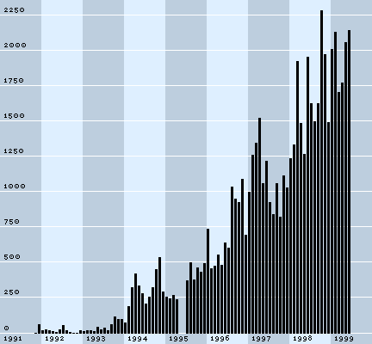
Newsgroup traffic

Slide 18
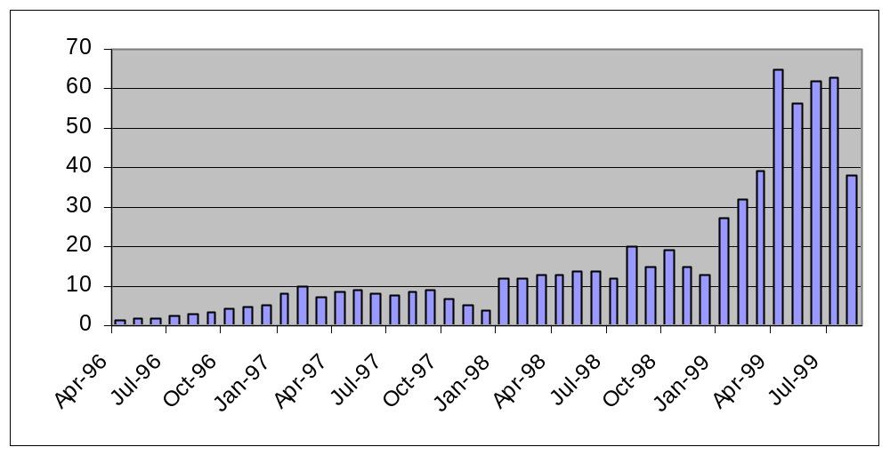
Downloads (Gigabytes)

Slide 19
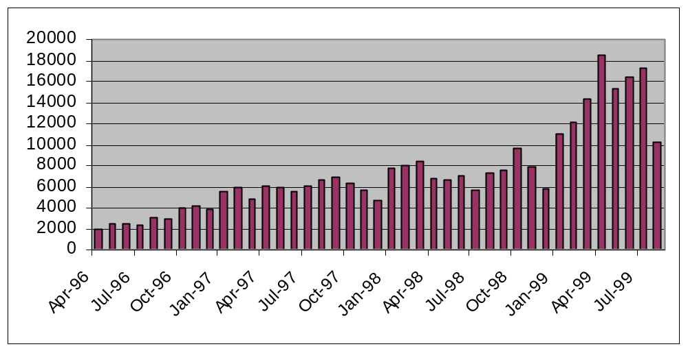
Downloads (hosts)

Slide 20
Python’s Future
Python 1.6 - in 2000
Python 2.0 - way beyond

Slide 21
Python 1.6
Last of 1.x breed; release in 2000
Language compatible with 1.5.2
Serious reworking of internals
Fix most urgent problems
Some new syntax
May push some ideas to 2.0

Slide 22
Python 1.6 Plans
Unicode!
Rich comparisons; coercions
Flexible import hooks
Better install/build support
Restructure Virtual Machine
Some new syntax

Slide 23
Python 2.0
  May be incompatible!
    C API level & advanced Python
  Release in 2001+
  Total rewrite in C++? (or Java???)
  Opportunity for radical changes
  Fix major problems with language
  May start out slower than 1.6
  Focus on VM; more stuff in Python

Slide 24
Expected problems
Monumental effort
Is C++ ready?
Books, docs need to be rewritten
JPython synchronization
  two rewrites!
Key extension modules

Slide 25
The Python Consortium
Support Python development
LLNL, Digital Creations, ...
Need more members!
Member benefits:
  vote on specifications
  early access to consortium code
  place engineers at CNRI

Slide 26
CP4E
...?

Slide 27
CP4E
Computer Programming for Everybody
Empower computer users
  teach programming
  provide programming tools
The future of programming!

Slide 28
CP4E Goals
Better software development tools
Better software
Software modifyable by end users
...and Python world domination :)

Slide 29
CP4E Plans
Teach Python to kids
  high school, middle school
  college freshmen (CS / non-CS)
  fun projects e.g. 3D games
Develop easy programming tools
  super version of IDLE
  add program analysis tools

Slide 30
CP4E Funding
DARPA funding for 1st task
  1.5 people, 2 years
May fund expanded version
  5 people, 5 years
  plus collaborations (CMU, Chicago,...)
Looking for other sources
  NSF? Industry? Python Consortium?

Slide 31
IPC8
International Python Conference 8
  In Alexandria near Washington, DC
  January 24-27, 2000
Tutorials, keynotes, papers, demos, developers’ day
Paper deadline Sept. 30!
  Get your flyer at the door!

