Slide 1
IDLE
An Integrated DeveLopment Environment in and for Python
Guido van Rossum
guido@python.org
Open Source Conference
Monterey, August 1999

Slide 2
Overview
Intro
How it’s done
      undo engine
      colorizer
      sample extension (autoindent)
      call tips (Mark Hammond)
      class browser
      debugger
Demo

Slide 3
My ideal environment
Knows more about Python than you can teach Emacs:
    Perfect colorization
    Perfect auto-indent
    Interactive shell with auto-indent
    Integrated Python debugger
Is written in portable Python
  hence extensible in Python

Slide 4
It's not done yet!
Debugger unfinished
Customization
    beyond editing the source :)
Tons of details, e.g.:
    Emulate more Emacs keybindings
    Back up files, check if file changed
    Typing above prompt in shell window
    Reformat whole buffer

Slide 5
Possible developments
More newbie-proof (CP4E)
Project management tools
Syntax suggestions (templates?)
Name suggestions (type analysis?)
Continuous syntax check & lint
    (like a spell checker)

Slide 6
How it's done
Industrial strength editor window
  Several extensibility dimensions:
    loadable extensions (e.g. autoindent)
    stackable filters (undo, colorization)
    subclassing
Interactive shell window
  subclass of editor window
  adds history, command execution

Slide 7
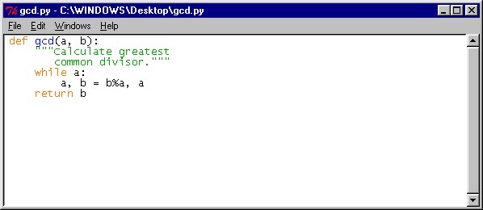
EditorWindow.py

Slide 8
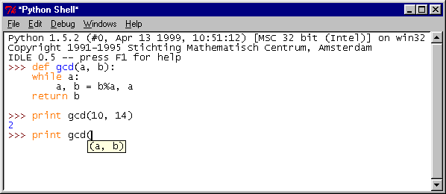
PyShell.py

Slide 9
The undo engine
Intercept all buffer-changing ops of widget command (not events)
  rename widget command in Tcl
  define new command in its place
    delegate all ops except insert/delete
Mechanism allows dynamically stacked interceptors
  colorization inserted below undo

Slide 10
Undo details
Each command has an inverse
Some marks also remembered
  needed by shell (too ad-hoc)
Grouping option
  undo/redo several ops at once
  used by high level cmds e.g. reformat
Keeps track of "file-changed" flag

Slide 11
The colorizer
Insert/delete mark text as dirty
Colorize while idle, stop on editing
Perfect Python tokenizer using optimized regular expressions
Restart at sync point before dirty
Continue until sync points match
>200 lines/sec on 300 MHz P-II

Slide 12
Colorizer example
!def gcd(a, b):
! """Calculate greatest
? common divisor."""
! while a:
! a, b = b/a, a
! return b

Slide 13
AutoIndent.py
class AutoIndent: # Thanks to Tim Peters
menudefs = [(“edit”,
[(“_Tab”, “<<smart-indent>>”),...])]
keydefs = {“<<smart-indent>>”: “<Key-Tab>”,...}
def __init__(self, editwin):
self.editwin = editwin
def smart_indent_event(self, event):
text = self.text
first, last = self.editwin.get_selection_indices()
...

Slide 14
CallTips.py
Bind (, ), ESC, KeyRelease events
def paren_open_event(self, event):
# Thanks to Mark Hammond
self._remove_calltip_window()
arg_text = get_arg_text(self.get_object_at_cursor())
if arg_text:
self.calltip_start = self.text.index("insert")
self.calltip = self._make_calltip_window()
self.calltip.showtip(arg_text)
return "" #so the event is handled normally.

Slide 15
Class browser
New Tree widget class
  uses model/view/controller
  path browser: change model only
pyclbr.py parses module source
  looks for classes and methods
  modified to find top-level functions

Slide 16
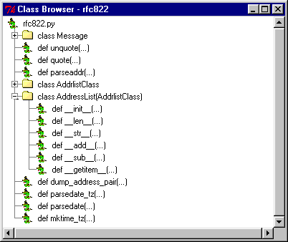
ClassBrowser.py

Slide 17
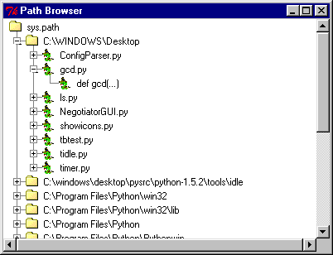
PathBrowser.py

Slide 18
Debugger
Currently sucks :(
    Go, step, over, out commands
    Set break points in source window
    view call stack, locals, globals
      and source, in editor window
Stack viewer separately usable
    post-mortem inspection
Right-click in stack trace: go to src

Slide 19
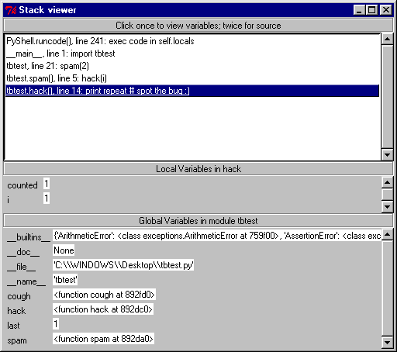
StackViewer.py

Slide 20
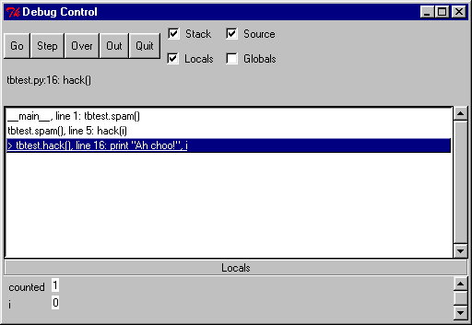
Debugger.py

Slide 21
Demo
(If there’s time left)

