Slide 1
State of the
Python Union
OSCON, July 24, 2002
Guido van Rossum
Director of PythonLabs at Zope Corporation
guido@zope.com
guido@python.org

Slide 2
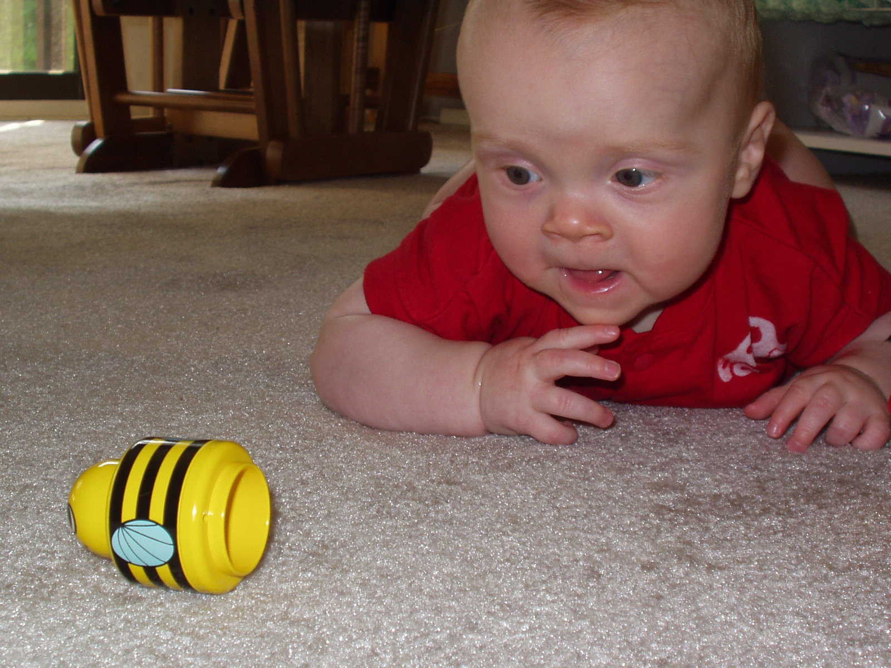

Slide 3
Recent Releases
Python 2.2
  iterators!
  generators!!
  new-style classes!!!
  and too much to summarize here...
Python 2.1.3
  bug fix release for 2.1; focus on stability
Python 2.2.1
  bug fix release for 2.2; ditto
What's with this stability focus...? (...see later!)

Slide 4
Python Organizations
Python Software Foundation
  www.python.org/psf
  US non-profit for research and education
  owns the current Python copyright
  looking for donations and sponsors
Python Business Forum
  www.python-in-business.org
  EU non-profit for businesses based on Python
  plans:
    Python in a Tie
    Compile farm
Python Secret Underground

Slide 5
Python in a Tie
Result of stability discussion on c.l.py
Plan:
  pick a release and maintain it for 18+ months
  bleeding edge development releases continue
Purpose:
  have a reliable target for commercial users
  stability more important than latest features
Which release will wear the tie?
  Python 2.2!

Slide 6
PBF Compile Farm
Joint venture of PBF and Lysator
    Lysator: oldest Swedish computer (student) society
  Lysator owns a very diverse hardware farm
  PBF provides motivation, funding
Goals:
  testing on many platforms
    Python-in-a-Tie as well as bleeding edge code
    core Python as well as 3rd party extensions
  build binary releases for Python-in-a-Tie
    hopefully "sumo releases"

Slide 7
Python Conferences in 2003
EuroPython will probably be repeated
Python11 will be at OSCON 2003
Yet Another Python Conference (YAPyC)
  these plans are tentative
  co-organizers: YAS and PSF
  registration fee: <= $150; expect 300 attendees
  time: January/February 2003
  location: downtown Washington, DC (GWU)
  format: workshop-like
  looking for volunteers to help organize!

Slide 8
Python.Org HTTP Statistics
May 2002
  7.9M HTTP requests from 257K hosts
    291K hits for "/"
  52K downloads of Python 2.2.1
    about 70% Windows installer
Feb 2001
  5.5M HTTP requests from 164K hosts
    212K hits for "/"
  23K downloads of Python 2.0
    over 70% Windows installer

Slide 9
Controversy of the Year
Yearly recap of a recent flame war
This year's topic:
  to bool or not to bool

Slide 10
Why bool()?
I always regretted having left it out
If it's not built-in, people define their own
Explicit is better than implicit: "return True"
A bool result is distinguished in output
  >>> x == y
  True
  >>>
"bool(x)" normalizes Booleans
  was "not not x"
RPC tools can special-case Booleans

Slide 11
Why Not bool()?
All misunderstandings (in my opinion)
Will "if x:" require x to be a bool? (Never!)
Some people write "if x == True:" (Yuck)
"No function should return a bool" (Huh?)
It's confusing to teach
  I don't buy this:
    You need to explain the Boolean concept anyway
    You need to pick representatives anyway
    You need to explain that (almost) all types have a Boolean interpretation anyway

Slide 12
How To bool()?
bool is a new built-in type
True and False are the only values
  singletons like None ("dualtons"?)
Cannot be subtyped
bool is a subtype of int, for compatibility
  True + 1 == 2
  True == 1
  str(True) == "True" # The only incompatibility
  will stay this way in Python 3.0
    it's useful and harmless

Slide 13
Lessons Learned
It's a growth opportunity!
Everything is controversial
  QOTY: "When a group becomes large enough there are no uncontroversial topics any more."
      Erik van Blokland (in personal email)
Anticipate potential misunderstandings
  explain in advance
  I thought the PEP was clear - not so :-(
In the end, do what you think is right
  can't please everyone

Slide 14
The Future: Python 2.3
No new syntax, except yield w/o __future__
Library focus, e.g.:
    support extended slices, e.g. "dlrow olleh"[::-1]
    bool() and enumerate()
    more callable types; basestring
    import from zip files
    timeouts for sockets
    logging module
    gnu_getopt and option parser modules
    new compiler package
    berkeleydb module
Fixing bugs

Slide 15
PendingDeprecationWarning
Discourage certain things in new code
  But don't warn about them normally
  Use:
    warnings.warn("your message here", PendingD...)
      No output by default (unlike other warnings)
  To see the warnings:
    python -Wall::PendingDeprecationWarning
Potential examples:
  string module (use string methods)
  types module (use built-in type names)
  has_key() (use 'in' operator)

Slide 16
2.3 Release Schedule
Surprise: we have none!
Focus on feature completeness, not dates
Hope: alpha soon, final before 2002 ends
See PEP 283 for details

Slide 17
Pace of Change
Users demand a stop to all new features
Except for their personal favorite
  this contradiction seems unavoidable
What do do about this?
Is Python-in-a-Tie sufficient?

Slide 18
"Would You Rather..." [1]
  Learn more syntax; or
  use a library module?
  Understand a deep concept; or
  live with fuzzy rules?
  Fix design mistakes; or
  be backwards compatible?
  [1] http://barry.wooz.org/poems/wyr.html

Slide 19
Example: String Interpolation
Problem: % interpolation is cumbersome
  print x, "+", y, "=", x+y
  "%s + %s = %s" % (x, y, x+y)
  "%(x)s + %(y)s = %(z)s" % vars()
  str(x) + " + " + str(y) + " = " + str(x+y)
The print form is most readable
  but not general enough (doesn't return a string)
The other forms leave a lot to desire
This is a very common need
  so a clean solution would be nice; hence PEP 292

Slide 20
Solutions Explored
Solution 1: "$foo".sub() # runtime
  "$x + $y = $z".sub()
Solution 2: x"$foo" # compile-time
  x"$x + $y = $(x+y)"
Alternatives: %x, `x`, <<x>>, ?x?, @x@
Solution 3: func(foo) # no new notation
  func(x, " + ", y, " = ", x+y)
None of these are satisfactory!
Even more issues when considering i18n

Slide 21
Why Is This Important To Me?
Preserve the "sweet spot". Python is:
  small enough to learn and remember easily
  convenient for expressing common patterns
  powerful for advanced usage
Improving 2 or 3 often threatens 1
Compatibility requirement prevents throwing away failed experiments
  like `back ticks` or lambda
No obvious solution

Slide 22
Python 3.0
No release schedule either :-)
Not within two years
Question: what to focus on???
Zope 3 experience may be relevant
  Rebuild from scratch
    Refactor mercilessly during development
    No concern for backwards compatibility
      But learn from past: good ideas, bad ideas
    Use coding "sprints"
  Later, add compatibility (Zope 3x -> Zope 3)
  Or: Later, merge best features back into 2.x

Slide 23
Open Mike
It's your turn!

