Slide 1

The State of the
Python Union
OSCON – August 3, 2005
Guido van Rossum
Elemental Security, Inc.
guido@elementalsecurity.com
guido@python.org

Slide 2
Health Update

Slide 3
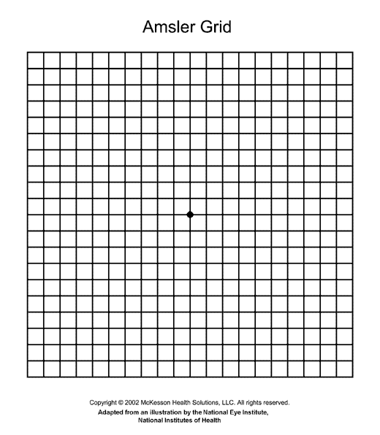

Slide 4
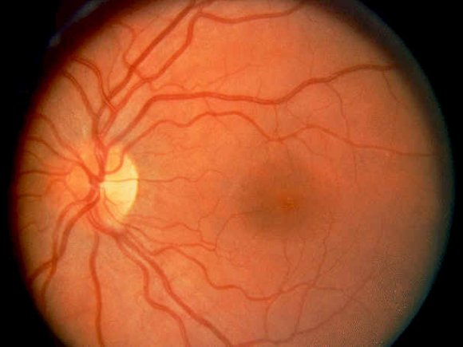

Slide 5
Prologue

Slide 6
Elemental Security, Inc.
Enterprise security software
    express, monitor and enforce security policies for any computer connecting to the network (cross-platform)
    scored 9.3 in recent InfoWorld Test Center
Startup (no longer in stealth mode!)
    C round just closed; 11M led by Lehman Brothers
Using lots of Python (and Java!)
We're always hiring!
See http://www.elementalsecurity.com
    Now a real website :-)

Slide 7
Elemental Security and Python
Paid for Python port to HP-UX 11.23 on Itanium2
  Giving back to PSF, of course!
  AIX 5.3 to follow shortly
Also plan to contribute:
  ElementClass (yet another XML tool :-)
  pgen reimplemented in Python
  yeah, I know, I promised these last year too...
Talk Wednesday (09:30 in VB)
  "What I did last year"

Slide 8
The Python Software Foundation
Holds and protects the IP (©, ®) behind Python
Makes PyCon possible by taking the financial risk
Funds grants, e.g. Jython grant and python.org redevelopment
Participates in Google's Summer of Code
There are 750K+ Python programmers
  if 1% gave $100/yr (or 10% gave $10/yr) we would have $750K/year budget

Slide 9
Appetizers

Slide 10
Python's Growing Popularity
14% (from 8%) – InfoWorld survey (Sept '04)
  "But the big winner this time around is the object-oriented scripting language Python, which saw a 6 percent gain in popularity, almost doubling last year's results. "
    www.infoworld.com/article/04/09/24/39FErrdev_1.html
Burton Group report on "P-languages":
  "Both Perl and Python have been used in application development and for limited integration, but it appears that Python is a better fit for this domain for several reasons. Python is easy to learn, fully functional, syntactically clean, and very modular. "
    Report available for $$ via www.burtongroup.com
Tim O'Reilly: Python book sales are gaining on Perl!

Slide 11
Jolt Productivity Award for Python
Category: Languages and Development Tools
Runner-up, shared with IntelliJ & RealBasic
Category winner: Eclipse
SD Magazine & Conference
Second time around (last time won was in 2000)

Slide 12
Python.org Growth
Feb 2004 python.org traffic:
  793K visits from 421K sites (1.0 TB)
Feb 2005 python.org traffic:
  1023K visits from 473K sites (1.3 TB)
Growth in one year:
  visits +29%, originating sites +12%, data +30%
  and Feb 2004 had a leap day :-)

Slide 13


O'Reilly CodeZoo
Now with Python section!
http://python.codezoo.com/

Slide 14
Languages Used on SourceForge
data = "..." # scraped from SF website
import re
lines = [line.strip() for line in data.splitlines()]
lines = [line for line in lines if line]
table = []
for line in lines:
m = re.match("(.*)\s\((\d+) projects\)", line)
if m:
table.append((int(m.group(2)), m.group(1)))
table.sort()
table.reverse()
for count, language in table:
print "%6d %s" % (count, language)

Slide 15
Top 20 Languages on SourceForge
15934 C++
15621 Java
15260 C
11427 PHP
5974 Perl
4200 Python
2597 C#
2488 JavaScript
2127 Visual Basic
1841 Delphi/Kylix
1746 Unix Shell
1571 Assembly
1114 PL/SQL
886 Tcl
697 Objective C
545 ASP
360 Ruby
338 Pascal
317 Lisp
267 Object Pascal

Slide 16
Main Course

Slide 17
PEP 342 and PEP 343
Discussion on python-dev broke all records
Results are really nice
PEP 342 adds generator enhancements
  patch by Phillip Eby just checked in (needs work)
PEP 343 adds with-statement
  no patch yet
Both PEPs accepted at EuroPython last month

Slide 18
QOFT
"I still haven't gotten used to Guido's heart-attack inducing early enthusiasm for strange things followed later by a simple proclamation I like. Some day I'll learn that the sound of fingernails on the chalkboard is frequently followed by candy for the whole class."
  Jack Diederich

Slide 19
PEP 342: Generator Enhancements
yield-expression instead of yield-statement
  x = yield a, b, c
  print (yield abc)
  "yield" is equivalent to "yield None"
g.send(value) causes yield to return value
  g.send(None) is equivalent to g.next()
  initial call must be next() or g.send(None)
g.throw(exc, [val, [tb]]) causes yield to raise exc
g.close(): throws GeneratorExit; called by GC
yield is now allowed inside try/finally

Slide 20
What Does This Buy Us?
More coroutine-like functionality
Natural asynchronous event handling
Generators can emulate lightweight threads
Twisted example (from memory):
    d = Deferred(...)
    w = WaitForDeferred(d)
    yield w
    data = w.getResult()
    ...use data...
  becomes:
    d = Deferred(...)
    data = yield d
    ...use data...

Slide 21
PEP 343: The With-Statement
with EXPR [as VAR]:
BLOCK
Translation:
abc = EXPR
[VAR =] abc.__enter__()
try:
BLOCK
finally:
abc.__exit__(...)
The ... mean that __exit__() is called as follows:
  if BLOCK raised exception, __exit__(*sys.exc_info())
  otherwise, __exit__(None, None, None)
I'm no longer favoring Pascal-style with-statement

Slide 22
What Does This Buy Us?
No excuse any more to write this:
    mutex.acquire()
    ...critical section code...
    mutex.release()
    (See the bug?)
Because this is less typing:
    with mutex:
    ...critical section code...
Observation:
  using try/finally blocks is often a requirement of an API rather than a choice for that API's user
  at least when you use try/except anywhere else

Slide 23
Rejected PEPs
Raymond Hettinger pushed me to pronounce on these:
PEP 336 – Make None Callable
PEP 313 – Roman Numerals
PEP 303 – Extended divmod()
PEP 284 – Integer for-loops
PEP 281 – Loop counter iteration with [x]range()
PEP 276 – Simple iterator for ints
PEP 274 – Dict Comprehensions (withdrawn by author)
PEP 265 – Sorting Dictionaries by Value
PEP 239, 240 – Rational Type and Rational Literal
Several others superseded by PEPs 342/343
  288, 310, 319, 325, 340, 346

Slide 24
Hopeful PEPs
PEP 3000 – Python 3.0 Plans
PEP 344 – Exception Chaining & Embedded Tracebacks
PEP 341 – Unifying try/except/finally (accepted)
PEP 315 – do-while statement
PEP 246 – Adaptation (won't die, won't commit :-)
not quite PEP 245 – Interface declarations
PEP-to-be-named – Exception Reform
Probably others, but I've been too busy to check

Slide 25
Exception Reform Proposal
PEP by Brett Cannon forthcoming
Bare 'except:' catches StandardError
Exceptions must derive from 'Exception'
Some restructuring of the hierarchy
Some new exceptions
Some new inheritance
Rename some exceptions
Deprecate WindowsError
Use multiple inheritance for compatibility period
Discussion is still ongoing!!!

Slide 26
Possible New Exception Hierarchy
Exception
+ ControlFlowException (new)
+ StopIteration
+ GeneratorExit
+ SystemExit
+ CriticalError (new)
+ KeyboardInterrupt
+ MemoryError
+ SystemError
+ StandardError
+ AssertionError
+ SyntaxError
+ IndentationError
+ TabError
+ UserError (rename of RuntimeError)
+ ArithmeticError
+ FloatingPointError
+ DivideByZeroError
+ OverflowError
+ UnicodeError
+ UnicodeDecodeError
+ UnicodeEncodeError
+ UnicodeTranslateError
+ LookupError
+ IndexError
+ KeyError
+ TypeError
+ AttributeError
+ EnvironmentError
+ OSError
+ IOError
+ EOFError (new inheritance)
+ socket.error (new inheritance)
+ select.error (new inheritance)
+ ImportError
+ NotImplementedError (new inheritance)
+ NamespaceError (rename of NameError)
+ UnboundGlobalError (new)
+ UnboundLocalError
+ UnboundFreeError (new)
+ ValueError
+ Warning
+ UserWarning
+ AnyDeprecationWarning (new)
+ PendingDeprecationWarning
+ DeprecationWarning
+ SyntaxWarning
+ SemanticsWarning (rename of RuntimeWarning)
+ FutureWarning
+ WeakReferenceError (rename of ReferenceError)
+ WindowsError (deleted)

Slide 27
Python 3000
(To be clear: this is the same as Python 3.0)
Not "second system syndrome done right"
In particular, not rewriting CPython from scratch
More likely, various Py3k features will show up in Python 2.5, 2.6, ...; some directly, some with a __future__ import
Python 3.0 will be incompatible with Python 2.9
Focus on language + library, not implementation
Library restructuring needs a champion!
Many VMs competing: Jython, IronPython, Parrot,...

Slide 28
Optional Type Declarations
The controversial topic that keeps coming back!
See my blogs of last December – January
Mostly in support for documentation, IDEs
No compile-time checking (but can help PyChecker)
Perhaps no run-time semantics (docs only)
Perhaps adaptation-based semantics
  customizable by overriding __typecheck__
    should probably rename this (to what?)
  see blogs for details
Perhaps most useful in interface declarations

Slide 29
My Favorite Syntax
def f(x: str, y: list[int], z: file|None = None)->bool:
...
Full syntax for an argument:
  ARG ::= NAME [':' EXPR] ['=' EXPR]
  Possibly also for (esp. instance) variables
x[y] and x|y operators supported by type metaclass
  x[y] probably only for container types (e.g. list, dict)
  x[y, z, ...] supported too
  user-defined types (classes) can do this too
Variables in type expressions resolved at run-time
  (at function definition time, like default expressions)

Slide 30
Rejected Syntax Alternatives
ARG ::= NAME as TYPE
  VB style
  PEP 343 uses 'as' very differently (with EXPR as VAR)
ARG ::= TYPE NAME
  C/C++/Java/C# style
  ambiguous as soon as TYPE is more than a name
ARG ::= TYPE(NAME)
  Pythonic cast style (my name for it)
  doesn't read well when TYPE is list[int] or file|None

Slide 31
Dessert

Slide 32
Python 2.4.2 Release Schedule
"the plan is still for a 2.4.2 in mid-September"
  Anthony Baxter (release manager)

Slide 33
Coffee, Cognac

Slide 34
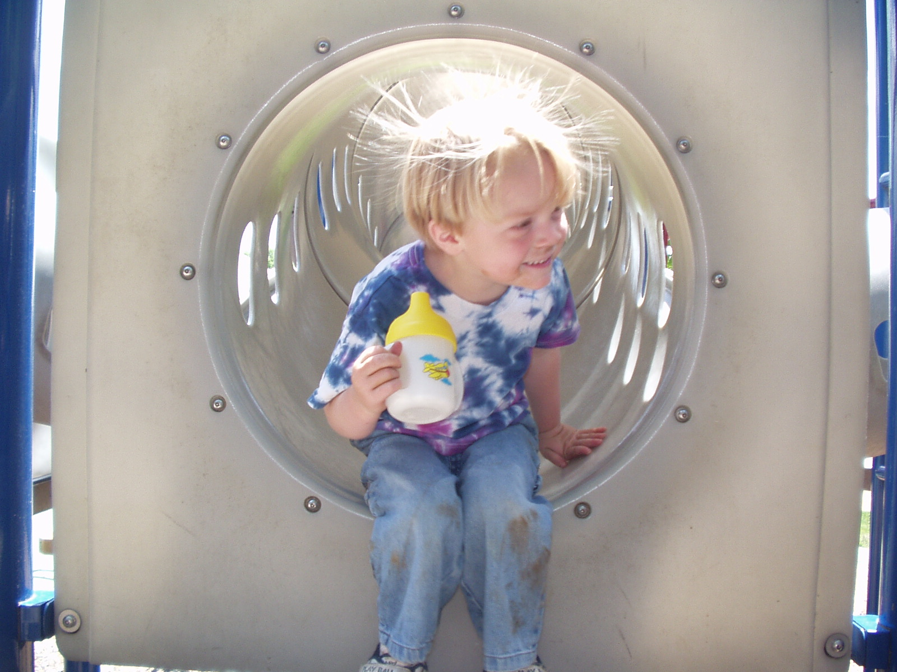

Slide 35
Question Time

