Slide 1
State of the
Python Union
PyCon DC, March 26-28, 2003
Guido van Rossum
Director of PythonLabs at Zope Corporation
guido@zope.com
guido@python.org

Slide 2
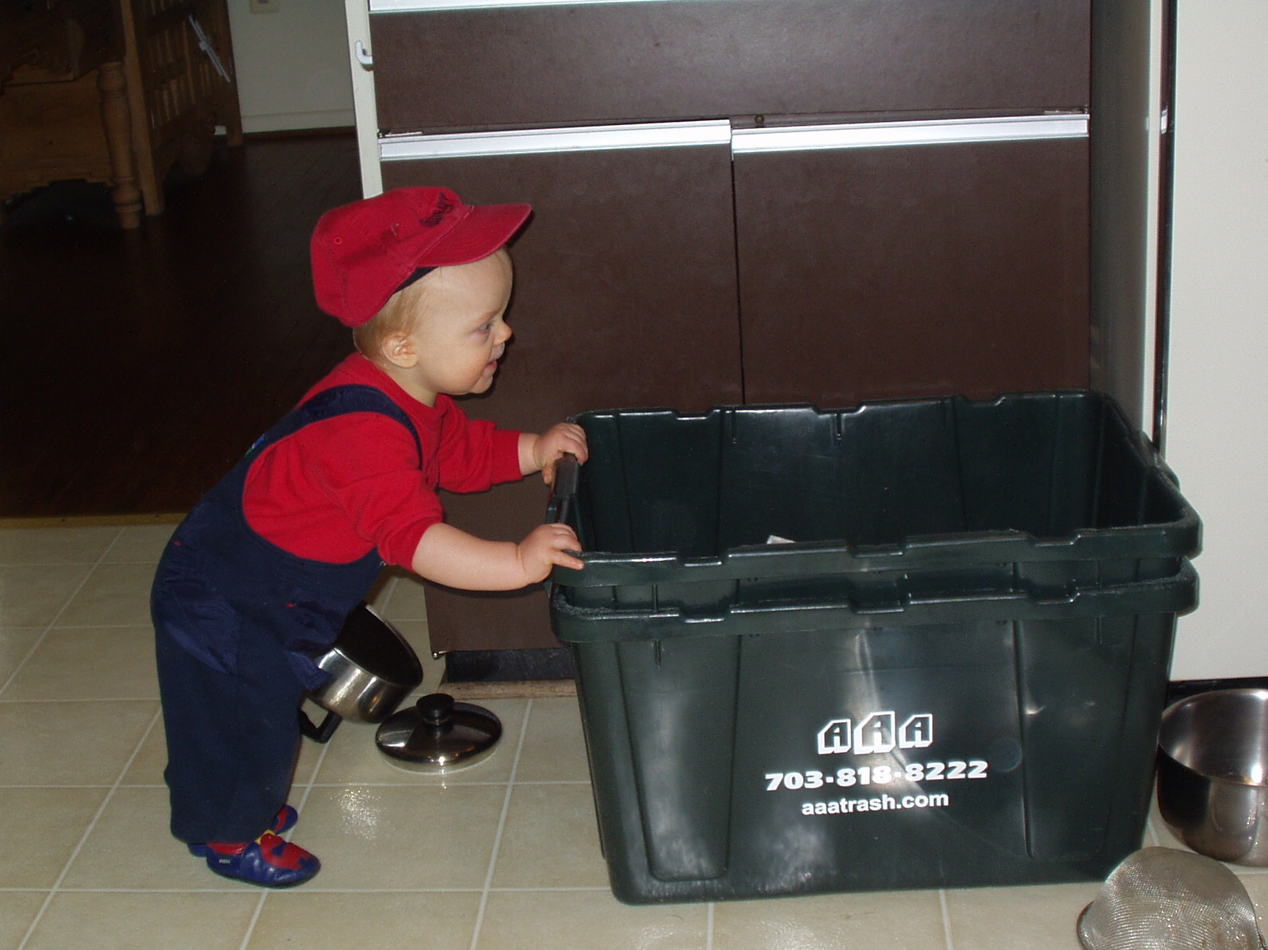

Slide 3
Python.Org HTTP Statistics
Feb 2003
    9.5M requests from 288K hosts (358K hits for "/")
    50K downloads of Python 2.2.2 (65% Windows)
May 2002
    7.9M requests from 257K hosts (291K hits for "/")
    52K downloads of Python 2.2.1 (70% Windows)
Feb 2001
    5.5M requests from 164K hosts (212K hits for "/")
    23K downloads of Python 2.0 (70% Windows)

Slide 4
Let's start the PR offensive
Python is more visible than ever
  But still seen as a small player
  Hard to move into enterprises
  Hard to conquer education
PSF can accept donations now
  How to use the money: PR or development?
  I'd rather spend money on "real" stuff
  But we need to bootstrap the donations
    some PR necessary to get our name known
    some money necessary to write grant proposals

Slide 5
Controversy of the year
Yearly recap of a recent flame war
This year's topic:
  adding an if-then-else expression
    maybe not a flamewar
    but definitely controversial :-)
  don't call it "ternary expression"
    that's descriptive of form, not function

Slide 6
Forces at work
Pro:
  expressiveness
  avoids bug in "c and x or y" (what if x is false)
Con:
  more to learn
  encourages hard-to-read code
Arguments both Pro and Con strongly felt!
  even more strongly argued :-)

Slide 7
Two separate decisions
Whether to add if-then-else expression at all
Which syntax to use
Are these choices really independent?

Slide 8
And the winner is...
Four candidates got most of the votes:
  235. (if C: x else: y)
  206. C ? x : y
  168. if C then x else y
  161. x if C else y
Voting procedure was complicated
  Total votes received:
    436 ranking + 82 reject-all = 518 total
  Ranked votes (up to 3 rankings per vote received):
    w/o reject-all: 851 accept + 452 reject = 1303 total
    with reject-all: 851 accept + 698 reject = 1549 total
      each of 82 reject-all counted as 3 ranked rejects

Slide 9
Condorcet voting
Alternative elections (under 100 votes)
Also re-interpreted official votes
Ranking of official votes:
  1. no change
  2. (if C: x else: y)
  3. C ? x : y
  4. x if C else y
  5. if C then x else y
Alternative election had different set of choices; no change wins there, too

Slide 10
So what will I do?
No more voting!
I'll to decide between:
  no change
  (if C: x else: y)
If accepted:
  I'll extend the syntax to use elif, e.g.:
    (if C1: x1 elif C2: x2 elif C3: x3 else: y)
  It may be possible to omit the parentheses in certain syntactical positions, e.g.:
    min = lambda a, b: if a < b: a else: b
    but is this really clearer?

Slide 11
The Zen of Python - part 1
(Formulated by Tim Peters)
Beautiful is better than ugly.
Explicit is better than implicit.
Simple is better than complex.
Complex is better than complicated.
Flat is better than nested.
Sparse is better than dense.
Readability counts.
Special cases aren't special enough to break the rules.
Although practicality beats purity.
Errors should never pass silently.
Unless explicitly silenced.

Slide 12
The Zen of Python - part 2
In the face of ambiguity, refuse the temptation to guess.
There should be one — and preferably only one — obvious way to do it.
Although that way may not be obvious at first unless you're Dutch.
Now is better than never.
Although never is often better than right now.
If the implementation is hard to explain, it's a bad idea.
If the implementation is easy to explain, it may be a good idea.
Namespaces are one honking great idea — let's do more of those!
... (left for me to fill)

Slide 13
1. Beautiful is better than ugly
But which is more beautiful?
  if c: x else: y
  if c then x else y
  x if c else y
  c ? x : y

Slide 14
2. Explicit is better than implicit
Except when it isn't:
  2 + 2.5 # 2 converted to float
    But see float division issue for some nastiness
  "abc" + u"def" # "abc" is converted to unicode
    Not everyone likes this one
Trend towards implicitness:
  for key in dict: ...
  if substring in string: ...

Slide 15
3. Simple is better than complex
Should this always favor less typing?
Sometimes yes:
  "if key in dict" vs. "if dict.has_key(key)"
  "sub in s" vs. "s.find(sub) >= 0"
Sometimes no:
  return (if x > 0: x else: None)
  vs.
  if x > 0:
  return x
  else:
  return None

Slide 16
4. Complex is better than complicated
Some things are simply complex
  And trying to simplify them too much makes them complicated!
But sometimes complicated is the only way we know how to do something
  E.g. when following a complicated external standard
    go fight the standard, but in the mean time use it

Slide 17
5. Flat is better than nested
Hence the flat standard library namespace
Why is this so?
  Distaste for "extreme structure"
It's okay to add more nesting later
As a system grows, all dimensions grow:
  package nesting depth
  modules per package
  classes per module
  methods per class
  lines per method
  characters per line
  number of kinds of files (extensions)

Slide 18
6. Sparse is better than dense
When a line gets too long:
store a subexpression in a variable
rather than using line continuation features
  Don't worry about speed
    local variables are as fast as the stack!
But a list comprehension can be very clear

Slide 19
7. Readability counts
When are you in more of a hurry:
  When reading code?
    e.g. trying to find a bug that crashes a live server
  Or when writing code?
    e.g. trying to meet an arbitrary deadline set by marketroids
When writing code, think of your readers!

Slide 20
8. Special cases aren't special enough to break the rules
For example, __future__ imports

Slide 21
9. Although practicality beats purity
For example, __future__ imports

Slide 22
10. Errors should never pass silently
But the definition of error is debatable
  E.g. "abc" + u"" vs. "\xff" + u""

Slide 23
11. Unless explicitly silenced
E.g. the encode() and decode() methods
  default behavior is to raise exception
  optional argument to ignore errors
Watch out for silencing too much!
  unqualified except usually evil

Slide 24
12. In the face of ambiguity, refuse the temptation to guess
This applies to 1+"2" (3 or "12"???)
Also explains requirement for "self.ivar"
Really a rehash of "explicit vs. implicit"

Slide 25
13. There should be one
—and preferably only one—obvious way to do it
Not quite TOOWTDI
Is violated a lot
Explains why I don't like xrange(), lambda
Introducing a better way often leaves the old way as an entrenched idiom for years
Which way is obvious isn't always obvious
Example: __new__ vs. __init__

Slide 26
14. Although that way may not be obvious at first unless you're Dutch
IOW the BDFL decides :-)
It's a matter of user education
Example: lists vs. tuples
  this is often misrepresented as "tuple are readonly lists", which is wrong
  use cases are quite different
  but... tuples also usable as readonly lists

Slide 27
15. Now is better than never
Some things are so important that it is okay to add a provisional feature first
Example: new-style classes introduced
  static & class methods
  properties
  slots
  super
without new syntax

Slide 28
16. Although never is often better than right now
Always count till 10 before deciding
  For important decisions, count till 100 :-)
Still counting for if-then-else
If I can't find an acceptable way to spell something, I'd rather leave it out
  when in doubt, don't pass

Slide 29
17. If the implementation is hard to explain, it's a bad idea
Very important to me!
  If I can't see how to implement something (efficiently) I can't get myself to add it
  "Constructive math" ideal
Implementation usually needs to be documented anyway
  Because it explains limitations, and users will run into those; better warn them
  This applies to the general implementation strategy, not to every little detail

Slide 30
18. If the implementation is easy to explain, it may be a good idea
Implementation sometimes suggests a generalization of a feature
  This is why I like straightforward, understandable implementations
Sometimes an implementation is over-specified and using an implementation hack would preclude future improvements
  But the stable sort was too good to pass by

Slide 31
19. Namespaces are one honking great idea
— let's do more of those!
Also relates to the usefulness of dictionaries
Somewhat contradicts "flat vs. nested"

Slide 32
20. ...
Raymond Hettinger suggested:
  Iterators unified access to containers
  — let's fine more of those.
  Substitutability simplifies development
    so shelves have a full dictionary interface
    but tuples won't sprout a count method
    because lists differ in intent.
  Deprecation comes at a price but cruft has a cost of its own.
  Holistic refactoring beats piecemeal optimization.
  Comment generously, the best modules are an education to read. (*)
  Be kind on the Usenet; some posters are only eleven.

Slide 33
Where I'd like to take Python
Reduce feature duplication
  Examples:
    string module vs. string methods
    xrange() vs. range()
    classic vs. new-style classes
    int vs. long
    8-bit vs. unicode strings
    map/filter vs. list comprehensions
    lambda vs. def
Change rules slightly to benefit code analysis
Wanna hear my "Python Regrets" talk?

Slide 34
And about the implementation
Short term:
  speed hacks
    call_attr
    obj_attr
  fix rexec?
Long term:
  native code compilation
  Psycho?
  PyPy?
  Parrot?

