Slide 1

What's New in Python?
"Not your usual list of new features"
Stanford CSL Colloquium, October 29, 2003;
BayPiggies, November 13, 2003
Guido van Rossum
Elemental Security
guido@python.org
guido@elementalsecurity.com

Slide 2
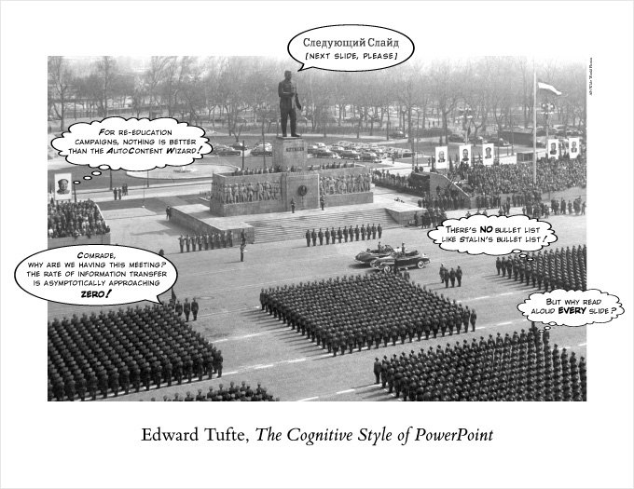

Slide 3
Talk Overview
About me
About Python
Case study 1: iterators and generators
Case study 2: new classes and descriptors
Question Time

Slide 4
About Me
Age 4: first Lego kit
Age 10: first electronics kit (with two transistors)
Age 18: first computer program (on punched cards)
Age 21: first girlfriend :-)
1982: "drs" math degree; joined CWI in Amsterdam
1987: first worldwide open source release
1989: started work on Python in spare time
1995: moved to Virginia, USA to join CNRI
2000: got married
2001: became a father
2003: moved to California to join Elemental Security

Slide 5
About Elemental Security
Enterprise security software
Early stage startup in stealth mode
Using lots of Python
We're hiring!
See http://www.elementalsecurity.com

Slide 6
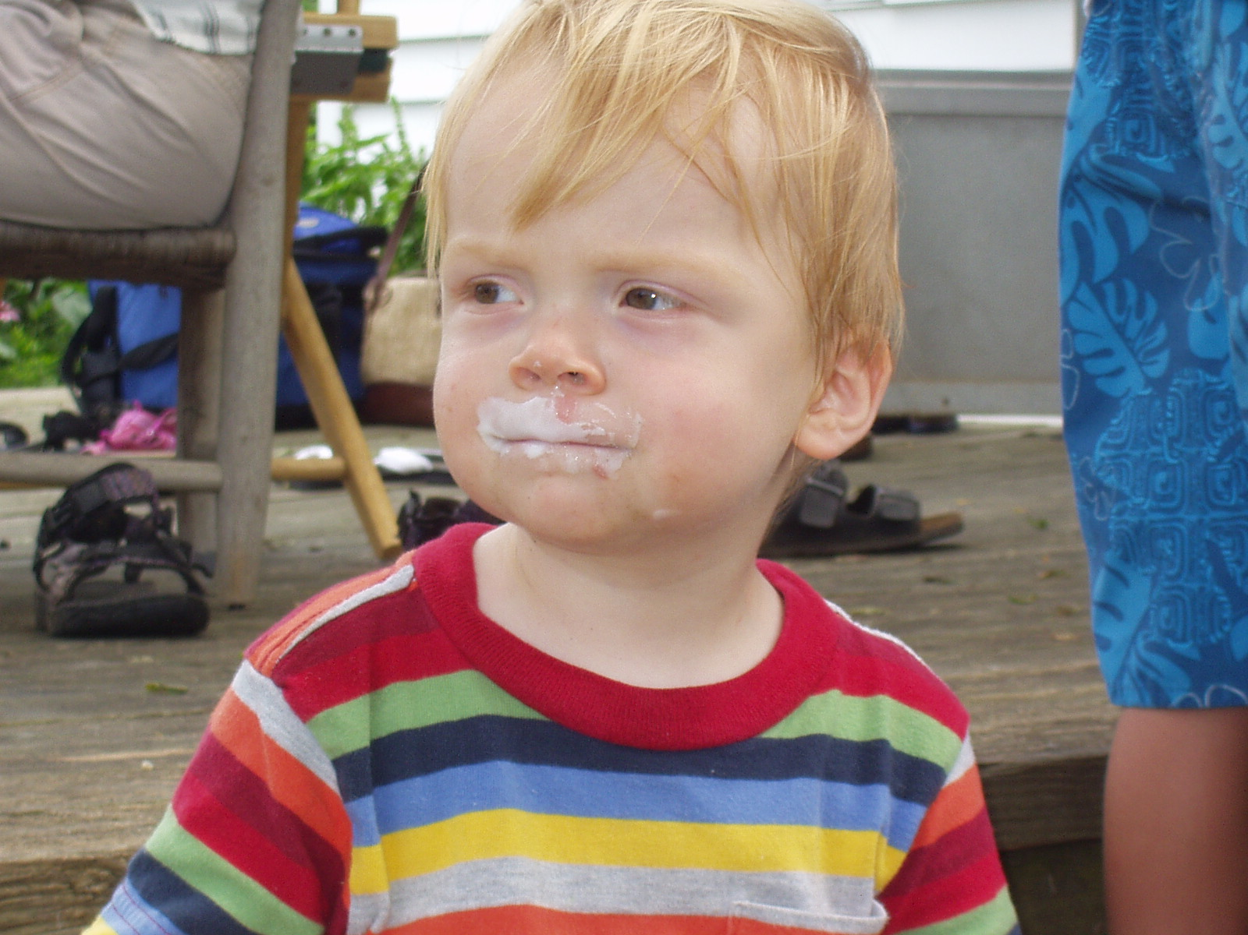

Slide 7
About Python
"The promotional package"

Slide 8
Executive Summary
Dynamically typed object-oriented language
Python programs look like executable pseudo-code
Supports multiple paradigms:
  procedural, object-oriented, some functional
Extensible in C, C++, Fortran, ...
Used by:
  Google, ILM, NASA, Red Hat, RealNetworks, ...
Written in portable ANSI C (mostly...)
Runs on:
  Unix, Windows, Mac, Palm, VxWorks, PlayStation 2, ...
Jython: Java version, translates to Java byte code

Slide 9
Why Use Python?
Dynamic languages are more productive
Python code is more readable
Python code is more maintainable
Python has fast built-in very high-level data types
Developer time is more expensive than CPU time
When Should You Not Use Python (Yet)?
Things like packet filters, MP3 codecs, etc.
Instead, write in C/C++ and wrap Python around it

Slide 10
Example Function
def gcd(a, b):
"Greatest common divisor of two integers"
while b != 0:
a, b = b, a%b
return a
Note:
  no declarations
  indentation+colon for statement grouping
  doc string part of function syntax
  parallel assignment (to swap a and b: "a, b = b, a")

Slide 11
Sample Use Areas
Server-side web programming (CGI, app servers)
Client-side web programming (HTML, HTTP, ...)
XML processing (including XML-RPC and SOAP)
Databases (Oracle, MySQL, PostgreSQL, ODBC, ...)
GUI programming (Qt, GTK+, Tcl/Tk, wxPython, ...)
Scientific/numeric computing (e.g. LLNL)
Testing (popular area for Jython)
Scripting Unix and Windows
Rapid prototyping (e.g. at Google)
Programming education (e.g. Oxford physics)
  from middle school to college

Slide 12
Standard Library
File I/O, socket I/O, web protocols (HTTP, CGI, ...)
XML, HTML parsing (DOM, SAX, Expat)
Regular expressions (using standard Perl re syntax)
compression (gzip/zlib, bz2), archiving (zip, tar)
math, random, checksums, algorithms, data types
date/time/calendar
threads, signals, low-level system calls
Python introspection, profiling, debugging, testing
email handling
and much, much more!
  and 10x more in 3rd party packages (e.g. databases)

Slide 13
Python Community
Python is Open Source software; freely distributable
Code is owned by Python Software Foundation
  501(c)(3) non-profit taking tax-deductible donations
  merit-based closed membership (includes sponsors)
License is BSD-ish (no "viral" GPL-like clause)
Users meet:
  on Usenet (comp.lang.python)
  on IRC (#python at irc.freenode.net)
  at local user groups (e.g. www.baypiggies.net)
  at conferences (PyCon, EuroPython, OSCON)
Website: www.python.org (downloads, docs, devel)

Slide 14
Python Development Process
Nobody gets paid to work full-time on core Python
  Though some folks get paid for some of their time
    their employers use Python and need enhancements
The development team never sleeps
  For example, for the most recent release:
    release manager in Australia
    key contributors in UK and Germany
    doc manager and Windows expert in Virginia
    etc.
Key tools: email, web, CVS, SourceForge trackers
  IRC not so popular, due to the time zone differences

Slide 15
Python Enhancement Proposals (PEP)
RFC-like documents proposing new or changed:
  language features
  library modules
  even development processes
Discussion usually starts in python-dev mailing list
Wider community discussion on Usenet
BDFL approval required to go forward
  BDFL = "Benevolent Dictator For Life" (that's me :-)
  this is not a democracy; let Python have my quirks
  we don't want design by committee or majority rule
  the PEP system ensures everybody gets input though

Slide 16
Python Release Philosophy
"Major releases": 2.0 -> 2.1 -> 2.2 -> 2.3
  12-18 month cycle
  Focus on new features
  Limited backward incompatibilities acceptable
    usually requires deprecation in previous major release
"Minor releases": e.g. 2.3 -> 2.3.1 -> 2.3.2
  3-9 month cycle
  Focus on stability; zero backward incompatibilities
  One previous major release still maintained
"Super release": 3.0 (a.k.a. Python 3000 :-)
  Fix language design bugs (but nothing like Perl 6.0 :-)
  Don't hold your breath (I'll need to take a sabbatical)

Slide 17
Case Study 1:
Iterators and Generators
"Loops generalized and turned inside out"

Slide 18
Evolution of the 'For' Loop
Pascal: for i := 0 to 9 do ...
C: for (i = 0; i < 10; i++) ...
Python: for i in range(10): ...
General form in Python:
for <variable> in <sequence>:
<statements>
Q: What are the possibilities for <sequence>?

Slide 19
Evolution of Python's Sequence
Oldest: built-in sequence types: list, tuple, string
  indexed with integers 0, 1, 2, ... through len(seq)-1
    for c in "hello world": print c
Soon after: user-defined sequence types
  class defining __len__(self) and __getitem__(self, i)
Later: lazy sequences: indeterminate length
  change to for loop: try 0, 1, 2, ... until IndexError
Result: pseudo-sequences became popular
  these work only in for-loop, not for random access

Slide 20
Python 1.0 For Loop Semantics
for <variable> in <sequence>:
<statements>
Equivalent to:
seq = <sequence>
ind = 0
while ind < len(seq):
<variable> = seq[ind]
<statements>
ind = ind + 1

Slide 21
Python 1.1...2.1 For Loop Semantics
for <variable> in <sequence>:
<statements>
Equivalent to:
seq = <sequence>
ind = 0
while True:
try:
<variable> = seq[ind]
except IndexError:
break
<statements>
ind = ind + 1

Slide 22
Example Pseudo-Sequence
class FileSeq:
def __init__(self, filename): # constructor
self.fp = open(filename, "r")
def __getitem__(self, i): # i is ignored
line = self.fp.readline()
if line == "":
raise IndexError
else:
return line.rstrip("\n")
for line in FileSeq("/etc/passwd"):
print line

Slide 23
Problems With Pseudo-Sequences
The __getitem__ method invites to random access
  which doesn't work of course
  class authors feel guilty about this
    and attempt to make it work via buffering
    or raise errors upon out-of-sequence access
    both of which waste resources
The for loop wastes time
  passing an argument to __getitem__ that isn't used
  producing successive integer objects 0, 1, 2, ...
    (yes, Python's integers are real objects)
      (no, encoding small integers as pseudo-pointers isn't faster)
        (no, I haven't actually tried this, but it was a nightmare in ABC)

Slide 24
Solution: The Iterator Protocol (2.2)
for <variable> in <iterable>:
<statements>
Equivalent to:
it = iter(<iterable>)
while True:
try:
<variable> = it.next()
except StopIteration:
break
<statements>
# There's no index to increment!

Slide 25
Iterator Protocol Design
Many alternatives were considered and rejected
Can't use sentinel value (list can contain any value)
while it.more():
<variable> = it.next()
<statements>
  Two calls are twice as expensive as one
    catching an exception is much cheaper than a call
  May require buffering next value in iterator object
while True:
(more, <variable>) = it.next()
if not more: break
<statements>
  Tuple pack+unpack is more expensive than exception

Slide 26
Iterator FAQ
Q: Why isn't next() a method on <iterable>?
A: So you can nest loops over the same <iterable>.
Q: Is this faster than the old way?
A: You bet! Looping over a builtin list is 33% faster.
This is because the index is now a C int.
Q: Are there incompatibilities?
A: No. If <iterable> doesn't support the iterator
protocol natively, a wrapper is created that
calls __getitem__ just like before.
Q: Are there new possibilities?
A: You bet! dict and file iterators, and generators.

Slide 27
Dictionary Iterators
To loop over all keys in a dictionary in Python 2.1:
  for key in d.keys():
  print key, "->", d[key]
The same loop in Python 2.2:
  for key in d:
  print key, "->", d[key]
Savings: the 2.1 version copies the keys into a list
Downside: can't mutate the dictionary while looping
Additional benefit: you can now write "if x in d:" too instead of "if d.has_key(x):"
Other dictionary iterators:
  d.iterkeys(), d.itervalues(), d.iteritems()

Slide 28
File Iterators
To loop over all lines of a file in Python 2.1:
  line = fp.readline()
  while line:
  <statements>
  line = fp.readline()
And in Python 2.2:
  for line in fp:
  <statements>
  40% faster than the 'while' loop
    (which itself is 10% faster compared to Python 2.1)
    most of the savings due to streamlined buffering
    using iterators cuts down on overhead and looks better

Slide 29
Generator Functions
Remember coroutines?
Or, think of a parser and a tokenizer:
  the parser would like to sit in a loop and occasionally ask the tokenizer for the next token...
  but the tokenizer would like to sit in a loop and occasionally give the parser the next token
How can we make both sides happy?
  threads are way too expensive to solve this!
Traditionally, one of the loops is coded "inside-out"
(turned into a state machine):
  code is often hard to understand (feels "inside-out")
  saving and restoring state can be expensive

Slide 30
Two Communicating Loops
Generator functions let you write both sides (consumer and producer) as a loop, for example:
  def tokenizer(): # producer (a generator)
  while True:
  ...
  yield token
  ...
  def parser(tokenStream): # consumer
  while True:
  ...
  token = tokenStream.next()
  ...

Slide 31
Joining Consumer and Producer
tokenStream = tokenizer(); parser(tokenStream)
The presence of yield makes a function a generator
The tokenStream object is an iterator
The generator's stack frame is prepared, but it is suspended after storing the arguments
Each time its next() is called, the generator is resumed and allowed to run until the next yield
The caller is suspended (that's what a call does!)
The yielded value is returned by next()
If the generator returns, next() raises StopIteration
"You're not supposed to understand this"

Slide 32
Back To Planet Earth
Generator functions are useful iterator filters
Example: double items: A B C D -> A A B B C C D D
  def double(it):
  while True:
  item = it.next()
  yield item
  yield item
Example: only even items: A B C D E F -> A C E
  def even(it):
  while True:
  yield it.next()
  xx = it.next() # thrown away
Termination: StopIteration exception passed thru

Slide 33
Generators in the Standard Library
tokenize module (a tokenizer for Python code)
  old API required user to define a callback function to handle each token as it was recognized
  new API is a generator that yields each token as it is recognized; much easier to use
  program transformation was trivial:
    replaced each call to "callback(token)" with "yield token"
difflib module (a generalized diff library)
  uses yield extensively to avoid incarnating long lists
os.walk() (directory tree walker)
  generates all directories reachable from given root
  replaces os.path.walk() which required a callback

Slide 34
Stop Press! New Feature Spotted!
Consider list comprehensions:
  [x**2 for x in range(5)] -> [0, 1, 4, 9, 16]
Python 2.4 will have generator expressions:
  (x**2 for x in range(5)) -> "iter([0, 1, 4, 9, 16])"
Why is this cool?
  sum(x**2 for x in range(5)) -> 30
    computes the sum without creating a list
    hence faster
  can use infinite generators (if accumulator truncates)

Slide 35
Case Study 2:
Descriptors
"Less dangerous than metaclasses"

Slide 36
Bound and Unbound Methods
As you may know, Python requires 'self' as the first argument to method definitions:
  class C: # define a class...
  def meth(self, arg): # ...which defines a method
  print arg**2
  x = C() # create an instance...
  x.meth(5) # ...and call its method
A lot goes on behind the scenes...
NB: classes and methods are runtime objects!

Slide 37
Method Definition Time
A method defined like this:
  def meth(self, arg):
  ...
is really just a function of two arguments
You can play tricks with this:
  def f(a, b): # function of two arguments
  print b
  class C: # define an empty class
  pass
  x = C() # create an instance of the class
  C.f = f # put the function in the class
  x.f(42) # and voila! magic :-)

Slide 38
Method Call Time
The magic happens at method call time
Actually, mostly at method lookup time
  these are not the same, you can separate them:
    "xf = x.f; xf(42)" does the same as "x.f(42)"
    "x.f" is the lookup and "xf(42)" is the call
If x is an instance of C, "x.f" is an attribute lookup
  this looks in x's instance variable dict (x.__dict__)
  then in C's class variable dict (C.__dict__)
  then searches C's base classes (if any), etc.
Magic happens if:
  f is found in a class (not instance) dict, and
  what is found is a Python function

Slide 39
Binding a Function To an Instance
Recap:
  we're doing a lookup of x.f, where x is a C instance
  we've found a function f in C.__dict__
The value of x.f is a bound method object, xf:
  xf holds references to instance x and function f
  when xf is called with arguments (y, z, ...), xf turns around and calls f(x, y, z, ...)
This object is called a bound method
  it can be passed around, renamed, etc. like any object
  it can be called as often as you want
  yes, this is a currying primitive! xf == "curry(x, f)"

Slide 40
Magic Is Bad!
Why should Python functions be treated special?
Why should they always be treated special?

Slide 41
Magic Revealed: Descriptors
In Python 2.2, the class machinery was redesigned to unify (user-defined) classes with (built-in) types
  The old machinery is still kept around too (until 3.0)
  To define a new-style class, write "class C(object): ..."
Instead of "if it's a function, do this magic dance", the new machinery asks itself:
  if it supports the descriptor protocol, invoke that
The descriptor protocol is a method named __get__
__get__ on a function returns a bound method

Slide 42
Putting Descriptors To Work
Static methods (that don't bind to an instance)
  a wrapper around a function whose __get__ returns the function unchanged (and hence unbound)
Class methods (that bind to the class instead)
  returns curry(f, C) instead of curry(f, x)
    to do this, __get__ takes three arguments: (f, x, C)
Properties (computed attributes done right)
  __get__ returns f(x) rather than curry(f, x)
  __set__ method invoked by attribute assignment
  __delete__ method invoked by attribute deletion
  (__set__, __delete__ map to different functions)

Slide 43
Properties in Practice
If you take one thing away from this talk,
it should be how to create simple properties:
  class C(object): # new-style class!
  __x = 0 # private variable
  def getx(self): # getter function
  return self.__x
  def setx(self, newx): # setter function
  if newx < 0: # guard
  raise ValueError
  self.__x = newx
  x = property(getx, setx) # property definition

Slide 44
Useful Standard Descriptors
Static methods:
  class C(object):
  def foo(a, b): # called without instance
  ...
  foo = staticmethod(foo)
Class methods:
  class C(object):
  def bar(cls, a, b): # called with class
  ...
  bar = classmethod(bar)
See: http://www.python.org/2.2.3/descrintro.html

Slide 45
A Schizophrenic Property
Challenge: define a descriptor which acts as a class method when called on the class (C.f) and as an instance method when called on an instance (C().f)
  class SchizoProp(object):
  def __init__(self, classmethod, instmethod):
  self.classmethod = classmethod
  self.instmethod = instmethod
  def __get__(self, obj, cls):
  if obj is None:
  return curry(self.classmethod, cls)
  else:
  return curry(self.instmethod, obj)
Do Not Try This At Home! :-)

Slide 46
Question Time
"If there's any time left :-)"

