Slide 1
Why Design Another Language?
Python UK & ACCU Spring Conference
Oxford - April 2, 2003
Guido van Rossum
Director of PythonLabs at Zope Corporation
guido@python.org
guido@zope.com

Slide 2
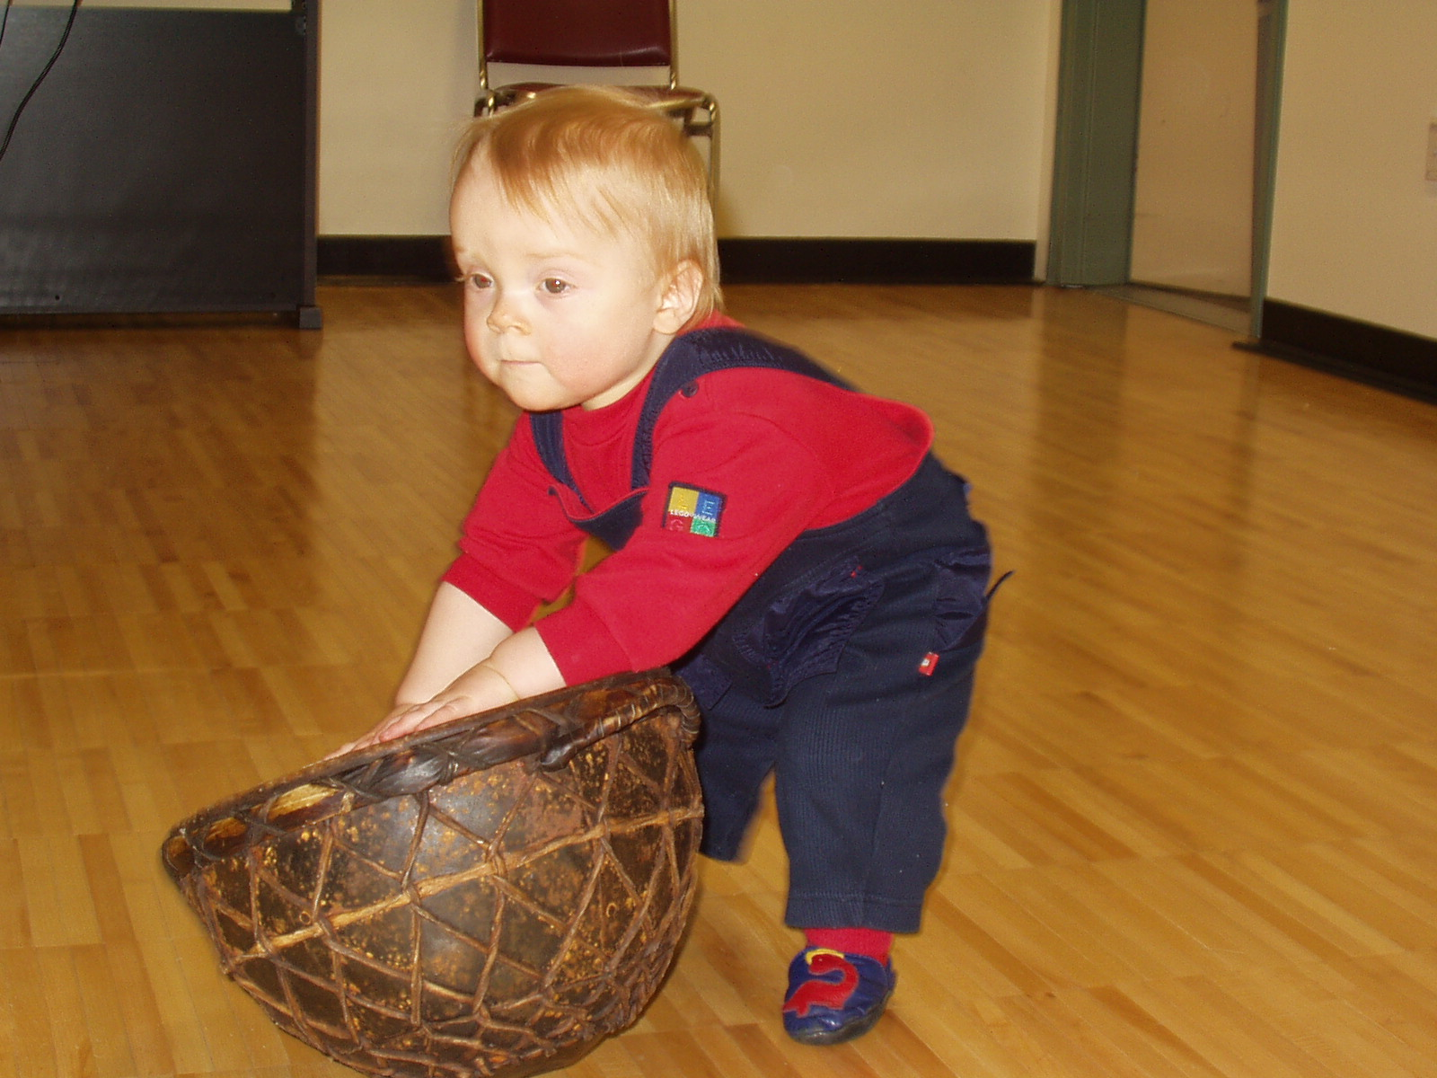

Slide 3
Overview
The birth of a new language
The Zen of Python
What does the future hold?

Slide 4
Ancient History: ABC
  late 70s, early 80s at CWI in Amsterdam
  Lambert Meertens, Leo Geurts, Steven Pemberton, and others
  www.cwi.nl/~steven/abc
  original goal: "stamp out BASIC"
  aimed at beginners and non-professionals
  language as well as environment
  5 powerful data types
    number, string, tuple, list, dictionary
  nesting by indentation
  I joined the team to help finish the implementation

Slide 5
ABC Example
Define function words to collect the set of all words in document:
HOW TO RETURN words document:
PUT {} IN collection
FOR line IN document:
FOR word IN split line:
IF word not.in collection:
INSERT word IN collection
RETURN collection

Slide 6
Python Equivalent
def words(file):
"Set of all words in a file."
words = {} # dict used as set
for line in file:
for word in line.split():
words[word] = 1
return words.keys()

Slide 7
ABC's Strengths
  interactive
  structured programming support
    no "goto"
  orthogonal design (hence easy to learn)
    small number of powerful constructs
  abstraction away from hardware quirks
    no 16/32-bit limits on numbers, object sizes
    no files (!?)
  data types designed after task analysis
  static typing (without declarations!)

Slide 8
ABC's Downfall
  reinventing terminology
  poor integration with OS
    no "file" concept
  hard to extend/adapt
    monolithic implementation
    interactive environment tightly integrated
  hard to find users
    beginners didn't have computers
    experts put off by non-standard approach
    no internet or www, only uucp/usenet

Slide 9
Fast Forward to 1989
  needed a scripting language for Amoeba
  existing languages found wanting
  fondly remembered ABC
  audience: C programmers
  goal: bridge gap between shell and C
  time available
  enjoyed Monty Python reruns :-)
  other influences: Modula-3, C/C++
    and even Smalltalk, Icon, Pascal, Algol-68

Slide 10
ABC's Influences
  interactivity (but as an option!)
  nesting by indentation
  abstraction away from hardware
  structured programming
  data type design
    containers, immutability
  many string operations
  [raw_]input(), has_key(), print, ``
  reference-counted memory allocation

Slide 11
ABC's Anti-Influences
  extensible implementation design
  good integration with OS environments
  favor simplicity and practicality
    may compromise purity and abstractions
  dynamic instead of static typing (!!)
  replaced ABC's sorting lists and tables
    order-preserving lists and hash tables instead
  separate int and long types (a mistake!)
  no rational numbers
  object instead of value semantics

Slide 12
Influences from C
  zero-based indexing
  lexical definitions of most tokens
    numbers, strings, identifiers
  return, break, continue
  expression operators
  standard I/O library
  assignment syntax
    much later: augmented assignments
  anti-influence (amongst many others):
    no assignment in expressions

Slide 13
Other Influences
  Modula-3, via DEC SRC's Modula 2+:
    modules, import, from/import
    exceptions: raise, try/execpt, try/finally
    method/function equivalence (explicit self)
    marshalling / pickling (data serialization)
  Smalltalk: dynamic typing, bytecode
  C++: operator overloading
  Icon, Algol-68: slice notation
  Pascal: ord(), chr()
  Shell: # comment (for #! convenience)

Slide 14
Other Anti-Influences
Perl (as it was in 1989; Perl 3?)
  Unix-specific (no hope of Amoeba port)
  too much magic
  focus on text processing
    useful, but not what I needed
  data types not well thought-out
    (try creating a hash of hashes)
Pascal: structure by nested functions
Lisp: lack of syntax

Slide 15
Python's Success
  being at the right place at the right time
  user feedback taken seriously
  open source license
  does one (fairly large :-) thing well
  cross-platform portability
  integrates well in any OS environment
  writing extensions is easy (enough)
  "batteries included" standard library
  and... the Zen of Python

Slide 16
The Zen of Python - part 1 of 2
(Formulated by Tim Peters)
Beautiful is better than ugly.
Explicit is better than implicit.
Simple is better than complex.
Complex is better than complicated.
Flat is better than nested.
Sparse is better than dense.
Readability counts.
Special cases aren't special enough to break the rules.
Although practicality beats purity.
Errors should never pass silently.
Unless explicitly silenced.

Slide 17
The Zen of Python - part 2 of 2
In the face of ambiguity,
refuse the temptation to guess.
There should be one —and preferably only one— obvious way to do it.
Although that way may not be obvious at first unless you're Dutch.
Now is better than never.
Although never is often better than right now.
If the implementation is hard to explain,
it's a bad idea.
If the implementation is easy to explain,
it may be a good idea.
Namespaces are one honking great idea
— let's do more of those!

Slide 18
What Next?
Python is successful
  to remain so, it needs to evolve
  while being careful not to break things!
Compatibility endangers elegance
  cruft accumulates over years
I'm no fan of grand redesign
  second system syndrome
  easy to lose emergent qualities

Slide 19
The Plan: Focused Evolution
Python 3000:
  idealized, utopian target
  hard to imagine (too far away)
Python 3.0:
  next big step; new stuff replaces cruft
  some incompatibilities allowed
Python 2.3, 2.4, 2.5, ...:
  each step (nearly) compatible
  deprecate cruft in 2.x, remove in 2. x+1

Slide 20
Python 3000
  Paul Graham's "100-year language"?
  my vision of Python 3000 is changing
  broadened scope:
    reaches higher and lower levels
    compiles to machine code as needed
    extensive standard library
    optional interfaces and type declarations
    compiler warns about likely bugs
    design your own domain-specific language

Slide 21
Python 3.0
  three years from now (ambitious)
  complete "big deprecations"
    int/int will return float
    string module gone
    classic classes gone
  new standard I/O implementation
  use more iterators and generators
    range() becomes iterator factory
  tweak rules for better code generation
    so compiler can recognize builtin names

Slide 22
Python 2.3
  first beta in two weeks
  final release June or July this year
  conservative release
    no syntactic changes
    lots of library additions
    performance tuned up
    many bugs fixed

Slide 23
Python Software Foundation
  US non-profit organization
  www.python.org/psf
  donations benefit Python development
  beginning major fund-raising
    Python 3.0 needs resources

