Slide 1

Exploratory Data Analysis
G2M insight for cab investment firm
05/21/2024

Slide 2
Executive Summary
Background
XYZ is a private equity firm in US. Due to remarkable growth in the Cab Industry in last few years and multiple key players in the market, it is planning for an investment in Cab industry, based on the various factors such as customer base, profitability and customer segmentation
Objective: The objective for the above analysis is to assist XYZ, a private equity firm, in making an informed investment decision in the US cab industry. The objective is to leverage data-driven analysis to support xyz in making a strategic investment decision that aligns with their business goals and objectives.
The analysis has been divided into three parts:
Data Understanding
Forecasting profit and number of rides for each cab type
Finding the most profitable Cab company
Recommendations for investment

Slide 3
Hypothesis
Hypothesis 1: The customer distribution between the two companies shows a significant difference, indicating one company is growing faster annually than the other. Seasonal trends significantly affect the yearly customer distribution for both companies.
Hypothesis 2: There is a significant difference in monthly transactions between the two companies, potentially influenced by promotional activities or seasonal events. Monthly transactions for both companies exhibit a strong correlation with specific holidays or events.
Hypothesis 3: One company has a significantly higher proportion of female customers compared to the other, suggesting better-targeted marketing or service preferences. Gender distribution of customers varies significantly by city or region for both companies.
Hypothesis 4: Younger customers (e.g., age 18-35) prefer one cab company over the other, possibly due to better app interface, pricing, or marketing strategies. Age distribution shows significant variation across different cities or regions.
Hypothesis 5: Certain cities have a significantly higher number of customers for one company compared to the other, indicating stronger brand presence or better service coverage. The number of customers per city correlates with city-specific factors like population density, availability of alternative transportation, or city size.
Hypothesis 6: There is a significant difference in the number of transactions on weekends versus weekdays for both companies, suggesting variations in travel behavior. One company experiences higher customer activity on specific days of the week compared to the other, potentially due to targeted promotions or differing service quality.
Hypothesis 7: The most frequent customers of one company have a higher retention rate compared to the other company, indicating better customer satisfaction or loyalty programs.

Slide 4
Data Exploration
Data Exploration
15 number of features
4 derived features(Month,Year,Day,Margins).
Timeframe of the data: 31-01-2016 to 31-12-2018
Total data points 359,392
Assumptions:
Outliers are present in Price Charged feature but due to unavailability of trip duration details ,we are not treating this as outlier
Profit of rides are calculated keeping other factors constant and only Price_Charged and Cost_of_Trip features used to calculate profit.
Users feature of city dataset is treated as number of cab users in the city,we have assumed that this can be other cab users as well(including Yellow and Pink cab)

Slide 5
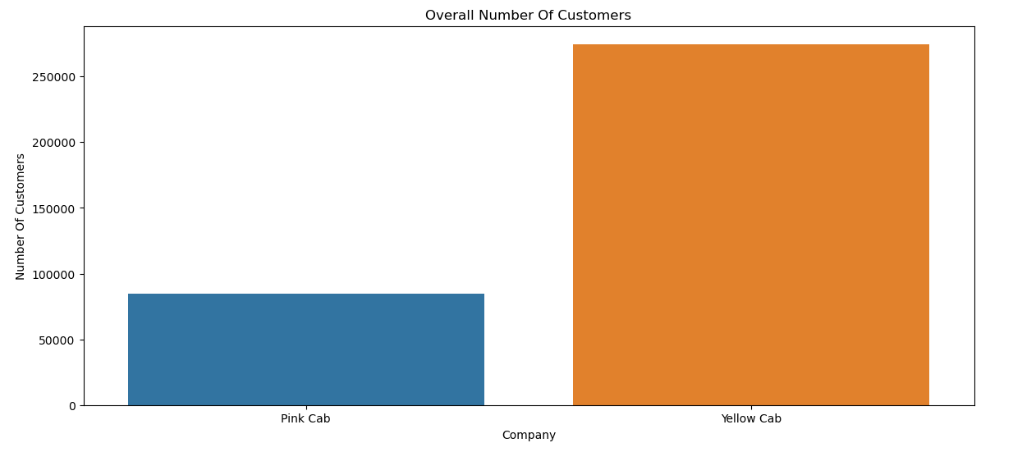
Data Understanding
Data Understanding
Yellow cab has the majority of
Customers compared with pink cab.

Slide 6
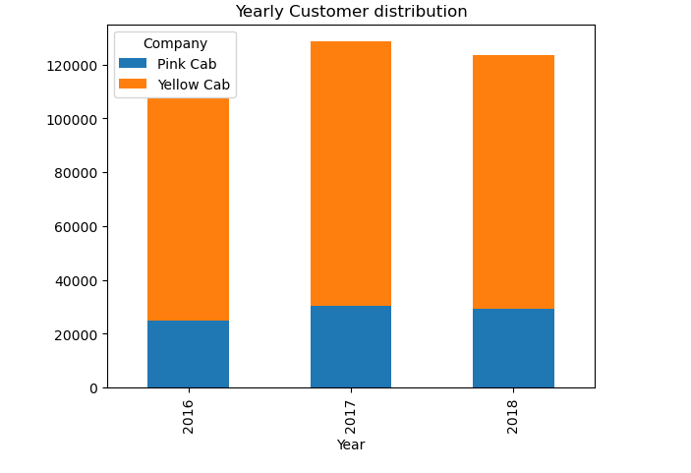
Yearly Customer Distribution
.
Yellow Cab has the majority of customers across the three years

Slide 7
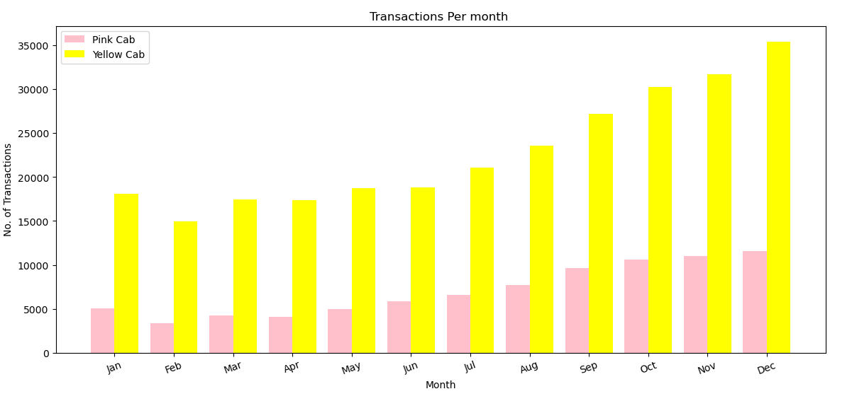
Monthly Transactions Analysis
Monthly Transaction Analysis
The busiest Months are the holiday months heading towards January for both Cabs with Yellow cab taking the lions share

Slide 8
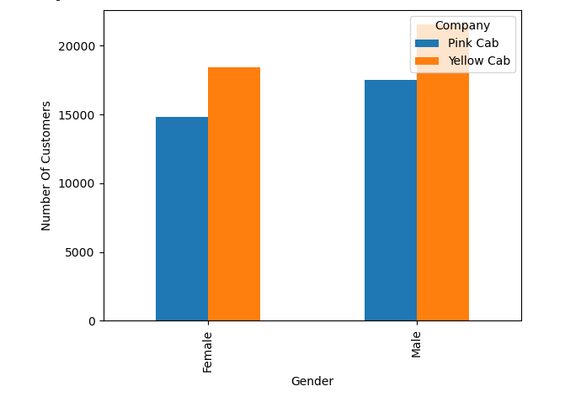
Gender Distribution
Gender Distribution
Most of the customers for both Cabs are Male
with the Yellow Cab taking the lions share in both

Slide 9
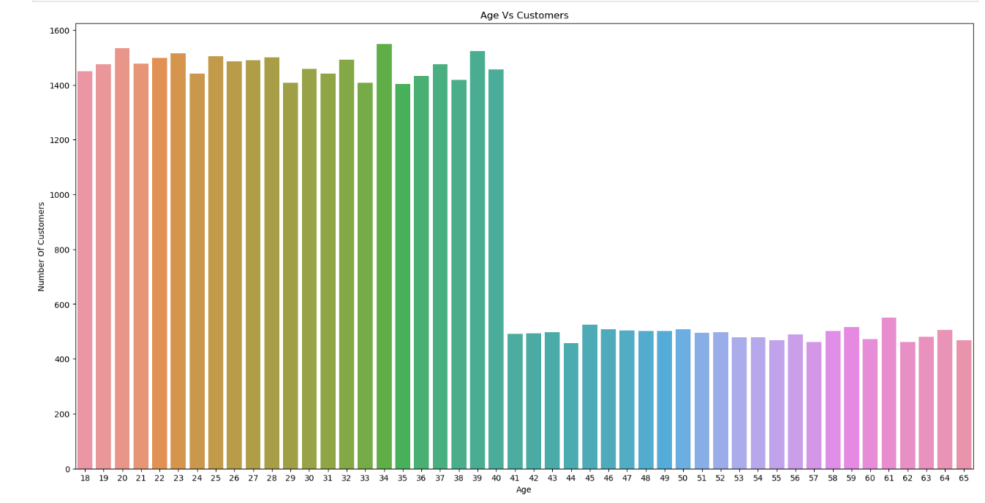
General Age Distribution Analysis
General Age Distribution Analysis
Most of the Customers are Young
that is below 40 Years of age

Slide 10
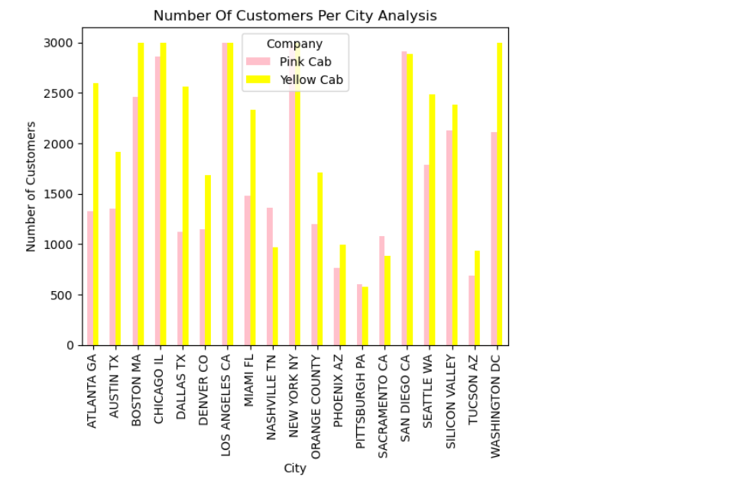
City Customer Analysis
No of Customers per City Analysis
Yellow cab leads on most of the cities with Pink Cab only leading in 4 cities:-
San Diego
Nashvilee
Sacramento
Pittsburgh

Slide 11
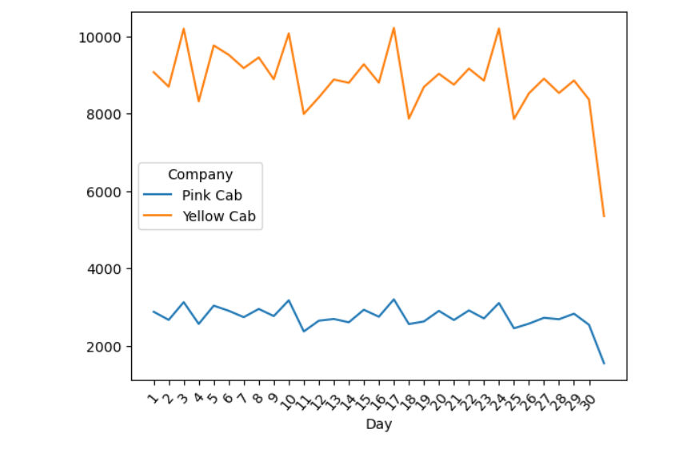
Day Of the Month Analysis
Day of the month Analysis

Slide 12
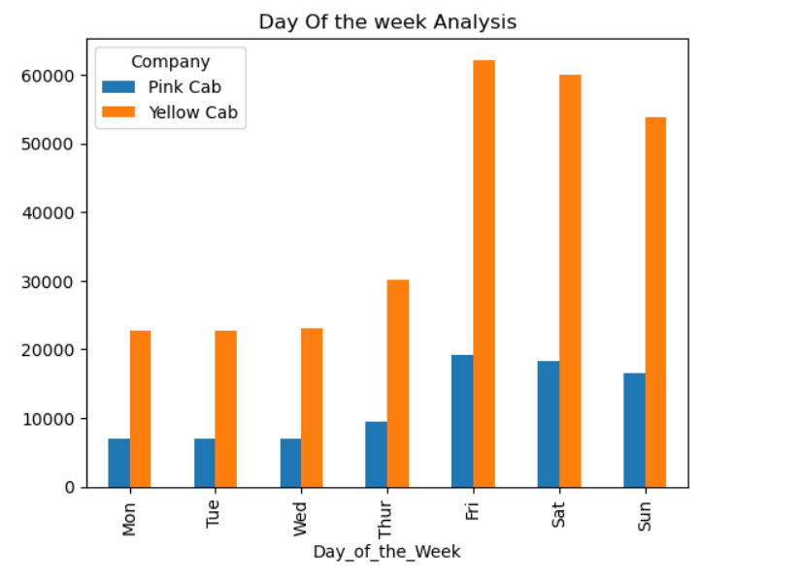
Day Of the week Analysis
Day of the week Analysis
On average most of the customers use the cabs as from Friday heading into the weekend.

Slide 13
Most frequent customer for both Cabs(Customer Retention)
Pink Cab (Customer_ID ) | Frequency
8120 | 18
8595 | 17
6159 | 17
7927 | 17
8915 | 16
8474 | 16
7340 | 16
7938 | 15
8119 | 15
Yellow Cab (Customer_ID) | Frequency
1803 | 47
1360 | 47
494 | 47
636 | 46
126 | 45
2766 | 45
903 | 45
1673 | 44
2577 | 44
Yellow cab customers frequent the cabs more often showing that they have a high customer retainability. Also the most frequent Pink Customers are also Yellow Cab Customers.

Slide 14
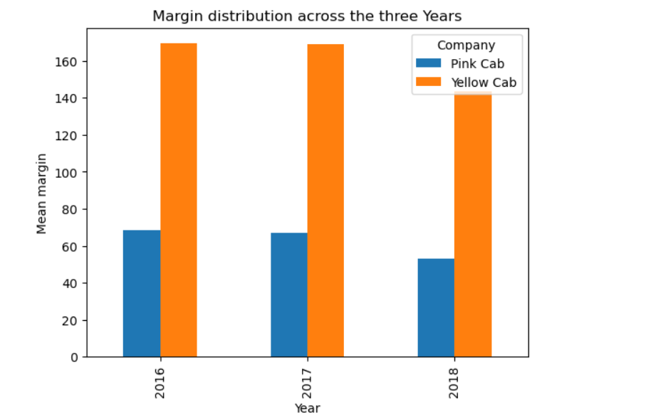
Margin Analysis
Margin Analysis
Yellow cab company has the most Profit compared to Pink cab company in the last three years.

Slide 15
Recommendations and Conclusion
Recommendations and Conclusion
We have evaluated both the cab companies on following points and found Yellow cab is better than Pink cab:
1. Customer Retainability: Yellow cab has a very high customer retainability rate compared to Pink Cab.
2. Customer Reach: Yellow cab has higher customer reach in all the 20 cities. Yellow cab Company has more users in populated cities such as New York City, Yellow cab company is charging more in populated City which is a good strategy for increase its profit.
3. Customer Retention: The top 5 users that has 50 rides with both Company, they had more than 40 rides with Yellow cab and closely 10 rides with Pink Cab. Most of the Users travelling in Yellow cab for shorter and longer distance trip.
4. Age wise Reach: Yellow cab has customer in all age group and it’s been observed that it’s even popular in 60+ age group as equally as it’s in 18-25 age group.
5. Over the years: Through the three Years yellow cab had the most customers and is not showing any signs of letting go off this trend.
6.Profit and Margin: Yellow cab seems to be making a higher profit margin compared to pink cab.
We will advise the XYZ company to invest in Yellow Cab company for its glorious benefit.

Slide 16


Thank You

