Slide 1

April 2022

Slide 2
Contents
1. Scope and Objectives
2. Segmentation Process
3. Key Findings
4. Segmentation Results

Slide 3
Segmentation: Objectives
Understand Customer Needs & Behavior
Enhance the value of the existing customer database
Target products & services at specific customer groups
Execute targeted Campaigns
Monitor campaigns efficiency
Improve services based on customer needs

Slide 4
Contents
1. Scope and Objectives
2. Segmentation Process
3. Key Findings
4. Segmentation Results

Slide 5

Areas Examined
Withdrawals
Sex
Geo Code
Transaction
Method
Casinos
Costs
Revenue
Age
Profits
Tenure

Slide 6
Contents
1. Scope and Objectives
2. Segmentation Process
3. Key Findings
4. Segmentation Results

Slide 7
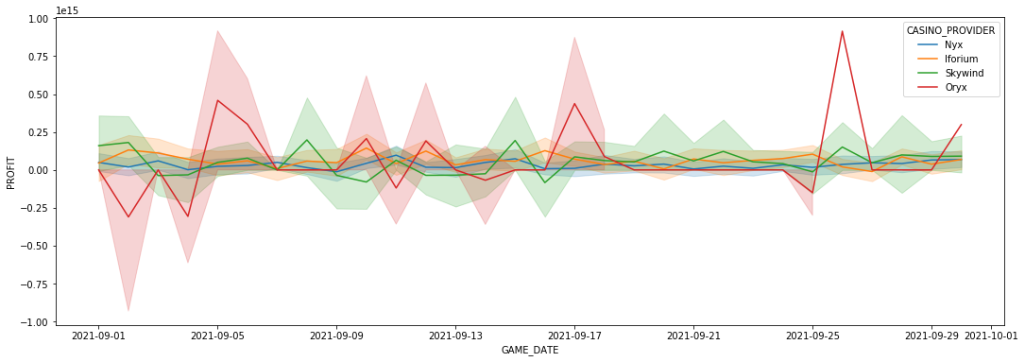
Insights
Most of casino games show constant mean meaning there is no seasonality or trend
Oryx though, has some high seasonality from time to time and brings in large amounts of profits
Could mean the existence of seasonal offers
Company Profit = Revenue – Costs
Revenue = Amount paid to the user
Cost = Amount earned from the user

Slide 8
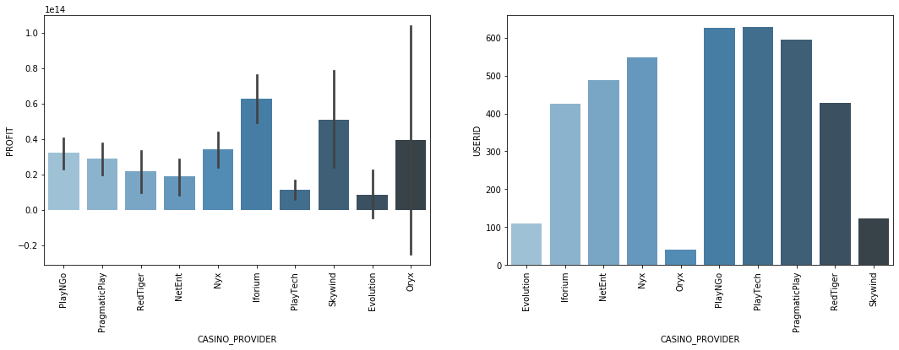
Insights
Iforium and Skywind bring in most of profit but they also have a lot of popularity between distinct users
On the contrary, Oryx has the largest profit/user ratio
Company Profit = Revenue – Costs
Revenue = Amount paid to the user
Cost = Amount earned from the user

Slide 9
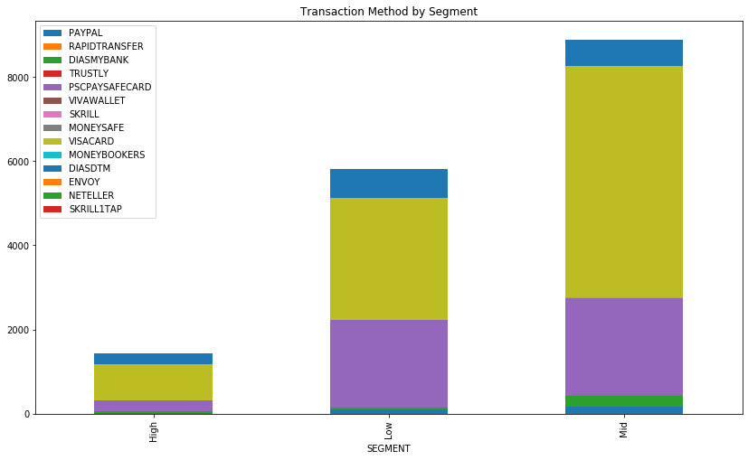
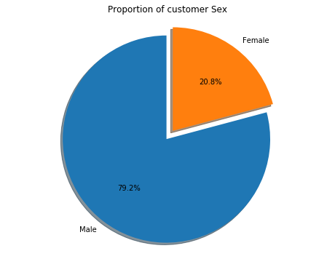
Insights
Transactions via VISA card are the majority
Transaction method does not present significant change between segments

Slide 10
Contents
1. Scope and Objectives
2. Segmentation Process
3. Key Findings
4. Segmentation Results

Slide 11
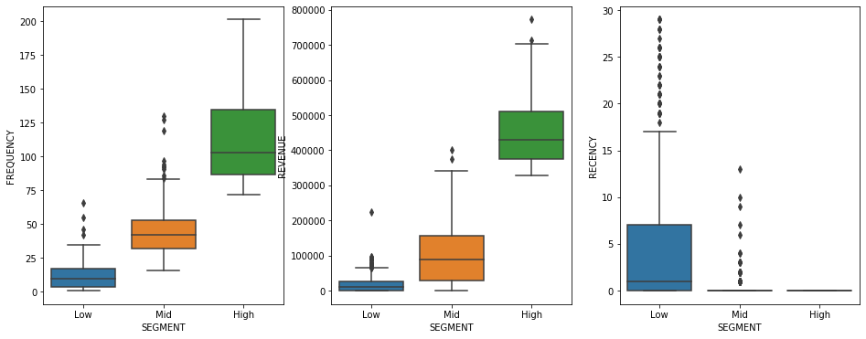
Clustering Output
3 Segments:
Entertainment Seekers
Concerned Users
Avid Supporters
Customer base:
~800 GR customers excl. October 2021 & inactive users

Slide 12
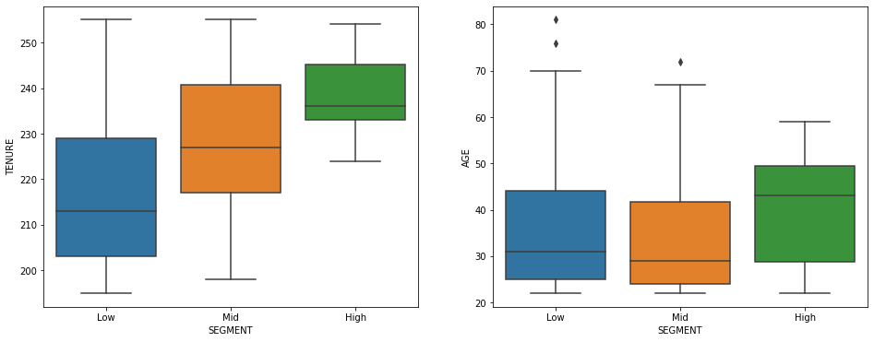
Clustering Output
3 Segments:
Entertainment Seekers
Concerned Users
Avid Supporters
Heavy users seem to be older on average than the rest
Heavy users are longer with the company on average

Slide 13
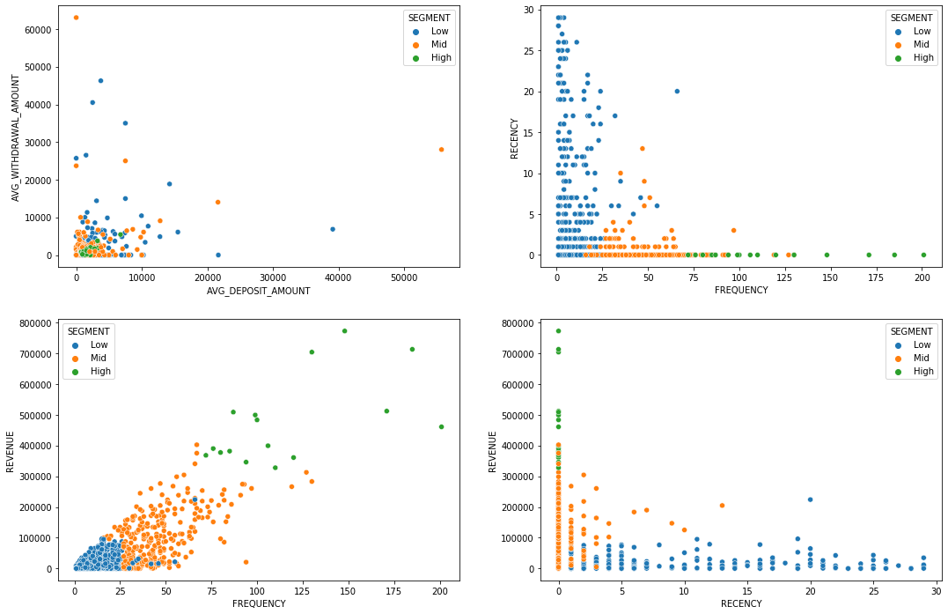
Clustering Output
3 Segments:
Entertainment Seekers
Concerned Users
Avid Supporters
Heavy users seem to be older on average than the rest
Heavy users are longer with the company on average

Slide 14
September 2021
 | Recency | Frequency | Revenue | Age | Tenure | Deposit Amount | Withdrawal Amount | Profit
Low | 5 | 11 | 18.264 | 35 | 217 | 1.896 | 1.362 | 1.482
Mid | 0 | 45 | 100.299 | 33 | 229 | 1.768 | 1.759 | 883
High | 0 | 117 | 465.594 | 40 | 237 | 1.993 | 1.361 | 4.489
Avid Supporters is by far the most abundant segment followed by Concerned users
Avid Supporters, although a small one, is the most valuable segment, when it comes to pretty much every inflow action

Slide 15

Avid Supporters
Very high revenue
Very high frequency
Very low recency
Long tenure
Older ages
Heavy Users
Size % | ≈ 2%
Avg. Profit | 4.489
Avg. Revenue | 466
Avg. Frequency | 117
Avg. Age | 40
Tenure (Days) | 237

Slide 16

Entertainment Seekers
Moderate revenue
Medium frequency
Very low recency
Medium/long tenure
Age on the young side
Regular Users
Size % | ≈ 37%
Avg. Profit | 883
Avg. Revenue | 100
Avg. Frequency | 45
Avg. Age | 33
Tenure (Days) | 229

Slide 17

Concerned Users
Low revenue
Very low frequency
Higher recency
Low/medium tenure
Age young/older
Reluctant Users
Size % | ≈ 61%
Avg. Profit | 1.482
Avg. Revenue | 18
Avg. Frequency | 11
Avg. Age | 33
Tenure (Days) | 217

Slide 18
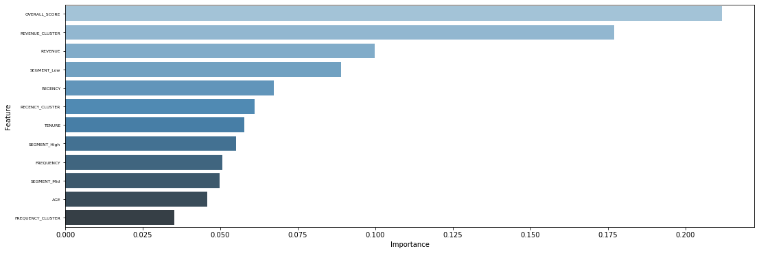
CLV Prediction – October 2021
 | Precision | Recall | F1-Score | Support
Low | 0.00 | 0.00 | 0.00 | 17
Mid | 0.73 | 0.94 | 0.82 | 98
High | 0.58 | 0.40 | 0.47 | 35
accuracy |  |  | 0.71 | 150
macro avg | 0.44 | 0.45 | 0.43 | 150
weighted avg | 0.61 | 0.71 | 0.65 | 150
Prediction model manages to predict quite well CLV of mid class users
Prediction of high and low value customers needs more data to produce better results since the sample is quite small

Slide 19
Thank you!

