Slide 4
% of total memory accesses

Slide 5
a)
Average
b)
Average
c)
Average

Slide 6
CACTI :
Cache power estimation + Energy model
Source code
Compiler : GCC 4.9.1
Middle-end
Gem5 : Functionnal simulator
Static Analysis : RO data detection
Ruby : Memory system and coherency protocol simulation
Back-end
Collaborative caching
CPU
CPU
…
Instrumented application

Slide 7
P1
P2
P1
P2
RW Cache
L1D
L1D
RO Cache
L1D
RO Cache
Interconnection network
Interconnection network
MESI coherency protocol
MESI coherency protocol
Cache L2 Shared
Cache L2 Shared
Baseline
Scenario A : Private L1 RO Cache
P1
P2
L1D
RO Cache
L1D
Interconnection network
MESI coherency protocol
Cache L2 Shared
Scenario B : Shared L1 RO Cache

Slide 8
Standard MESI protocol
Non coherent RO cache
Cache block Replacement
Read
Read
L1D
RO Cache
INV
GetS
Ack INV
Data
GetS
Data
LLC
LLC
5 issued messages
3 issued messages
Transition from Modified to Shared
Read
Read
L1D
RO Cache
GetS
Data
Ack
GetS
Data
LLC
LLC
Fwd Gets
Unblock
Fwd Gets
L1D
L1D
5 issued messages
Cache block becomes shared
3 issued messages
Cache block stays M in L1D

Slide 9
for (i = 0; i < N; i++)
for (j = 0; j < N; j++)
for (k = 0; k < N; k++)
C[i][j] += A[i][k]*B[k][j]
(a) Simple
for (jT = 0; jT < N/J; j++)
for (k = 0; k < N/K; k++)
for (i = 0; i < N; i++)
for (j = jT; j < (jT+1)*N ; j++)
for (k = kT; j < (kT+1)*N; k++)
C[i][j] += A[i][k]*B[k][j];
(b) 2D Blocking
for (iT = 0; iT < N/I; j++)
for (jT = 0; jT < N/J; j++)
for (k = 0; k < N/K; k++)
for (i = iT; i < (iT+1)*N; i++)
for (j = jT; j < (jT+1)*N ; j++)
for (k = kT; j < (kT+1)*N; k++)
C[i][j] += A[i][k]*B[k][j];
(c) 3D Blocking

Slide 10
a) Average AMAT of the RW datapath
b) Average AMAT of the RO datapath

Slide 12
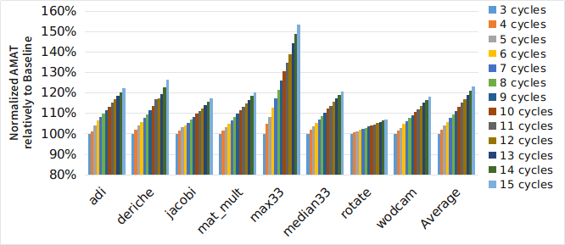

Slide 13
Pintools Instrumentation
Full Memory Trace
Detection of:
- Strictly Read-only data
- Important read-only phases
RO Data detection algorithm
RO Trace
RW Trace
Reuse distance analysis

Slide 17
