Slide 4
% of total memory accesses

Slide 5
a)
Average
b)
Average
c)
Average

Slide 6
CACTI :
Cache power estimation + Energy model
Source code
Compiler : GCC 4.9.1
Middle-end
Gem5 : Functionnal simulator
Static Analysis : RO data detection
Ruby : Memory system and coherency protocol simulation
Back-end
Collaborative caching
CPU
CPU
…
Instrumented application

Slide 7
P1
P2
P1
P2
RW Cache
L1D
L1D
RO Cache
L1D
RO Cache
Interconnection network
Interconnection network
MESI coherency protocol
MESI coherency protocol
Cache L2 Shared
Cache L2 Shared
Baseline
Scenario A : Private L1 RO Cache
P1
P2
L1D
RO Cache
L1D
Interconnection network
MESI coherency protocol
Cache L2 Shared
Scenario B : Shared L1 RO Cache

Slide 8
Standard MESI protocol
Non coherent RO cache
Cache block Replacement
Read
Read
L1D
RO Cache
INV
GetS
Ack INV
Data
GetS
Data
LLC
LLC
5 issued messages
3 issued messages
Transition from Modified to Shared
Read
Read
L1D
RO Cache
GetS
Data
Ack
GetS
Data
LLC
LLC
Fwd Gets
Unblock
Fwd Gets
L1D
L1D
5 issued messages
Cache block becomes shared
3 issued messages
Cache block stays M in L1D

Slide 9
for (i = 0; i < N; i++)
for (j = 0; j < N; j++)
for (k = 0; k < N; k++)
C[i][j] += A[i][k]*B[k][j]
(a) Simple
for (jT = 0; jT < N/J; j++)
for (k = 0; k < N/K; k++)
for (i = 0; i < N; i++)
for (j = jT; j < (jT+1)*N ; j++)
for (k = kT; j < (kT+1)*N; k++)
C[i][j] += A[i][k]*B[k][j];
(b) 2D Blocking
for (iT = 0; iT < N/I; j++)
for (jT = 0; jT < N/J; j++)
for (k = 0; k < N/K; k++)
for (i = iT; i < (iT+1)*N; i++)
for (j = jT; j < (jT+1)*N ; j++)
for (k = kT; j < (kT+1)*N; k++)
C[i][j] += A[i][k]*B[k][j];
(c) 3D Blocking

Slide 10
a) Average AMAT of the RW datapath
b) Average AMAT of the RO datapath

Slide 11
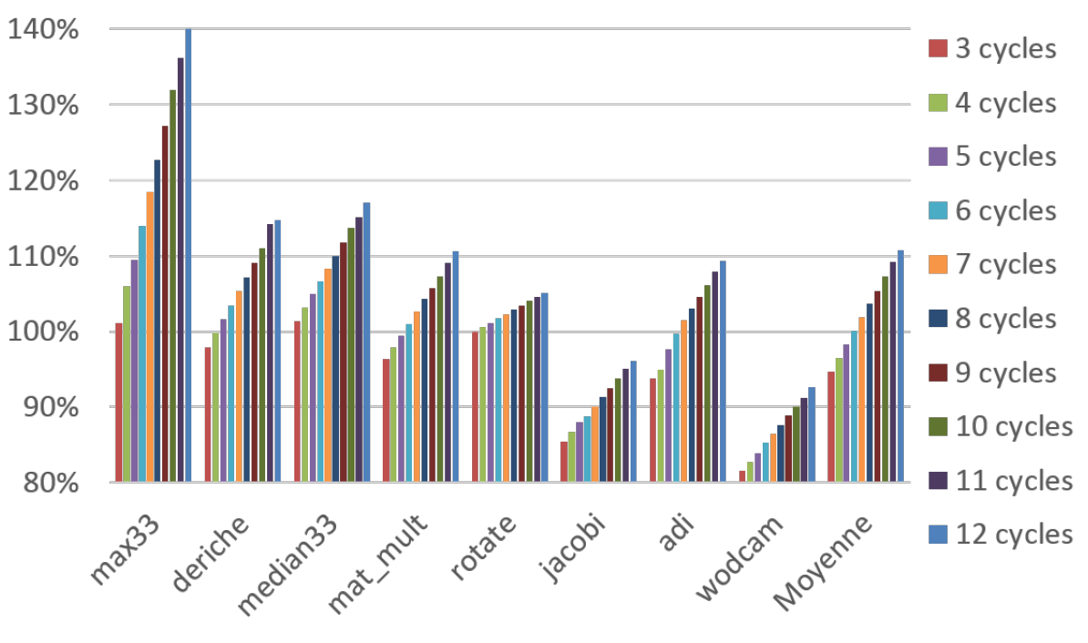
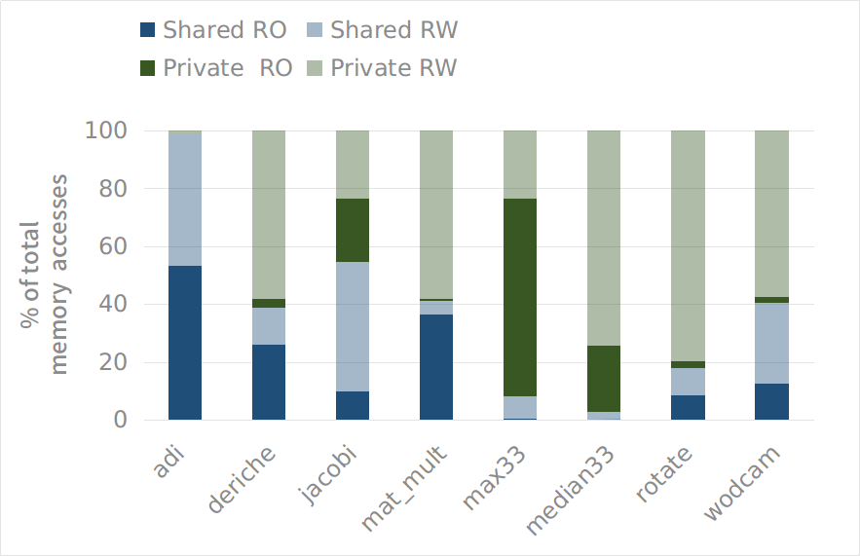
Normalized AMAT
relatively to Baseline

Slide 12
Pintools Instrumentation
Full Memory Trace
Detection of:
- Strictly Read-only data
- Important read-only phases
RO Data detection algorithm
RO Trace
RW Trace
Reuse distance analysis

