Slide 1

To Cross, or Not to Cross Pages for Prefetching?
Georgios Vavouliotis¹ Marti Torrents² Boris Grot^{1,3} Kleovoulos Kalaitzidis¹ Leeor Peled¹ Marc Casas²
¹Huawei Technologies ²Barcelona Supercomputing Center ³University of Edinburgh
— Huawei Confidential —

Slide 2
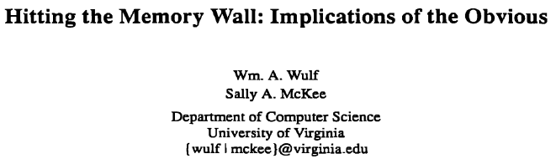
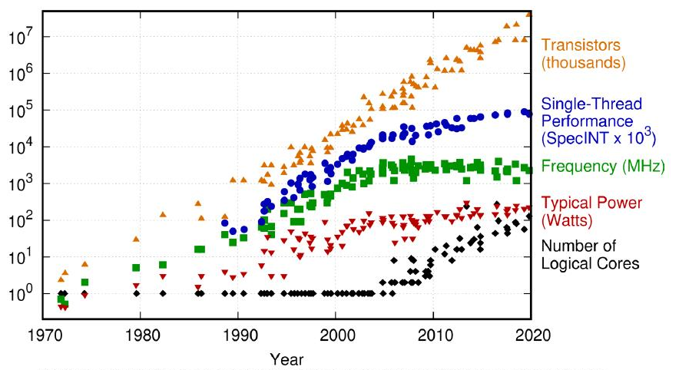


Hardware Prefetching in Post-Moore Era
Free lunch is over!
Pref
Pref
CORE
L1C
L2C/LLC
DRAM
Hardware Prefetching dominates IPC uplifts between processor generations
 | IPC Uplift (%)
HW Prefetching | 5.3%
Total | 13.0%
40%

Slide 3
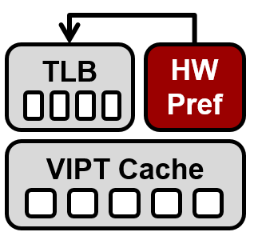
Hardware Prefetching and VIPT Caches
HW prefetchers for VIPT caches drive prefetching with v@
Prefetch requests need to go through the TLB hierarchy

Slide 4
Hardware Prefetching and VIPT Caches
HW prefetchers for VIPT caches drive prefetching with v@
Prefetch requests need to go through the TLB hierarchy
If translation is stored in TLB → issue cache prefetch
TLB HIT

Slide 5
Hardware Prefetching and VIPT Caches
HW prefetchers for VIPT caches drive prefetching with v@
Prefetch requests need to go through the TLB hierarchy
If translation is stored in TLB → issue cache prefetch
What if the translation is NOT stored in TLB?
TLB MISS
Trigger page walk to fetch the translation
Prefetching timeliness
TLB/Cache pollution
Energy overhead
Discard page-cross prefetch request
Sub-optimal performance gains
Safest option

Slide 6

Mismatch Between Academia and Industry
¹Berti: an Accurate Local-Delta Data Prefetcher, MICRO’22
²Bouquet of Instruction Pointers: Instruction Pointer Classifier-based Spatial Hardware Prefetching, ISCA’20
³
Academia
Typically proposes prefetch engines that target in-page patterns
Capture more patterns than prior prefetcher designs^{1,2}
Neglect page-cross prefetching
Industry
Optimize prefetching for both in-page and cross-page patterns³
No additional information provided
Permit all page-cross prefetches?
Dynamically optimize decisions?

Slide 7

Mismatch Between Academia and Industry
¹Berti: an Accurate Local-Delta Data Prefetcher, MICRO’22
²Bouquet of Instruction Pointers: Instruction Pointer Classifier-based Spatial Hardware Prefetching, ISCA’20
³
Academia
Typically proposes prefetch engines that target in-page patterns
Capture more patterns than prior prefetcher designs^{1,2}
Neglect page-cross prefetching
Industry
Optimize prefetching for both in-page and cross-page patterns³
No additional information provided
Permit all page-cross prefetches?
Dynamically optimize decisions?
We analyze page-cross prefetching across various cache prefetchers
We show that constantly permitting page-cross prefetching provides suboptimal gains
We propose a prefetcher-agnostic scheme to optimize prefetching across page boundaries
We call architects to pay more attention to page-cross prefetching

Slide 8
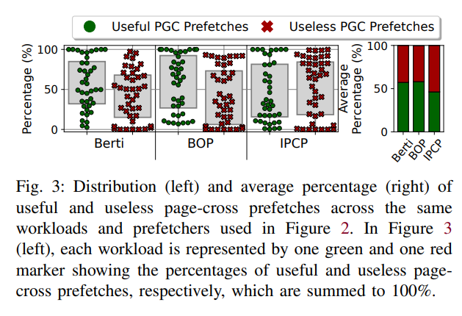
Static Policies are Suboptimal
¹Berti: an Accurate Local-Delta Data Prefetcher, MICRO’22

Slide 9

Static Policies are Suboptimal
¹Berti: an Accurate Local-Delta Data Prefetcher, MICRO’22

Slide 10

Static Policies are Suboptimal
¹Berti: an Accurate Local-Delta Data Prefetcher, MICRO’22
Constantly permitting or discarding page-cross prefetching provides suboptimal gains
>40% of the page-cross prefetches are inaccurate
Can we filter out the useless page-cross prefetches?

Slide 11
MOKA: A Framework for Designing Page-Cross Filters

Slide 12

MOKA: A Framework for Designing Page-Cross Filters
Page-Cross Filter
TLB
HW
Pref
Page
yes
Cross?
L1D
L2C/LLC/DRAM

Slide 13
MOKA: A Framework for Designing Page-Cross Filters
Page-Cross Filter
Permit?
no
Discard
yes
TLB
HW
Pref
Page
yes
Cross?
L1D
L2C/LLC/DRAM

Slide 14
MOKA: A Framework for Designing Page-Cross Filters
Epoch-based scheme that uses runtime information to tune activation threshold
WT1
Wi
WTN
Wi
…
SF1
SFN
…
Page-Cross Filter
Program Features
Adaptive
Scheme
System Features
Take into account system state on decision making
Virtual Update Buffer (vUB)
Physical Update Buffer (pUB)
pUB
p@ | hash
Weight Tables storing perceptron weights
vUB
v@ | hash
Permit?
no
Discard
yes
stores issued page-cross prefetches
TLB
HW
Pref
Page
yes
Cross?
False positive detection: stores predicted to be useless page-cross prefetches
L1D
L2C/LLC/DRAM
Page Cross Bit (PCB)

Slide 15

DRIPPER: A Page-Cross Filter Prototype
MOKA framework comes with a set of program features and system features
Offline exploration of features
Optimization metric → IPC speedup
Considered prefetchers → Berti¹, IPCP², BOP³
 | Selected Features | DRIPPER’s Storage Overhead
Berti | Delta, TLB MPKI, TLB MissRate | 1.5KB
BOP | PC^Delta, TLB MPKI, TLB MissRate | 1.5KB
IPCP | PC^Delta, TLB MPKI, TLB MissRate | 1.5KB
¹Berti: an Accurate Local-Delta Data Prefetcher, MICRO’22
²Bouquet of Instruction Pointers: Instruction Pointer Classifier-based Spatial Hardware Prefetching, ISCA’20
³Best Offset Hardware Prefetching, HPCA’16

Slide 16
Simulation Infrastructure and Workloads
ChampSim simulator
1-core and 8-core experiments
5-level radix-tree page table
Page sizes: (1) 4KB (2) 4KB+2MB
Workloads
Training Set (218 workloads)
Validation Set (178 workloads)
Component | Configuration
Core | 1-8 cores, 4GHz, 352e ROB
BP | hashed perceptron
RAS | 64-entry
L1 ITLB | 64-entry, 4-way, 1cc
L1 DTLB | 64-entry, 4-way, 1cc
L2-TLB | 1536-entry, 12-way, 8cc
PT Walker | 4-level split PSC
L1I Cache | 32KB, 8-way, 4cc
L1D Cache | 48KB, 12-way, 5cc
L2 Cache | 512KB, 8-way, 10cc
LLC | 2MB, 16-way, 20cc
DRAM | 4GB (1-core), 16GB(8-core)
Benchmark Suites
SPEC CPU 2006 | PARSEC
SPEC CPU 2017 | GeekBench5
GAP | CVP-1 INT, FP
LIGRA
Benchmark Suites
SPEC CPU 2006
SPEC CPU 2017
GAP
LIGRA
PARSEC
GeekBench5
CVP-1 INT, FP

Slide 17
Performance Evaluation
DRIPPER provides significant IPC uplifts across different prefetchers
¹Perceptron-Based Prefetch Filtering, ISCA’19
1
1

Slide 18
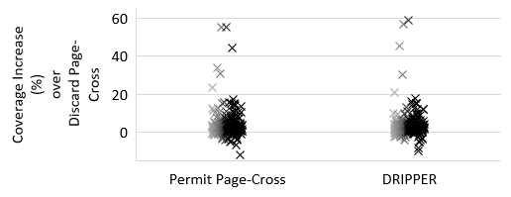
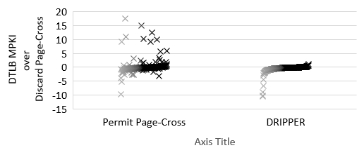
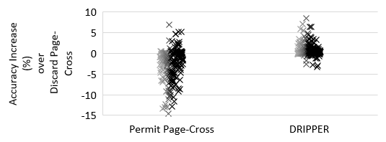
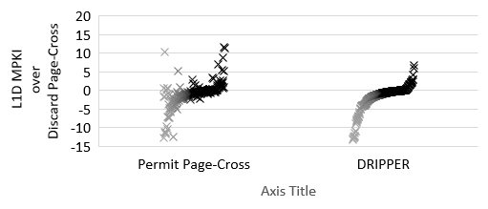
Why DRIPPER Provides Benefits?
DRIPPER has similar coverage to Permit Page-Cross
DRIPPER has higher accuracy than Permit Page-Cross
DRIPPER has positive impact on DTLB MPKI
DRIPPER has positive impact on L1D MPKI

Slide 19
Additional Evaluation
Multi-core evaluation
Impact on the validation set of workloads
Evaluation when multiple page sizes are used
Comparison between system features and program features
Evaluation across different L2C prefetchers

Slide 20
Putting Everything Together
Prefetching beyond page boundaries needs more attention
Static policies for page-cross prefetches are suboptimal
Big fraction of page-cross prefetches are inaccurate
MOKA: A Framework for designing Page-Cross Filters
DRIPPER: A Page-Cross Filter Prototype
IPC gains across different prefetchers and benchmark suites
Small storage overheads

Slide 21


THANK YOU
ZURICH RESEARCH CENTER
Copyright © Huawei Technologies Switzerland AG. All Rights Reserved.
The information in this document may contain predictive statements including, without limitation, statements regarding the future financial and operating results, future product portfolio, new technology, etc. There are a number of factors that could cause actual results and developments to differ materially from those expressed or implied in the predictive statements. Therefore, such information is provided for reference purpose only and constitutes neither an offer nor an acceptance. Huawei may change the information at any time without notice.

Slide 22
Backup Slides
ZURICH RESEARCH CENTER
Copyright © Huawei Technologies Switzerland AG. All Rights Reserved.
The information in this document may contain predictive statements including, without limitation, statements regarding the future financial and operating results, future product portfolio, new technology, etc. There are a number of factors that could cause actual results and developments to differ materially from those expressed or implied in the predictive statements. Therefore, such information is provided for reference purpose only and constitutes neither an offer nor an acceptance. Huawei may change the information at any time without notice.

Slide 23
Usefulness of Page-Cross Prefetching

Slide 24

Page-Cross Filter – Prediction
Page-Cross Filter
WT1
Wi
F1
#
…
WTN
Wi
yes
L1D
L2C/LLC/DRAM
FN
#
>Tact
no
SF1
Discard
…
SFN

Slide 25
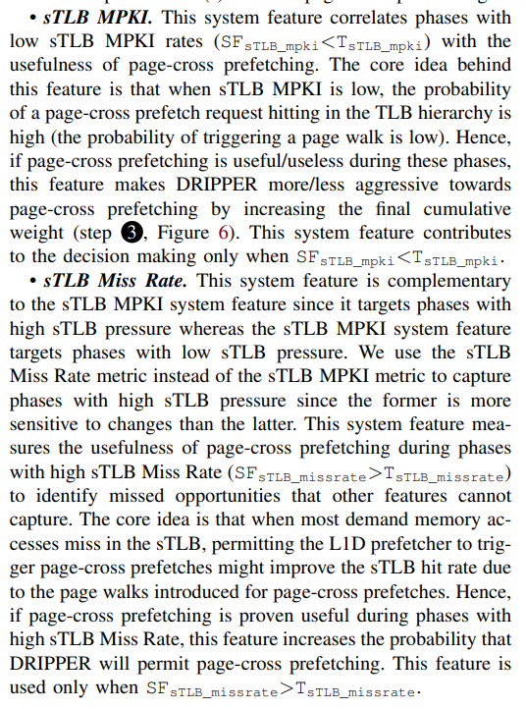
System Features
L2-TLB MPKI
Targets phases with low L2-TLB MPKI
High probability for a page-cross prefetch to hit in TLB
Make DRIPPER more aggressive during these phases
L2-TLB Miss Rate
Targets phases with high L2-TLB pressure
Idea → most demand L2-TLB accesses are misses
Try if page-cross prefetching can reduce the pressure
Miss rate is more sensitive to changes than MPKI

Slide 26
Detailed Storage Overhead of DRIPPER
 | Storage Overhead
Program Features | 0.625KB
System Features | 0.00125KB
vUB/pUB | 0.024KB/0.768KB
Total | 1.44KB

Slide 27
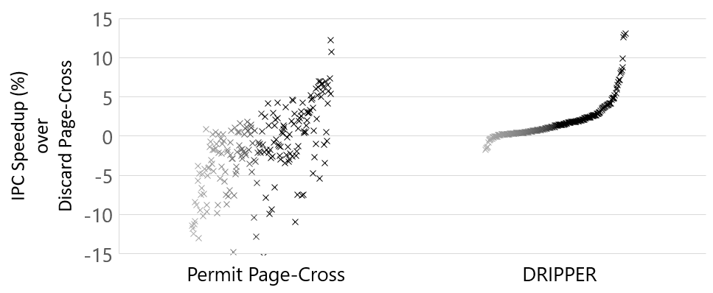
8-core Evaluation

Slide 28
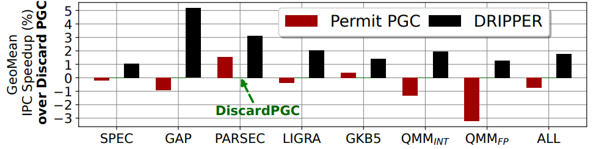
IPC Gain Breakdown

