Slide 1
Bumper: Hinting Instruction Usefulness for Robust Unified Caches
Georgios Vavouliotis†, Tom Rollet†, Davide Basilio Bartolini†, Boris Grot †‡, Leeor Peled † , Yang Lixia†
† Huawei ‡ University of Edinburgh
ISCA, 1st July 2026, Raleigh, USA

Slide 2


Mobile workloads and CPU microarchitecture
50× more mobile CPUs than server CPUs are produced every year
Large variety of mobile workloads
  Chat app, video app, search engine, messaging app, games
  Megabytes of hot code and hot data
Our objectives:
Analyze real-world mobile workloads
  Simulate mobile CPU representative of modern chips (Huawei Kirin series, Qualcomm Oryon series, Apple A/M series)
  Industry-grade simulator
Propose new microarchitectural scheme that improves performance of modern mobile applications

Slide 3
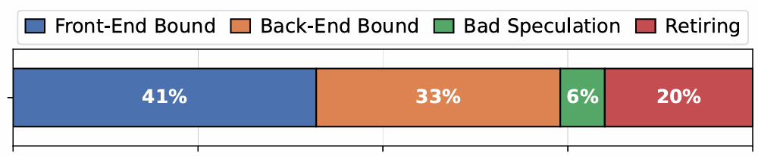
Mobile workloads bottlenecks
12 real-world mobile workloads
0.5 - 2.5MB instruction footprint
2 - 15MB data foot print
Frontend | 192KB L1I, 32-entry FTQ, 16-wide fetch, 16K-entry last-level BTB
Backend | 10 wide, 620 entries ROB, 128KB L1D
L2 Cache | 6MB, Non Inclusive-Non Exclusive, DDRIP, multiple prefetch engines
* Approximation of state of the art modern mobile core
Question: Do these workloads stress a modern mobile CPU?
The biggest bottleneck of mobile workloads is the frontend
The frontend does not deliver instructions fast enough to the backend

Slide 4
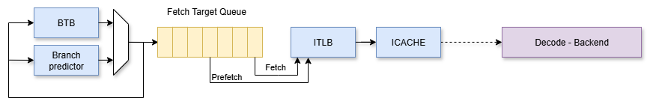
CPU Decoupled + FDIP frontend

Slide 5

FDIP and small/medium instruction working set
Small/Medium instruction working set
  Branches mostly fit in the BTB → FDIP is accurate, performance depends on BP accuracy

Slide 6

FDIP and large instruction working set
Large instruction working set
  Branches don’t fit in the BTB nor in the icache → FDIP is mostly inaccurate, many straight-line prefetches
Our mobile workloads belong to this category
Large instruction working set
Prefetches are not accurate they mostly follow a straight like path
Simulated mobiles workloads exhibit this behavior

Slide 7
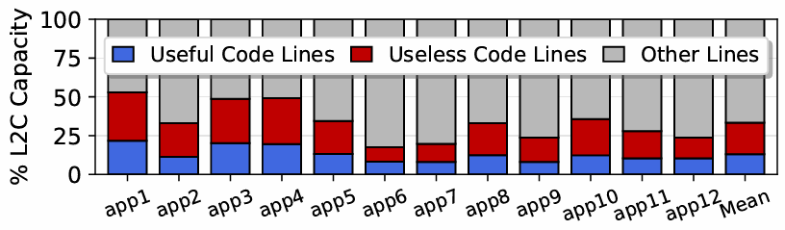
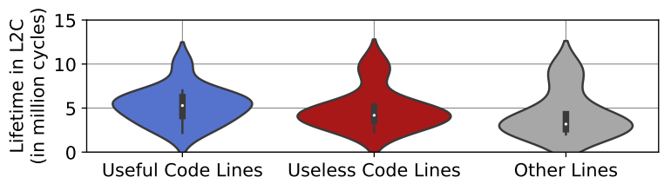
Effect of FDIP on L2 pollution
A cached code line is useless if no instruction contained within that line commits before eviction
A cached code line is useful when it contains at least one committed instruction
Fraction of L2C occupied by useful and useless code lines
Lifetime of useful and useless code lines in L2C
60% of code lines in L2C are useless
20% of overall L2C is occupied by useless code lines
Useful and useless code lines have similar lifetimes in L2C
L2 Cache is polluted with useless code lines → performance loss

Slide 8
How to solve FDIP pollution
Throttle FDIP
  Requires very accurate throttling, otherwise hurt perf
  Hard to achieve without significant storage overhead
Reduce lifetime of useless code lines in the caches
  Quickly evict useless code lines
    Other line types enjoy higher lifetime (including useful code lines)

Slide 9
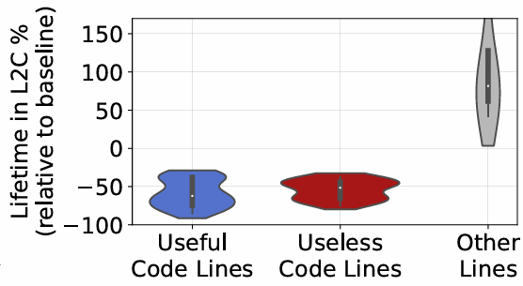
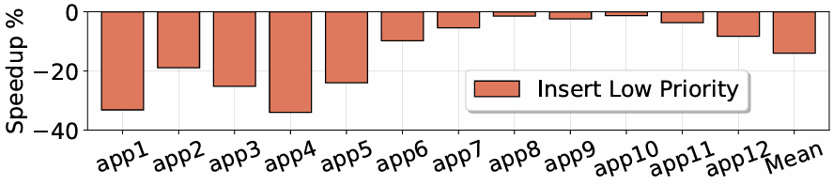
Reduce lifetime of useless lines in L2
Naïve Idea: insert all code blocks in L2C at the lowest priority
  Assumption: useful code lines will get hits, useless code lines will quickly get evicted
Why doesn’t it work?
  Both useful and useless code lines get evicted quickly
  Reuse distance of useful lines is now larger than their lifetimes in L2C

Slide 10
Bumper approach to reducing useless lifetime
Naïve insertion of all code lines at lowest priority at L2C
Detect useful code lines → promote them (increase their priority) at L2C
How to detect useful code lines?
  At fetch: 60% of fetch hits are on wrong path -> too many promotions of useless code lines
  At commit: need mechanism to propagate usefulness from commit to L2C
  How can this commit mechanism be efficiently implemented on real CPU microarchitecture?

Slide 11
Bumper micro-architecture
Goal: Efficiently propagate commit information from the retire stage to the L2C
Design principles
  Low storage overhead: no added metadata per L2C line
  Low power overhead: do not send promotion hints on every committed instruction
  Low bandwidth overhead: add minimum number of extra cache lookups and messages

Slide 12
Bumper micro-architecture
Fetch Target Queue
L1I Cache
Tag | Data
Tag | Data
L1I MISS
L2 Cache (Inst and Data)
Tag | Data | Low-priority
Tag | Data | High-priority

Slide 13
Bumper micro-architecture
Fetch Target Queue
L1I Cache
Tag | Data
Tag | Data
L1I MISS
L2 Cache (Inst and Data)
Tag | Data | Low-priority
Tag | Data | High-priority
L2C MISS

Slide 14
Bumper micro-architecture
Fetch Target Queue
L1I Cache
Tag | Data
Tag | Data
Tag | Data
L2 Cache (Inst and Data)
Tag | Data | Low-priority
Tag | Data | High-priority
Tag | Data | Low-priority
Cache Fill

Slide 15
Bumper micro-architecture
Fetch Target Queue
L1I Cache
Tag | Data
Tag | Data
Tag | Data
Cache Fill
L2 Cache (Inst and Data)
Tag | Data | Low-priority
Tag | Data | High-priority
Tag | Data | Low-priority
Cache Fill

Slide 16
Bumper micro-architecture
Retire
Stage
Fetch Target Queue
L1I Cache
Tag | Data
Tag | Data
Tag | Data
Fetch hit
Decode/Rename/Exec
L2 Cache (Inst and Data)
Tag | Data | Low-priority
Tag | Data | High-priority
Tag | Data | Low-priority

Slide 17
Bumper micro-architecture
Retire Queue
Retire
Stage
L1I Cache
Tag | Data | Commit Bit
Tag | Data
Tag | Data | 0
Decode/Rename/Exec
Fetch Target Queue
L2 Cache (Inst and Data)
Tag | Data | Low-priority
Tag | Data | High-priority
Tag | Data | Low-priority

Slide 18
Bumper micro-architecture
Retire Queue
Retire
Stage
L1I Cache
Tag | Data | Commit Bit
Tag | Data
Tag | Data | 0 -> 1
Decode/Rename/Exec
Fetch Target Queue
Promote Signal to L2C
L2 Cache (Inst and Data)
Tag | Data | Low-priority
Tag | Data | High-priority
Tag | Data | High-priority

Slide 19
Bumper micro-architecture
retire instruction with commit bit not set
Retire Queue
Retire
Stage
L1I Cache
Tag | Data | Commit Bit
Tag | Data
Tag | Data | 0 -> 1
Decode/Rename/Exec
Fetch Target Queue
commit bit passed alongside to instructions
Promote Signal to L2C
L2 Cache (Inst and Data)
Tag | Data | Low-priority
Tag | Data | High-priority
Tag | Data | High-priority

Slide 20
Bumper micro-architecture
retire instruction with commit bit not set
Retire Queue
Retire
Stage
L1I Cache
Tag | Data | Commit Bit
Tag | Data
Tag | Data | 0 -> 1
Decode/Rename/Exec
Fetch Target Queue
commit bit passed alongside to instructions
Promote Signal to L2C
Low storage overhead
L2 Cache (Inst and Data)
Tag | Data | Low-priority
Tag | Data | High-priority
Tag | Data | High-priority
Low power overhead
Low bandwidth overhead

Slide 21
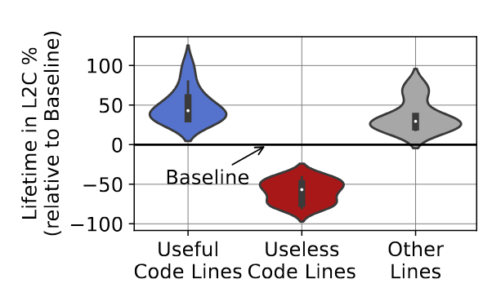
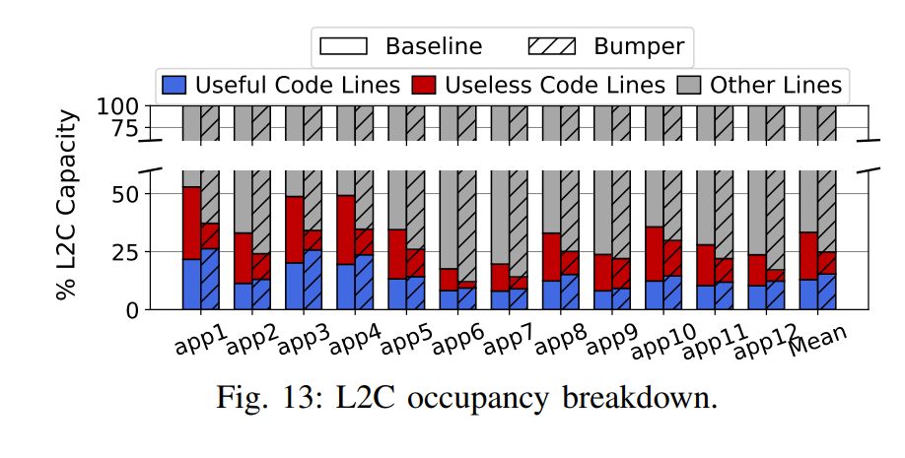
Evaluation – L2C lifetime
Reduction in lifetime of useless code lines and increase in lifetime of useful code lines and other lines
Reduction in occupancy of useless code lines by 50%
6.5% speedup over a 6MB L2C

Slide 22
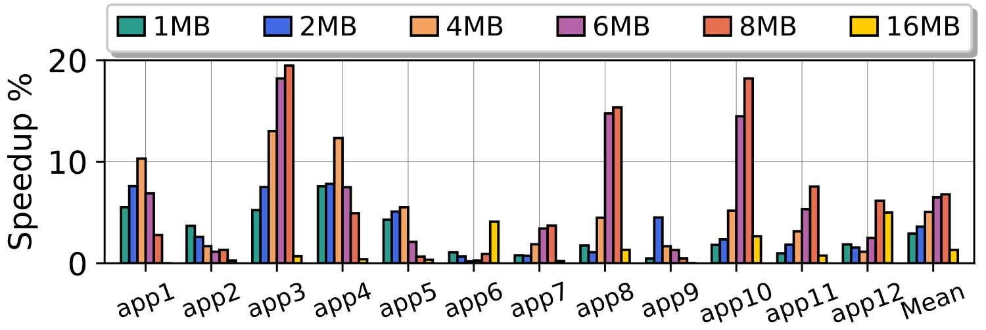
L2C size sensitivity
L2C
capacities
Consistent performance gains across different L2C sizes
Fixed storage overhead regardless of L2C size (422 bytes for 192KB L1I)

Slide 23
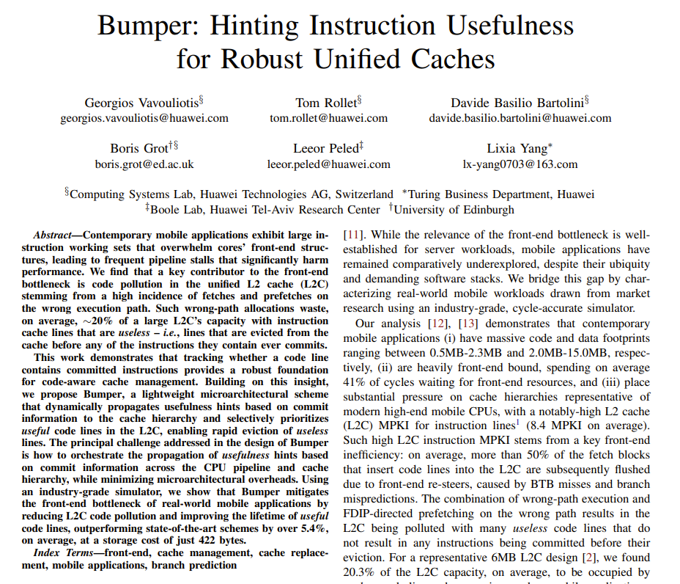
Additional information/evaluation in the paper
Complete design
Comparison with prior art
Impact of BTB size
Impact of L1I prefetchers
Bandwidth and power cost

Slide 24
Key takeaways
Mobile workload have large instruction working set
  BTB pressure
  Many useless FDIP prefetches due to BTB capacity misses → Cache pollution
Bumper addresses these challenges at minimal storage and power cost
  Reduction of L2C pollution by reducing the lifetime of useless prefetches
  Significant performance gains over an industrial baseline
  No added metadata per L2C line
What are other efficient ways to throttle FDIP?
Is FDIP a good base design for workloads with high BTB pressure?

