Slide 1
CSCE438 Distributed Systems
Machine Problem 1
Liuyi Jin (TA)
liuyi@tamu.edu

Slide 2

MP1: A Tiny Social Network Service (SNS)
What does a typical SNS looks like?
User1
Lionel Messi
Novak Djokovic
User1
…
FOLLOW
UNFOLLOW
UNFOLLOW
You

Slide 3
MP1: A Tiny Social Network Service (SNS)
What does a typical SNS looks like?
2024 Jan 24 Wed 15:00:23
There’s a flooding at Houston. The weather is terrible.
User1
2024 Jan 24 Wed 15:00:23
User1: There’s a flooding at Houston. The weather is terrible.
You

Slide 4

MP1: A Tiny Social Network Service (SNS)
What does a typical SNS looks like?
2024 Jan 24 Wed 16:57:23
I’m playing for Mr. David Beckham at Miami now! Come and visit us!
2024 Jan 24 Wed 15:00:23
User1: There’s a flooding at Houston. The weather is terrible.
You

Slide 5
MP1: A Tiny Social Network Service (SNS)
What does a typical SNS look like?
2024 Jan 24 Wed 19:15:26
Back to College Station from Houston. I need to work on 438 MP1 now!
User1
2024 Jan 24 Wed 15:00:23
User1: There’s a flooding at Houston. The weather is terrible.
You
2024 Jan 24 Wed 19:15:26
User1: Back to College Station from Houston. I need to work on 438 MP1 now!

Slide 6
What you have?
README.md
Makefile
client.h
client.cc
sns.proto
tsc.cc (“YOUR CODE HERE”)
tsd.cc (“YOUR CODE HERE”)
tsn-service_start.sh

Slide 7
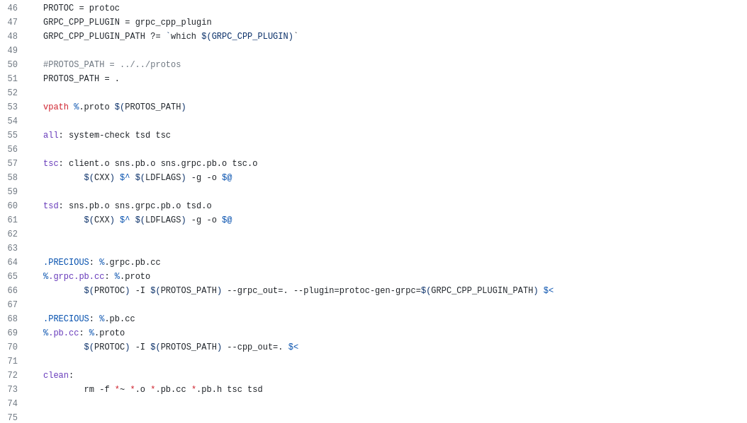
What you have?
Makefile

Slide 8
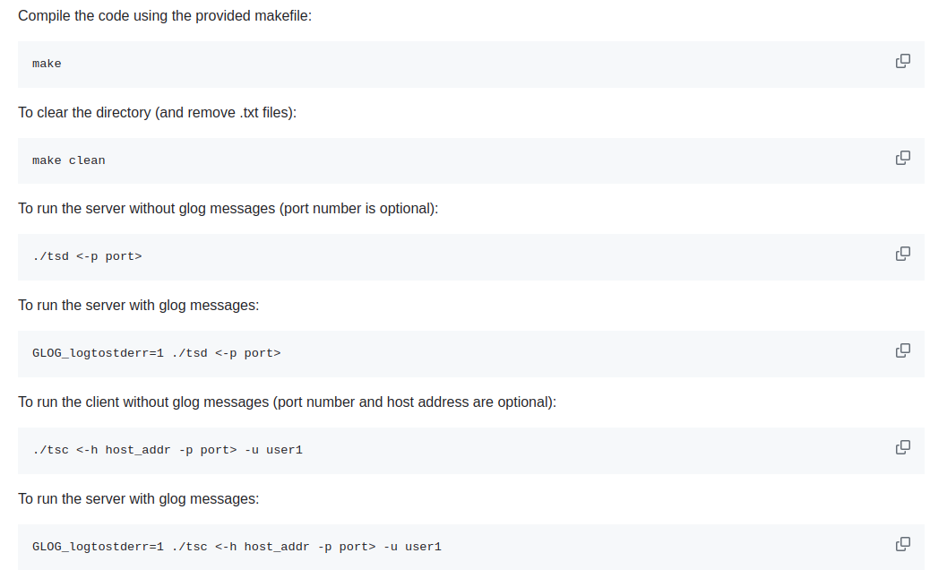
What you have?
README.md

Slide 9
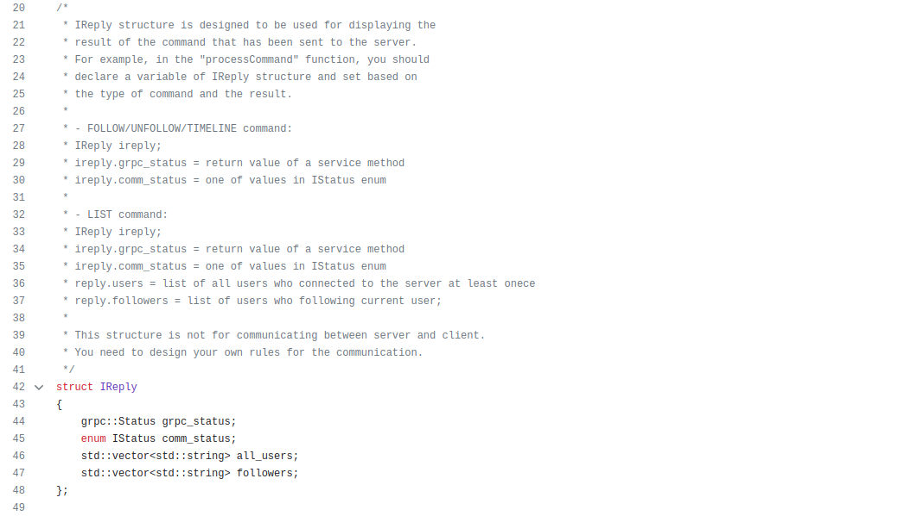
What you have?
client.h
Member fields and functions declarations for the Class IClient
IReply

Slide 10
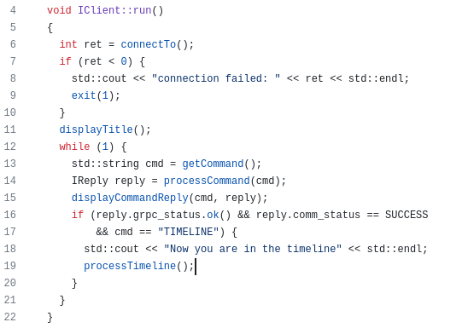
What you have?
client.cc
Member function implementations for the class IClient
The client instance "myc" in the "main" function of tsc.cc will loop infinitely inside this "while(1)" to respond to the input commands in the client terminal.

Slide 11
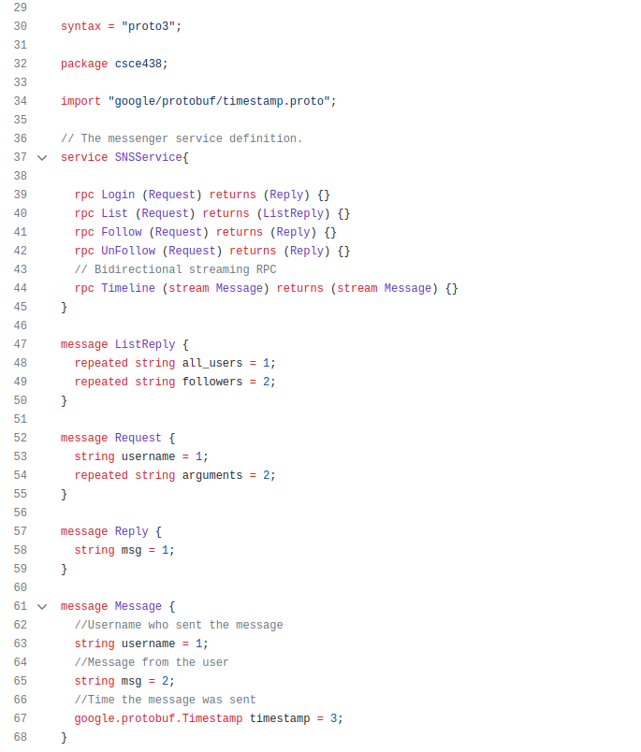
What you have?
sns.proto
Using grpc, the grpc client and grpc server communicates with each other through customized "message" structures.

Slide 12
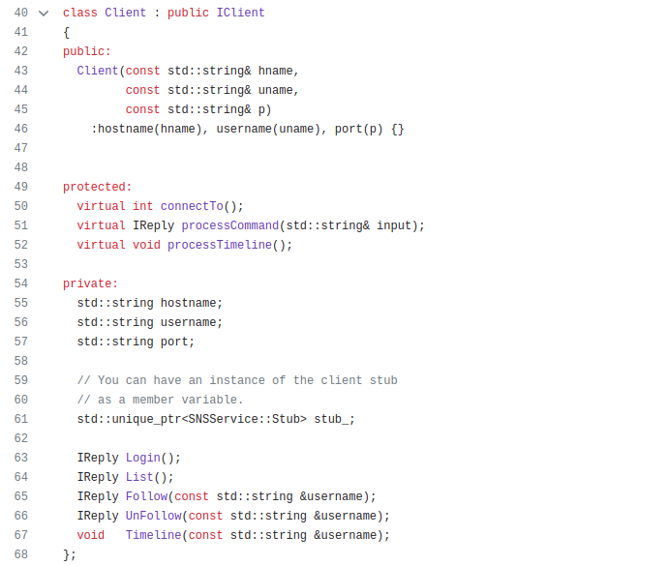
What you need to do?
tsc.cc: client code(“YOUR CODE HERE”)
Instead of IClient, the class Client is the grpc client, and is the one you want to work on in tsc.cc.
There are 8 functions in class Client: 3 protected functions and 5 private functions. You need to implement 7 functions of the 8 ("processTimeline" calls "Timeline").
Pay attention to "stub_". 6 functions need to use "stub_" (connectTo, Login, List, Follow, UnFollow, Timeline).

Slide 13
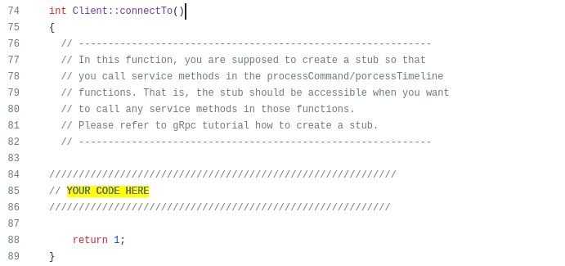
What you need to do?
tsc.cc: client code(“YOUR CODE HERE”)
login_info = hostname + ":" + port
stub_ = new SNSService::Stub(…, login_info, ...)
reply = login()
if (!reply.status.ok()) {
return –1;
}
return 1

Slide 14
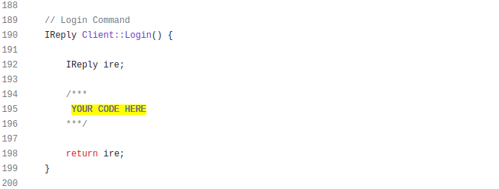
What you need to do?
tsc.cc: client code(“YOUR CODE HERE”)
Status status = stub_->Login(..., request, &reply);
if (reply.msg() == "you have already joined") {
Connection failed;
} else {
Connection succeeded;
}

Slide 15
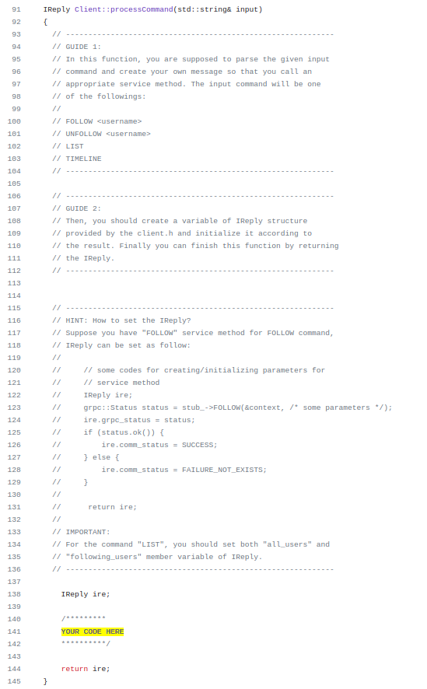
What you need to do?
tsc.cc: client code (“YOUR CODE HERE”)
cmd, arg = split(input)
if("follow" == cmd){
Follow(arg)
}else if("unfollow" == cmd){
UnFollow(arg)
}else if("list" == cmd){
LIST()
}else if("timeline" == cmd){
TIMELINE()
}

Slide 16
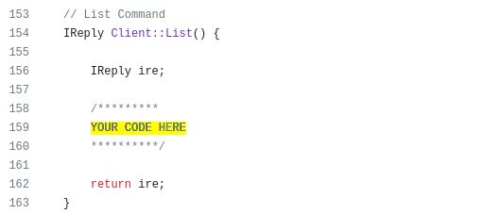
What you need to do?
tsc.cc: client code (“YOUR CODE HERE”)
Status status = stub_->List(..., request, &list_reply);
if(status.ok()){
for u in (all users of list_reply):
add u to (ire users)
for f in (all followers of list_reply):
add f to (ire followers)

Slide 17
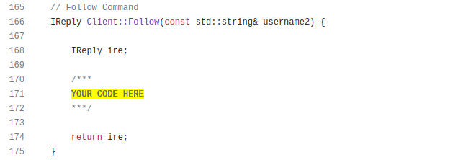
What you need to do?
tsc.cc: client code (“YOUR CODE HERE”)
Status status = stub_->Follow(..., request, &list_reply);
if(reply.msg() == "you have already joined"){
Follow failed
else if(reply.msg() == "Follow Successful"):
Follow succeeded

Slide 18
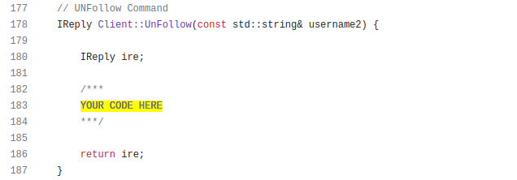
What you need to do?
tsc.cc: client code (“YOUR CODE HERE”)
Status status = stub_->UnFollow(..., request, &list_reply);
if(reply.msg() == "You are not a follower"){
UnFollow failed
else if(reply.msg() == "UnFollow Successful"):
UnFollow succeeded

Slide 19
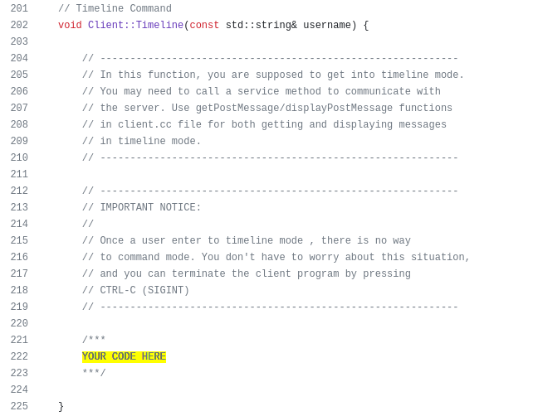
What you need to do?
tsc.cc: client code (“YOUR CODE HERE”)
gRPC_RW_Steam stream(stub_->Timeline(...));
writer_thread([...](){
while(1){
stream->writeMessageToStream(terminal_message);
}
});
reader_thread([...](){
while(stream.read(Message m)){
displayPostMessage(…, m, timestamp);
}
});
threads_join()

Slide 20
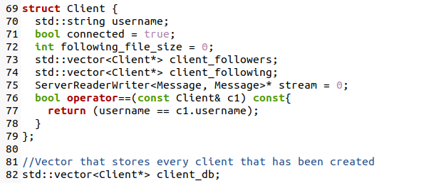
What you need to do?
tsd.cc: server code(“YOUR CODE HERE”)
This class Client is the one you want to work with in tsd.cc.
You need to implement 5 functions in tsd.cc.
client.db is where server saves the clients information in the memory.

Slide 21
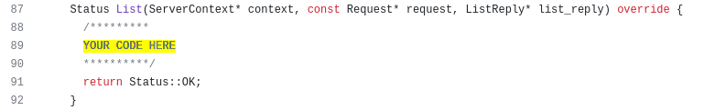
What you need to do?
tsd.cc: server code(“YOUR CODE HERE”)
c = client_db[request->username];
add users in client_db to list_reply;
add (followers of c) to list_reply;
return Status::OK;

Slide 22
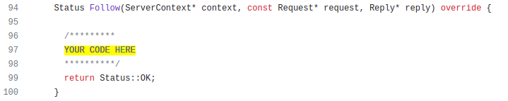
What you need to do?
tsd.cc: server code(“YOUR CODE HERE”)
u1, u2 = request.username, request.args[0]
c1, c2 = getClient(u1), getClient(u2)
c1.client_following.push_back(c2);
c2.client_followers.push_back(c1);
return Status::OK;

Slide 23
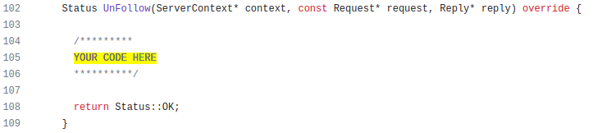
What you need to do?
tsd.cc: server code(“YOUR CODE HERE”)
u1, u2 = request.username, request.args[0]
c1, c2 = getClient(u1), getClient(u2)
c1.client_following.erase(u2);
c2.client_followers.erase(u1);
return Status::OK;

Slide 24
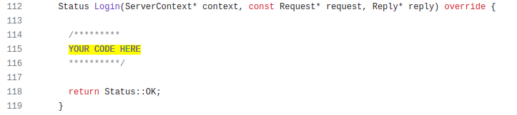
What you need to do?
tsd.cc: server code(“YOUR CODE HERE”)
c = getClient(request.username)
if (c.connected){
login failed
}else{
login succeeded
}
return Status::OK;

Slide 25
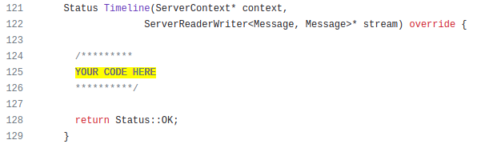
What you need to do?
tsd.cc: server code(“YOUR CODE HERE”)
Message m;
while(stream.read(&m)){
string u = m.username
Client c = getClient(u)
ffo = format_file_output(timestamp, request.username, m)
if(!first_timeline_stream()){
append ffo to file u.txt
}else{
lat20 = read 20 latest massages from file u_following.txt;
stream->write(lat20);
}
for f in c.followers:
f->stream->write(ffo)
append ffo to the file f_following.txt
}

