Slide 1
Maritime Assurance
Data Exploration
Gavin van der Nest
Senior Statistician

Slide 2
Vessel Selection:
SIRE reports: 200-300 questions, 30-40 master mariners review reports and give risk ratings.
Team of 30 professionals, experience bias. Serious incident review: incident where 2 died due to freak wave on deck. E.g. people who experienced that type of incident when they were ship pilots will be more risk averse/ perceptive to threat.
2000 incidents per year, can't review them all.
Have a nice tool which brings together information about Shell's fleet and 3rd party vessels: their specs/operational constraints, safety data like incident reports (textual data - NLP).
Currently just the last report being reviewed for a vessel, and then it's marked eligible. Would like to get a risk rating.
Validity of report usually a year, if any longer then have to do manual review of vessel.
Only get an' observation' if answer is NO ('negative response')
Initial manager comment is secondary, might be a final one too.
KLM: 10 is high, 3, is medium, 1 is low. Potential risk value is system generated. The observed and final risks are the decisions the master mariners in the team are making. Will only be something if there is a NO.
Suggesting time to do inspection / new review would be good. Quality mindset: what would be interval want to do inspections based on historical data (when did it last fail, what for, …)
Currently rigid process uniform for all vessels but e.g. location risk is not considered.

Slide 3
Data Preparation
Data Fields:
VIQ7 questionnaire responses (negative only)
Initial, observed, and final risk ratings:
Is there a standardized rubric for decision making?
Vessel info, incident reports, inspections (frequency), knowledge of crew & route
Vessel details (outstanding): type, size, age, operator
Assessor details (location, background)
Data cleaning and transformation:
Filter: Extract only negative responses [Specific column - definition] from raw data
Consistency check: Validate for missing values, duplicates (currently many rows are exact duplicates), and inconsistencies
Missing responses: Drop or impute?
Normalization: Standardize data format – risk ratings [difference in Q – default value]?
Data Integration:
Combine datasets: Merge information from different sources (e.g., vessel details with questionnaire responses)

Slide 4
Data Quality and Consistency
Quality Analysis:
Completeness: Check for missing values or incomplete records.
Consistency: Verify that risk ratings are consistently applied across different assessors and locations.
Variability Analysis:
Inter-Rater Reliability: Use metrics like Kappa or ICC [define] to assess the agreement between observed and final risk ratings among different assessors.
Regional and Background Differences: Compare ratings across different locations and assessor backgrounds to identify any significant patterns or biases.

Slide 5
Question Level Analysis
Risk Ratings Comparison:
Initial vs. Observed vs. Final Risks: Perform statistical tests to compare the risk ratings at different stages (initial, observed, final).
Tailored Risk Ratings: Investigate if different vessel types require tailored initial risk ratings.
Trend Analysis:
Temporal Patterns: Examine how risk ratings and decision patterns change over time.

Slide 6
Vessel Type and Attribute Analysis
Attribute Analysis:
By Vessel Type: Analyze whether risk ratings vary by vessel type (e.g., Oil, Chemical, LNG).
By Vessel Characteristics: Look at how factors like vessel size and age affect risk ratings.
Statistical Tests:
ANOVA or Kruskal-Wallis Test: Use these tests to compare risk ratings across different vessel types and characteristics.
[Intro slide about idea approaches / not solutions]

Slide 7
Handling Missing Data
Data Gaps Analysis:
Identify Missing Data: Determine what data is missing for cross-comparison between OCIMF submitting members.
Synthetic Data: Create a synthetic dataset if necessary to illustrate how missing data impacts analysis and to propose solutions for data collection. [EXAMPLE: Multiple master mariners / experts (raters) per independent case/]
Data Imputation:
Techniques: Use imputation techniques (e.g., mean imputation, regression imputation) to fill in gaps where feasible.

Slide 8
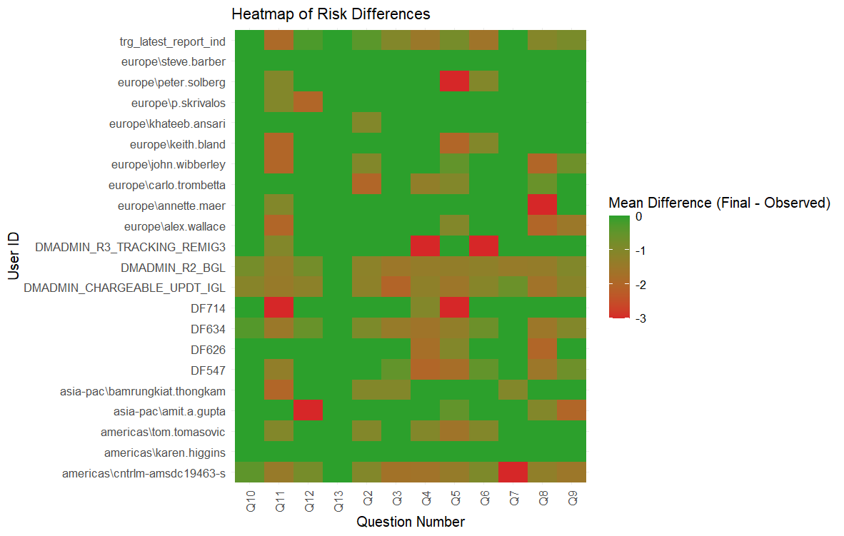
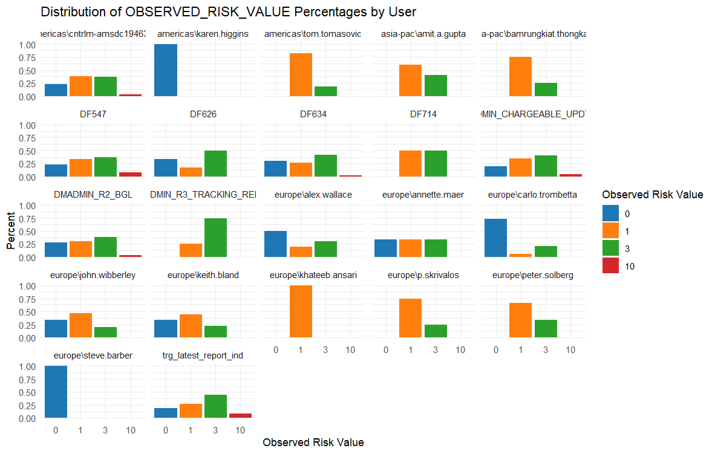
EDA (exploratory d analysis)

Slide 9
Next Steps
Leading Questions
Absence of comparable data [how to visually illustrate: user as row and cases as column – diagonal matrix with …] – difference on outcome on given question – what do we do about this – synthetic data – case gathering higher quality data.
Extra data fields to support analysis
Give an idea of which questions are most NB (weighting)
Desire to move away from binary logic for fields which have a degree of greyscale. Can this crew field this vessel is not a yes/no, is the vessel safe is not a yes/no but rather a scale of risk. Longer term ambition to combine these fields in such a way that a level of risk is communicated rather than just a binary outcome. [Develop a risk rating from 0 – 10 scaled according to risk of voyage failure]
Currently just the last report being reviewed for a vessel, and then it's marked elligible. Would like to get a risk rating
With incident reports being key input here, there is an NLP [What is NLP? Natural language processing?] component to this project also. Though it's in early phases.
Interesting question from Emma: Can we look back at incident data as a covariate to explain e.g. increased risk aversion in maritime experts decision making over time?

