Slide 1

HighTowers Web
Mission reporting + tower analysis + ForeFlight Content Pack updates
30-minute management overview (with live demo)
Notes:
Open with: “Today I’ll walk through HighTowers Web—one place to capture tower observations, analyze tower photos, export the customer PDF, and update ForeFlight Content Packs for next season’s crews.” Goal: throughput + quality + repeatability.

Slide 2
The problem we’re solving
Manual re-entry and seasonal rework create avoidable delay and error.
Manual re-entry across tools (photos, notes, coordinates, heights)
Inconsistent waypoint naming and coordinate rounding
Seasonal effort to refresh ForeFlight crew navigation packs
Hard to audit: “what changed” and “why” across missions
HighTowers Web — internal leadership briefing
Notes:
Emphasize risk reduction: fewer transcription errors; faster turnaround; better standardization.

Slide 3
What HighTowers Web does
A single workflow from mission setup to report export and crew-pack update.
Mission + flight plan + waypoints (route context)
Air Force Report Form: up to 6 towers per mission
Tower Data Analysis: photo-assisted height + location capture
Export Reported Data: standardized customer-ready PDF
ForeFlight Content Pack Update: bulk refine/append user waypoints in a ZIP
HighTowers Web — internal leadership briefing
Notes:
Keep this slide high-level—details come next. Call out “new” ForeFlight pack update capability.

Slide 4
End-to-end workflow
From mission creation to export, with optional analysis and pack updates.
1) Select or create mission; associate a flight plan (waypoints)
2) Capture tower observations (structure, lighting, notes, coordinates)
3) Optional: Tower Data Analysis from image + map record → estimated height
4) Export Reported Data PDF (map + photos when configured)
5) Update ForeFlight Content Pack ZIP for next season’s crews
HighTowers Web — internal leadership briefing
Notes:
Message: “once data is captured, export becomes a button—less rework.”

Slide 5
Data model (plain English)
Structured records enable consistent exports and pack updates.
Missions: metadata + Additional Notes
Flight plans: ordered waypoints used for naming and context
Tower reports: per observation (date, notes, structure, lighting, height estimate)
Tower locations: lat/long/elevation + image-derived metadata
Local-first storage for fast load and resilience (optional API for map/PDF)
HighTowers Web — internal leadership briefing
Notes:
Focus on “structured data” → “repeatable outputs.” Avoid deep technical details.

Slide 6
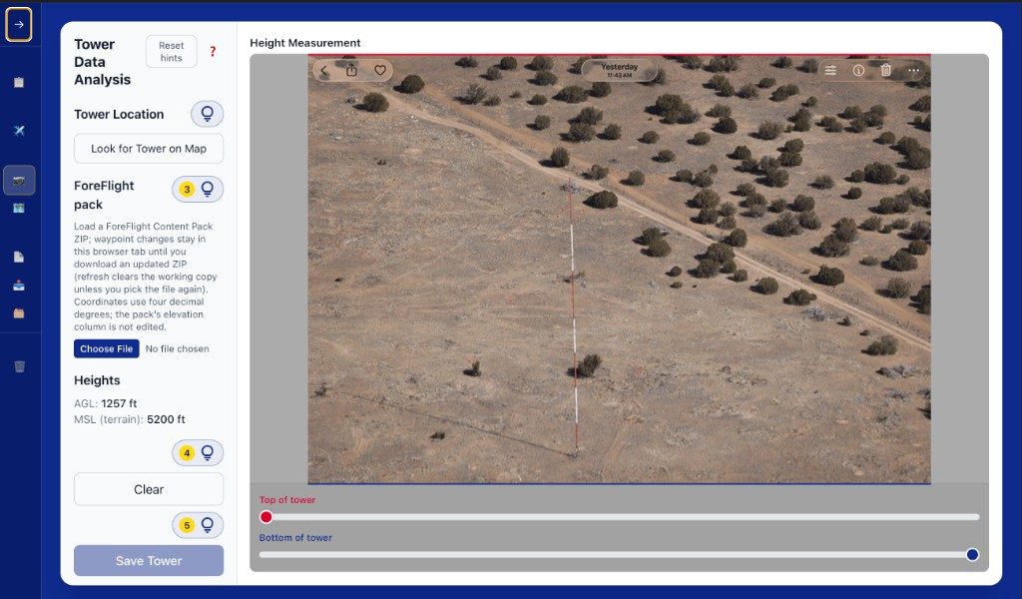
Tower Data Analysis
Photo-assisted height workflow that writes back to the mission record.
HighTowers Web — internal leadership briefing
Notes:
Demo cue: show selecting an image, recording map point, aligning sliders, saving.

Slide 7
Export Reported Data
One-click PDF generation for the customer / stakeholder.
Standardized Air Force Route Survey Report PDF
Mission map included when configured (Mapbox token + hosted API as needed)
Tower photos include CAP-style coordinate overlay; size optimized for sharing
Additional Notes printed on the report (and ready for leadership review)
HighTowers Web — internal leadership briefing
Notes:
Demo cue: generate the PDF and show the Additional Notes section near the end.

Slide 8
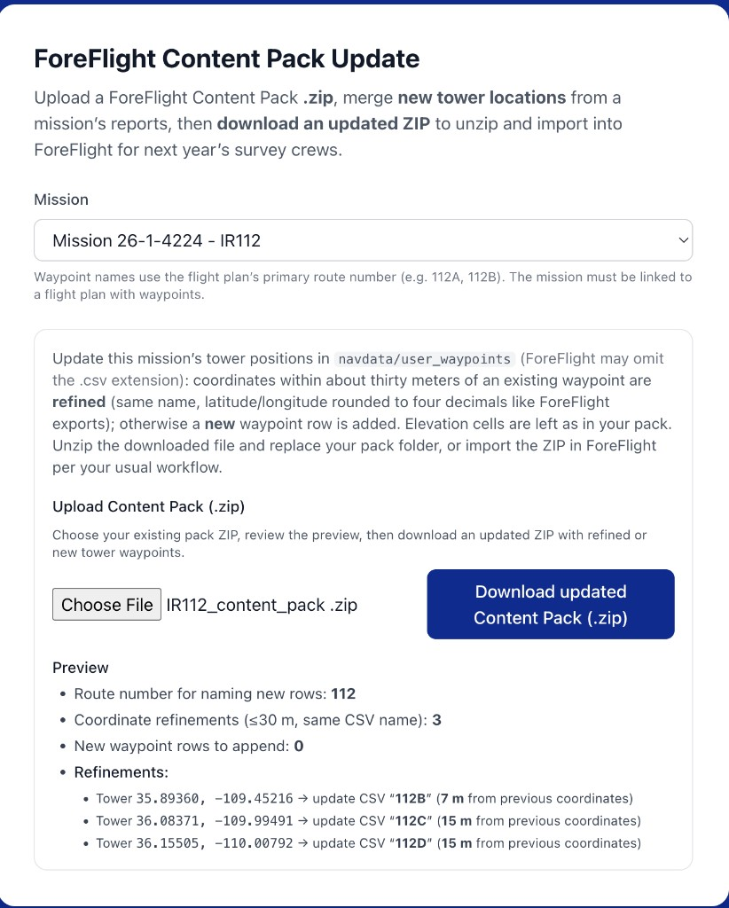
ForeFlight Content Pack Update (new)
Bulk-refresh crew navigation packs from mission tower reports.
Upload ForeFlight Content Pack ZIP
App updates `navdata/user_waypoints` (CSV) inside the pack
Download an updated ZIP; unzip/import into ForeFlight
Two outcomes per tower:
• Refine an existing waypoint when within ~30 m (same name)
• Append a new waypoint row otherwise (named from primary route number)
Screenshot: Content Pack preview + download
HighTowers Web — internal leadership briefing
Notes:
Demo cue: upload ZIP, point to preview counts (refined vs appended) and example refinements.

Slide 9
Precision & safety rules
Conservative logic reduces risk of unintended navigation changes.
Refinement threshold: ~30 m to prevent accidental mismatches
Writes lat/long using 4 decimals (matches ForeFlight export convention)
Leaves pack elevation cells untouched (no elevation edits in the ZIP)
Blocks new-row appends if mission lacks flight-plan route context for naming
Preview step before download provides transparency and quick QA
HighTowers Web — internal leadership briefing
Notes:
Position this as “guardrails”: reduce false matches; keep changes explicit and reviewable.

Slide 10
Value to the organization
Speed, consistency, and season-to-season readiness.
Faster turnaround: fewer manual steps and less re-entry
Fewer errors: consistent naming, rounding, and formatting
Repeatability and auditability: structured records and deterministic exports
Crew readiness: ForeFlight packs updated from actual reported towers
Lower training burden: guided UI + smoke test checklist
HighTowers Web — internal leadership briefing
Notes:
Tie back to leadership priorities: efficiency, quality, risk, and readiness.

Slide 11
Live demo (5 minutes)
Show the workflow end-to-end with one mission.
1) Pick mission and confirm flight plan/waypoints
2) Tower Data Analysis: save one tower report
3) Export Reported Data: generate the PDF
4) ForeFlight Content Pack Update: upload ZIP → preview → download updated ZIP
HighTowers Web — internal leadership briefing
Notes:
Keep the demo tight: one tower save + one export + one pack preview. If Mapbox isn’t configured, call it out briefly and proceed (PDF still generates).

Slide 12
Next steps
Pilot, harden, and scale.
Pilot with 1–2 crews; collect workflow feedback
Finalize training: quickstart + smoke test checklist
Decide/confirm hosting for PDF map rendering (if required)
Operationalize season refresh: pack updates per mission, then consolidated for crews
Track success metrics: time-to-report, corrections, pack-update time
HighTowers Web — internal leadership briefing
Notes:
Close with an “ask”: approve pilot; confirm hosting; define success metrics.

