Slide 1

ISE - Device Access Policy Automation
User requests access to a device
The system admin receives the request details to approve/reject
If approved, the access to the device is provided
The user joins the requested identity group, which already has access to a certain device/s
The user is to submit a request asking to join a specific identity group that has access to a certain device/s
The admin can receive the request via email, chatbot, SMS, etc..

Slide 2

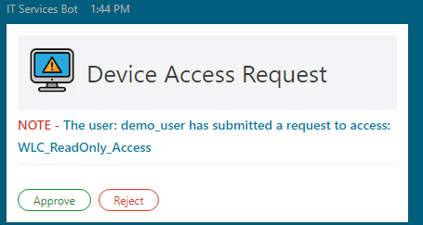
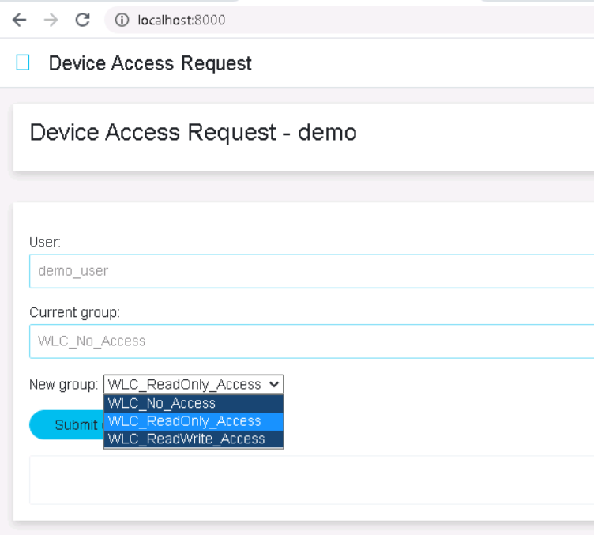


High Level Design PoV
Admin receives the request details to Approve/Reject
(for example: through a Webex chatbot)
The user is to submit a request asking to join a specific identity group that has access to a certain device/s
If approved, the web app/script will invoke ISE APIs to change the user’s identity group, resulting to have the requested access

Slide 3
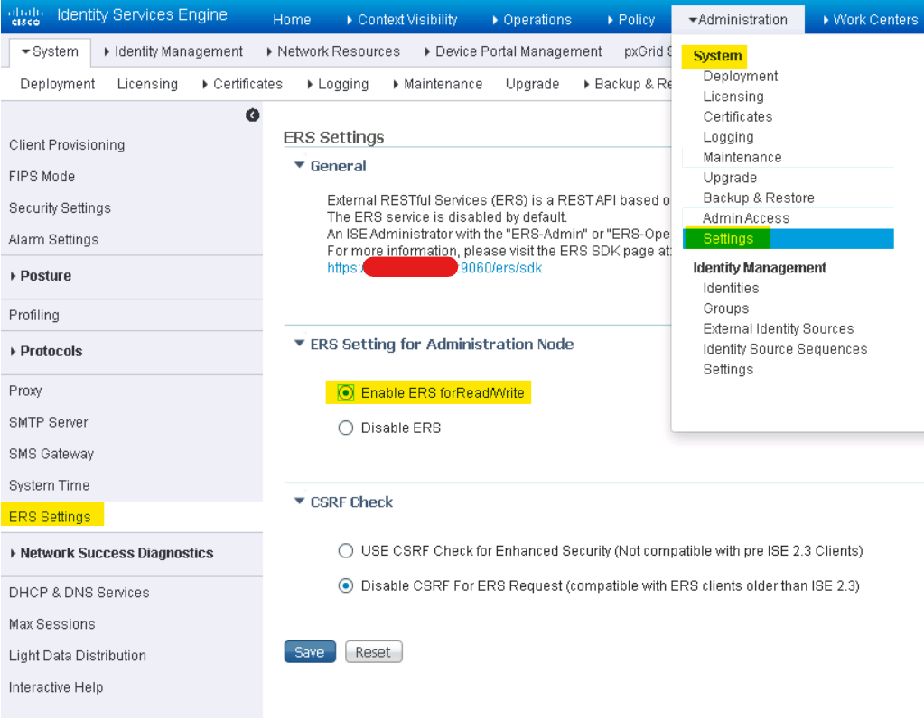
Setup for Device Access Policy Automation
Setup for Device Access Policy Automation
1. Enable ISE REST APIs, AKA External RESTful Services (ERS)
ERS are disabled by default for security. Must be enabled as follows:
Login to your ISE PAN using the admin or other SuperAdmin user.
Navigate to Administration > System > Settings and select ERS Settings from the left panel.
Enable the ERS APIs by selecting Enable ERS for Read/Write
Select Save to save your changes.

Slide 4
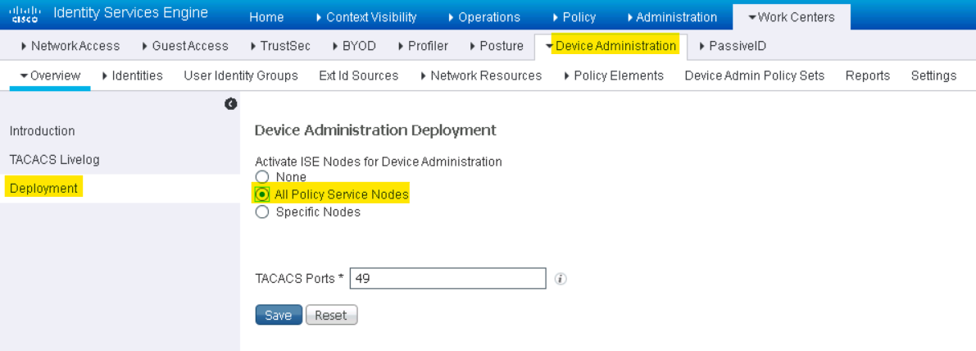
Setup for Device Access Policy Automation
Setup for Device Access Policy Automation
Setup for Device Access Policy Automation
2. Enable Device Administration service (TACACS+) on ISE
TACACS+ is disabled by default. Must be enabled as follows:
In ISE, navigate to Work Centers > Device Administration.
Navigate to Overview > Deployment
Activate ISE Nodes for Device Administration by selecting All Policy Service Nodes or Specific Nodes (depending on your environment)
Select Save to save your changes.

Slide 5
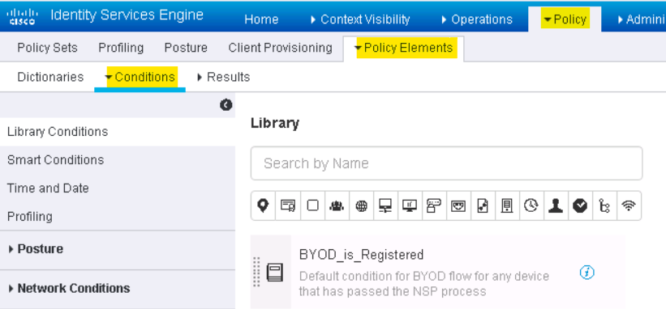
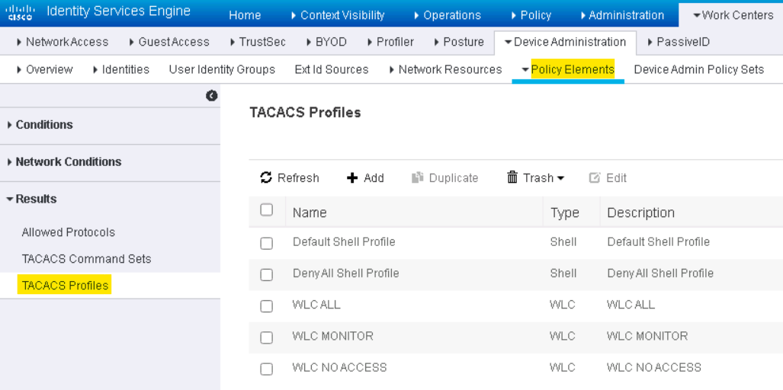
Setup for Device Access Policy Automation
Setup for Device Access Policy Automation
Setup for Device Access Policy Automation
3. Create/Configure the needed Policy Elements & TACACS+ profiles
Policy Elements:
You may enter one or more roles/profiles to allow read and write access to any particular features/commands, apply time-conditions, and more.
More Details:
Device Administration
TACACS+ Profiles

Slide 6
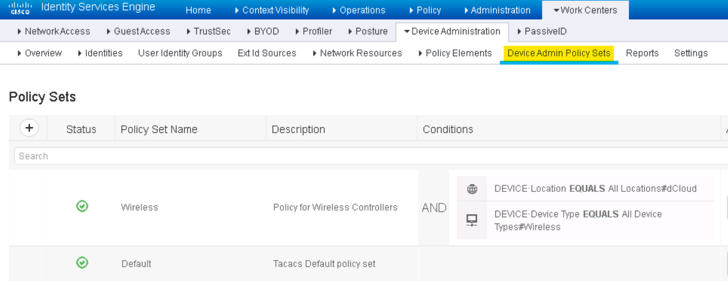
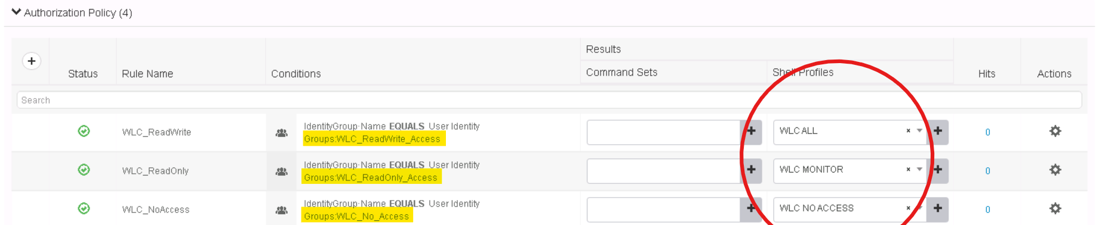
Setup for Device Access Policy Automation
Setup for Device Access Policy Automation
4. Create/Configure the needed Device Admin Policy Sets
Device Admin Policy Sets:
A Regular policy set comprises a rule table contains a set of rules to select actions required to authenticate a network device.
More details: Device Admin Policy Sets
Authorization Policy Rules:
A component of Device Admin Policy Sets to define authorization policies and configure authorization profiles for specific users and groups to access specific network resources.
More details: Authorization Policies

Slide 7
Setup for Device Access Policy Automation
ISE API calls
Get-By-Id example in python:
5. Once the policy setup is completed, ISE APIs can be used to change the user’s identity group programmatically, resulting in giving the needed access after the request is approved. As follows:
''' Printing user's current details '''
url = host+":9060/ers/config/internaluser/" + user_id
method = "GET"
response = requests.request(
method, url, headers=headers, data=payload)
print('Response Code: ' + str(response.status_code))
print(response.text)
Internal-user APIs:
Allows the client to add, delete, update and search Internal Users
Get-By-Id API call can be used to get the user’s current identity group/s.
Update API call can be used to update the user’s identity group/s.
More useful resources:
ISE ERS API Examples
Lab Guide: Device Administration (TACACS)
ISE - User Modification through Rest API
Update example in python:
''' Update the user's group '''
url = host+":9060/ers/config/internaluser/" + user_id
method = "PUT"
payload = {
"InternalUser": {
"id": user_id,
"name": user_name,
"identityGroups": new_group_id
}
}
response = requests.request(
method, url, headers=headers, data=json.dumps(payload))
print('Response Code: ' + str(response.status_code))
print(response.text)

Slide 8

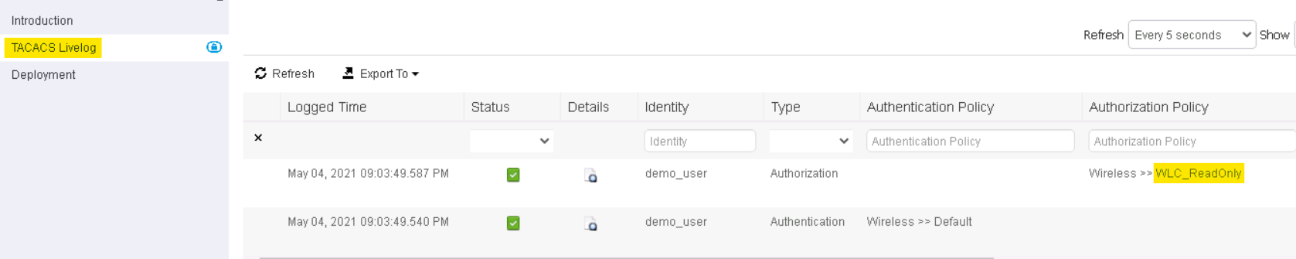

Sample run
Setup for Device Access Policy Automation
As an example, a Wireless Controller was configured with TACACS+ as its AAA server and added as a Network Device to ISE. The user: demo_user was changed groups as follows:
Group: WLC_ReadOnly_Access:
TACACs Livelog:
WLC trap logs:
Group: WLC_ReadWrite_Access:
TACACs Livelog:
WLC trap logs:

Slide 9
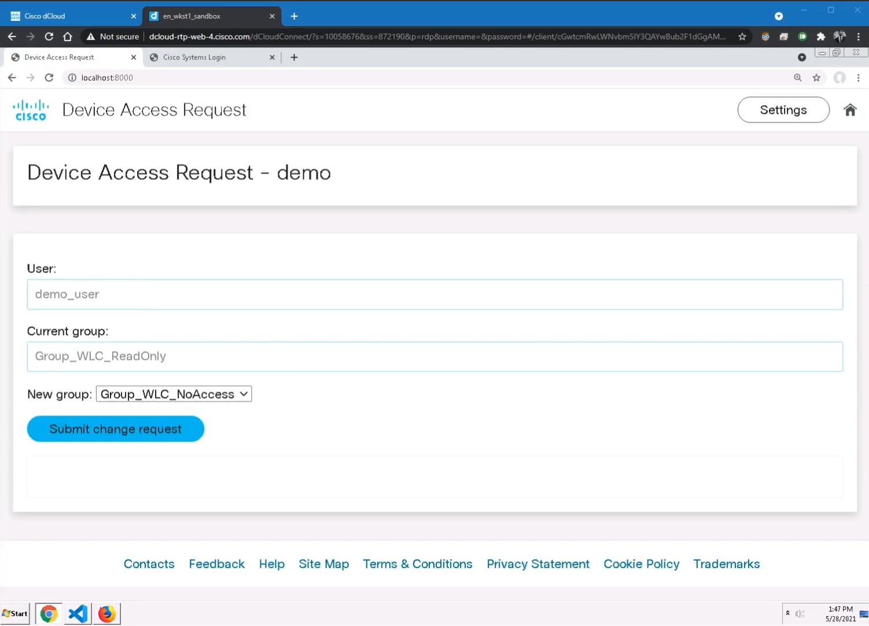
Show GUI or mockup
https://youtu.be/X6eBdJmDp1I

Slide 10
Tools (products) Used
Python
Flask
ISE
TACACS+

