Slide 1
Chat Application
High Level Architecture

Slide 2
Major Modules
User sign up page
Sign up page is used for people to register an account and use the chat application if the user has successfully registered.
User login Page
Login Page is used for registered users and be able to use the chat application.
Forgot Password
Forgot Password page is used for registered users to reset their password in case they forgot their password.
Chat Application Interface
This is the main Interface page for the chat application where users can send messages to each other.

Slide 3
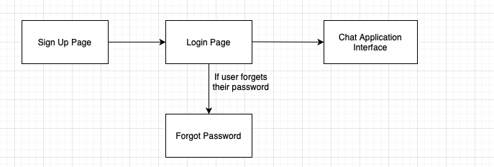
Module Connections

Slide 4
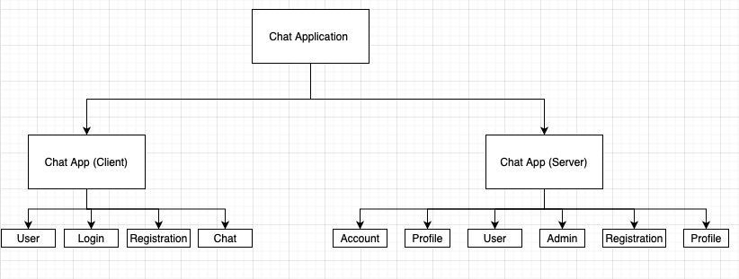
Major Modules Architecture

Slide 5
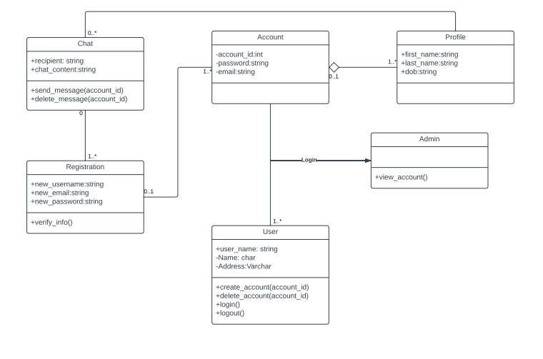
Class Diagram for Server Side

Slide 6
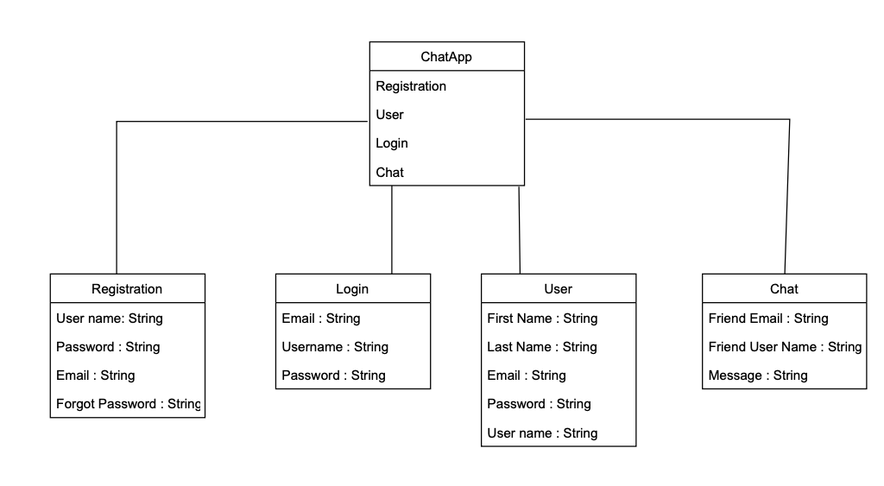
Class Diagram for Client Side

Slide 7
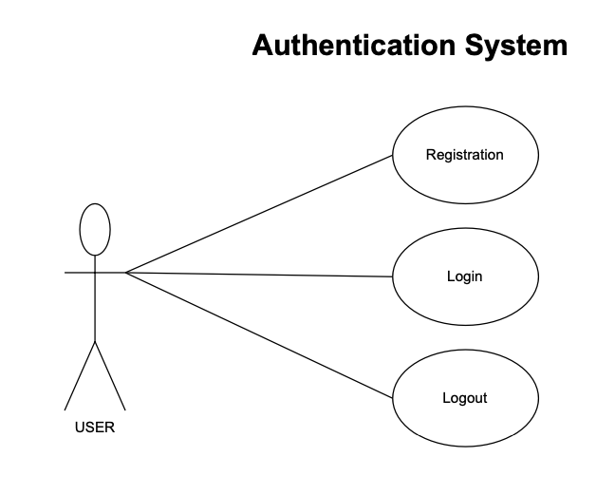
Chat App User Authentication system.

Slide 8
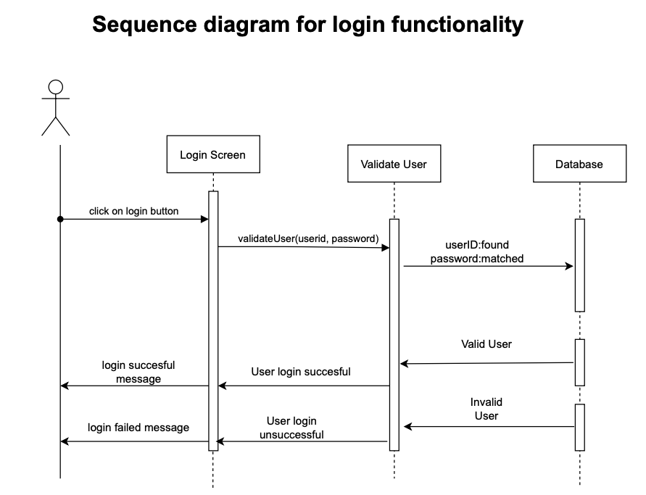

Slide 9
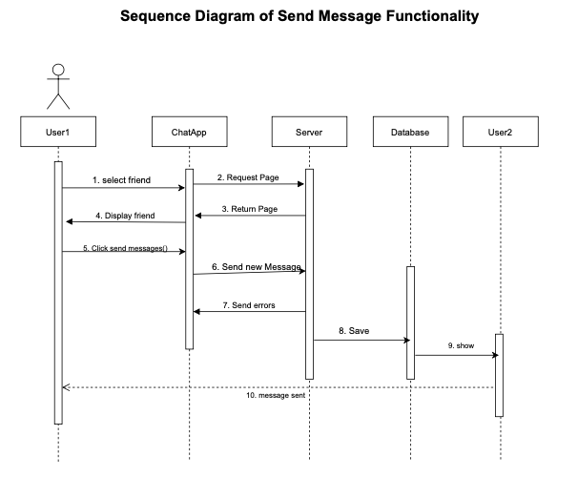

Slide 10
THE END
Thank you

