Slide 1
Library management system
Team members:
Vedhan reddy Gaddam
Keerthi kumar reddy Kancham reddy

Slide 2
Description:
The motivation for building a library management system is to automate the processes involved in managing a library's catalog, loans, and user accounts. By automating these processes, libraries can reduce the workload on staff, improve the accuracy of loan tracking, and provide a better user experience for everyone working.

Slide 3
Functionalities :
Different roles to manage the library - Admin and users.
Admin can access and update the user information.
Only admin have access to add the new user to the library management system.
Dashboard displays all the active stats of the library.
Both admin or user can add, edit or delete the categories in the library.
Both admin or user can add, edit or delete the book information.

Slide 4
Functionalities :
Both admin or user can add, edit or delete the student information.
Both admin or user can keep track of all the transactions in the library.
Both admin or user can add or update any transaction.
User can update his profile information.
User can also reset his password by himself without reaching out to admin.

Slide 5
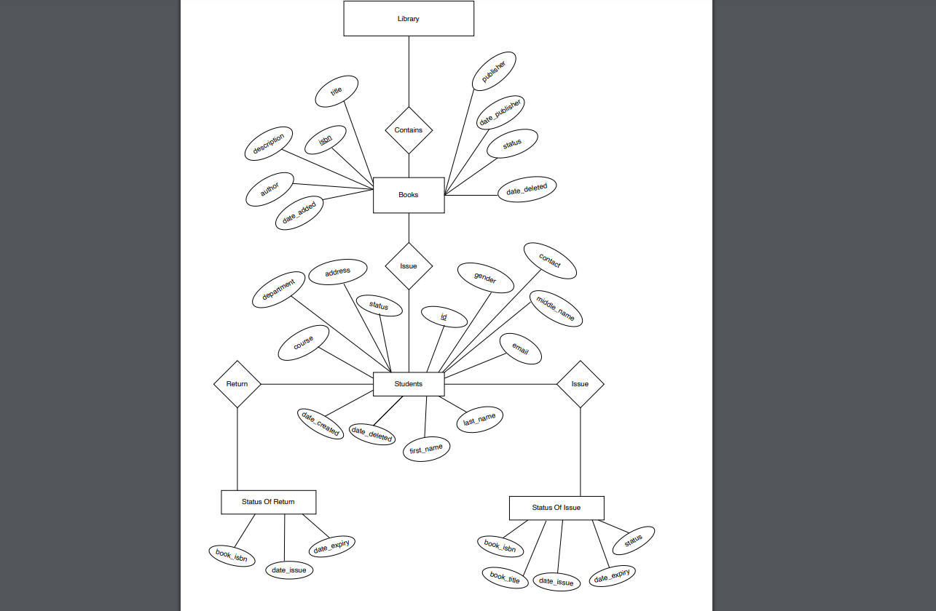
ER Diagram:

Slide 6
Schema
Below are the different tables available in our schema :
Table name : Category
Id | Name | Description | Status | Datetime
Table name : Sub_Category
Id | Category | Name | Description | Status | Datetime
Table name : Books
Id
ISBN | Category/Sub-Category | Title | Description | Author | Publisher | Date-published | Status | DateAdded

Slide 7
Schema
Table name : Students
Id | StudentId | Firstname | Middlename | Lastname | Department | Status | Gender | Contact | Email
Address | Course
Table name : Borrow
Id | Student | Book | BorrowingDate | ReturnDate | Status
DateAdded

Slide 8
Technical details :
Code is written in Python.
HTML and CSS are used for Front-end.
Django framework is used. Version – 4.0.3.
Django framework uses MVT(Model, View, Template) architecture.
Sqlite3 is used as the database which is a RDBMS.

Slide 9
Description of prototype system:
User authentication and account management
Book loan management
Admin dashboard and management
Security

Slide 10
Demo

Slide 11
Future Scope :
Can develop student role, where student can see their transactions.
Can implement Penalty feature for late returned books if the library wants to charge.
Can implement a discussion board by creating channels for available categories for students to ask their questions.

