Slide 1
George who?
Research programmer/PhD Candidate on Biostatistics at USC
Economist turned (bio)statistician
Business undergrad turned Economist
Yes, my name is really George (people in Chile don’t believe it either… nor Starbucks baristas)
Married, two children (4 and 1 ½), one dog, enjoys playing guitar and singing (currently looking for sidekicks willing to leave academia for music).

Slide 2
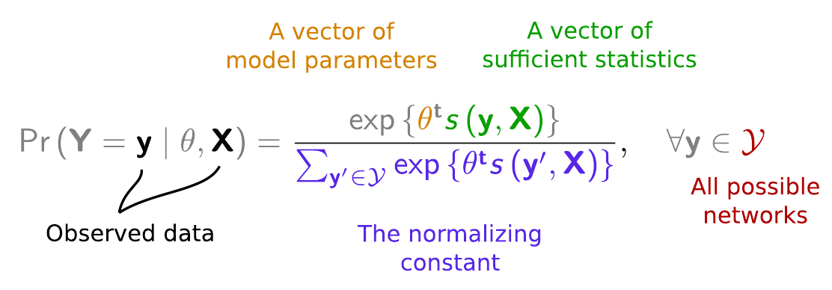
ERGMitos
ERGMs are computationally hard
State-of-the-art uses approximations
We use “exact methods” instead

Slide 3
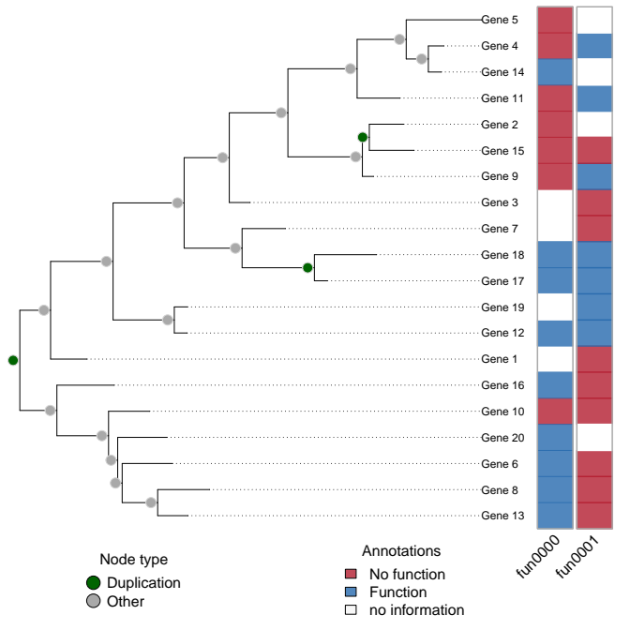
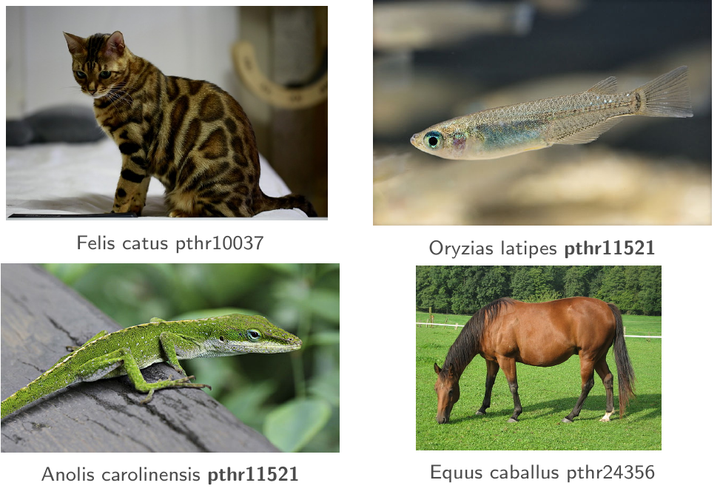
Predicting gene functions

Slide 4
Misc on statistical computing
Tools development (on CRAN):
  fmcmc: A friendly MCMC framework.
  rgexf: Build, Import and Export GEXF Graph Files
  slurmR: A Lightweight Wrapper for 'Slurm'
  ergmito: Exponential Random Graph Models for Small Networks
  ABCoptim: Implementation of Artificial Bee Colony (ABC) Optimization
  netdiffuseR: Analysis of Diffusion and Contagion Processes on Networks
Education: Various workshops and tutorials online https://ggvy.cl

Slide 5

Thank you!
ggvy.cl

