Slide 1
Analysis Of Nursing Home Data: A brief introduction to Exponential Random Graph Models
George G Vega Yon, Ph.D.
Chong Zhang, Karim Khader, Mathew Samore, Alun Thomas, Kyle Kazemini, Nelson Chang, Lindsay Visnovsky, Candace Haroldsen, and Kristina Stratford
UTAH CDC Site Visit

Slide 2
Overview
Statistical Models of Networks
Application: Long-term healthcare facilities
Discussion and future directions

Slide 3
Statistical Models of Networks

Slide 4
Exponential Family Random Models [ERGMs]
Statistical Model of Social Networks.
The lingua franca of Social Network Analysis [SNA.]
The key idea:
We are not interested in predicting ties.
We want to identify what phenomena characterize the network… using sufficient statistics (aka motifs.)
A generalization of other network inference models
Permutation-tests.
Rewiring algorithms (degree-sequence/distribution.)
Etc.

Slide 5
Logit vs ERGM
ERGMs are computationally complex to fit.
We could still fit a 0/1 logit/probit model…
But ERGMs leverage dependence between ties.
Nonetheless, if the ERGM only features “simple” motifs, then it is equivalent to a Logit.
The model is not focused on individual ties (yet, we could still predict them)…
…but on higher order structures (ties are not IID) that characterize the model, e.g., triangles, stars, or edge count.

Slide 6
Examples of Hypothesis/Motifs/Statistics
Using ERGMs, we could address the following questions:
Homophily
“Are individuals of the same gender more likely to become friends?”
Structural balance
“Do individuals who share a friend are more likely to become friends?”
Sender/receiver effect
“Do individuals with a given feature send/receive more ties?.”
Mixing effects
“Are individuals under respirators more likely to share a HCW?”

Slide 7
Application: Long-term healthcare facilities

Slide 8


Transmission of pathogens in LTCFs
LTCF residents experience high rates of infection due to antibiotic resistant bacteria (such as carbapenem-resistant Gram negative rods)
Especially long-term acute care hospitals (LTACHs) and ventilator-capable skilled nursing facilities (vSNFs)
And high incidence of infection and death due to SARS-CoV-2
Questions that motivated this study:
What is the impact of network structure?
Which network interventions may reduce transmission

Slide 9
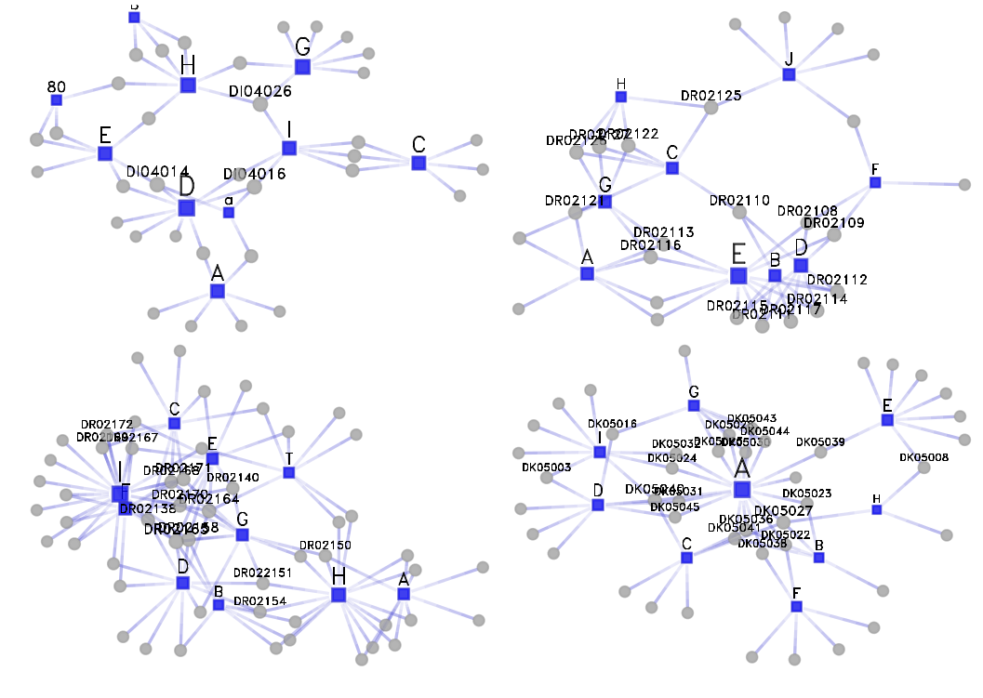
Collected data
Surveyed 25 Long-term Healthcare Facilities.
Seven types of healthcare workers: nurse assistants, nurses, physicians, and physical therapists/occupational therapists.
Residents under various care/health conditions: Ventilator, Wound care, Dialysis, Diabetes, etc.
A tie: Health Care Worker (HCW) interacts with Resident.
Descriptive Stats:
Mean degree resident: 2.3
Mean degree HCW: 9.3
Grand total:
4191 vertices
836 HCW (actors in the bi-partite graph)
7811 edges
100 bi-partite networks
Each bipartite graph is {facility x unit x day}

Slide 10
Analysis plan
What motifs characterize the structure of HCW-resident networks?
Pooled ERGMs
Bi-partite graphs
Healthcare workers
Residents
Pooled ERGMs are still rather new, even more using bipartite graphs.
Notes:
- Multilevel (as in pooled) ERGM are becoming more common.
- Nonetheless, flexiblity and methods for dealing with more complex hypotheses, e.g., interaction effects and controling for network-level features, is rather recent.
- Krivitsky et. Al. (2022), toghether with ERGM 4 and the new R package ergm.multi, have introduced important advancements and tools to deal with this type of data.
- Here we go a bit further, leveraging the new ERGM operators, we fit pooled ERGMs with bipartite graphs.
- In the case of ABM, we are using a new C++ library we developed at the U. Bottom line of this ABM framework is that we can propotype and run models very fast.
- Right now, we wanted to start assessing how important is the graph structure.

Slide 11
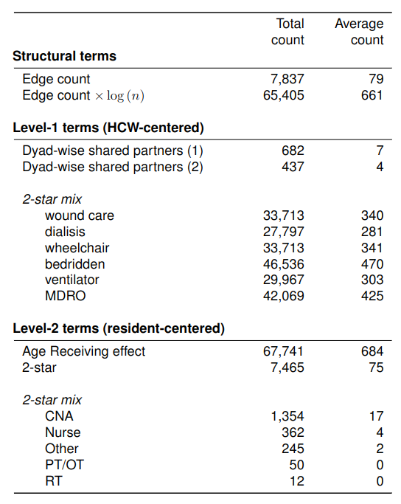
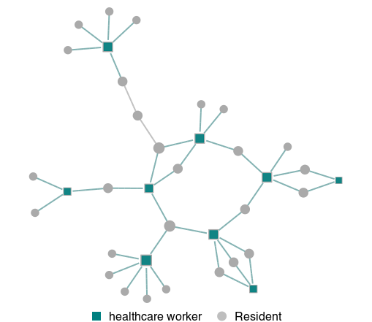
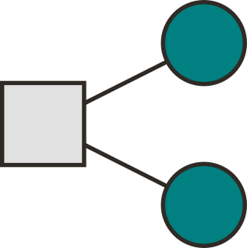
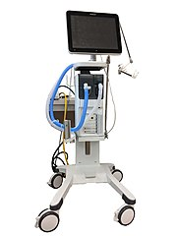

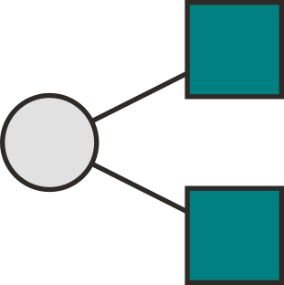
Final model selected
HCW 2-star
HCW sharing
Residents
(dyad-wise)
HCW 2-star
Mixing
Vent. patients
resident 2-star
Mixing Nurse

Slide 12
Preliminary results
Resident 2-star centered:
(-) Nurse
(-) PT/OT
(-) RT
Health Care Worker centered 2-star mixing
(+) dialysis, MDRO, and ventilator (most stable).
(-) wound care, wheelchair, bedridden.
Other significant effects:
(-) HCW dyad-wise shared one and two partners.
(-) Covariate effect on sqrt(resident age).
(+) Edge count, (-) Edge count x log(n), and (-) 2-start resident.
Notes:
- So far, we have not found significant differences across HC facilities.
- Edge-count adjusted by network size shows a significant effect.
- For post-estimation, we are following Krivitstky and others (2022) for inspecting the results.
- We also use linear regressions to assess the benefit of incorporating other ERGM terms before actually running the ERGM (George can explain more about it.)

Slide 13
Discussion and future directions

Slide 14
ERGMs
Simulate networks
In network interventions
Penalize optimization

Slide 15
a. Simulate Networks
Use ERGMs to create realistic graphs
No need to survey the entire population.
Simulations can be based on fitted models.
Networks can be scaled up/down as needed.
Sample a “small” population
Find the right ERGM
Generate artificial networks

Slide 16
B. Interventions
“Would isolating (removing) a node create new ties elsewhere?”
“What happens if we delete/add a tie?”
Generate graphs under a constrained model.
In SNA:
Isolate an individual (remove a tie)
How the network will react (transition)
Isolate this
node
(Question that can’t answer with a Logit)

Slide 17
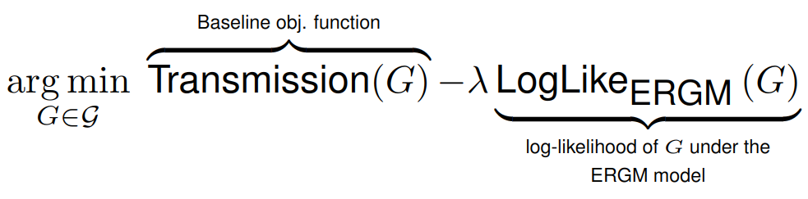
C. Penalize optimization
Common setup “Find the network that minimizes transmission”
The problem: Who says is a reasonable suggestion?
Possible solution: ERGMs
Unlikely graphs under the ERGM will be penalized

Slide 18
Discussion
ERGMs are used to characterize networks through motifs.
Example with pooled ERGM in LTHCF resident-hcw graphs (bi-partite.)
Discussed three ways to leverage ERGMs
Simulations
Interventions
Optimization

Slide 19

Acknowledgments:
Funded by Centers for Disease Control and Prevention (CDC) through the Prevention Epicenters (grant number U01CK000555-01-00
Collaboration with CDC Emerging Infections Program (EIP)
Site Principal Investigators:
Morgan Katz, Mary-Claire Roghmann, Philip Polgreen, Scott Fridkin

Slide 20
Analysis Of Nursing Home Data: A brief introduction to Exponential Random Graph Models
Thank you!
George G Vega Yon, Ph.D.
Chong Zhang, Karim Khader, Mathew Samore, Alun Thomas, Kyle Kazemini, Nelson Chang, Lindsay Visnovsky, Candace Haroldsen, and Kristina Stratford
UTAH CDC Site Visit

Slide 21
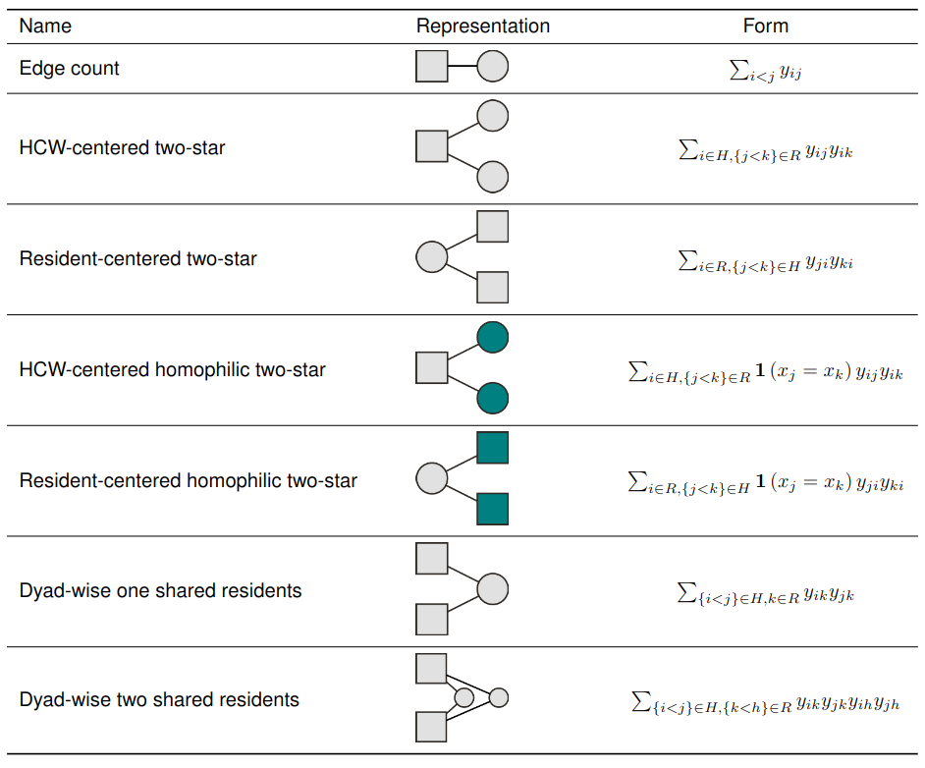
Suff. Statistics (Motifs)

Slide 22
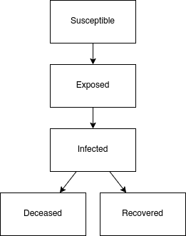
Plan: Agent-Based Model
SEIRD: Susceptible-Exposed-Infected-Recovered-Deceased
(*) Three sets of 1,000 simulations {ERGM, Deg. Seq., Bernoulli}.
One infected not on ventilator.
Residents on ventilator have:
Lower recovery rate
Higher mortality rate
Simulated 120 days.
(*): Deg. Seq. and Bernoulli were generated by rewiring the ERGM
Notes:
- We used the estimates of the fitter ERGM model to simulate the set of 100 networks.
- For each ERGM simulated graph, we then rewired the network in two ways: preserving the degree sequence and completely rewiring the graph, a bernoulli graph.
- We repeated the procedure 1,000 times, totaling 3,000 random graphs.
- For each graph, we simulated an outbreak with an SEIRD model for 120.
- Finally, we compared the epi curves, the death curve under each set of models.
- This is just a first pass, next plan we will vary simulation parameters and regress simulation outcomes against results.

Slide 23
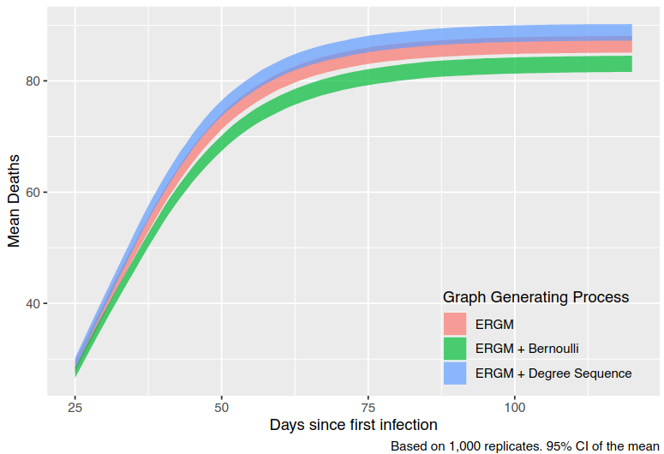
Preliminary results: ABM
Death curve as a function of the network:
Used fitted ERGM from real data.
ERGM taken as a baseline, then rewire.
Statistically significant differences in the average number of deaths.
ERGMs are specially useful when network data is not available!
We can use ERGMs as a Data Generating Process for Arbitrary studies.
Notes:
- Again, we took one of the fitted models and use that as a data-generating process [DGP].
- The figure shows the average number of deaths per DGP across the 1,000 replicates.
- It is apparent from the figure that network structure can result in significantly different results, from the statistical point of view.
- Nonetheless, this is merely a simple exercise compared to what we can do, which is run large simulation studies under different network treatments and assess what components of the different scenarios as the strongest effect on the simulation outcomes. This is of real value for policy making process.
- It is worthwhile pointing that the set of 3,000 simulation experiments took less than 30 seconds.

Slide 24
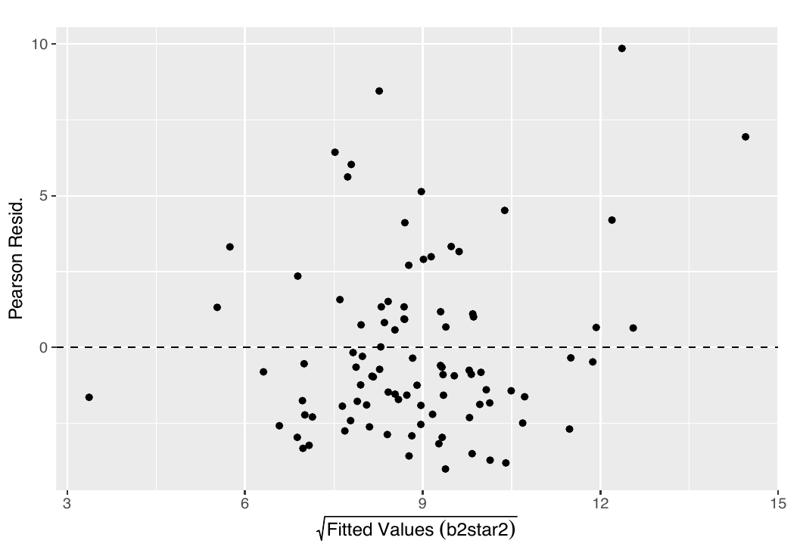
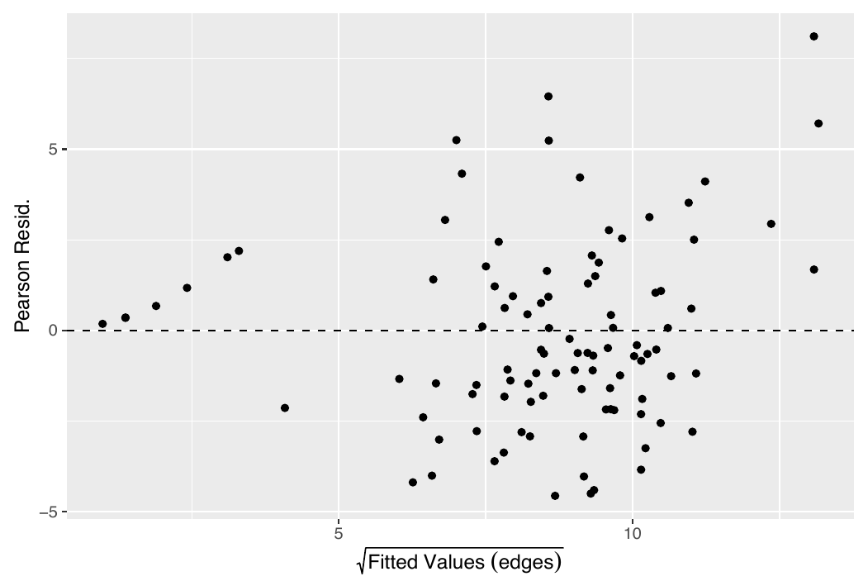
Appendix: Post-estimation analyses

Slide 25
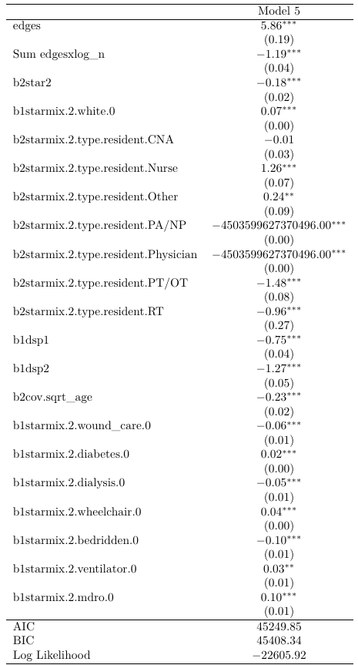
Appendix: ERGM estimates
We have tried various setups.
Effects interacting with the log(n) and log(n)^2 were not significant.
The ERGM specification has:
Bi-partite graph, and
Block-diagonal constrain
We have functions to assess GOF using residual analysis.
Still work in progress.

