Slide 1
Causal inference for marketing cookbook APA 2020 SoSe
Georg Velev
Kutay Oncu Yilmaz

Slide 2
Outline
Introduction
2. Observational Studies vs. Randomized Controlled Trials
3. Observational Studies
3.1 Challenges for Observational Studies
3.2 Solutions for Observational Studies
4. Challenges & Solutions for A/B Testing
4.1 Challenges for A/B Testing
4.2 Solutions for A/B Testing
5. Empirical Analysis

Slide 3
Why do we need this TE guidebook?
A marketing cookbook
Special attention to issues surrounding their application of estimation techniques (in marketing)
To match challenges to the existing solutions from the field of causal inference

Slide 4
Two main settings
Observational study is where the assignment of subjects into a treatment group versus a control group is outside the control of the investigator.
In contrast, randomized controlled trials are where each subject is randomly assigned to a treatment group or a control group.
Which one to prefer and why?

Slide 5
Randomized Controlled Trials
Gold standard for estimating treatment effects in causal models.
When there is no randomization of assignment, we face the confounding variable problem, that affect both treatment and outcome.
RCTs can be costly and time-consuming
“However, true randomization with a robust result for marketing treatment assignments requires an advertiser to forego showing ads to some users, and possibly to pay for public service announcements or blank ads that appear in its allotted space instead. Often advertisers are not keen to relinquish an opportunity to advertise or to pay for non-campaign ads. Randomization also requires the study to be set up before the campaign runs. Therefore, RCT can be costly and time-consuming.”

Slide 6
Observational Studies
Estimation without randomization is more difficult but not always impossible.
We can make solid inferences from Observational Data with several methods
Challenges:
Selection bias
Missing counterfactual
Confounding bias

Slide 7
Solutions for Observational Studies(Varian 2016)
Difference in Differences :The goal is to compare the average change over time in outcome variable for the treatment group with the change in the control group.
Regression Discontinuity: This model uses a threshold to compare subjects near the threshold. To put it differently, observations close to, but just below, a threshold should be similar those close to, but just above, the threshold.

Slide 8
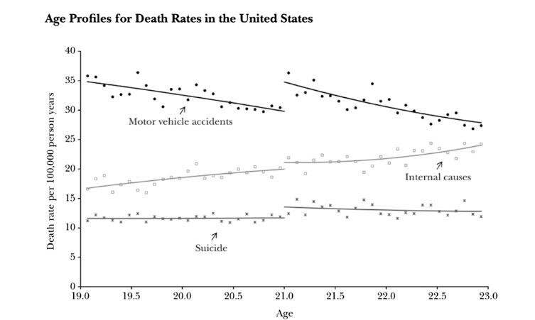
Regression Discontinuity

Slide 9
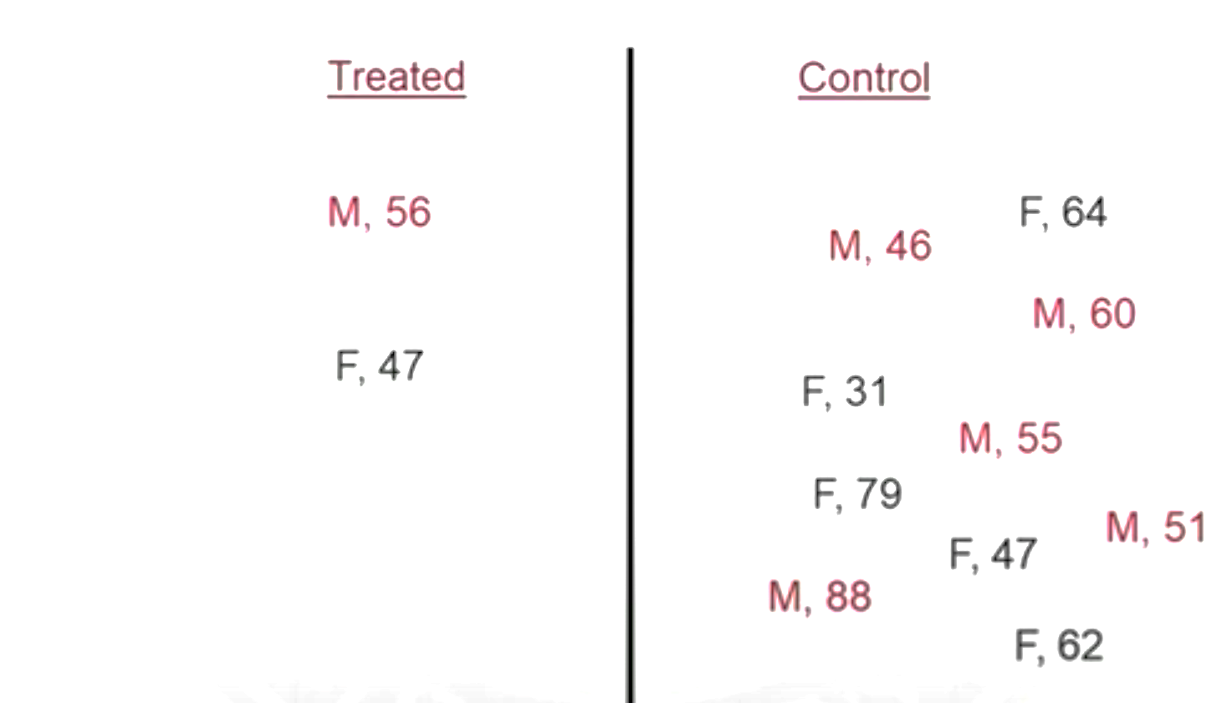
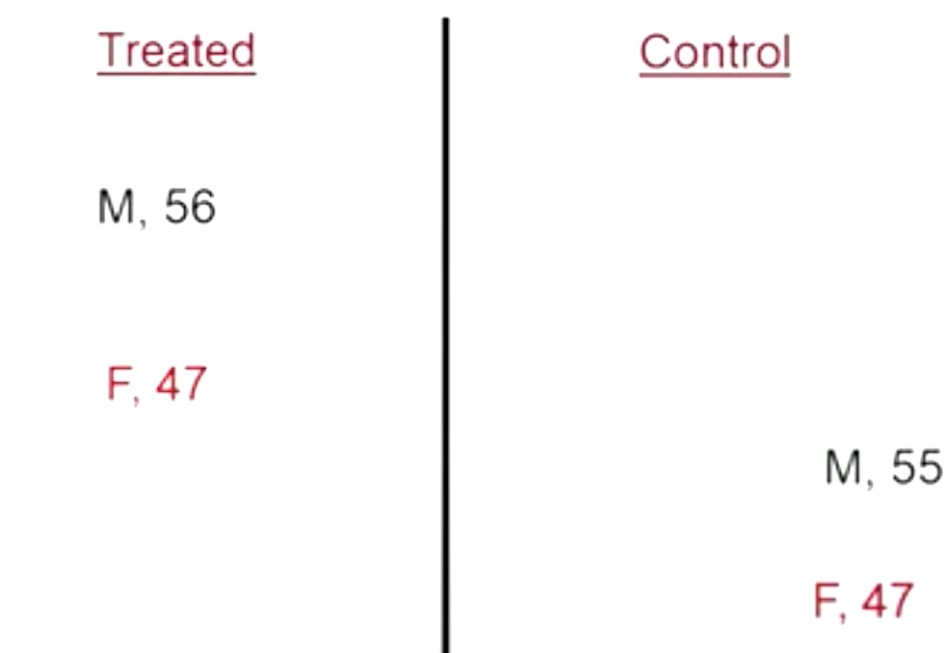
Solutions for Observational Studies
Matching
Matching techniques such as Nearest Neighbor Matching, Optimal Matching, Stratification matching ,DDM, Mahalanobis metric matching, Caliper Matching

Slide 10
Solutions for Observational Studies
Propensity Score Matching (Rubin, Waterman, 2006)
Propensity score is the probability of receiving treatment, rather than control, given set of covariates
P(A=1|X)
We fit a logistic regression on outcome ‘A’ ,which is binary
From the model we get the predicted probability for each subject, since it is a logistic regression the value is between 0 and 1
Finally, one of the matching techniques is preferred

Slide 11
Challenges for A/B Testing
The idea behind A/B Testing and Randomized Controlled Trials is same
Which variant is better(statistically significant)?
When to stop the test (cost efficiency purposes)?

Slide 12
Solutions for Sequantial A/B Testing
Which variant is better(statistically significant)?
Null Hypothesis
Sequential Hypothesis Testing With Bayes Factors (Schönbrodt , 2017)
Schönbrodt proposes the technique which uses Bayes Factors. Simulation is run while comparing sample sizes (test durations) needed for conclusive tests.

Slide 13
A/B Testing
When to stop the test (cost efficiency purposes)?
Fixed Horizon
Experimenter or A/B testing tool determines size of the A/B test before it is started.
Continuous monitoring with early stopping
This approach allows to carry out statistical test multiple times throughout the duration of an A/B test

Slide 14
Empirical Analysis
Presented in the jupyter notebook

