Slide 1
fNIRS Signal Quality
February 2nd, 2021

Slide 2



Meeting
Litterature review
Methods
Discussion

Slide 3
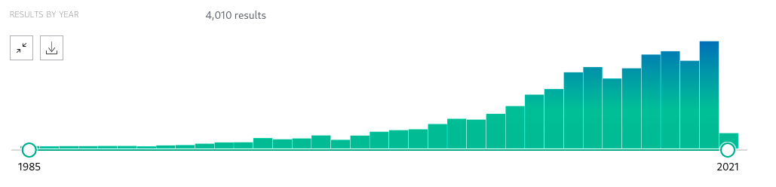
Review
((fNIRS) OR (NIRS)) AND (brain)
459
Reproductibility / Replication crisis
→ fMRI / MEEG…
In fNIRS started with openfnirs, .sfnirs and BIDS format.
‘Best practices for fNIRS publications’ Yucel et al., 2021
Gorgolewski et al., 2016

Slide 4
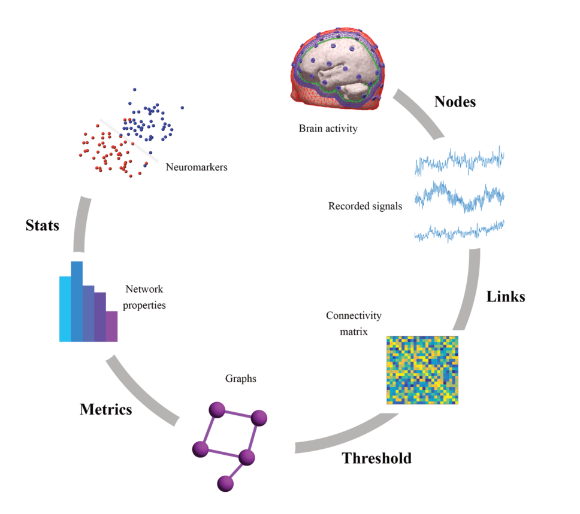
Neuroimaging pipeline
Project
Fallani et al., 2014; Vergotte 2018

Slide 5
fNIRS preprocessing
Toolbox:
Oxysoft
Aurora
Optonet
Turbo-satori
FOLD
Fieldtrip
NAP
NIRS-SPM
Nirstorm
Fnirs soft
FOSA
FC-NIRS
Homer2-3
ICNNA
NIRfast
Potato
Phoebe
Analyzir
Still in development:
NICA (Raggam et al., 2020)
LioNIRS (Tremblay et al., 2020)
NIRSkit (Hou et al., 2021)

Slide 6
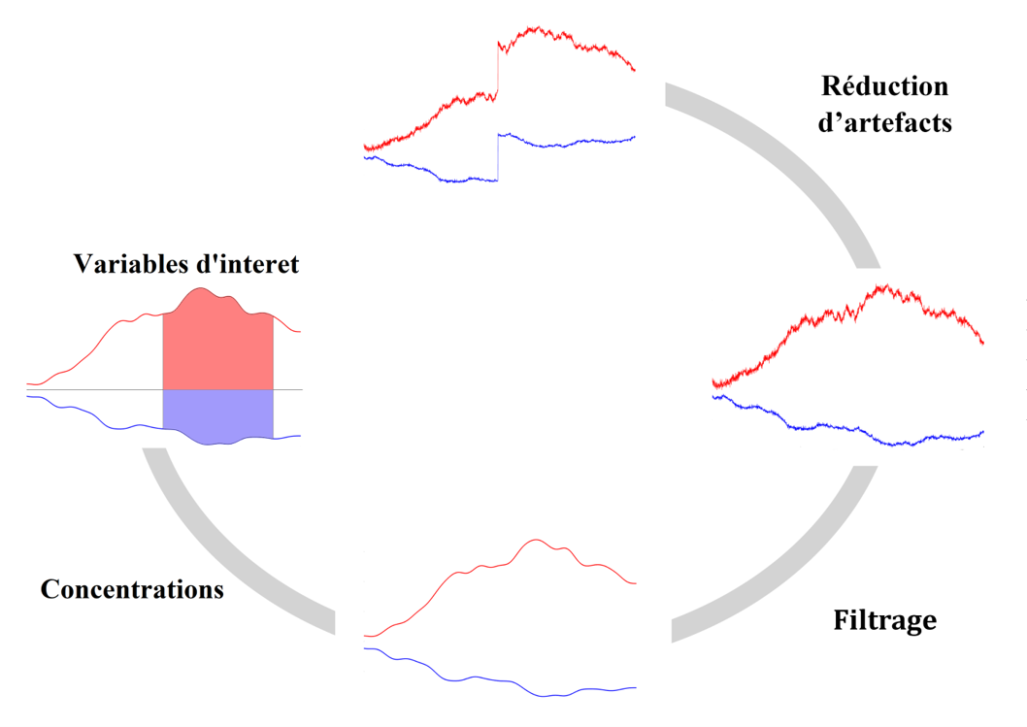
fNIRS preprocessing
Signal quality

Slide 7
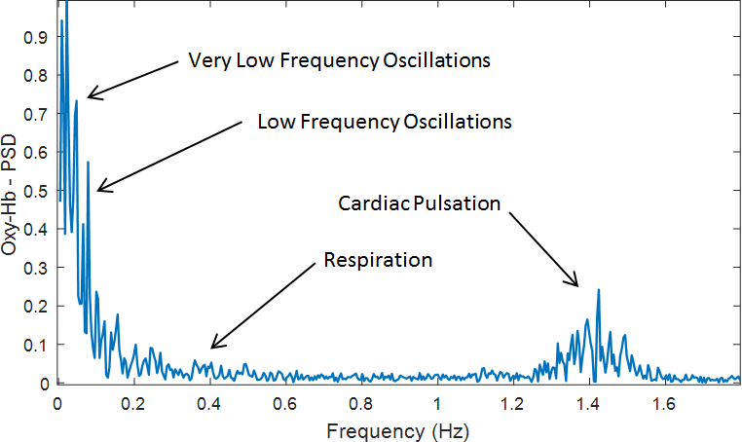
fNIRS signal quality
A) Visual
User dependant
Not binary
B) PSD
User dependant
Not binary
C) Signal to noise ratio
System dependant
User dependant

Slide 8
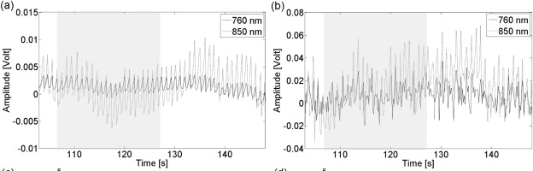
fNIRS signal quality
D) Scalp coupling index
Bandpass (0.5-2.5Hz)
Normalize
Cross correlation at lag 0
Threshold 0.8
0.97
0.48
No comparison with existing methods.
Pollonini et al., 2014

Slide 9
fNIRS signal quality
E) Scalp coupling index and cross spectral power (Phoebe toolbox)
similarity = xcorr(filtered_nirs_data1(:,col),filtered_nirs_data2(:,col),'unbiased');
similarity=length(filtered_nirs_data1(:,col))*similarity./sqrt(sum(abs(filtered_nirs_data1(:,col)).^2)*sum(abs(filtered_nirs_data2(:,col)).^2));
[pxx,f] = periodogram(similarity,hamming(length(similarity)),length(similarity),handles.fs,'power');
[pwrest,idx] = max(pxx(f<fcut_max));
sci = similarity(length(filtered_nirs_data1(1:end,i)));
power = pwrest;
SCI influenced by wavelength and artefacts. No comparison with existing methods.
Threshold set empirically to 0.1.
Pollonini et al., 2016

Slide 10
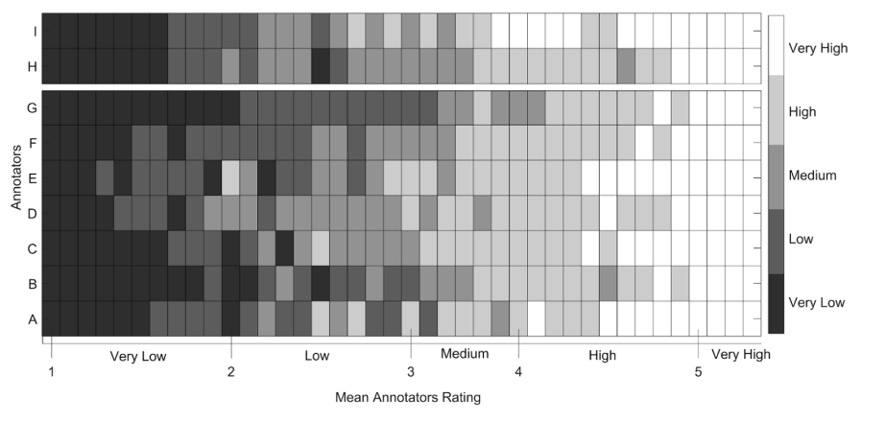
fNIRS signal quality
F) Signal quality index
Comparing SCI, Cross spectral power and SQI
158 time series (Artinis) for the training phase (10sec / 14 subjects)
7 experts (features) scale from 1 to 5
Validation with 40 time series (10 sec / 4 participants)
Sappia et al., 2020

Slide 11
fNIRS signal quality
F) Signal quality index
Algorithm comprises two preprocessing steps (OD / HBO and HHB)
Followed by three consecutive rating stages:
1) identifying very low quality signals
2) identifying very high quality signals
3) signal quality rating.
Sappia et al., 2020

Slide 12
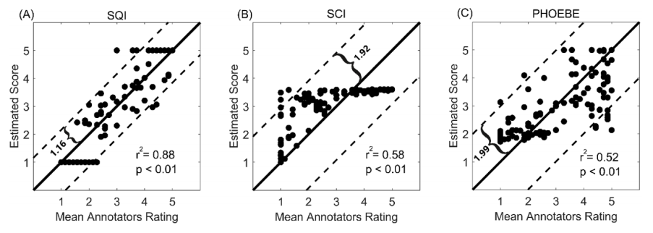
fNIRS signal quality
F) Signal quality index
1)
Absolute Intensity (T= 0.04 – 2.5)
STD of OD (Flat = 0)
Ratio HBO/HHB summation (T empirical 1.95)
2)
acorrDiff _ODs = std(OD1acorr − OD2acorr) (T = 0.025)
3)
logStdHb = ln(std(O2Hb/HHb))
Sappia et al., 2020

Slide 13
Methods
Authors | Ref | System | Method | Etc.
1
2

Slide 14
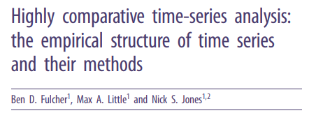
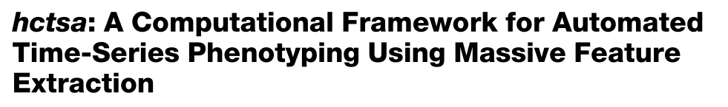
Methods

Slide 15
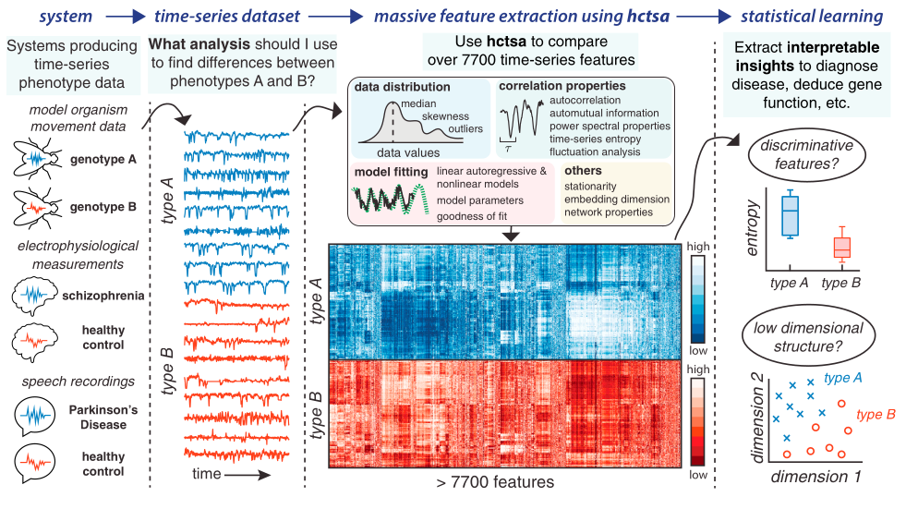
FNIRS signal quality

Slide 16
FNIRS signal quality
Distribution
Model fitting
HCTSA
Stationarity
Correlation
Statistics
Non linear
Entropy
Fourier
Wavelet

Slide 17
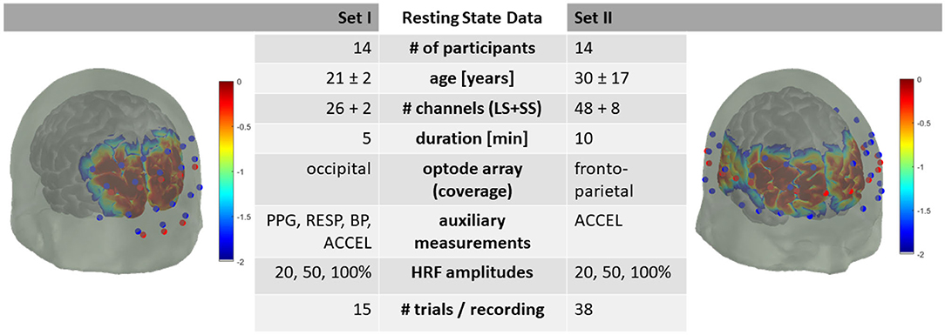
FNIRS signal quality
Data set: Resting state
1- open access (TechEn 50Hz, Luhmann et al., 2020)
2- Lena data Exomode (Artinis 10Hz)
3- Lena data2 (Brainsight or Seenel 10 or around 1Hz)

Slide 18
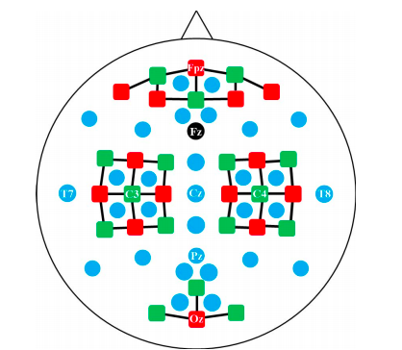
FNIRS signal quality
Data set task: Shin et al.,2016
29 participants (Nirx 12.5Hz)
Motor Imagerie Left / Right / baseline

Slide 19
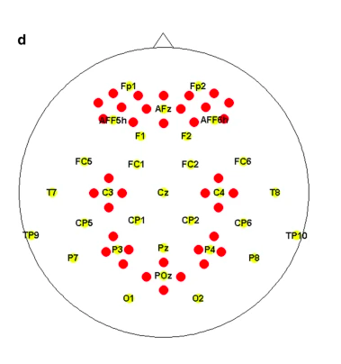
FNIRS signal quality
Data set task: Shin et al.,2018
26 participants
N-back
Discrimination / selection
Word naming

Slide 20
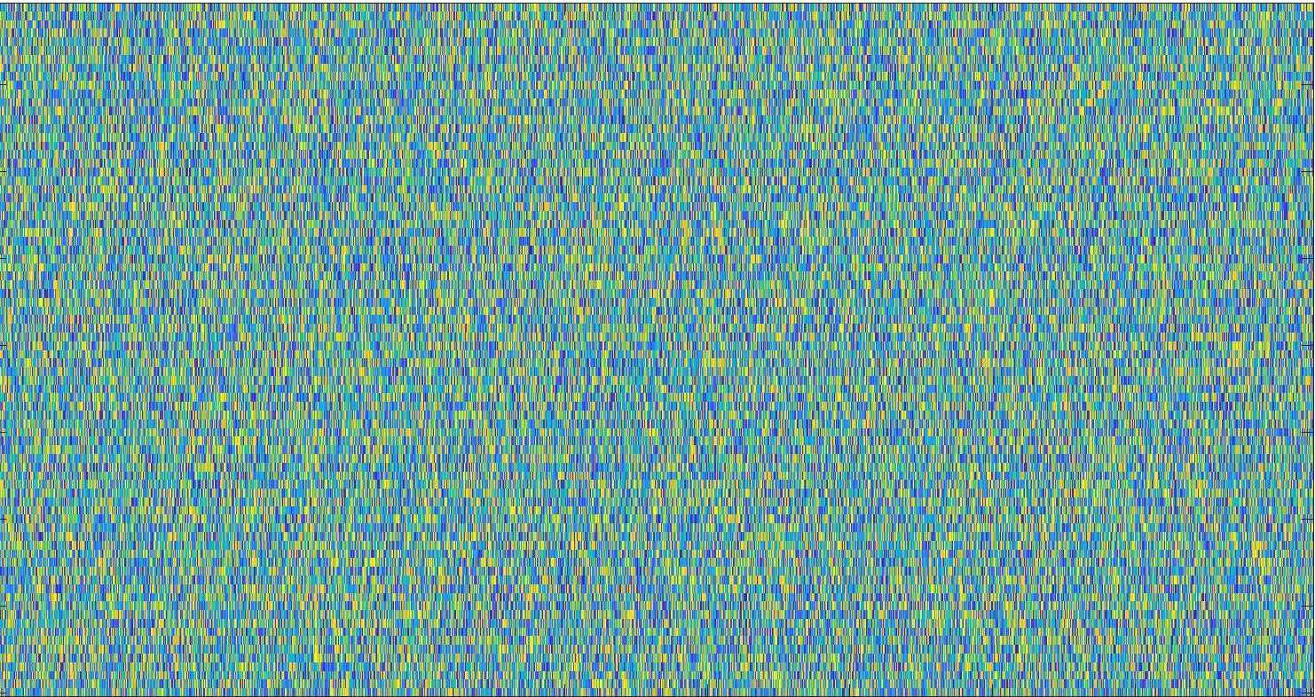
Matrices
Intensity
OD
Concentration
SCI
SQI
Online
. . . .
HBO
HHb
N > 46260
D1
Rest
D2
Dn
D1
Task
Dn
Features (N > 7710)

Slide 21
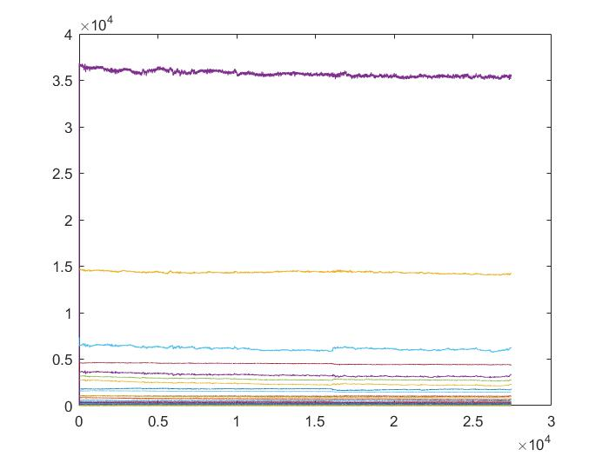
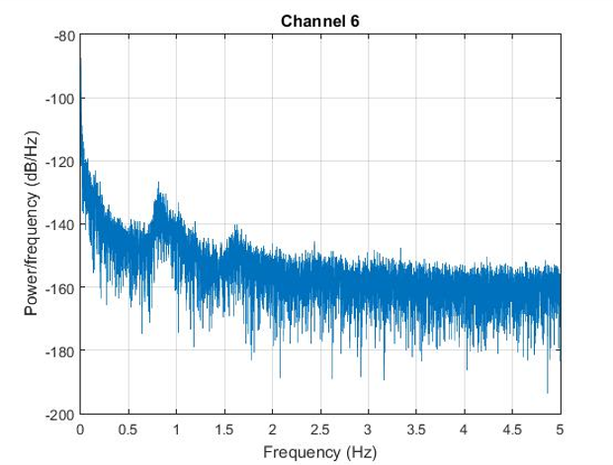
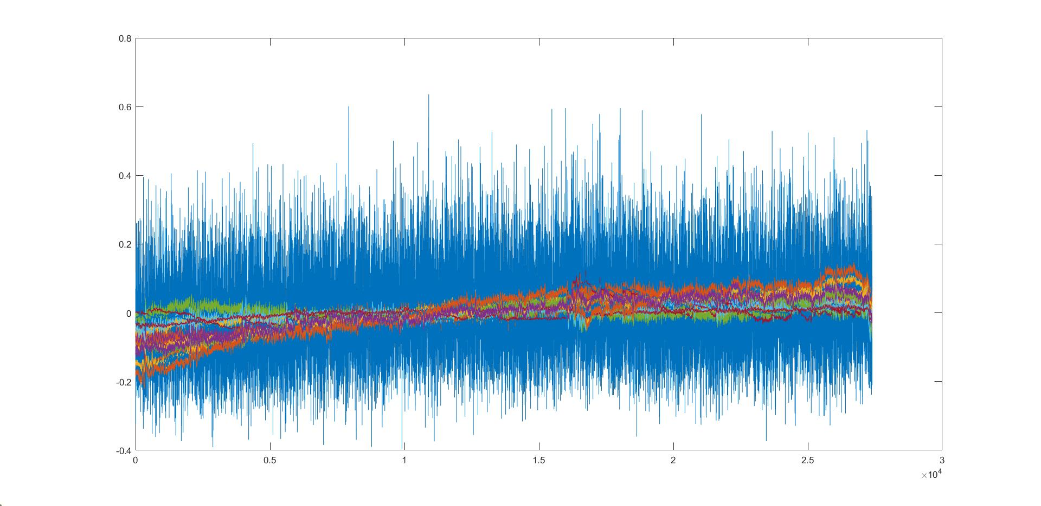
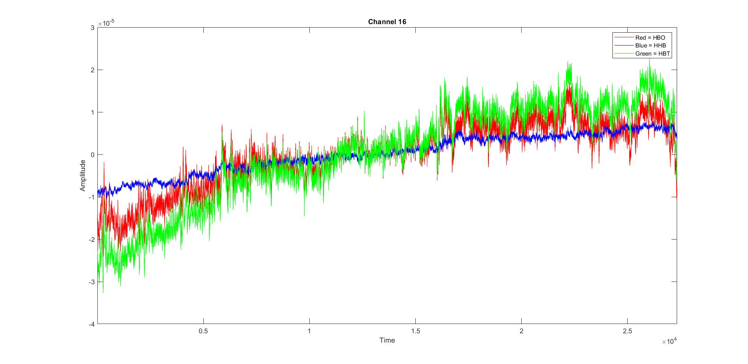
Online (Gorilla)
Bad
Good

Slide 22
Machine learning
Find a set of best markers to remove bad signals
e.g. 1 metric on the instensity combine with SQI and fractal analysis
→ Homer toolbox

Slide 23
Limits / Questions
Time series:
Only rest or task too?
10 sec? 1 min? 5Min?
Add MFDFA, DTW, ideas?
Open data / script?
Artefacts?
Online:
Less than 15min
Scale or binary?
Ethics
Machine learning:
Ok with SCI, SQI and Online?

