Slide 1

One slideshow, on every screen in the room —
streamed from your own device, stored nowhere.
Investor overview · August 2026 · vinboo.com
Notes:
Vinboo is a working, deployed product built with no outside capital. This deck covers what it is, what is already built, the market it points at, and what the next phase of engineering buys.

Slide 2
Showing a deck in someone else’s room is still bad
A sales representative walks into a client’s conference room. Three things can happen, and all of them are poor.
1
2
3
They hand over the file
They fight the room
Everyone crowds one laptop
Emailed ahead or left on a USB stick. It now lives on the client’s machine and can be forwarded to a competitor. The presenter has no way to take it back.
The wrong adaptor, a dead HDMI port, guest wifi, a screen-sharing tool the client’s network blocks. Minutes of a short meeting go to cabling.
A room with three screens in it, and the deck is on a 13-inch display being turned around the table.
The cost, at three client meetings a week and five minutes lost to connecting: roughly 7.7 million hours a year across 641,000 US representatives — about $385M of selling time.
Notes:
The meeting-time figure is derived, not sourced: headcounts are from BLS, the three-meetings and five-minutes assumptions are ours.

Slide 3
What Vinboo is
A browser slideshow broadcaster. The presenter opens a page; every screen in the room shows the same slide.
For the presenter
For everyone watching
Open vinboo.com, choose photos or a PowerPoint file
Nothing uploads — the files stay on the device
A six-character code and a temporary password appear
Hand off the show and the laptop can close entirely
Scan a QR code, or type the code into any browser
No account, no app, no store approval on a television
Televisions, laptops and phones, all at once
No cable, no dongle, no shared network required
Live today at vinboo.com. Photos, PowerPoint decks, unlimited screens.
Notes:
Everything on this slide is shipped and working today.

Slide 4
The inversion
Every comparable service uploads your files and distributes them. Vinboo makes the presenter’s browser the origin and the server a blind relay.
1
2
3
4
A screen asks
The server parks it
The browser answers
One reply, many screens
A television requests slide four.
Rather than answering, it holds the request open and hands the job to the presenter’s browser.
It reads the file off the device and returns the bytes.
The answer is fanned out to everyone waiting on that slide, then forgotten.
Ten screens on the same slide cost the presenter one upload.
The bytes exist in server memory only while in flight. It runs over ordinary HTTPS long-polling — no WebSockets, no peer-to-peer — so it passes through the corporate proxies and hotel networks that block those protocols.
Notes:
This is the mechanism that makes the privacy claim structural rather than a policy promise, and it is what makes unlimited-screens pricing affordable.

Slide 5
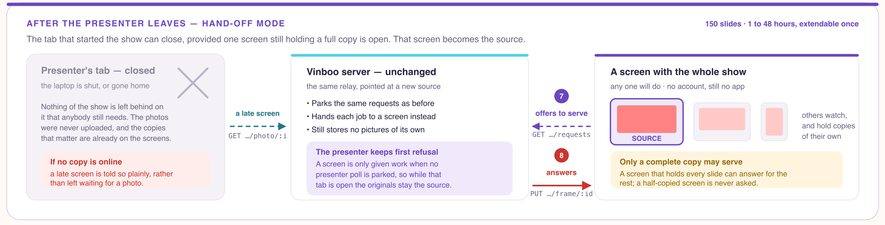
The show outlives the tab that started it
SHIPPED AND RUNNING TODAY — hand-off mode. Every screen copies the whole show as it plays, so the presenter can close the laptop and leave the room.
The limit, stated plainly
One screen holding a complete copy has to stay open. When none is, a late arrival is told so rather than left waiting for a photo that will never come. The show expires after the 1-to-48 hours chosen at the start, extendable once — nothing here is long-term storage, by design.
Notes:
This is what lets a wedding reception keep playing after the couple put their phones away, and a shop window keep playing after the manager goes home — without the platform ever holding the pictures.

Slide 6
What the architecture buys
Three consequences fall out of the design rather than being features bolted on.
Nothing
Unlimited
No app
is stored. The relay keeps no copy, so a confidential deck never lands on a company server or a client’s machine. A competitor cannot match this without rebuilding.
screens for one price. Marginal cost for the eighth television is near zero, because one upload is fanned out. Pixo bills per screen and caps at six.
anywhere. Viewers use a browser they already have — no install, no account, no app-store approval on a smart television.
And it inverts the cost structure. A competitor built on store-and-distribute pays per screen served, so it must bill per screen. Vinboo’s bandwidth grows with shows, not with audience — which is why unlimited screens is a price they cannot follow.
Notes:
This is the business-model moat. It is more durable than any patent we could realistically defend on the relay itself.

Slide 7
This is already built
Not a prototype and not a design document. A deployed product, in daily working order, with no outside capital in it.
98%
267
$0
of slides in 32 real corporate decks render with nothing missing — in the browser, nothing uploaded
automated tests passing across seven suites
of outside capital raised to date
Shipped and working
Not yet built
Live relay: photos and PowerPoint to unlimited screens
Hand-off mode — the show survives the presenter leaving
PowerPoint, SmartArt, charts and Visio drawn in the browser
Deck fidelity measured on 32 real decks, not assumed
QR joining, accounts, multiple concurrent shows, feedback
Payment processing and subscription management
WMF metafiles and a few objects with no preview
End-to-end encryption (the Private tier)
Horizontal scale — one process holds all state today
Notes:
Being candid about the "not yet" column is deliberate. Every item there is on the roadmap slide with a cost attached.

Slide 8
Who buys it
Sized bottom-up from headcounts, because “the presentation software market is worth $X billion” says nothing about whether anyone pays $15 for this.
Business presenters
1.6M US wholesale, manufacturing and technical sales representatives. Assuming 40% carry a deck into client meetings: ~641,000 people.
$115M
The primary market
serviceable market at $180/year
Event vendors
2.5M US weddings a year. A DJ works forty weddings; a couple works one — so a few thousand vendor businesses reach the whole volume.
$475k
Reached through suppliers, not couples
per year at 1% attach, $19 an event
Consumers
Ad-funded free tier. It is the funnel and the advertising floor rather than the revenue.
$434k
Largest audience, weakest economics
per year at 250,000 monthly presenters
Notes:
Headcounts are sourced. The 40% deck-carrying rate and the penetration assumptions are ours and are stated as such.

Slide 9
The number that decides the strategy
Both models were built. One of them needs 39 times fewer people to make more money.
Business presenters at 1%
Consumer presenters
6,413
$1.15M
250,000
$434k
customers
per year
presenters
per year
8% of Mentimeter’s customer count, in an adjacent category doing $38M.
Plus all the bandwidth that 500,000 shows a month brings with it.
39× fewer people. 2.7× the revenue.
The party use case the landing page leads with is commercially the weakest of the three. The product should point at the business presenter — and that segment is gated behind one engineering problem.
Notes:
This slide is the strategic hinge of the whole deck. It sets up the roadmap.

Slide 10
The competition, and the real incumbent
The paid products are not what we mostly lose to.
 | Approach | Price | Where it falls short
Pixo | Ambient photos to televisions | $1.49 per screen / month | Bills per screen, caps at three or six; stores your photos
Mentimeter | Slides onto the audience’s phones | $12–25 per presenter / month | Uploads your deck; built for polling, not for a room
Sync | Screen mirroring | From $12.50 / month | Uploads; no hand-off
PowerPoint Present Live | Audience follows along | Bundled with Office | Retired by Microsoft for low usage
What we actually displace: an HDMI cable, an emailed PDF, and Teams.
A representative arrives with a bag of adaptors or emails the deck ahead. Those, not the paid products, are the incumbents — and Microsoft retiring Present Live is evidence that “the audience follows along” is the wrong pitch. The durable one is: your deck never lands on their machine.
Notes:
Naming Teams and the cable as the real competition is more credible than a feature grid where we win every row.

Slide 11
How it makes money
Photos are free. Sharing a PowerPoint is the business tier — and anyone can open and play their own deck first, to see how it renders before paying.
Free
Plus
Pro
Events
Private
Ad supported
$48 / year
$180 / year
$19 / event
Add-on
Photos to every screen. Open and play a deck locally — sharing one is Pro.
Photos, no ads, longer life, and a show that outlives the server restarting.
Sharing a PowerPoint deck. Plus a saved library, presenter notes and branding.
One-time pass sold through wedding and event vendors.
End-to-end encryption, added to Plus or Pro. Designed, not yet built.
Why the margin holds
94%
gross margin at Year 2 and above. The relay is I/O-bound long-polling, not CPU-bound: what matters is open connections, not volume.
Notes:
Year 1 and 2 are the consumer model; Year 5 assumes the business tier carries the revenue. Compute stays near flat because the relay is I/O bound.

Slide 12
Where it goes next
One of these is already done. Of what is left, two are prerequisites to the adoption curve and one is the moat.
1
2
3
4
Survive its own deploys
Scale past one machine
Deck fidelity — done
Vinboo Private
Persist the session record so a restart stops ending every live show. Days of work.
Shard on the show code so requests for a show always meet in one process. Removes a hard 200-show ceiling.
Measured at 98% of slides across 32 real corporate decks, in the browser, with nothing uploaded. This was the gate on the business tier.
End-to-end encryption. The strongest differentiator, and the one no competitor offers.
Commercially, the gap is smaller: no payment processing, subscription management or password recovery exists yet. All are prerequisites to charging anyone, and none are hard.
Notes:
Order is by dependency. Fidelity is the commercial gate; encryption is the differentiator.

Slide 13
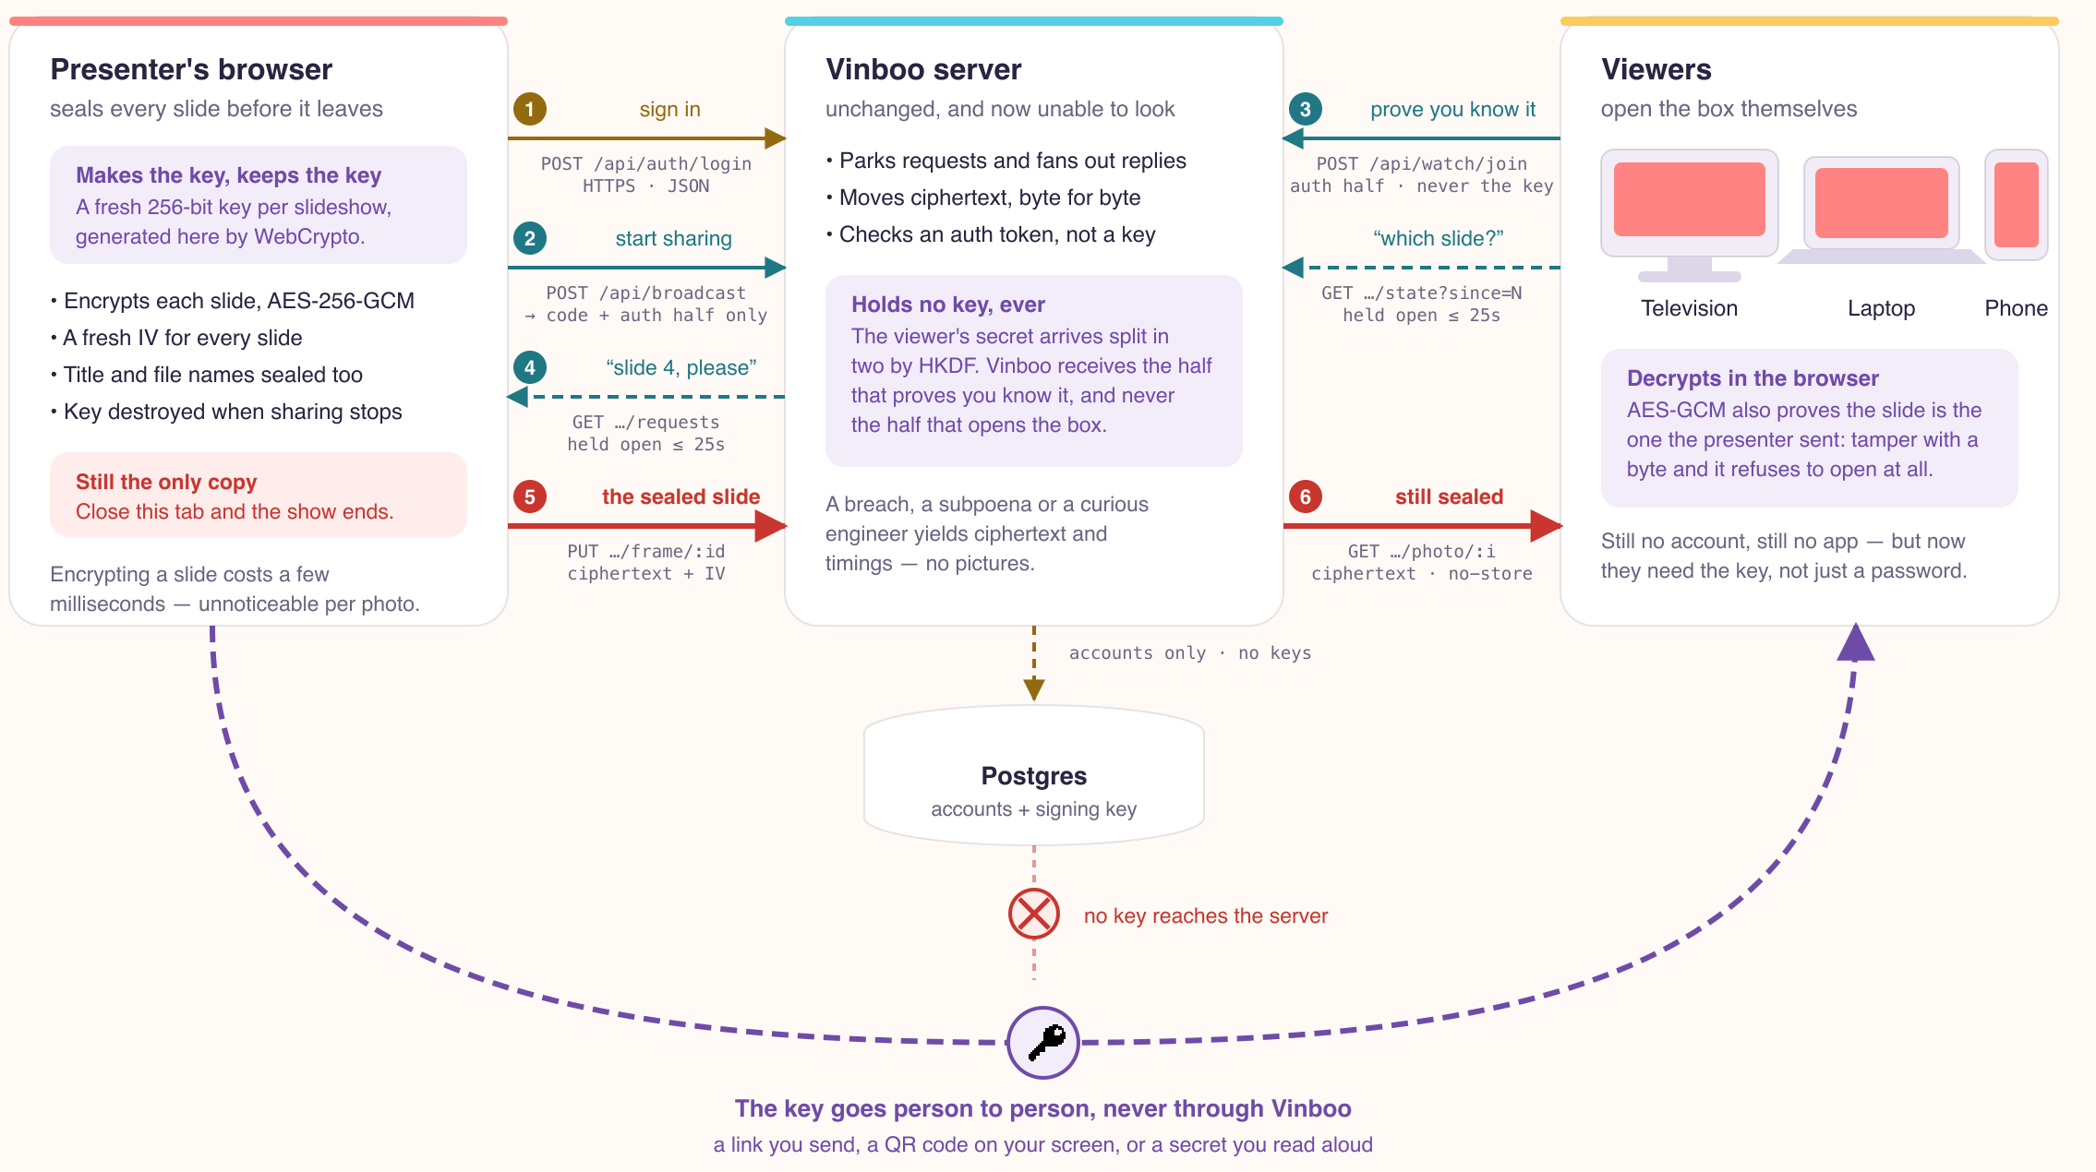
Vinboo Private: the same relay, carrying sealed boxes
DESIGNED, NOT YET BUILT — this is the architecture for the Private tier, not the system running today.
Notes:
The key never reaches the server. The viewer secret is split by HKDF: Vinboo receives the half that proves you know it, never the half that opens the box.

Slide 14
What that buys — and what it costs
The design is written down in full, including the parts that do not flatter it.
What the server cannot see
What it still learns
The honest limit
The pictures and the deck
The file names
The title of the show
A breach or subpoena yields ciphertext and timings — no images
That you are presenting, and when
How many screens, and for how long
How many slides, and the size of each
Shape and time, not content
The browser runs code Vinboo serves
A compromised operator could ship JavaScript that copies the key
Encryption narrows what a breach exposes; it does not remove trust in the page
Lose the link and the show is gone, by design
A tension that used to sit here has gone. Encryption and server-side conversion are mutually exclusive — a server cannot convert a deck it cannot read — which once meant Private would cost exact fidelity. Rendering now happens in the browser, so encryption costs the deck nothing.
Notes:
Investors with security backgrounds will ask about the JavaScript delivery problem. Answering it before they raise it is worth more than the claim itself.

Slide 15
What could go wrong
The four we take most seriously, and what each would take to answer.
Nobody wants the feature
Microsoft retired Present Live for low usage — the closest analogue, with a billion-seat channel.
Re-pitch on control, not participation. Validate with real sales professionals before building further.
Deck fidelity blocked the business tier
It did: 37% of one enterprise deck rendered as placeholders.
Answered. 98% of slides across 32 real decks, measured, in the browser.
The architecture will not scale
All state is in one process; a hard ceiling of 200 concurrent shows, breached by the Year 3 model.
Shard by show code. Days of work, not a rewrite. Documented in full.
No proven acquisition channel
The plan has no data on how customers are reached, and this is the weakest part of it.
Event vendors first: one DJ serves forty weddings a year where a couple serves one.
Left: the risk. Centre: the evidence against us. Right: the answer.
Notes:
Leading with the Present Live evidence is deliberate: a sophisticated investor will find it anyway.

Slide 16
A working product, a costed roadmap,
and a moat that is architectural.
$1.53M
7
4
projected Year 5 revenue
Pennsylvania employees by Year 5
engineering milestones to get there
The capital does not buy an idea. It buys the four things standing between a product that works and a product that sells.
vinboo.com
Notes:
Close on the distinction between funding an idea and funding the gap to revenue.

Slide 17
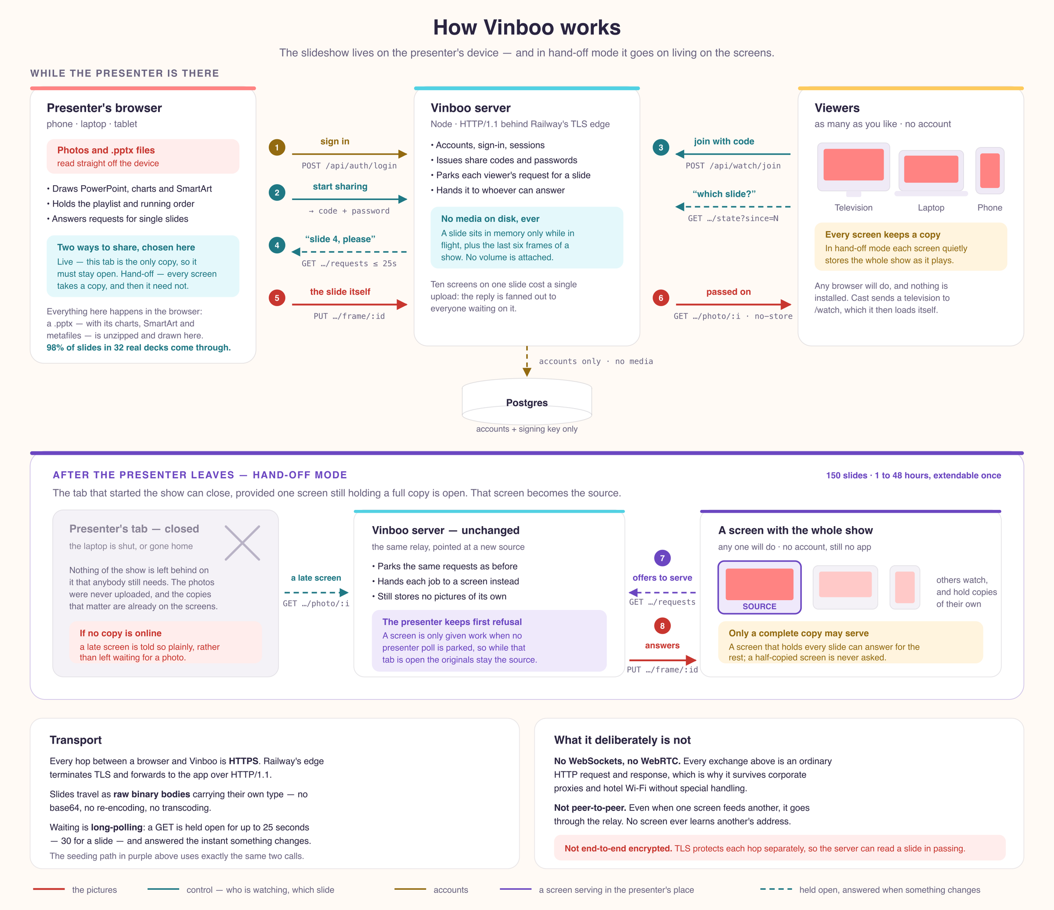
Appendix — the architecture as built
Shipped and running today. The encrypted design overleaf changes only what the server is able to read.
Notes:
Full-resolution source: docs/architecture.svg in the repository.

Slide 18
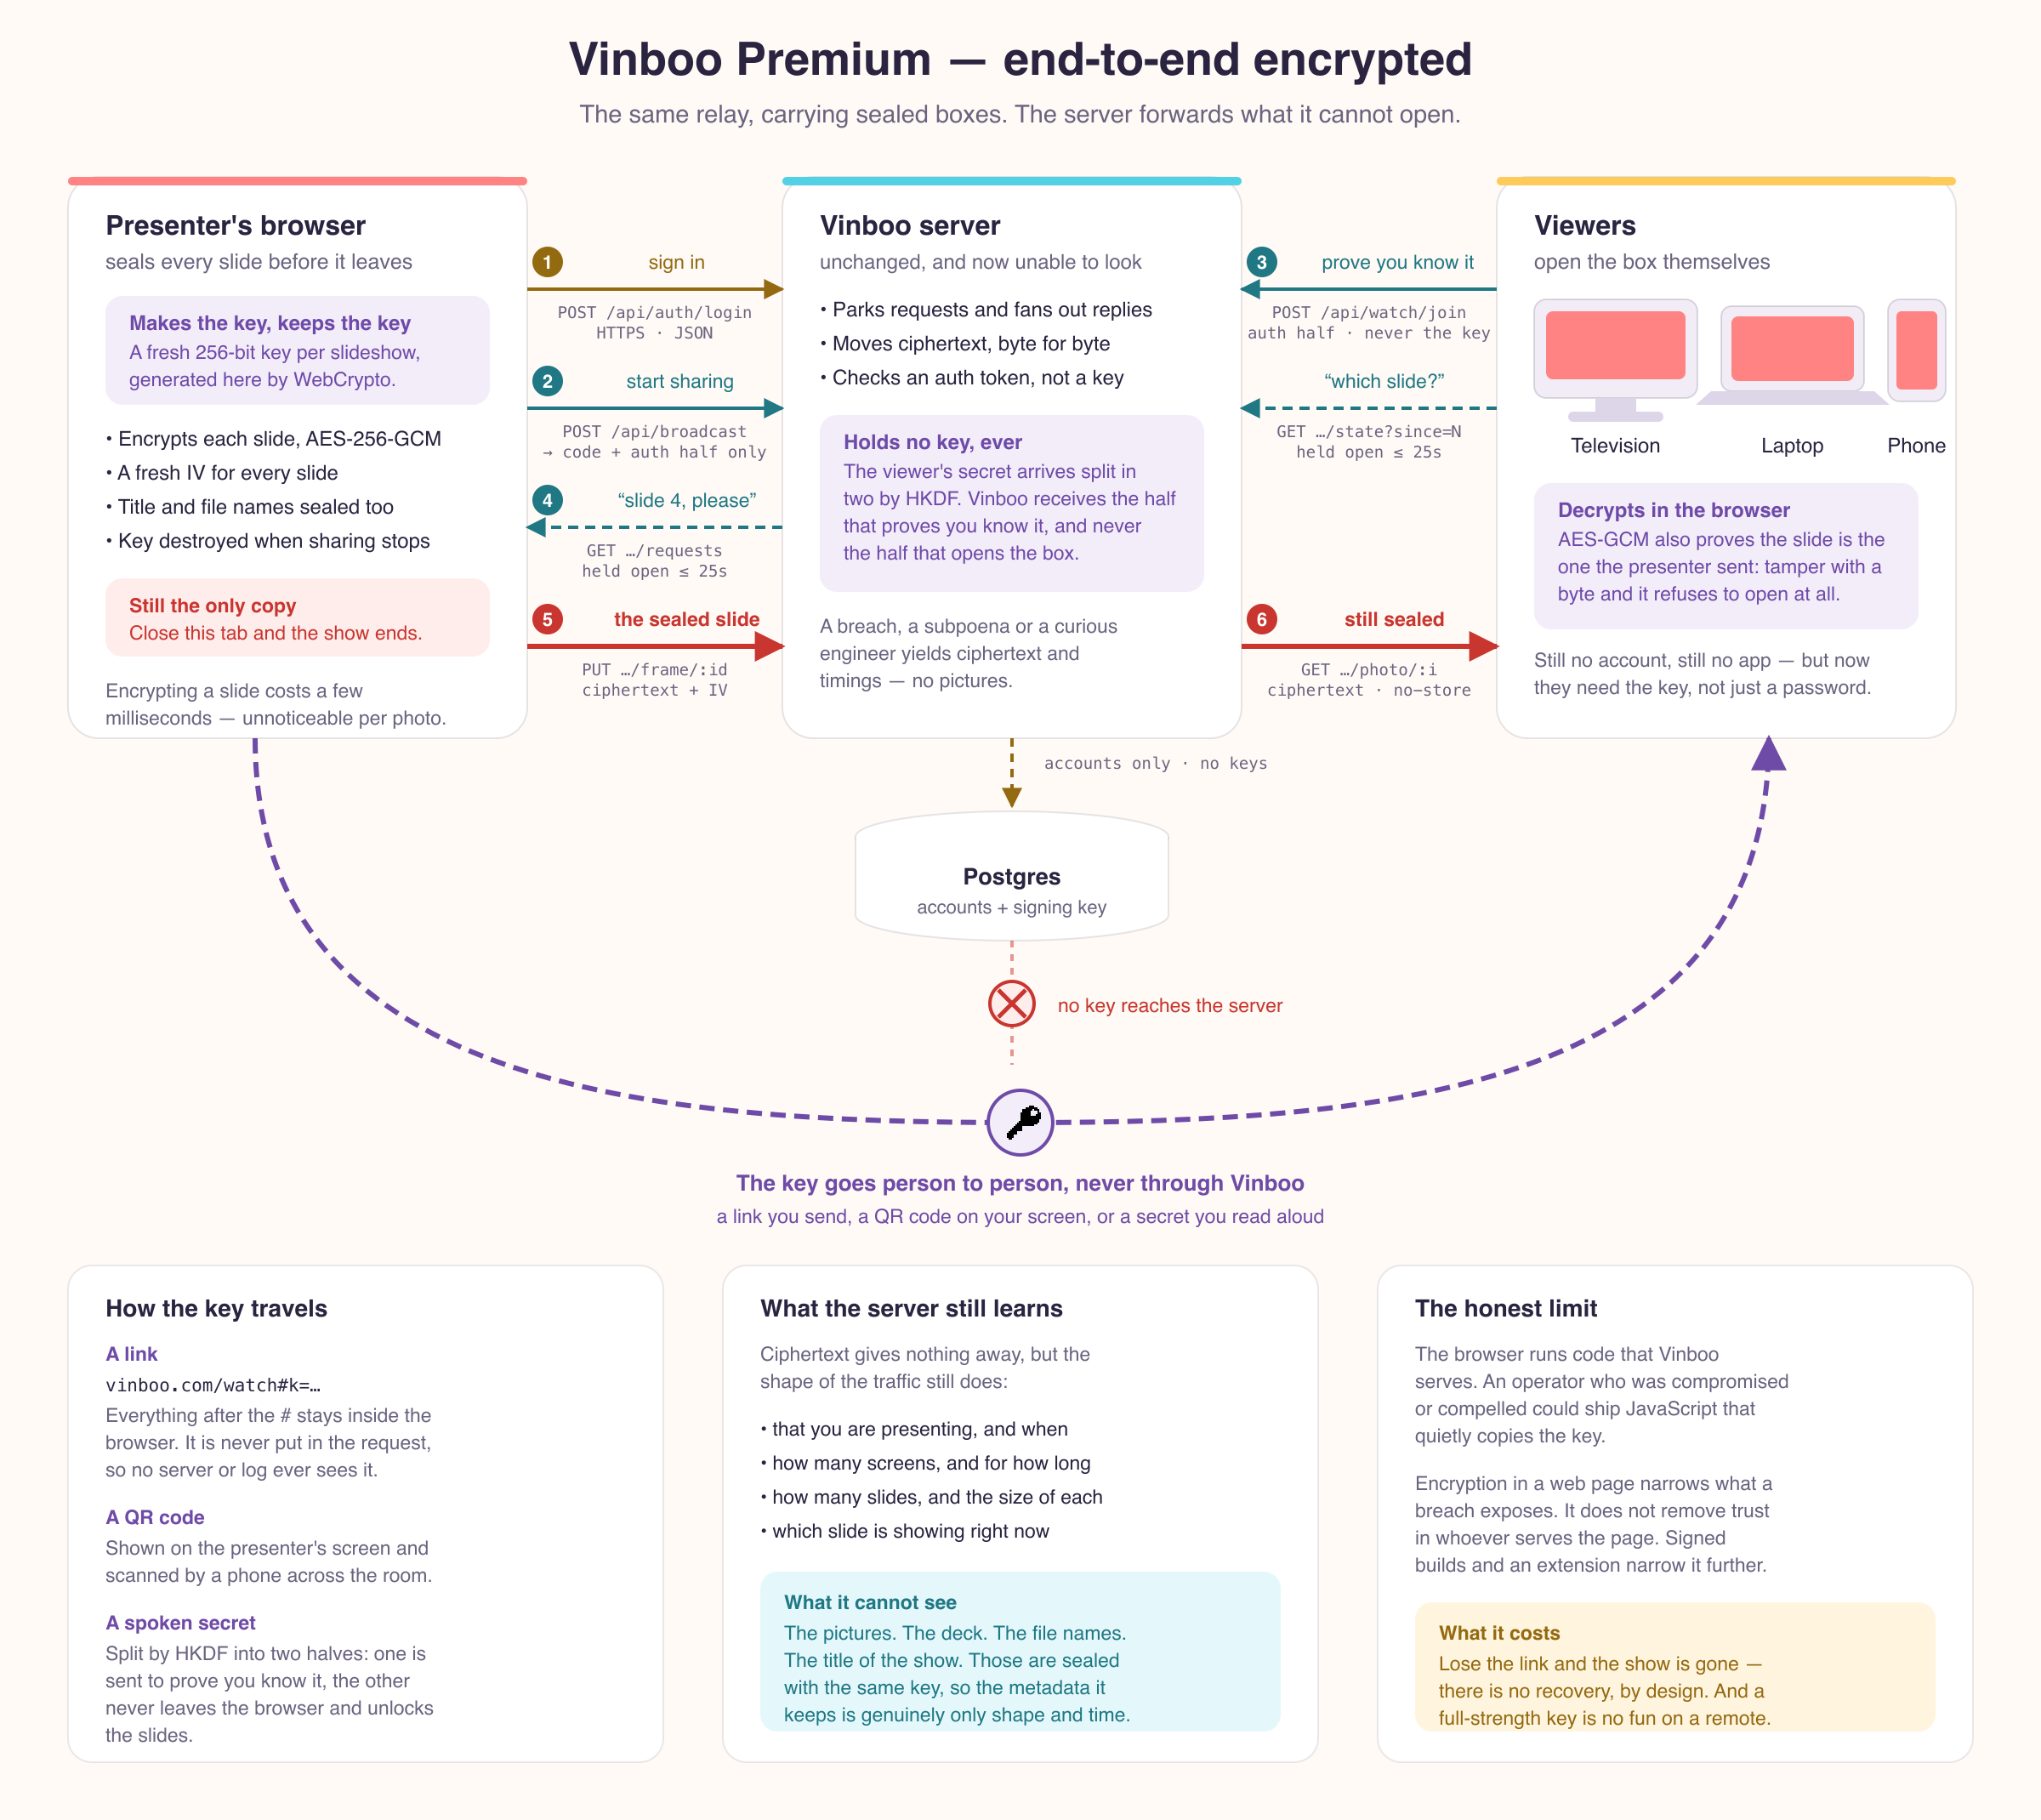
Appendix — Vinboo Private, in full
Complete architecture for the end-to-end encrypted tier. Designed, not yet built.
Notes:
Full-resolution source: docs/architecture-e2ee.svg in the repository.

