Slide 1
Project SEGUI (LORA)
TEAM and (c)
Author: VIERI GIOVAMBATTISTA
g.vieri@ent-it.com
(c) 2016 GIOVAMBATTISTA VIERI
All rights reserved

Slide 2
ABOUT TEAM
Experience in aerospace industry (ground segment) (ITALSAT/OLYMPUS/VLBI.. Ask for details )
Experience in Telco industry (TI, and other italian Telco)
Experience in Editorial industry (Gruppo Espresso, Caltanet … )
Now IT Consultant and Enterpreneur. (micro enterprise)
Floss developer

Slide 3
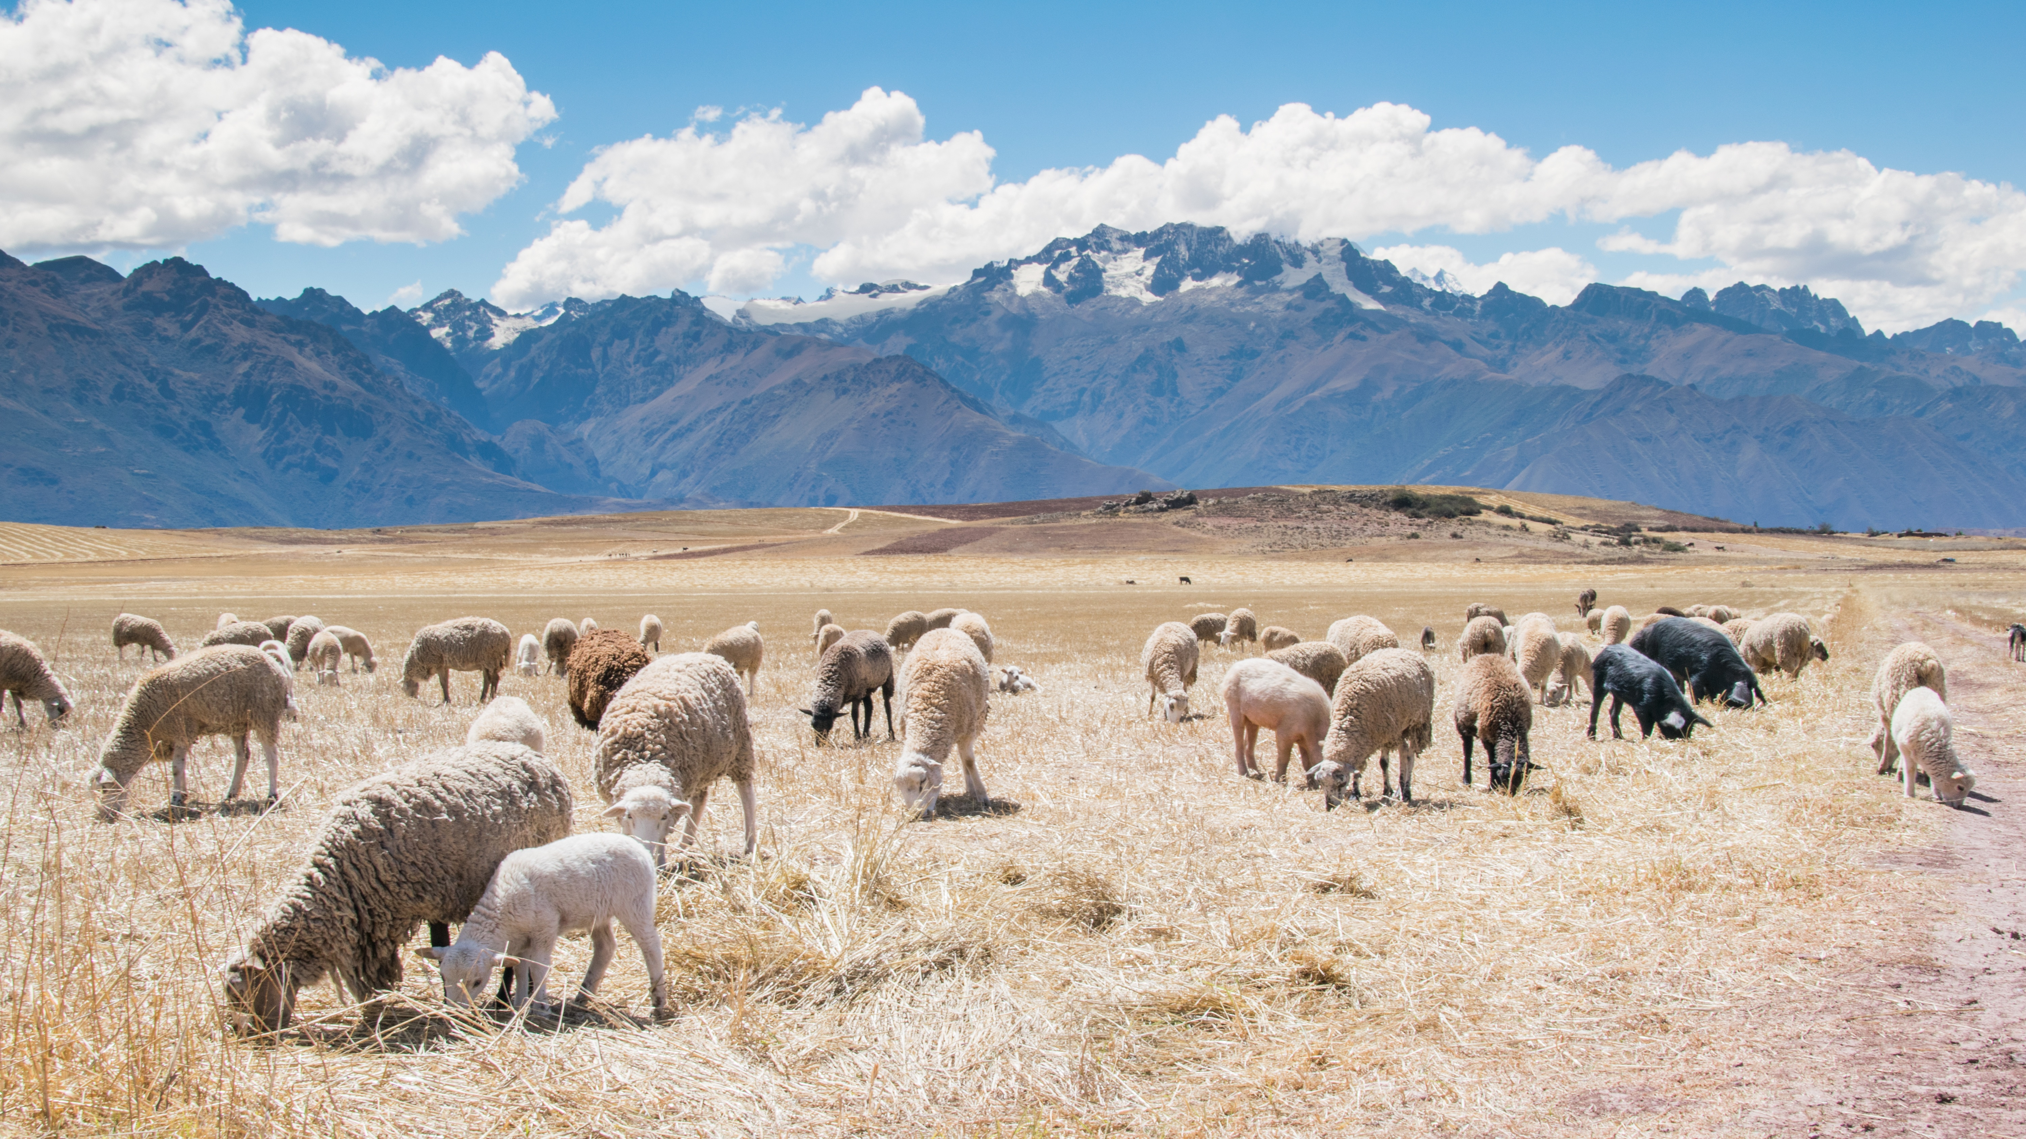
The challenge:
https://2016.spaceappschallenge.org/challenges/earth/emobile-pastoralism
A lot of Peoples, Animals are involved in pastoralism
We have people of very different cultures that are breeding rare kind of animal preserving very rare genetic pools.

Slide 4
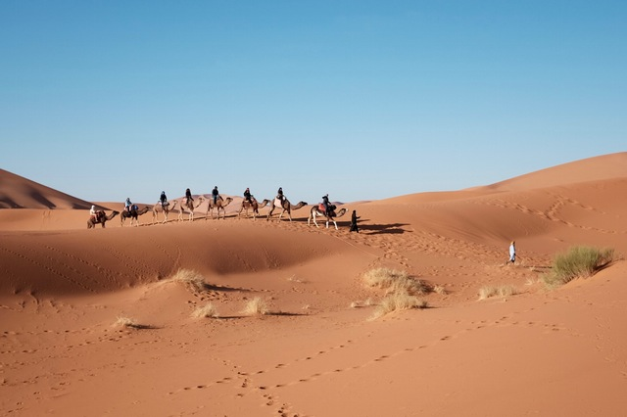
Pastoralism
Pastors are really important for nearby communities because they are sentinels of biodiversity
Pastors are economically important.
Pastors are ecomically distressed by climate change that impacts on natural resources.
Pastor needs primarily of clean water and pasture for their herds

Slide 5
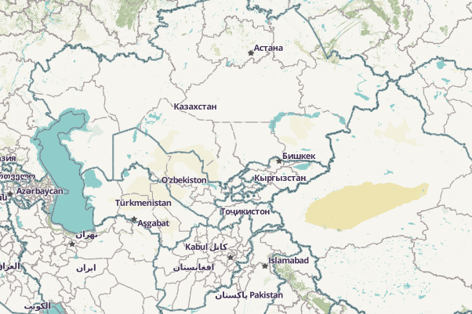
About central ASIA
A lot of border (both administrative and national)
A lot of ancient cultures and languages and dialect
A lot of varied landscapes (some kind of deserts, steppes, hills, mountains, … )
The “contained” regions are not the most enomically prominet of the planet.

Slide 6
A solution
Must enable peoples with different culture and language peoples to interact and communicate at a very basic level.
The exchanged messages must contain simple concepts, georeferenced when possible.
at LO-ng RA-nge

Slide 7
SEGUI
(LORA)
SOLVE THE PROBLEM.
  It is modular and multilayered
  The modules are quite indipendent
  Hardware agnostic
  Use low-consumption communication devices
  Can use existing communication infrastructures
  Can operate in a stand-alone way

Slide 8
THE CORE
Is SEGUI: a concept translator. It is a web app, that can become an android app.
LORA is low consumption/cost transmission system that can host SEGUI.
Communications Hub connect the preceding components to internet (for areas not covered by mobile phone communications)

Slide 9
SEGUI
SEGUI works on CONCEPTS expressed as SYMBOLS

Slide 10
SEGUI
It is a GUI (graphic user interface) web app.
Semantic
  No words
  Color
  Symbols/pictogram
It can use BLIH code (http://www.blih.info) for georeferenced presentation.

Slide 11
LORA
LO-ng RA-nge it is both the acronym of the module and one of the eligible communication protocol/devices
LORA its a composite module both hardware and software.(Raspberry(™), Edison(™), and others)
It can hosts the SEGUI module.

Slide 12
LORA
It is based on an embedded architecture: the prototype can reside on an INTEL EDISON ™ development board
It expose its services by wif-fi and bluetooth
It can reach other LORA modules using protocols as LORA™ , LoraWAN™, XBEE™ and others.

Slide 13
facts
LORA, Lorawan, XBEE are cheap and low consumption modules for “lowspeed” communications
With 250mw these board can reach 64km (in optimal condition)
Mobile phone with bluetooth are available in Pakistan for less than 50$
Android smartphone are today available for (quantity) at a price <50$

Slide 14
Communication hub
Can be a normal server. It MUST be connected to internet.
It fetch informations and dispatch to all LORA devices that are in range. .
SAR satellite's data will be a valuable information font. So that we can compare SAR and visible products to evaluate both the pasture and water available.

Slide 15
The communication model
MESHED NETWORK
B.A.T.M.A.N is a suitable example.
The message had both a Time To Live and a UUID to avoid to send “too old messages” and avoid to resend the same message.
In a such way the peoples can exchange info without the need to go in villages or in other area covered by mobile communications.

Slide 16
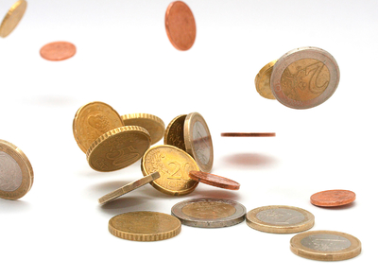
MONEY
COSTS
  SEGUI software module is available on github
  The mobile phone costs vary from country to country
  The components cost can vary in function of local tax.

Slide 17
YOU LOVE IT so build a prototype
Go on online reseller and order an android mobile phone with gps, Wifi, bluetooth for less than 50$
Buy a raspberry/similar for about 50$ plus power pack.
Buy a solar panel an batteries for another 20$
Buy some nice sensors for about 30$ (nice to have) and to use
TOTAL about 150$ without quantity discount.

Slide 18
Economic Sustainability
The team think that the project can be sustainable. Two possible ways:
Implementing the solution “hub” asking for a fee as a % of the gained/spared moneys. (See micro-credit business model).
Implementing SEGUI as android app then sell/rent on online marketplace.

Slide 19
credits
  All trademarks mentioned herein belong to their respective owners.
  Map from openstreetmap (humanitarian team)
  Github https://github.com/gvieri/segui
  Images coming from:
    Www.businessimagesfree.com (free images)
    Esa sites (images)
    https://www.pexels.com (free images)

Slide 20
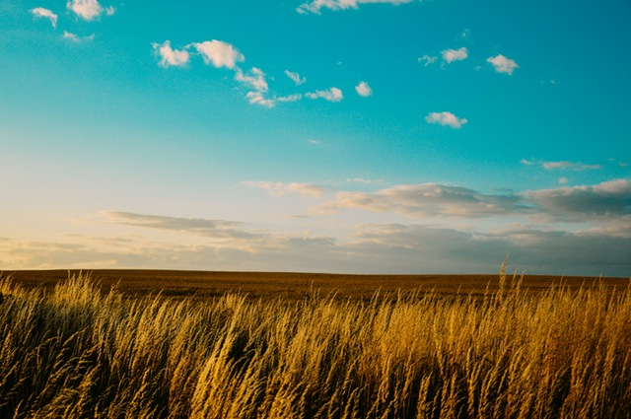
Conclusions
SEGUI standalone is able to improve both the environment both the living standard of pastors/herds
The whole systems is able to collect data from a lot of peoples acting as “scout” moving in important habitat.

