Slide 1


Hybrid Automation Framework

Slide 2
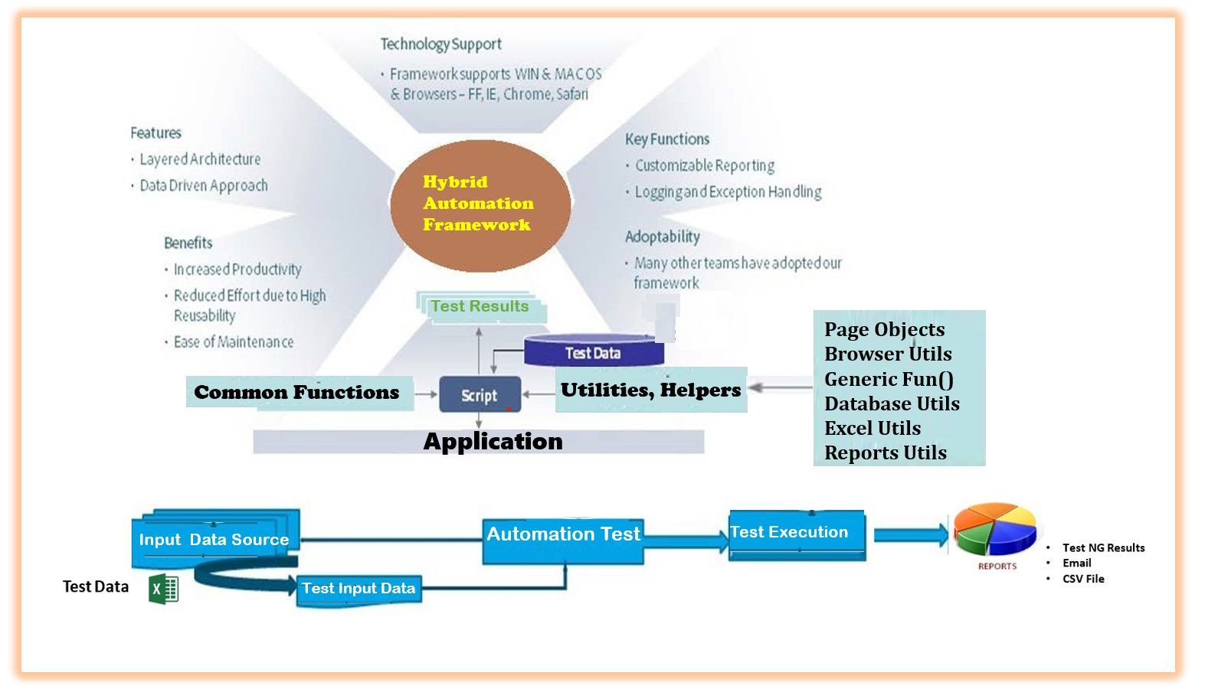

Slide 3












Test Automation Approach
Check-in
Notify Failure
Test NG Results
UI
WS/API
O/P CSV file

