Slide 1



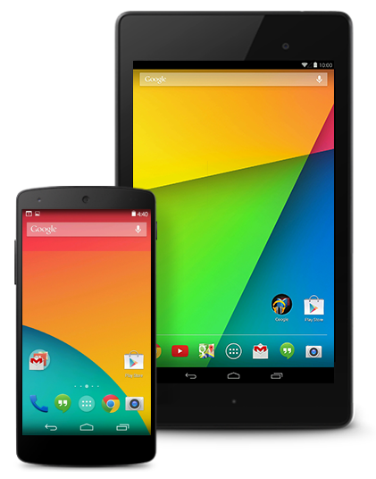


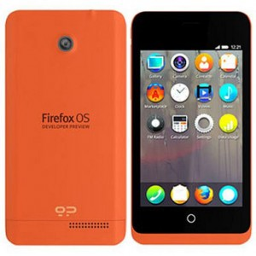
- iOS Automation (Instruments)
- Android 4.2+ Google's UIAutomator
- Android 2.3+
Google's Instrumentation
- Mozilla's Marionette
Appium
Server
(REST API)
Desired
Capabilities
POST/Session
JSON wire protocol
Selenium Web-driver
compatible languages
Any test framework
Appium client lib

