Slide 1

An Real-Time Eye Strain and Screen Safety Monitoring System
DSA0216-Computer Vison for Open cv for Modern AI
Supervisor
DR.S. Senthilvadivu
Dr.T. Kumaragurubaran
Dept of CSE
Saveetha School of Engineering
Presented by
G. VINAY KUMAR REDDY(192424245)
J.NIVAS(192424238)
A.ABHISHEK REDDY(192424192)
Saveetha School of Engineering

Slide 2


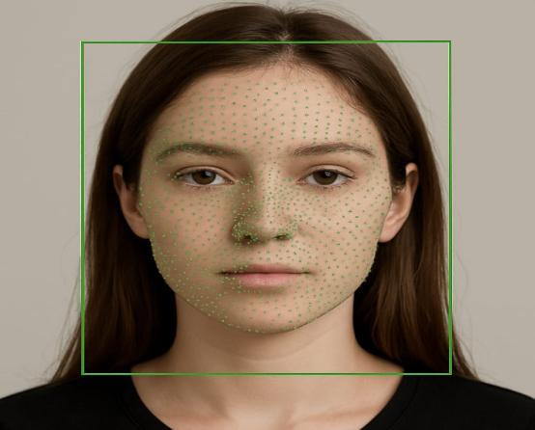
Introduction
Nowadays people use computers and mobiles for many hours, which causes eye problems.
This system checks the eyes continuously using a webcam.
It detects blinking and distance from the screen.
If the user does not blink or sits too close, it gives a warning.
The system helps users protect their eyes and use screens safely.

Slide 3
Proposed Objectives
To detect eye blinking using a webcam.
To identify eye strain caused by less blinking.
To measure the distance between the user and the screen.
To give alerts when the user needs to take a break.
To help users maintain healthy screen usage habits.

Slide 4
Literature Review
Paper Title | Author(s) | Major Findings | Year
Real-Time Eye Blink Detection Using Computer Vision | R. Kumar, S. Patel | Used Eye Aspect Ratio (EAR) with facial landmarks to detect blink rate accurately in real time. | 2024
Eye Fatigue Detection System Based on CNN | A. Sharma, N. Verma | Proposed CNN-based model to identify eye fatigue from eye images with improved detection accuracy. | 2024
Gaze Tracking and Screen Distance Estimation Using Webcam | P. Singh, M. Kaur | Developed a gaze tracking system to monitor screen distance and head position using facial landmark detection. | 2024
Drowsiness and Eye Strain Monitoring Using Deep Learning | S. Reddy, K. Rao | Combined deep learning with blink rate analysis to detect early signs of eye strain and fatigue. | 2025
Intelligent Screen Safety Monitoring System with Voice Alerts | V. Kumar, R. Mehta | Integrated eye tracking, distance measurement, and real-time voice alerts to improve user safety. | 2025

Slide 5
Identified Research Gaps
Many systems only check sleepiness, not eye strain from screen use.
Some systems only measure blinking but do not check screen distance.
Not all systems give quick alerts to the user.
Some systems do not work properly in low light.
There are very few simple and low-cost solutions for daily use.

Slide 6
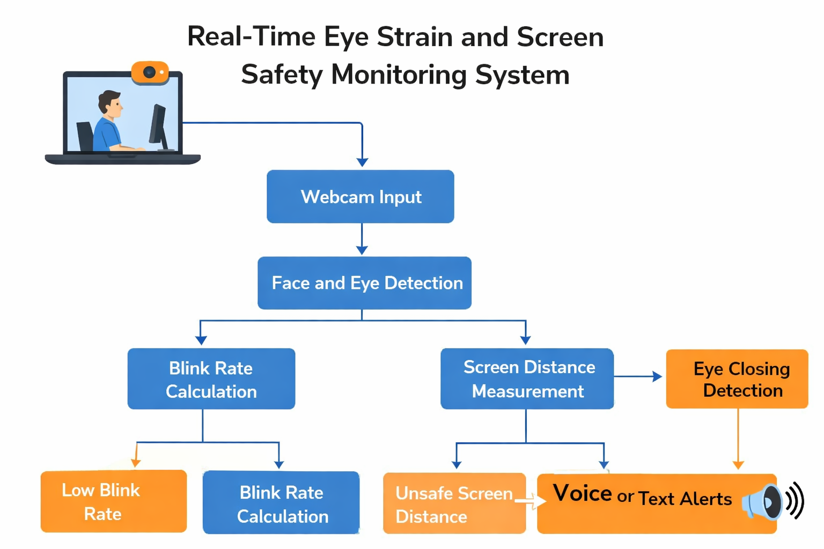
Architecture diagram

Slide 7
Modules
Module 1:Eye Blink Rate Detection & Fatigue Analysis
The webcam captures the user’s eye movements in real time.
The system detects the eyes using computer vision.
It calculates how many times the user blinks per minute.
If the blink rate is very low, it means the eyes may be getting tired.
The system identifies eye fatigue and sends the information to the alert module.

Slide 8
Modules
Module 2: Gaze Tracking & Screen Distance Monitoring
The system tracks where the user is looking using the webcam.
It checks if the user is continuously staring at the screen.
It measures the distance between the user and the screen.
If the user sits too close, it detects unsafe screen distance.
The system sends this information to the alert module for warning.

Slide 9
Modules
Module 3: Multilingual Voice Alert and User Notification System
This module gives alerts to the user when eye strain is detected.
It provides voice warnings if the user blinks less or sits too close to the screen.
It can give alerts in different languages.
It also shows text notifications on the screen.
The main aim is to remind the user to take breaks and maintain safe screen distance.

Slide 10
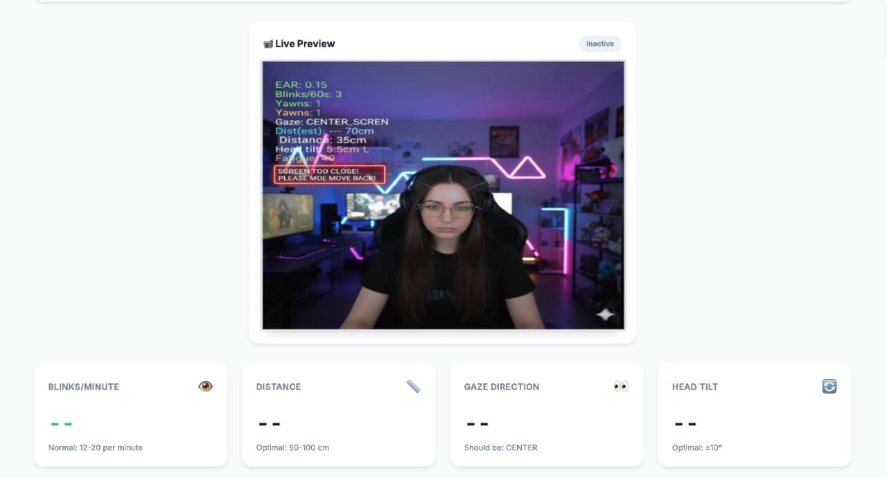
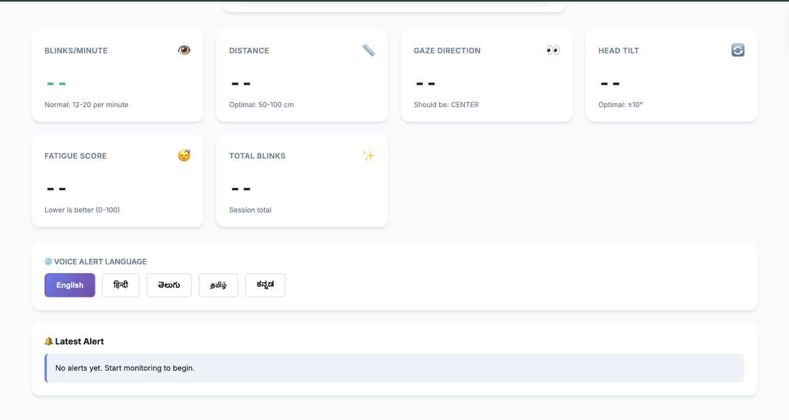

Slide 11
Results & Discussion
The system successfully detected eye blinking in real time.
It correctly identified low blink rate and signs of eye fatigue.
The screen distance was measured accurately using the webcam.
The system gave voice and text alerts when unsafe conditions were detected.
Overall, the system helped in promoting safe and healthy screen usage.

Slide 12
Challenges & Limitations
The system may not work properly in low lighting conditions.
Accuracy can reduce if the face is not clearly visible to the webcam.
It may not give exact distance measurement all the time.
Continuous webcam usage may consume system resources.
The system depends on camera quality for better performance

Slide 13
Future Scope
The system can be improved with higher accuracy using advanced AI models.
It can be developed as a mobile application.
It can be integrated with laptops and smart devices.
More health features like posture detection can be added.
It can be used in schools and offices to promote eye safety.

Slide 14
Conclusion
This project helps in monitoring eye strain during screen usage.
It detects blink rate and screen distance in real time.
The system gives alerts to protect the user’s eyes.
It is a simple and low-cost solution.
Overall, it promotes healthy and safe screen habits.

Slide 15
References
1. U. Dhankar and A. Kumar, “Real-Time Eye Wellness Monitoring Using Computer Vision,” International Journal of Computer Vision Applications, vol. 14, no. 2, pp. 45–52, 2025.
2. R. Mehta and P. Sharma, “Intelligent Screen Safety System for Eye Health,” Journal of Artificial Intelligence and Healthcare, vol. 9, no. 1, pp. 101–108, 2025.
3. N. Gupta and S. Verma, “AI-Based Eye Strain Detection Using Webcam,” International Journal of Advanced Computing Research, vol. 18, no. 3, pp. 210–218, 2025.
4. A. A. Jiman et al., “Eye Blinking Monitoring System for Computer Users,” Journal of Eye Movement Research, vol. 17, no. 5, pp. 1–10, 2024.
5. P. Singh and M. Kaur, “Gaze Tracking and Screen Distance Estimation Using Facial Landmarks,” Journal of Computer Vision and Image Processing, vol. 12, no. 4, pp. 150–158, 2024.

Slide 16


