Slide 1
Ex-11 PIG LATIN SCRIPTS FOR FINDING TF-IDF VALUE FOR BOOK DATASET

Slide 2
TF-IDF
TF-IDF stands for Term Frequency and Inverse Document frequency.
It is a ranking mechanism applied to search engine mostly.
It takes each unique words as terms in the document.
TF-IDF is a metric that represents how ‘important’ a word is to a document in the document set.
There are two steps involved here
Calculate Term Frequency(TF): Term frequency is the number of times a given term or query appears within a search index.
Calculate Inverse Document Frequency(IDF): IDF is the inverse of the document frequency which measures the informativeness of term t.

Slide 3
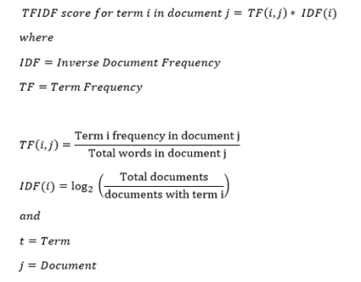

Slide 4
code
A = load '/tmp/books_small' using PigStorage('\n','-tagPath');
B = foreach A generate $0 as file, flatten(TOKENIZE((chararray)$1)) as word;
C = group B by (word, file);
D = foreach C generate COUNT(B) as n, group.word, group.file;
E = group D by file;
F = foreach E generate SUM(D.n) as N, flatten(D);
G = group F by word;
H = foreach G generate COUNT(F.file) as m, flatten(F);
R = foreach H generate file, word, ((1.0*n)/N)*LOG(10.0/m) as tfidf;
Dump R;

Slide 5
'tagPath' - Adds first column to indicate the input path of the record.
Referencing Fields
Fields are referred to by positional notation or by name (alias).
The TOKENIZE() function of Pig Latin is used to split a string (which contains a group of words).
The FLATTEN operator looks like a UDF syntactically, but it is actually an operator that changes the structure of tuples and bags
Positional notation (generated by system) | First Field $0 | Second Field $1 | Third Field $2

