Slide 1
Ex-6 STOP WORD ELIMINATION PROBLEM

Slide 2
Stopwords are the words in any language which does not add much meaning to a sentence.
stop words are words which are filtered out before or after processing of natural language data (text).
Though "stop words" usually refers to the most common words in a language.
There is no single universal list of stop words used by all natural language processing tools, and indeed not all tools even use such a list.

Slide 3
For some search engines, these are some of the most common, short function words, such as the, is, at, which, and on.
In this case, stop words can cause problems when searching for phrases that include them, particularly in names such as “The Who” or “Take That”.

Slide 4
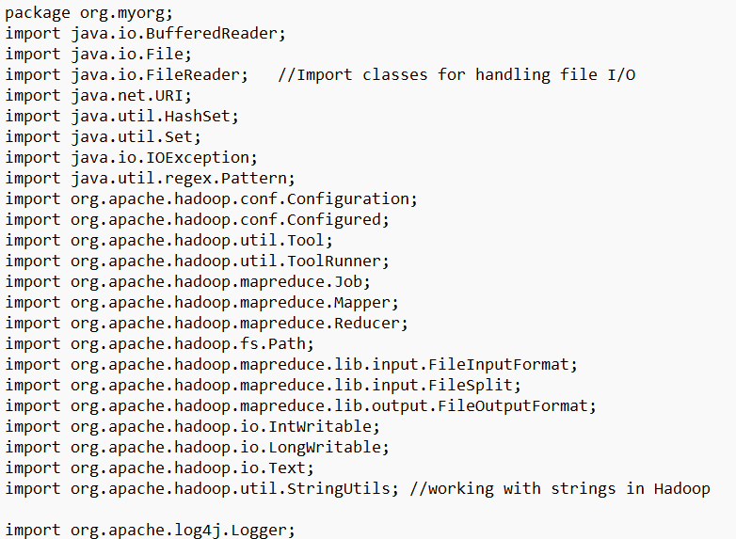

Slide 5
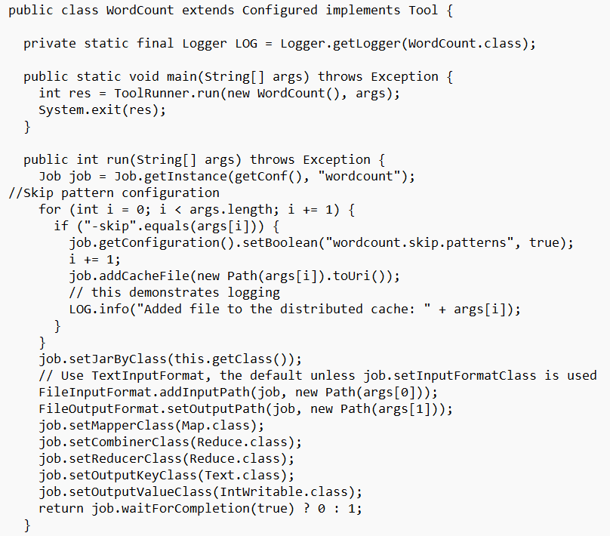

Slide 6
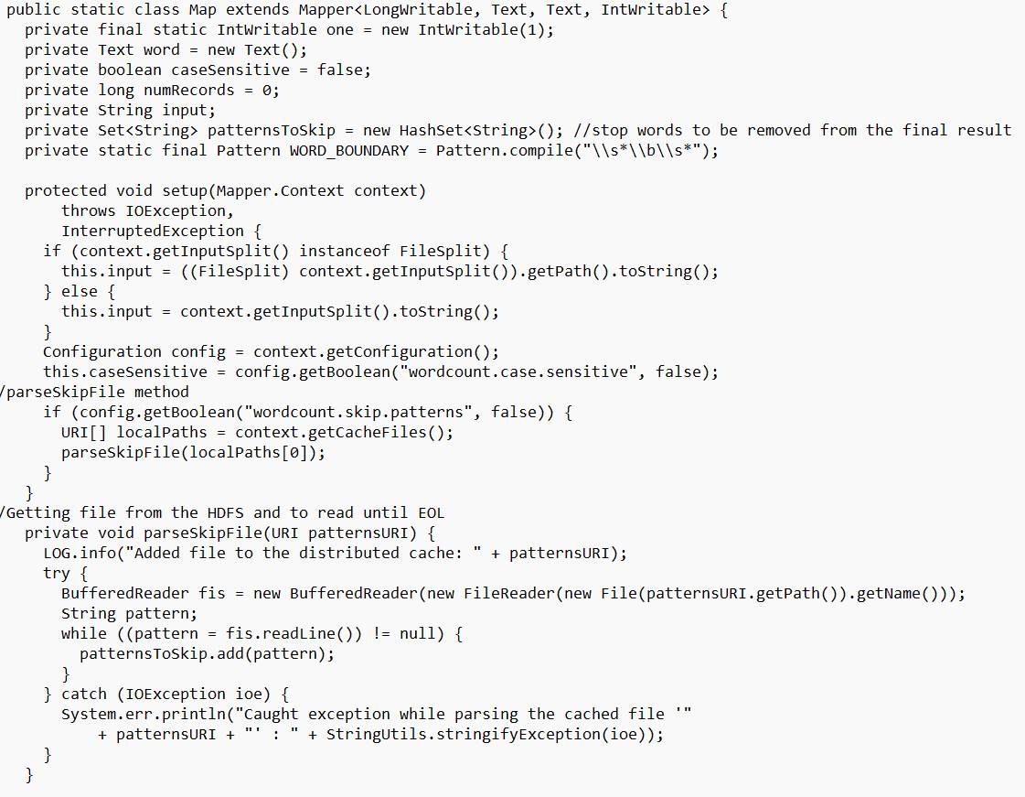

Slide 7
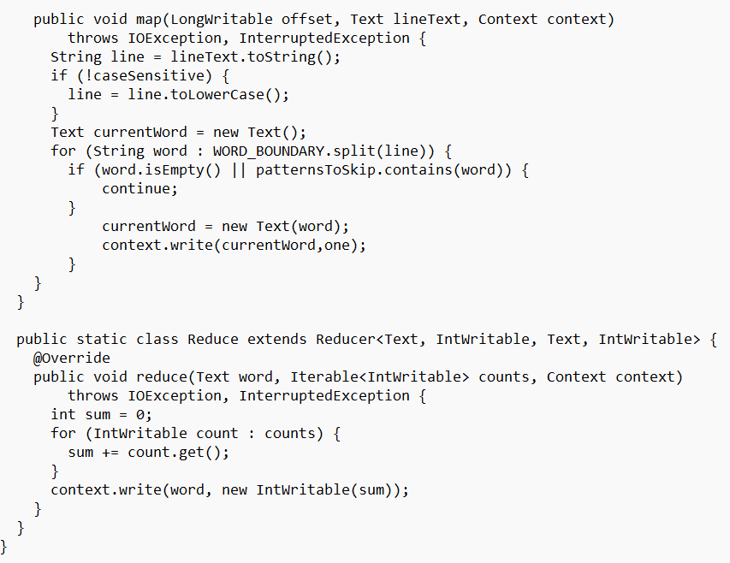

Slide 8
Process
wcsw/input_files/content.txt
wcsw/stopword.txt
wcsw/classfiles
wcsw/wordcount.java
hadoop jar jarfile classname /directory/input /directory/output –skip /directory/stopword.txt

Slide 9
References
https://github.com/arulalanv/WordCount-after-StopWords-Removal-using-MapReduce

