Slide 1
SRI KRISHNA KIRANA STORE
Weekly Performance, Inventory Health & Credit Analysis
Generated by Supermarket Ops AI Agent | Region: Coimbatore, TN

Slide 2
Weekly sales totaled ₹1,082.00 with outstanding credit of ₹2,000.00
STORE SALES REVENUE
₹1,082.00
Across 2 Transactions
GST TAX COLLECTED
₹68.52
Intrastate CGST/SGST 50/50
KHATA CREDIT BALANCES
₹2,000.00
Outstanding customer book value

Slide 3
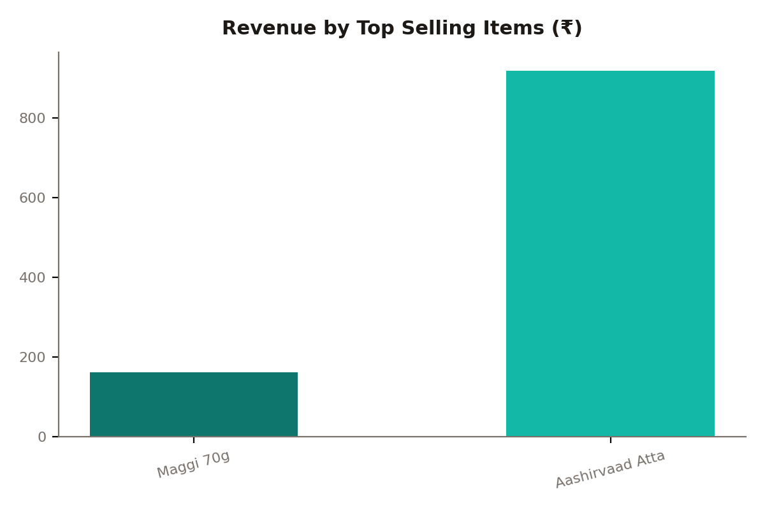
Fast-moving items like Atta & Butter drive major share of revenue
SALES COMPOSITION & MARGIN GAINS
• Volume Drivers: FMCG lines (Maggi, Parle-G) register high transaction velocities, ensuring steady daily cash and UPI inflows.
• Revenue Anchors: High-value packaged staples like Aashirvaad Atta 5kg and Fortune Oil contribute larger absolute billing values.
• Tax Distribution: Items fall under distinct GST brackets (0% for loose grains, 12% for Amul Butter, and 18% for Surf Excel & Maggi), creating a blended tax rate across general bills.

Slide 4
All essential SKU stock reserves are healthy
Item Name | Qty Left | Reorder Level | Action Code
All products have adequate stock levels. | - | - | HEALTHY
INVENTORY PROTECTION PROTOCOLS
• Automated Warnings: Trigger reorder requests immediately when a SKU sinks below or equals its pre-configured reorder level.
• FEFO Principles: Fresh dairy items (Amul Butter) are rotated to avoid expirations, applying First-Expiry First-Out.
• Suppliers Consolidated Orders: Combine low stock staples (loose flour, grains, sugar) in bulk orders to negotiate lower merchant shipping fees and improve store gross margin.

Slide 5
Prioritize credit recoveries and restock popular high-velocity FMCG items
IMMEDIATE BUSINESS ACTION ITEMS
• Proactive Khata Reminders & Settlements: With outstanding customer balances totals ₹2000.00, prioritize polite payment reminders to top ledger holders. Allow UPI payments directly against khata entries to ease settlement velocity.
• Multi-turn Billing Refinement: Leverage persistent session drafting to allow customers to build complex grocery bills across the day and check out in single transaction, reducing billing friction.
• Automated Replenishment of Low Stock SKU: Order replenishment batches for running-out staples and FMCGs to capitalize on high-velocity weekend demands and protect grocery retail customer trust.

