Slide 1
Rubber Ducky: Intermediate Lab
Lock Screen Prank (Bart Simpson)

Slide 2
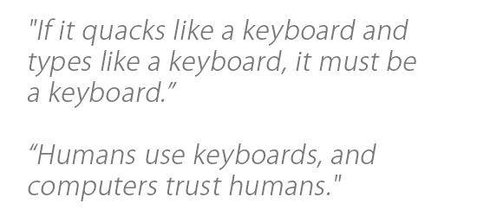
Required Materials
1 Windows PC (Windows 7 or newer)
Internet Access
USB Rubber Ducky (can be obtained from staff)
MicroSD to USB reader (can be obtained from staff)
WARNING! DO NOT plug in Rubber Ducky directly to your machine. First check the MicroSD card using card reader, ‘right click’ on drive and select ‘quick format’, then click ‘start.’ You do not know who was using this device before you, or what payload may remain.
ENJOY USING THE RUBBER DUCKY
Estimated Time to Complete: 45 min

Slide 3
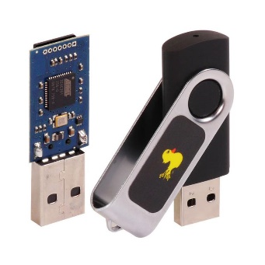
What is Rubber Ducky?
The USB Rubber Ducky is a powerful keystroke injection tool that can be disguised as an ordinary flash drive. Computers recognize it as a keyboard and accept pre-programmed keystroke payloads at over 1000 keystrokes per minute.
Payloads can be created using a simple scripting language that issues one command per line. For example, one command is ‘TAB’ which mimics using the TAB key, or another example of a command is ‘STRING hello world!’, which types/prints “hello world!” The full list of Windows commands and descriptions can be found here: https://github.com/hak5darren/USB-Rubber-Ducky/wiki/Duckyscript
Every computer (Desktop, Laptops, Tablets & Smartphones) takes inputs from the keyboard. Because the computer views the Rubber Ducky device as an input device (i.e., Keyboard). The program code that is resident in a file stored in the Rubber Ducky is treated as input to the compiler. This is why the Rubber Ducky USB device, which works as a Human Interface Device (HID) is automatically detected by most modern operating systems. By taking the advantage of this, one can penetrate the computer.

Slide 4
Ethics – Doing the Right Thing
The information and skills learned and taught in this lab can be used maliciously.
Never forget that cyber attacks/hacks no matter the intent are a serious crime, if convicted you can go to Federal prison!
(ISC)2 Code of ethics
-Protect society, the commonwealth, and the infrastructure.
-Act honorably, honestly, justly, responsibly, and legally.
-Provide diligent and competent service to principals.
-Advance and protect the profession.

Slide 5
Simpson’s Lock Screen Prank
Have you ever walked past another person’s computer and saw that it was unlocked?
An unlocked computer is what hackers love to see because the authentication process has already been completed.
We need to first create a script for this ‘Simpson’s lock screen prank’ using https://ducktoolkit.com/encoder/ and type in the script where it says “STRING Enter Ducky Script Here”.

Slide 6
Simpson’s Lock Screen Prank
The Rubber Ducky is a keyboard emulator that will automatically run pre-generated scripts.
This can come in handy when using Windows CLI (command line interface) OR PowerShell.
In this lab we will show you a ducky script that will attempt to make light of the dangerous risk with leaving a workstation alone and unlocked.
This is a benign way of showing how an unlocked computer can be exploited.
On the next slide, we will explain the sample code line-by-line

Slide 7
Simpson’s Lock Screen Prank Script – Line by Line
Script
DELAY 3000
GUI r
DELAY 200
STRING notepad.exe
ENTER
DELAY 300
STRING , ,\ ,'\,'\ ,'\ ,\ ,
ENTER
STRING , ,\/ \' `' ` ' /|
ENTER
STRING |\/ |
ENTER
STRING : |
ENTER
STRING : |
ENTER
STRING | |
ENTER
STRING | |
ENTER
STRING : -. _|
ENTER
STRING : \ `.
ENTER
STRING | ________:______\
ENTER
STRING : ,'o / o ,
ENTER
STRING : \ ,'-----./
ENTER
STRING \_ `--.--' )
ENTER
STRING ,` `. ,---'|
ENTER
STRING : ` |
ENTER
STRING `,-' |
ENTER
STRING / ,---. ,'
ENTER
STRING ,-' `-,------'
ENTER
STRING `. ,--'
ENTER
STRING `-.____/
ENTER
STRING \
ENTER
ENTER
STRING I will learn to lock my computer.
Description
Initial pause while computer reads Rubber Ducky
Opens ‘Run’ window
Opens Notepad
Legend
DELAY – Pauses for n milliseconds
‘GUI’ is the ‘Windows’ key and ‘GUI r’ opens the ‘Run’ window
ENTER – mimics pressing ‘enter’ key
STRING – mimics typing out the remainder of the line
*** The delays are required because there is a natural delay in the way that programs start***

Slide 8
Simpson’s Lock Screen Prank Script – Line by Line (continued)
ENTER
STRING I will learn to lock my computer.
ENTER
STRING I will learn to lock my computer.
ENTER
STRING I will learn to lock my computer.
ENTER
STRING I will learn to lock my computer.
ENTER
STRING I will learn to lock my computer.
ENTER
STRING I will learn to lock my computer.
ENTER
STRING I will learn to lock my computer.
ENTER
STRING I will learn to lock my computer.
ENTER
STRING I will learn to lock my computer.
ENTER
Displays Main window’s system menu
Maximizes notepad
Legend
DELAY – Pauses for n milliseconds
‘GUI’ is the ‘Windows’ key and ‘GUI r’ opens the ‘Run’ window
ENTER – mimics pressing ‘enter’ key
STRING – mimics typing out the remainder of the line
*** The delays are required because there is a natural delay in the way that programs start***
STRING I will learn to lock my computer.
ENTER
ENTER
STRING There, just like Bart Simpson.
ENTER
ENTER
STRING Please remember to lock your computer when you step away from your desk.
ENTER
ENTER
STRING Thank you.
ENTER
DELAY 100
ALT SPACE
STRING x

Slide 9
Implementation
Once you're ready with the script you will need to convert that into a .bin (binary) file
For this conversion you can either use following link or you can download encoder for rubber ducky.
url: https://ducktoolkit.com/encoder/
In order to generate the payload click on ‘generate payload’ on the right side of the screen, then click on the file called inject.bin, which will initiate the download
KEEP THE WEB BROWSER OPEN FOR NOW

Slide 10
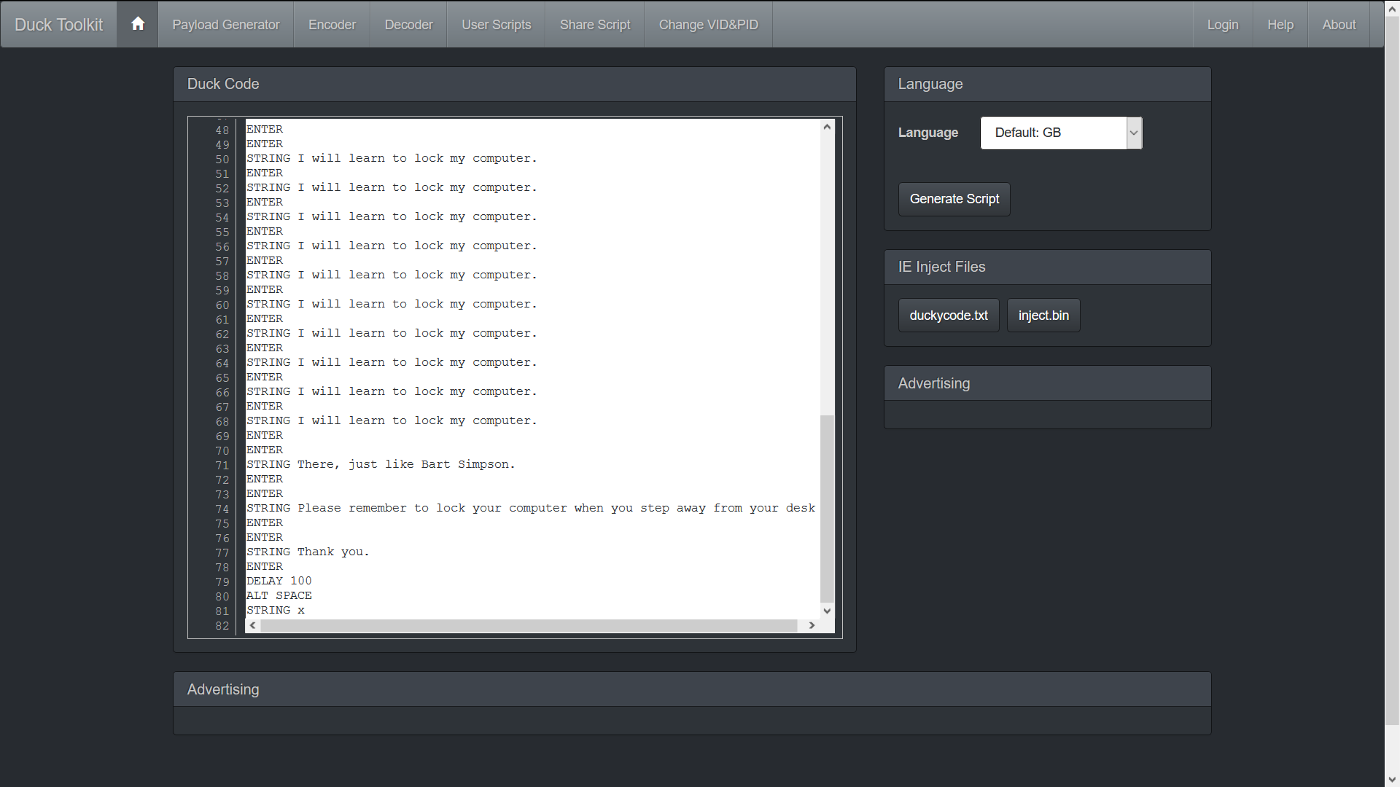

Slide 11
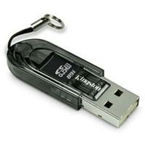
Implementation Continued
When you have the ‘inject.bin’ file downloaded, we need to transfer the file into microSD card using the microSD to USB card reader. (See below)
Once, finished, insert the microSD card into the rubber ducky and connect the ducky to the target machine
The script will automatically run and once you connect the ducky it will show you ‘Hello World!’ in notepad within 1.5 seconds.

Slide 12
What’s next?
Can you think of how to create a script when you can’t use the mouse?
Every Ducky script must be created with this principle in mind.
Make sure that you are recording every single keystroke.
In this lab we wanted our payload to be seen, but how could we cover our tracks to ensure that our activity cannot be easily discovered?

