Slide 1
Rubber Ducky Beginner Labs
Create a folder and a file

Slide 2
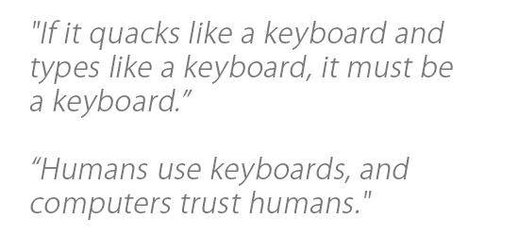
Required Materials
1 Windows PC (Windows 7 or newer)
Internet Access
USB Rubber Ducky (can be obtained from staff)
MicroSD to USB reader (can be obtained from staff)
WARNING! DO NOT plug in Rubber Ducky directly to your machine. First check the MicroSD card using card reader, ‘right click’ on drive and select ‘quick format’, then click ‘start.’ You do not know who was using this device before you, or what payload may remain.
ENJOY USING THE RUBBER DUCKY
Estimated Time to Complete: 30 min

Slide 3
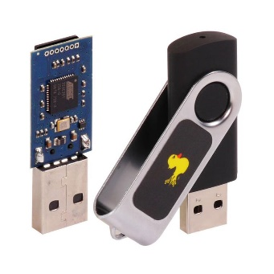
What is Rubber Ducky?
The USB Rubber Ducky is a powerful keystroke injection tool that can be disguised as an ordinary flash drive. Computers recognize it as a keyboard and accept pre-programmed keystroke payloads at over 1000 keystrokes per minute.
Payloads can be created using a simple scripting language that issues one command per line. For example, one command is ‘TAB’ which mimics using the TAB key, or another example of a command is ‘STRING hello world!’, which types/prints “hello world!” The full list of Windows commands and descriptions can be found here: https://github.com/hak5darren/USB-Rubber-Ducky/wiki/Duckyscript
Every computer (Desktop, Laptops, Tablets & Smartphones) takes inputs from the keyboard. Because the computer views the Rubber Ducky device as an input device (i.e., Keyboard). The program code that is resident in a file stored in the Rubber Ducky is treated as input to the compiler. This is why the Rubber Ducky USB device, which works as a Human Interface Device (HID) is automatically detected by most modern operating systems. By taking the advantage of this, one can penetrate the computer.

Slide 4
Ethics – Doing the Right Thing
The information and skills learned and taught in this lab can be used maliciously.
Never forget that cyber attacks/hacks no matter the intent are a serious crime, if convicted you can go to Federal prison!
(ISC)2 Code of ethics
-Protect society, the commonwealth, and the infrastructure.
-Act honorably, honestly, justly, responsibly, and legally.
-Provide diligent and competent service to principals.
-Advance and protect the profession.

Slide 5
Create a Folder & a File
In this lab we will learn how to use rubber ducky to automate some basic CLI (command line interface) commands. We will create a folder and then create a document in that folder. We will use notepad as our word processor, but you can use any other.
We need to first create a script for this ‘Create a folder & a file lab’ using https://ducktoolkit.com/encoder/ and type in the script where it says “STRING Enter Ducky Script Here”.

Slide 6
Create a Folder & a File
The Rubber Ducky is a keyboard emulator that will automatically run pre-generated scripts.
This can come in handy when using Windows CLI (command line interface) OR PowerShell.
In this lab we will show you a ducky script that will create a folder and a notepad file.
In order to have full understanding, you should understand the concepts of using the command prompt in Windows. (See “Command line intro” lab in the “1. Intro Labs” folder
On the next slide we will explain the sample code line-by-line

Slide 7
Script - Part 1
Create Folder / Create File in that folder
Windows Payload
COMMAND EXPLANATION
REM This is how to create a folder and notepad file <This is a comment that will not be executed>
DELAY 1000 <Delays 1000 milliseconds>
GUI r <opens ‘run’>
DELAY 500 <Delays 500 milliseconds>
STRING cmd <types ‘cmd’>
ENTER <opens command prompt>
DELAY 500 <Delays 500 milliseconds>
STRING mkdir Lab <creates folder/directory called ‘Lab’>
ENTER <executes command>
DELAY 100 <Delays 100 milliseconds>
STRING cd Lab <changes to ‘Lab’ directory>
ENTER <executes command>
DELAY 100 <Delays 100 milliseconds>
STRING start notepad HELLO.txt <opens notepad, and creates file named ‘HELLO.txt’>
ENTER <executes command>
DELAY 100 <Delays 100 milliseconds>
ENTER <closes dialog box, auto generated by Windows>
ALT TAB <switches to command prompt>
DELAY 100 <Delays 100 milliseconds>
STRING exit <types ‘exit’ to close command prompt>
ENTER <executes command>
DELAY 100 <Delays 100 milliseconds>
STRING HELLO!!! I’m into your computer :) <types ‘exit’ to close command prompt>
*** The delays are required because there is a natural delay in the way that programs start***

Slide 8
Implementation
Once you're ready with the script you will need to convert that into a .bin (binary) file
For this conversion you can either use following link or you can download encoder for rubber ducky.
url: https://ducktoolkit.com/encoder/
In order to generate the payload click on ‘generate payload’ on the right side of the screen, then click on the file called inject.bin, which will initiate the download
KEEP THE WEB BROWSER OPEN FOR NOW

Slide 9
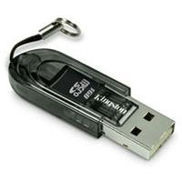
Implementation Continued
When you have the ‘inject.bin’ file downloaded, we need to transfer the file into microSD card using the microSD to USB card reader. (See below)
Once, finished, insert the microSD card into the rubber ducky and connect the ducky to the target machine
The script will automatically run and once you connect the ducky it will show you ‘Hello World!’ in notepad within 1.5 seconds.

Slide 10
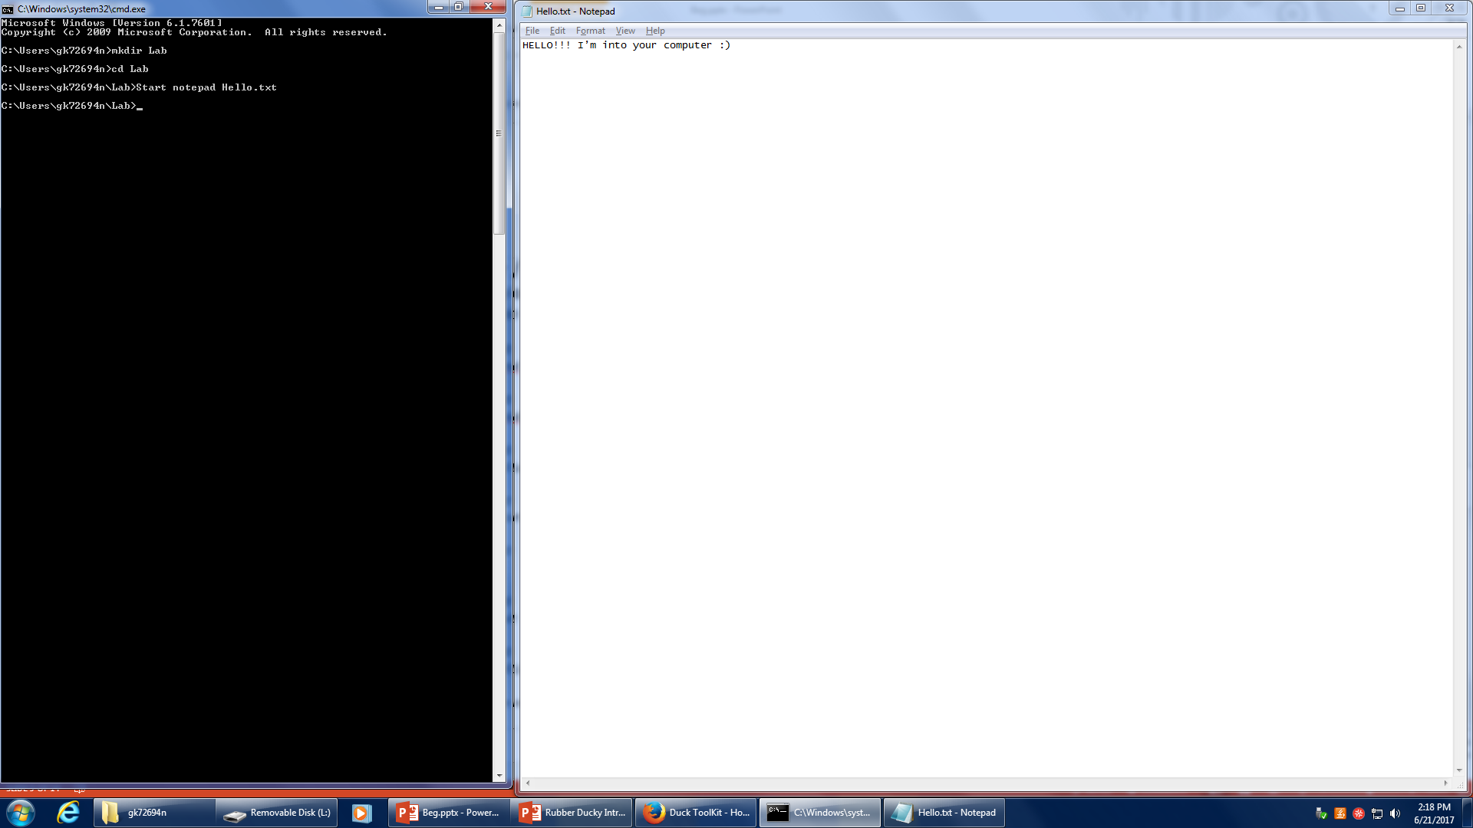

Slide 11
Fix the code
Do you think this code complete?
What if we wanted to save the file in the folder?
We can only use the keyboard.
Take a few minutes to think about it, then move onto the next slide.

Slide 12
Script - Part 2
Create Folder / Create File in that folder
Windows Payload
COMMAND EXPLANATION
ALT <selects menu bar>
DOWN <navigates through menu>
DOWN <navigates through menu>
DOWN <navigates through menu>
DOWN <navigates through menu>
ENTER <selects ‘Save As’>
STRING hello <types ‘hello’>
ENTER <saves file in current folder>

Slide 13
Merge the code
Now, place the code on the previous slide underneath the code you had originally created. (This is why I told you to leave the web browser open)
Regenerate the script.
Download inject.bin(mandatory) and duckycode.txt(optional)
When you have the ‘inject.bin’ file downloaded, we need to transfer the file into microSD card using the microSD to USB card reader. (See below)
Once, finished, insert the microSD card into the rubber ducky and connect the ducky to the target machine

Slide 14
What’s next?
Can you think of how to create a script when you can’t use the mouse?
Every Ducky script must be created with this principle in mind.
Make sure that you are thinking about every single keystroke.

