Slide 1
Rubber Ducky Beginner Labs
Hello World!

Slide 2
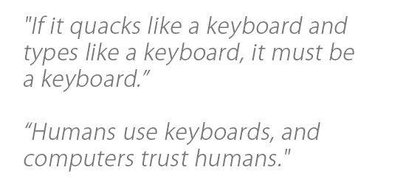
Required Materials
1 Windows PC (Windows 7 or newer)
Internet Access
USB Rubber Ducky (can be obtained from staff)
MicroSD to USB reader (can be obtained from staff)
WARNING! DO NOT plug in Rubber Ducky directly to your machine. First check the MicroSD card using card reader, ‘right click’ on drive and select ‘quick format’, then click ‘start.’ You do not know who was using this device before you, or what payload may remain.
ENJOY USING THE RUBBER DUCKY
Estimated Time to Complete: 30 min

Slide 3
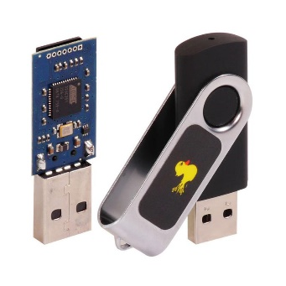
What is Rubber Ducky?
The USB Rubber Ducky is a powerful keystroke injection tool that can be disguised as an ordinary flash drive. Computers recognize it as a keyboard and accept pre-programmed keystroke payloads at over 1000 keystrokes per minute.
Payloads can be created using a simple scripting language that issues one command per line. For example, one command is ‘TAB’ which mimics using the TAB key, or another example of a command is ‘STRING hello world!’, which types/prints “hello world!” The full list of Windows commands and descriptions can be found here: https://github.com/hak5darren/USB-Rubber-Ducky/wiki/Duckyscript
Every computer (Desktop, Laptops, Tablets & Smartphones) takes inputs from the keyboard. Because the computer views the Rubber Ducky device as an input device (i.e., Keyboard). The program code that is resident in a file stored in the Rubber Ducky is treated as input to the compiler. This is why the Rubber Ducky USB device, which works as a Human Interface Device (HID) is automatically detected by most modern operating systems. By taking the advantage of this, one can penetrate the computer.

Slide 4
Ethics – Doing the Right Thing
The information and skills learned and taught in this lab can be used maliciously.
Never forget that cyber attacks/hacks no matter the intent are a serious crime, if convicted you can go to Federal prison!
(ISC)2 Code of ethics
-Protect society, the commonwealth, and the infrastructure.
-Act honorably, honestly, justly, responsibly, and legally.
-Provide diligent and competent service to principals.
-Advance and protect the profession.

Slide 5
Example of how Rubber Ducky Works
Open up notepad on your computer and type the following line:
Hello World!
Now close notepad. Now open up notepad on your computer and type the following line:
Hello World!
Now close notepad and repeat. Repeat 10 times. 100 times. 1,000,000 times.
Having a tool that can automate this process can be very helpful in repeating step-by-step tasks.

Slide 6
Hello World!
In this lab we will learn how to use rubber ducky to write one of the first commands used in programming (that is, to display the term ‘hello world’ on your screen). We will use notepad as our word processor, but you can use any other.
We need to first create a script for ‘Hello World Lab’ using https://ducktoolkit.com/encoder/ and type in the script where it says “STRING Enter Ducky Script Here”.

Slide 7
Ducky’s scripting language
Hello World! Script-
REM This is our hello world script <This command is used for comments>
DELAY 3000 <‘DELAY’ adds a pause between the commands in milisec.>
GUI r <It takes you to the ‘RUN’>
DELAY 100 <pauses 1/10 of a second>
STRING notepad <‘STRING’ prints the message>
ENTER <It will open the Notepad>
DELAY 100 <pauses 1/10 of a second>
STRING ‘Hello World!’ <This will type the message on the screen>
*** The delays are required because there is a natural delay in the way that programs start***
To write a payload you need to use a simple scripting language.
In Rubber Ducky’s scripting language ‘GUI’ mimics the ‘Windows Key’
Example: ‘GUI + r’ opens ‘Run’, which allows you to find a file/folder, program or internet resource; ‘GUI + d’ minimizes all windows

Slide 8
Script
Hello World!
Windows Payload:
DELAY 3000
GUI r
DELAY 100
STRING notepad
ENTER
DELAY 100
STRING Hello World!
Hello World!
Mac OS Payload:
DELAY 3000
COMMAND SPACE
DELAY 100
STRING textEdit
ENTER
DELAY 100
STRING Hello World!

Slide 9
Implementation
Once you're ready with the script you will need to convert that into a .bin (binary) file
For this conversion you can either use following link or you can download encoder for rubber ducky.
url: https://ducktoolkit.com/encoder/
In order to generate the payload click on ‘generate payload’ on the right side of the screen, then click on the file called inject.bin, which will initiate the download.
You can also save duckycode.txt file, which is a text file of your script, so you can use the code again without retyping it.

Slide 10
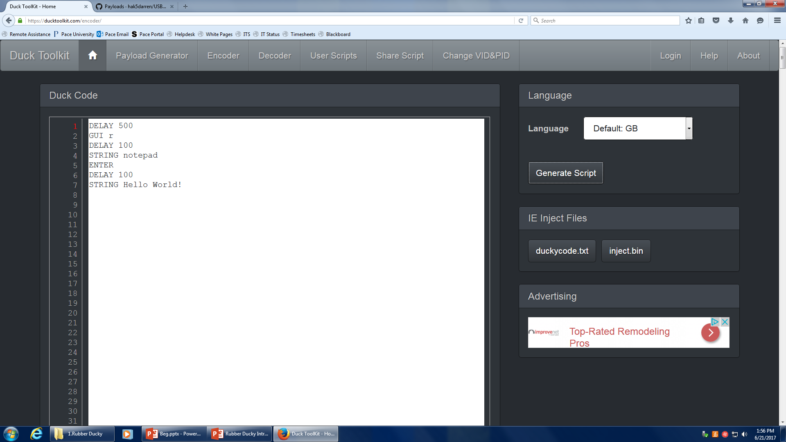

Slide 11
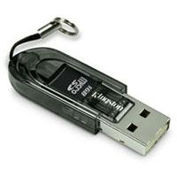
Implementation Continued
5. When you have the ‘inject.bin’ file downloaded, we need to transfer the file into microSD card using the microSD to USB card reader. (See below)
6. Once, finished, insert the microSD card into the rubber ducky and connect the ducky to the target machine
7. The script will automatically run and once you connect the ducky it will show you ‘Hello World!’ in notepad within 5 seconds.

Slide 12
What’s next?
Can you think of how to create a script when you can’t use the mouse?
Every Ducky script must be created with this principle in mind.
Make sure that you are thinking about every single keystroke.

