Slide 1
EE516 : Homework 4
Gaurav Kalra
(Student ID: 2016 45 93)
gvkalra@kaist.ac.kr

Slide 2
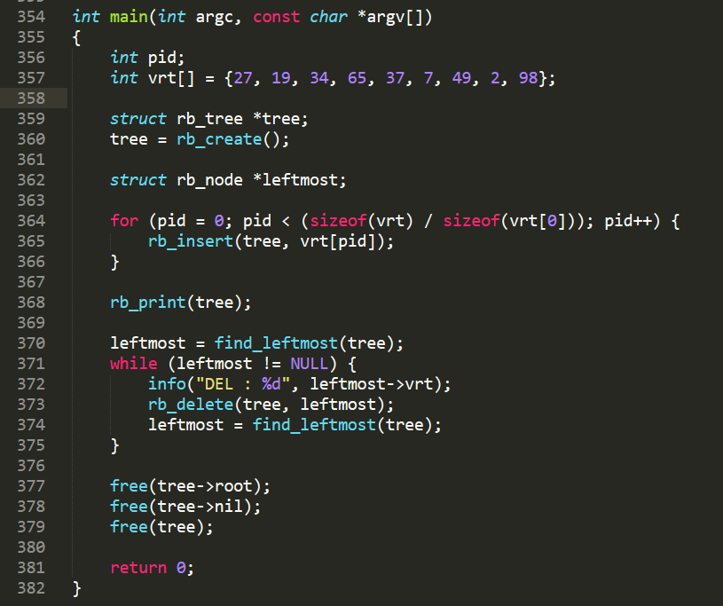
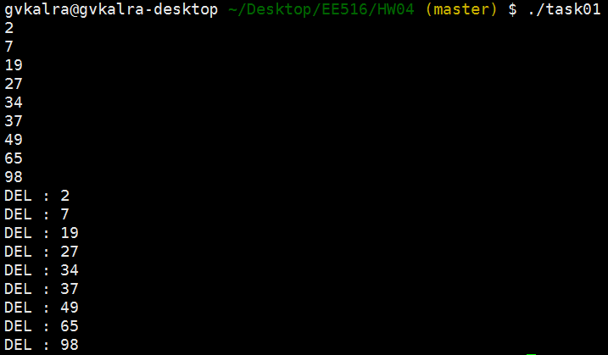
Make a program to construct red-black tree based on the virtual run time of each process.
Assume:
int pid;
int vrt[pid] = {27, 19, 34, 65, 37, 7, 49, 2, 98};
Remove the leftmost node and re-structure the red-black tree until all vrt[] nodes are removed from the tree.
1
2
3
4
Create a new RB tree
Insert given virtual run-times as keys
Print RB tree using in-order traversal
Iteratively delete leftmost node until there is no node left
In-order traversal of RB-Tree. Since RB-Tree is inherently a BST, the in-order traversal prints all elements in sorted order
Deleting leftmost node (least virtual run-time) is exploited in Completely Fair Scheduler (CFS) of Linux. The CFS keeps a cache of leftmost node & thus can schedule it in O(1) time

Slide 3
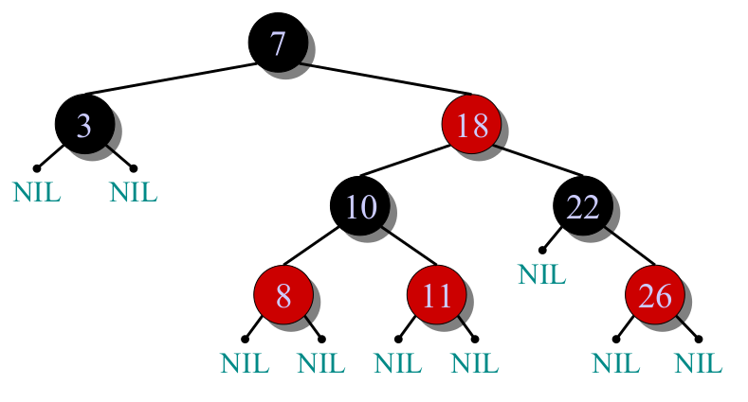
Importance of a Red-Black (RB) Tree
A Binary Search Tree (BST) supports basic operations like SEARCH, INSERT, DELETE, PREDECESSOR, SUCCESSOR, MINIMUM and MAXIMUM in O(h) time
A RB Tree guarantees:
h ≤ 2 log (n+1)
Thus all RB Tree operations are guaranteed to be O(log(n))
RB Node Attributes
struct rb_node {
color … enum {RED / BLACK}
key … Any comparable (< / = / >) data type
left_child … struct rb_node *
right_child … struct rb_node *
parent … struct rb_node *
}
Concept of Black Height
For a Node n:
Number of black nodes on any simple path from (but not including node n) to any leaf (NIL)
Denoted by bh(n)
For a RB Tree:
bh( <root node> )
RB Tree Properties
A RB Tree is a BST by definition with exactly 2 children for internal nodes and exactly 0 children for NIL (sentinel) nodes
Every node is either RED or BLACK
The root is BLACK
Every leaf (NIL) is BLACK
A RED node must have a BLACK parent
All simple paths from a node to NIL contains the same number of BLACK nodes
Since a RB Tree is inherently a BST, the leftmost node will always be the one with minimum value of key

Slide 4
References:
[1] https://ocw.mit.edu/courses/electrical-engineering-and-computer-science/6-046j-introduction-to-algorithms-sma-5503-fall-2005/video-lectures/lecture-10-red-black-trees-rotations-insertions-deletions/#vid_transcript
[2] http://web.mit.edu/~emin/Desktop/ref_to_emin/www.old/source_code/red_black_tree/index.html

