Slide 1
EE516 : Project 1
Gaurav Kalra
(Student ID: 2016 45 93)
gvkalra@kaist.ac.kr

Slide 2
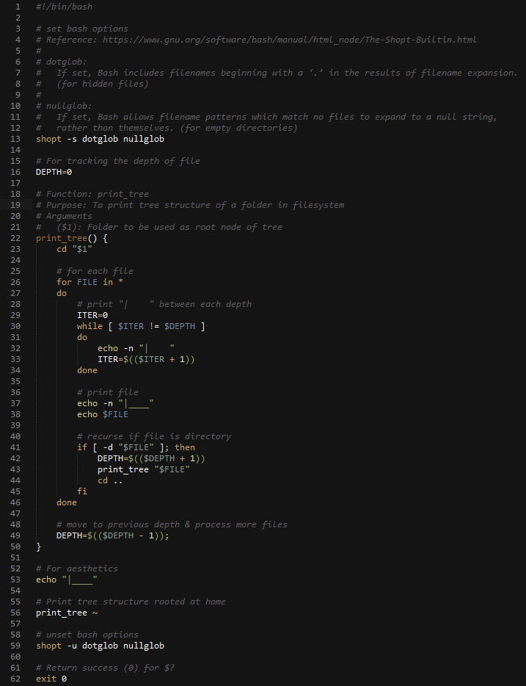
Task 1: Tree Script
Write a bash shell script that shows tree structure of the directories and files included in your own home directory.
1
2
3
4
5
6
7
Figure 1: Source code of Tree Script with Key Points highlighted

Slide 3
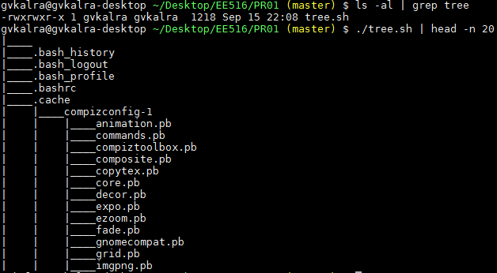
Figure 2: Sample output of executing Tree Script stripped to 20 lines
The core of tree.sh is implemented as a recursive function print_tree(), which keeps track of the depth of a sub-directory using DEPTH variable.
Bash options dotglob and nullglob are necessary to be set for enabling for FILE in * loop iterate on hidden files & reporting contents of an empty directory as null string respectively.
It is also important to double quote $1 and $FILE since the filenames may contain spaces, in which case print_tree() will treat one filename as multiple arguments.

Slide 4
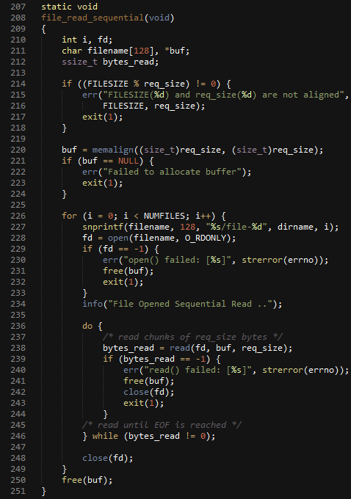
Task 2: Simple C Program
Implement Sequential Read, Random Write, Random Read for File System Benchmarking
1
2
Figure 3: Source code of Sequential Read with Key Points highlighted
The check for FILESIZE % req_size to be zero is added as a sanity measure for invalid inputs.
For sequential read(), I try to read req_size bytes of data in a while loop until EOF is reached.

Slide 5
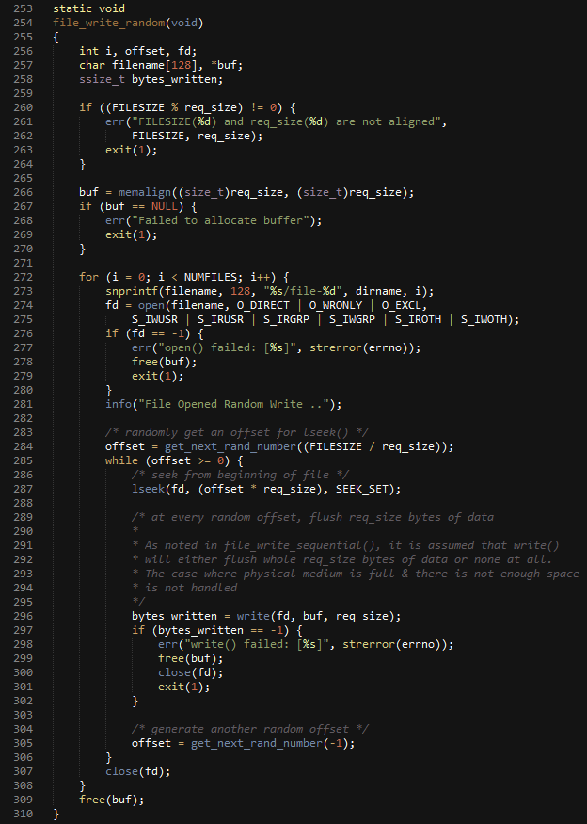
1
2
Figure 4: Source code of Random Write with Key Points highlighted
For random write(), I generate a unique random number, lseek() to the random offset & try to write req_size bytes of data until random number pool is exhausted (size of file becomes FILESIZE).

Slide 6
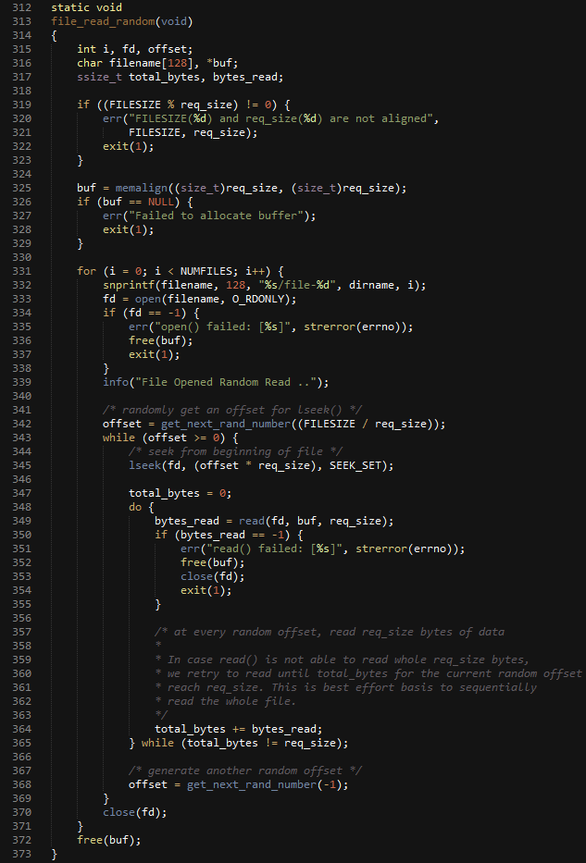
1
2
Figure 5: Source code of Random Read with Key Points highlighted

Slide 7
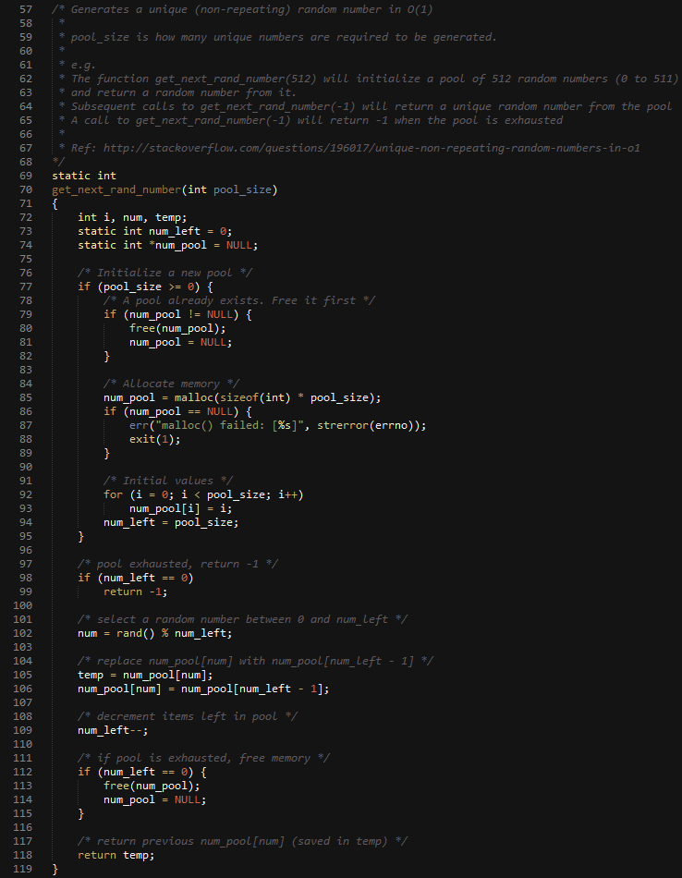
1
2
3
4
Figure 6: Random Number Generator with Key Points highlighted

Slide 8
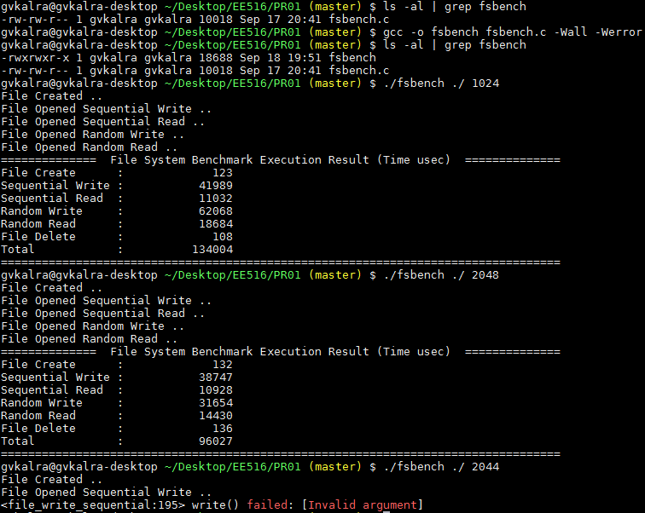
Figure 7: Output of compiling & executing File System benchmark
Please notice that ./fsbench ./ 2044 fails because current file offset, buffer, bytes to be written are not aligned in file_write_sequential(). Subsequent executions of fsbench will as well fail until “rm -f file-*” is executed in the current directory. This is a known & easy to fix bug. However, it is outside the purview of current assignment.
Notice that there are no warnings (source is compiled with -Wall -Werror flags).

Slide 9
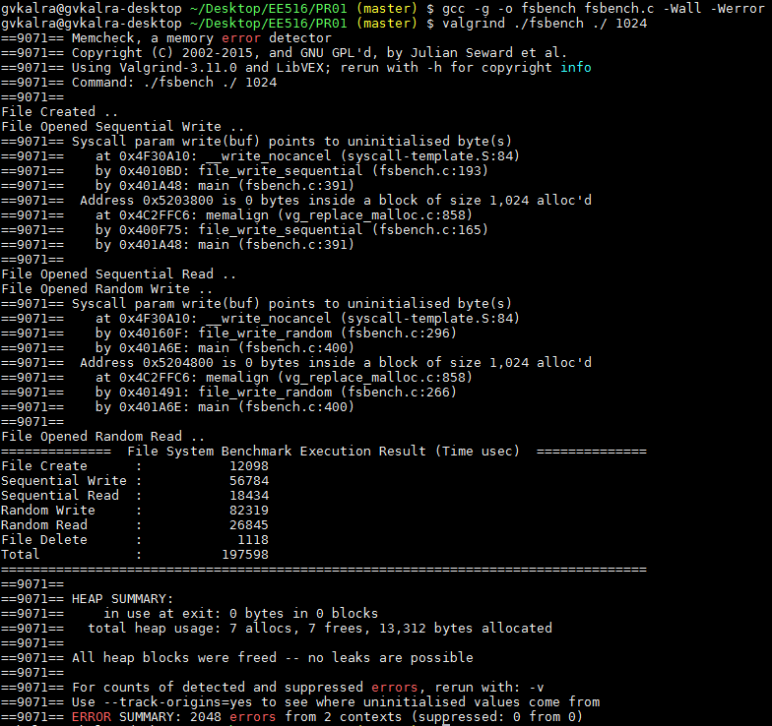
Figure 8: Output of compiling & executing File System benchmark with valgrind for checking heap memory leaks
Please notice “HEAP SUMMARY” which says “All heap blocks were freed – no leaks are possible”

Slide 10
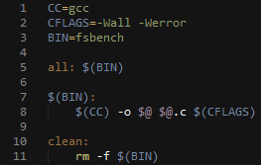
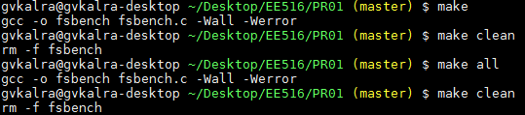
Task 3: Makefile
Write a Makefile for the source code of Task 2
1
2
Figure 9: Makefile of Task 2 with Key Points highlighted
Figure 10: Sample output of Makefile targets

