Slide 1
EE516 : Project 4
Gaurav Kalra
(Student ID: 2016 45 93)
gvkalra@kaist.ac.kr

Slide 2
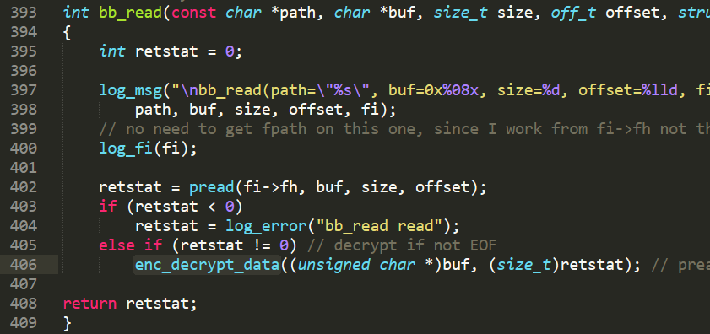
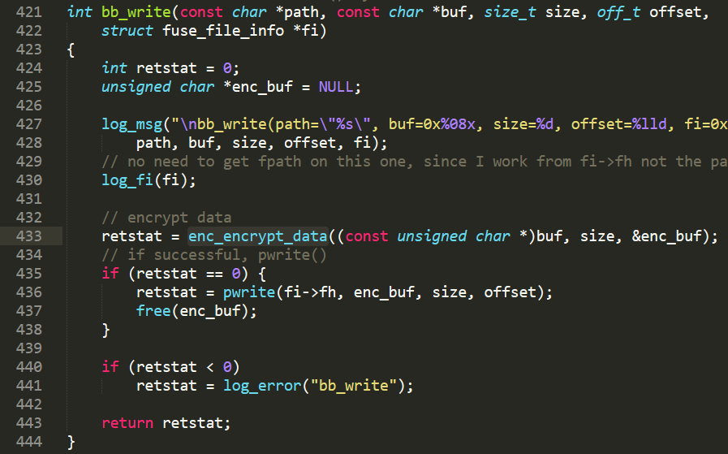
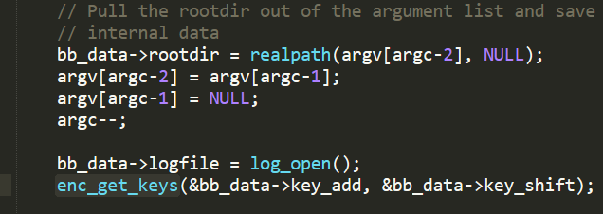
Task 1: Data encryption on FUSE file system
Figure 1: bb_read(), decrypt data after pread()
Figure 2: bb_write(), encrypt data before pwrite()
Figure 3: main(), save add/shift keys in BB_DATA

Slide 3
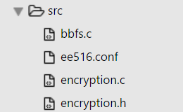
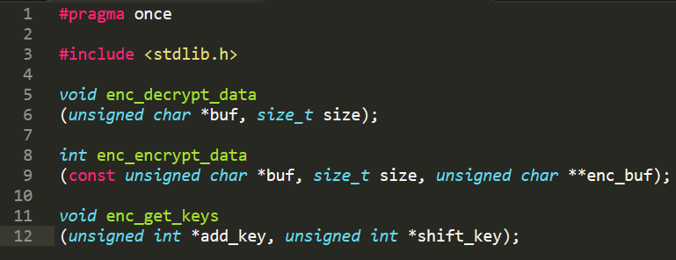
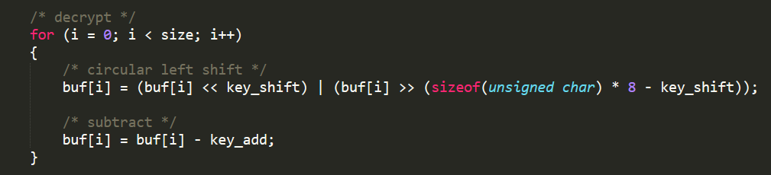
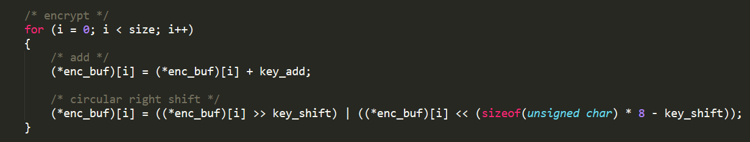
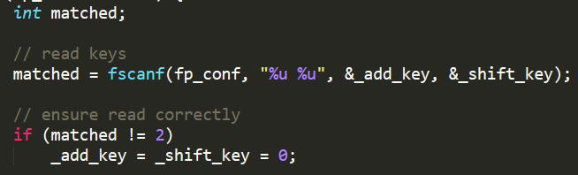
Figure 4: APIs of encryption module (encryption.h)
Figure 5: enc_decrypt_data() logic, circular left shift + subtraction
Figure 6: enc_encrypt_data() logic, addition + circular right shift
Figure 7: enc_get_keys() logic, reading add + shift keys from configuration file

Slide 4
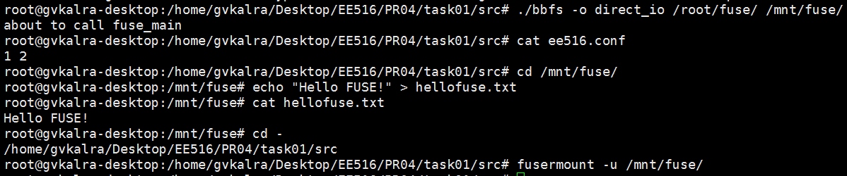
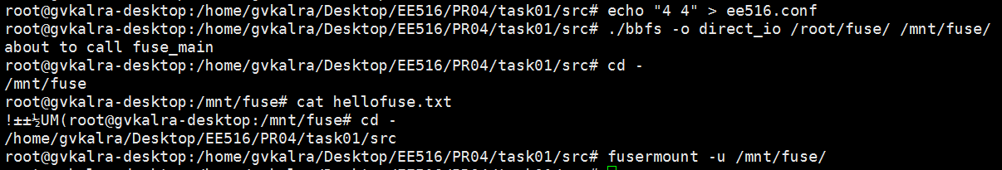
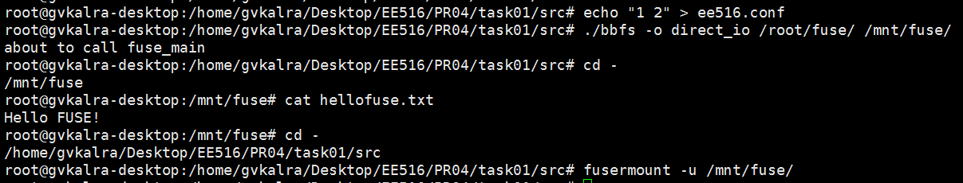
Figure 8: Writing & Reading “Hello FUSE!” to hellofuse.txt
add_key (1) and shift_key (2)
Figure 9: Reading hellofuse.txt
add_key (4) and shift_key (4)
Figure 10: Reading hellofuse.txt
add_key (1) and shift_key (2)

Slide 5
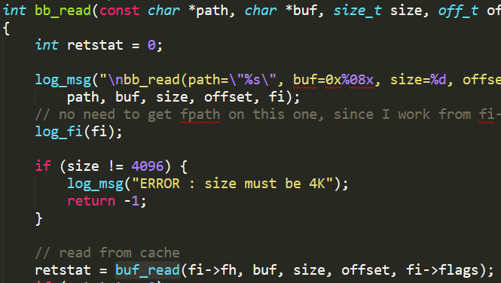
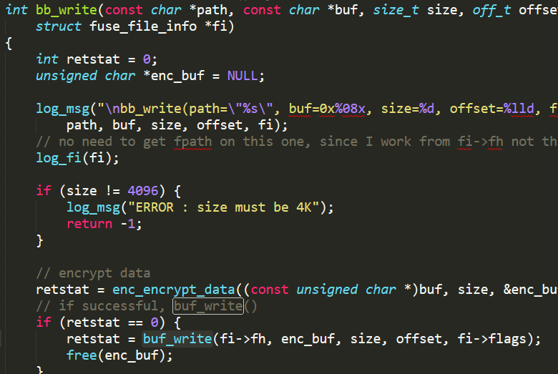
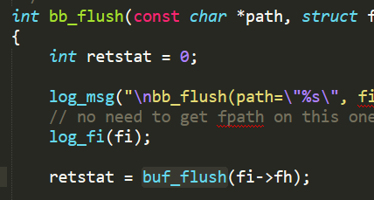

Task 2: Buffer cache implementation on FUSE file system
Figure 1: bb_read(), buffered read buf_read()
Figure 2: bb_write(), buffered write buf_write()
Figure 4: main(), reading/saving buffer policy in BB_DATA
Figure 3: bb_flush(), flushing dirty data with buf_flush()

Slide 6
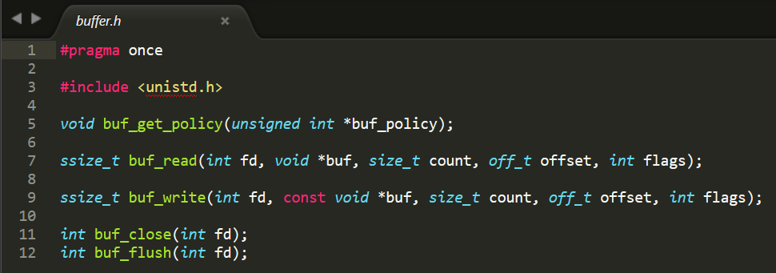
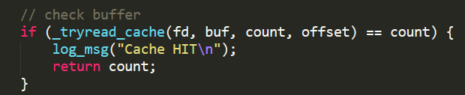
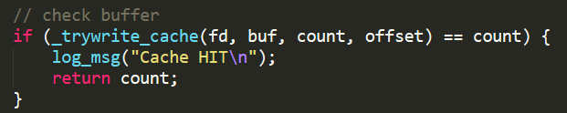
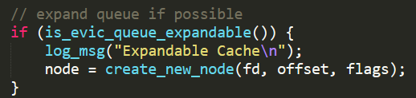
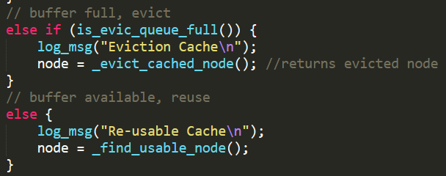
Figure 5: APIs of cache buffer module (buffer.h)
Key Idea:
0 | 1 | 2 | 3 | 4 | .. | .. | .. | .. | 1279
chunk_array consists of 1280 elements, each of which is 4KB in size
fd, offset, flags, chunk_index
fd, offset, flags, chunk_index
fd, offset, flags, chunk_index
…, …, …, …, …
fd, offset, flags, chunk_index
Double-Linked list of eviction_node, pointing to a chunk_index of chunk_array
occupied_chunks
total_chunks
max_chunks = 1280
front
rear
eviction_queue
For each bb_read() / bb_write():
Try reading (or writing) from (or to) cache
If cache miss, try expanding eviction_queue
If queue is at it’s maximum limit (1280), try utilizing an existing eviction_node which might have been flushed to disk, thereby available for re-utilization. In case there is no such node available, run eviction algorithm.

Slide 7
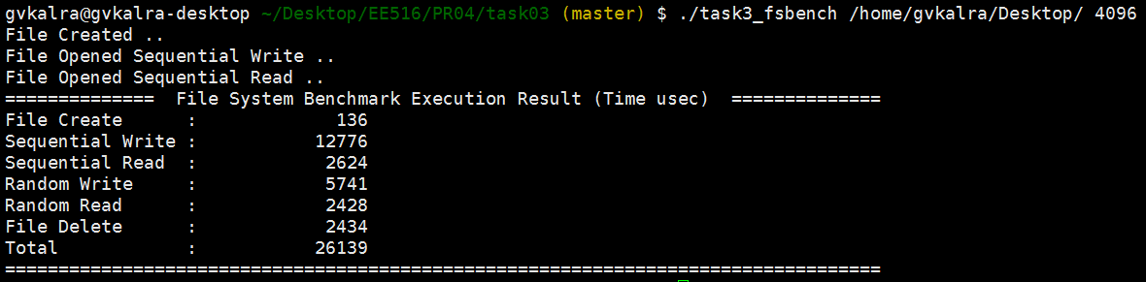
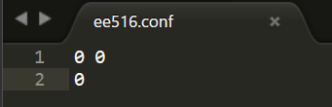
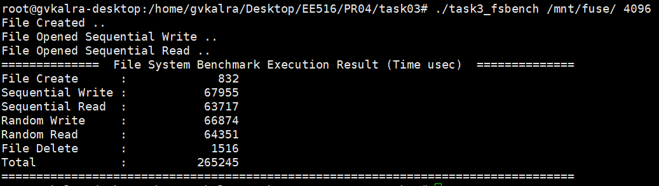
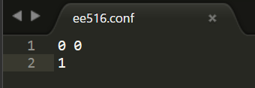
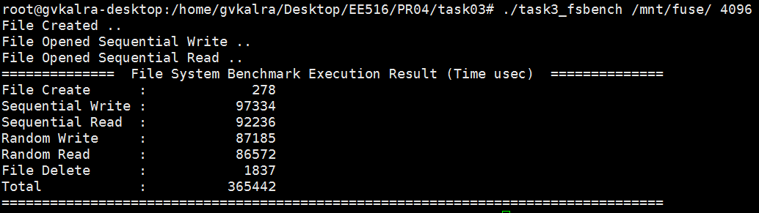
Task 3: File system performance evaluation
Figure 1: Current Linux file system
Figure 2: FUSE with no encryption and no buffer
Figure 3: FUSE with no encryption and random eviction buffer

Slide 8
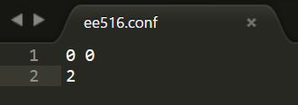
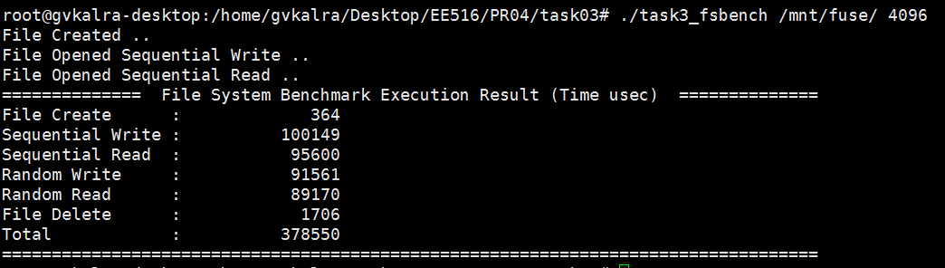
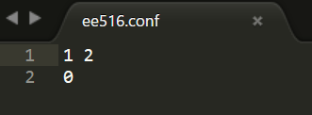
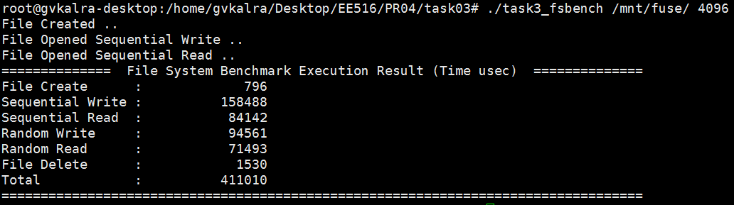
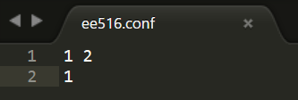
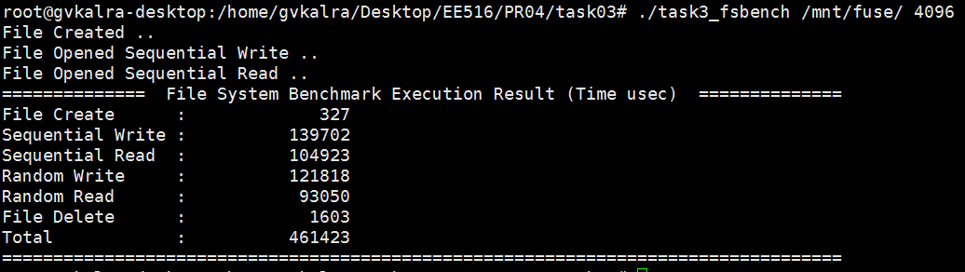
Figure 4: FUSE with no encryption and LRU buffer
Figure 5: FUSE with encryption and no buffer
Figure 6: FUSE with encryption and random eviction buffer

Slide 9
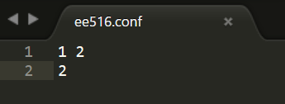
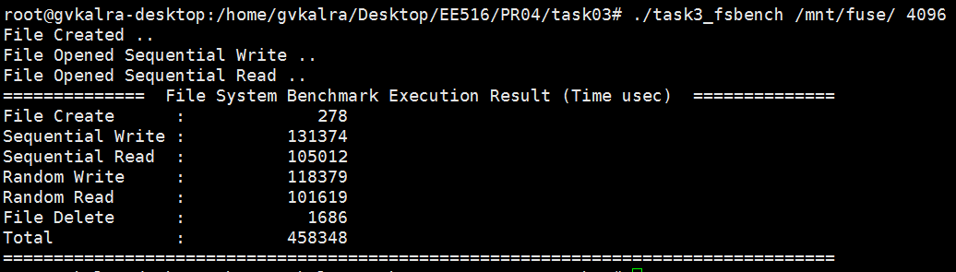
Figure 7: FUSE with encryption and LRU buffer
Legend
FUSE with:
No encryption and no buffer
No encryption and random eviction buffer
No encryption and LRU buffer
Encryption and no buffer
Encryption and random eviction buffer
Encryption and LRU buffer
Notes:
Time is in usec and data is averaged over 5 executions.

Slide 12
Discussion:
The total execution time has the following order:
No encryption and no buffer (fastest)
<
Encryption and no buffer
<
No encryption and LRU buffer
<
No encryption and random eviction buffer
<
Encryption and random eviction buffer
< (almost same)
Encryption and LRU buffer (slowest)
Why?
Any buffering algorithm is as good as the workload it targets. The benchmarking program doesn’t have a predefined workload which makes buffering an overhead.
The number of cache misses far outweigh cache hits in the benchmarking workload.

Slide 13
Q1. Pros. and Cons. of FUSE file system (against file system in kernel space)
Pros:
It lets non-privileged users create their own file systems without editing kernel code.
FUSE module provides only a "bridge" to the actual kernel interfaces.
It is particularly useful for writing virtual file systems. Unlike traditional file systems that essentially save data to, and retrieve data from, mass storage, virtual filesystems do not actually store data themselves. They act as a view or translation of an existing file system or storage device.
If a FUSE filesystem driver crashes, it won't panic your kernel: you'll see nothing worse than I/O errors in applications that were accessing the filesystem.
They can be programmed very quickly
Cons:
They're somewhat slower in comparison to file system in kernel space. This is mainly because of more context switches between user-space and kernel-space
It is not robust because a crashing / killed fuse process by mistake can take away the whole filesystem
They cannot be used on a boot media.
References:
https://en.wikipedia.org/wiki/Filesystem_in_Userspace
http://unix.stackexchange.com/a/4170
Q2. In our encryption, can different key pairs give same encrypted / decrypted data? Why?
Yes.
Encryption = Addition + Circular right shift
Decryption = Circular left shift + Subtraction
Let a data byte be 0xFF
Let one (add, shift) pair be (1, 2) and another be (1, 4)
1.1 Encryption
0xFF + 1 = 0x00 (since carry bit is lost in our encryption scheme)
(0x00 >> 2)_{circular} = 0x00
1.2 Decryption
(0x00 << 2)_{circular} = 0x00
0x00 - 1 = 0xFF
2.1 Encryption
0xFF + 1 = 0x00
(0x00 >> 4)_{circular} = 0x00 (same as 1.1)
2.2 Decryption
(0x00 << 4)_{circular} = 0x00
0x00 - 1 = 0xFF (same as 1.2)
Q3. List several encryption methods and analyze them.
To provide strong enough encryption it is necessary to encrypt as much data together in a chaining fashion that includes bit substitutions and transpositions, such that each byte encrypted depends on some of the prior ones. However, doing so would mean that each time we need to decrypt a single byte anywhere in the file, all prior bytes would have to be decrypted as well -- a major performance problem. So, in general, fixed-length block ciphers are used in file system encryption. e.g.
1. DES (too big and slow)
2. Blowfish (fast, compact, simple)

Slide 14
Cryptfs (A Stackable Vnode Level Encryption File System) uses Blowfish with Cipher Block Chaining (CBC) encryption mode for each block (4-8KB depending on page size) to be encrypted.
References:
http://www.fsl.cs.sunysb.edu/docs/cryptfs/node2.html#SECTION00022000000000000000
https://en.wikipedia.org/wiki/Blowfish_(cipher)
https://en.wikipedia.org/wiki/Data_Encryption_Standard
https://en.wikipedia.org/wiki/Block_cipher_mode_of_operation#CBC
Q4. Why performances of Linux and FUSE file systems are different?
A Linux file system (e.g. ext4) runs completely inside a kernel, whereas part of a FUSE file system executes within user-space. This means to perform an operation using Linux file system, the user space process needs to invoke a single system call, which gets handled by the implementation of VFS inside the kernel.
However, in case of FUSE file system, VFS delegates the handling responsibility to FUSE, which further delegates it to a user-space program. In brief, FUSE introduces an extra layer of context switching between user and kernel space, thus contributing to degraded performance.
References:
https://github.com/libfuse/libfuse#about
Q5. Why performances of different eviction algorithms are different? In which cases each eviction algorithm can have advantage?
Performance of an eviction algorithm depends on the locality of workload (data to read and write). That is why performance of different eviction algorithms are different under various scenarios and there is no one eviction algorithm suitable for all types of workloads. e.g.
Least Recently Used:
It evicts the least recently used victim. In other words, LRU responds quickly to what has happened recently. This is advantageous for most types of user activities. However, this general prediction may not be valid for all types of workloads. e.g although LRU responds to repeated requests quickly, it gets burdened by long scans since we need to maintain aging information.
Random Eviction:
It chooses the victim of eviction randomly. In other words, it doesn't need to maintain aging information (unlike LRU). However, random workloads occur rarely in reality. Most memory, filesystem related workloads have a locality pattern and are not random. Random eviction may be better suited when there is no inherent information associated with access patterns, which is seldom (rare).

