Slide 1
EE516 : Homework 2
Gaurav Kalra
(Student ID: 2016 45 93)
gvkalra@kaist.ac.kr

Slide 2

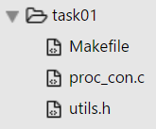
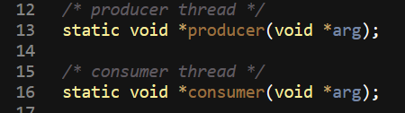
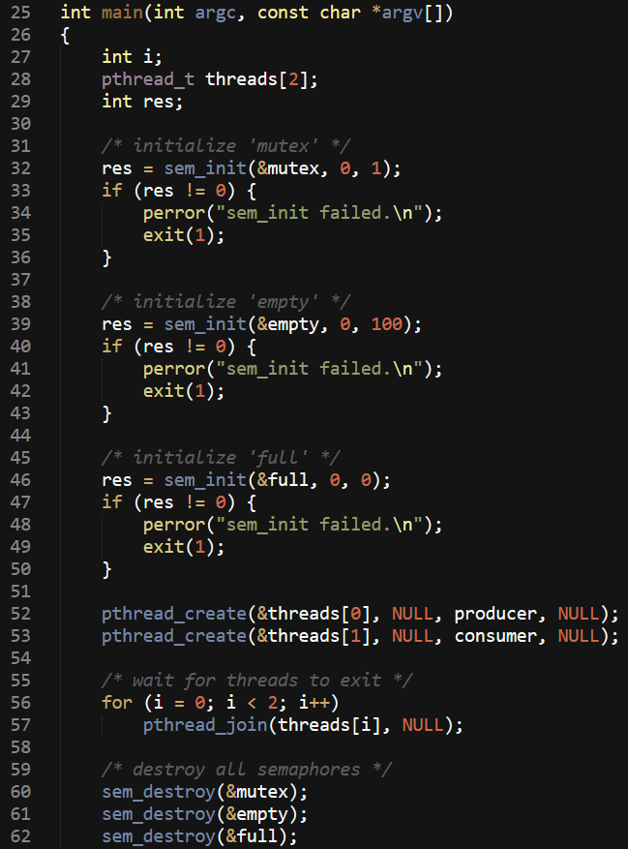
Problem 1: Write code for producer & consumer problem
Assume that there is one producer and one consumer, where each producer produces 100 items and each consumer consumes 100 items.
Figure 1: Spawning producer-consumer threads, setting up semaphores

Slide 3
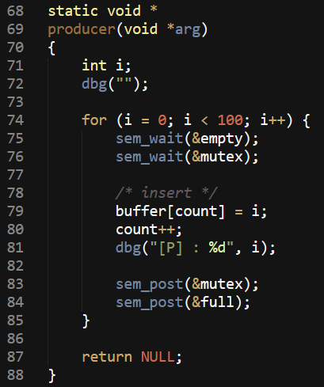
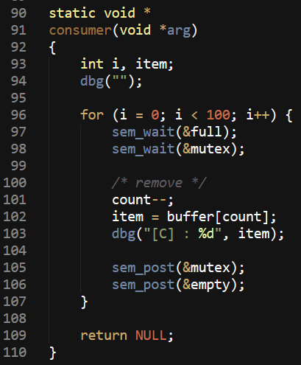
Figure 2: Producer & Consumer synchronizing access for shared data
sem_wait(&variable) will atomically decrement (lock) ‘variable’
if ‘variable’ = 0, it will wait (block) until the value becomes > 0
else, it will simply decrement ‘variable’ atomically
sem_post(&variable) will atomically increment (unlock) ‘variable’
if ‘variable’ consequently becomes > 0, then another task blocked
in sem_wait() will be woken up & proceed to decrement (lock)
‘variable’

Slide 4
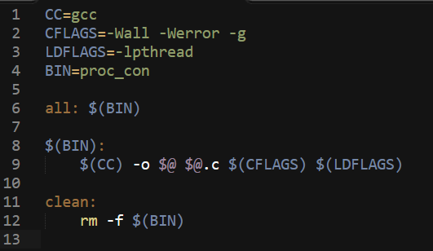
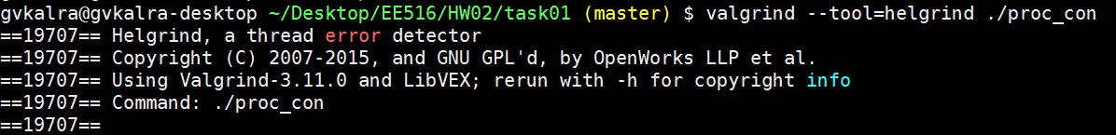
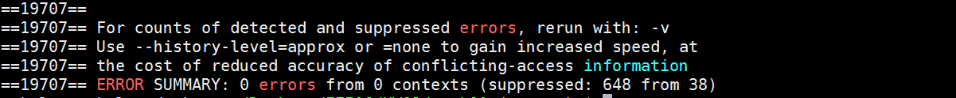
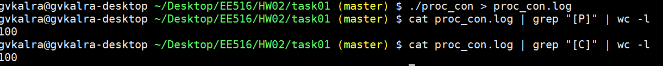
For debugging symbols
Figure 3: Makefile
Figure 4: Verification using “helgrind”
Figure 5: Verification using logs (P & C must be 100 each)

Slide 5
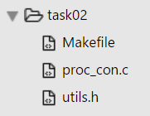

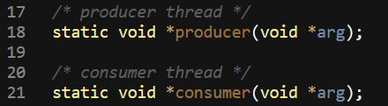
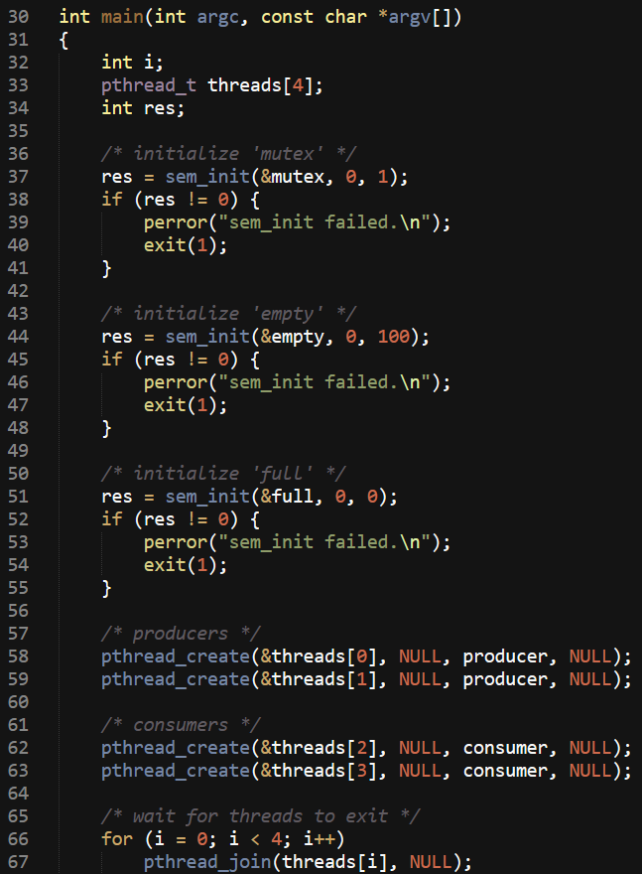
Problem 2: Write code for producer & consumer problem
Assume that there are two producers and each one, produces 100 items.
And there are two consumers and each one, consumes 100 items.
Figure 6: Spawning producer-consumer threads, setting up semaphores

Slide 6
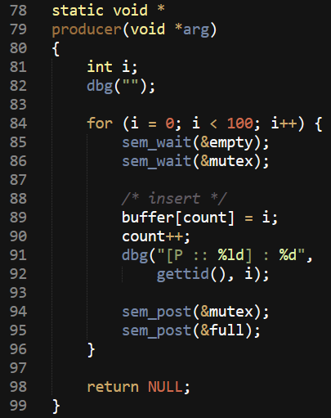
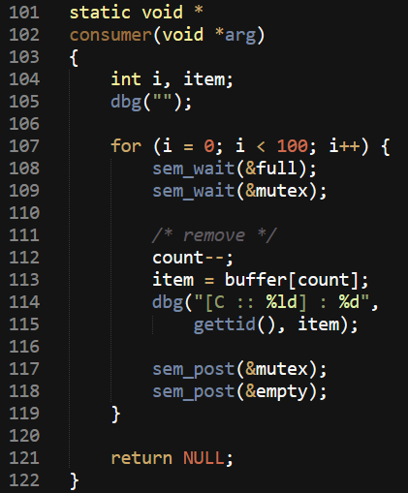

Figure 7: Producer & Consumer synchronizing access for shared data
Figure 8: gettid() for fetching thread-ID
sem_wait(&variable) will atomically decrement (lock) ‘variable’
if ‘variable’ = 0, it will wait (block) until the value becomes > 0
else, it will simply decrement ‘variable’ atomically
sem_post(&variable) will atomically increment (unlock) ‘variable’
if ‘variable’ consequently becomes > 0, then another task blocked
in sem_wait() will be woken up & proceed to decrement (lock)
‘variable’

Slide 7
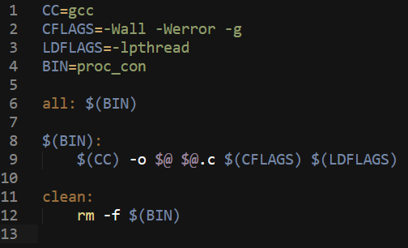
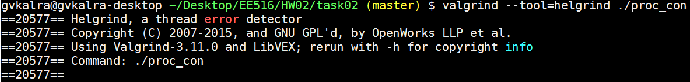
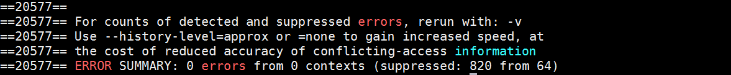
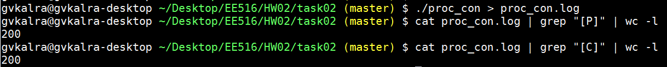
For debugging symbols
Figure 9: Makefile
Figure 10: Verification using “helgrind”
Figure 11: Verification using logs (P & C must be 200 each)

Slide 8
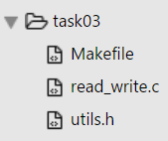
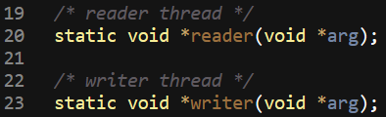
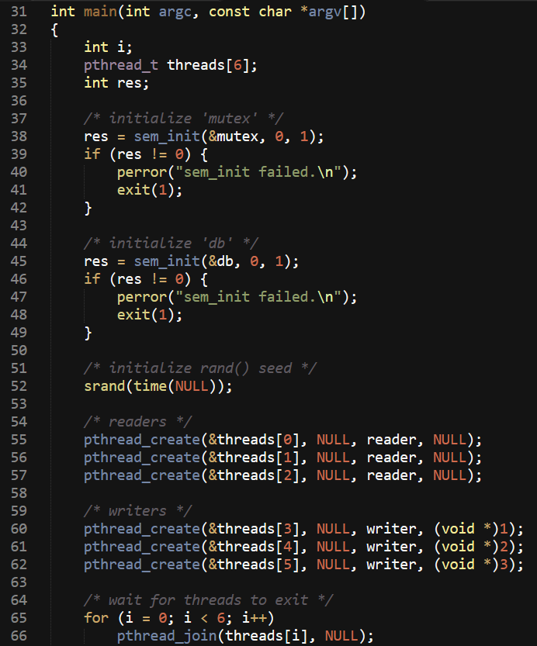
Problem 3: Write code for reader & writer problem
Assume that there are 3 readers and 3 writers, the size of database is only 1 byte, writer-i writes i to the database every 1 second, readers read database randomly
Figure 12: Spawning reader-writer threads, setting up semaphores

Slide 9
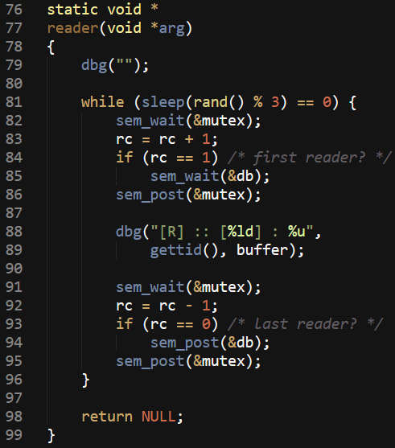
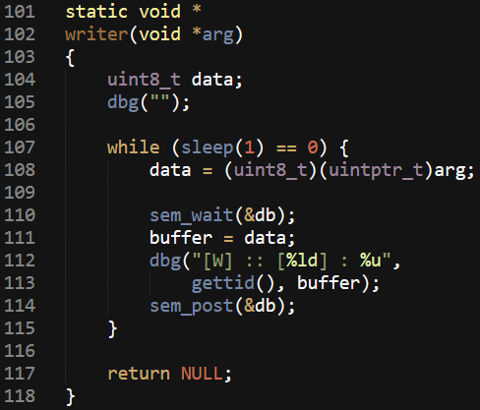

Figure 13: Reader & Writer synchronizing access for shared data
sem_wait(&variable) will atomically decrement (lock) ‘variable’
if ‘variable’ = 0, it will wait (block) until the value becomes > 0
else, it will simply decrement ‘variable’ atomically
sem_post(&variable) will atomically increment (unlock) ‘variable’
if ‘variable’ consequently becomes > 0, then another task blocked
in sem_wait() will be woken up & proceed to decrement (lock)
‘variable’
rand() is used to make the reader sleep() for random seconds (between 0 to 2).
At any given time, there can be many ‘readers’ reading the database. However, during such times, database access is not given to any ‘writer’. Consequently, if database is locked for writing, no reader is allowed access to the database.

Slide 10
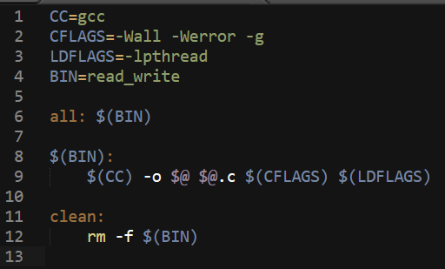
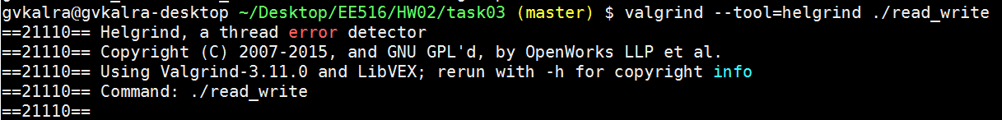
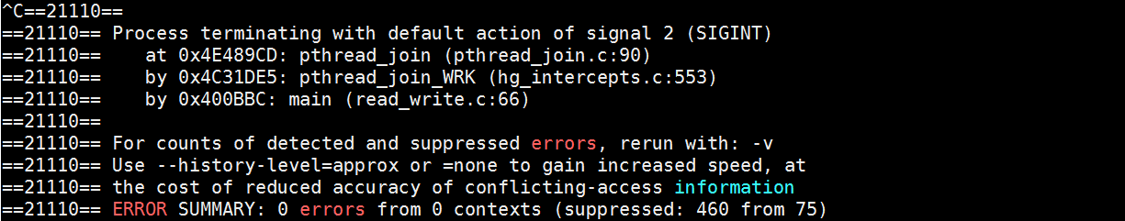
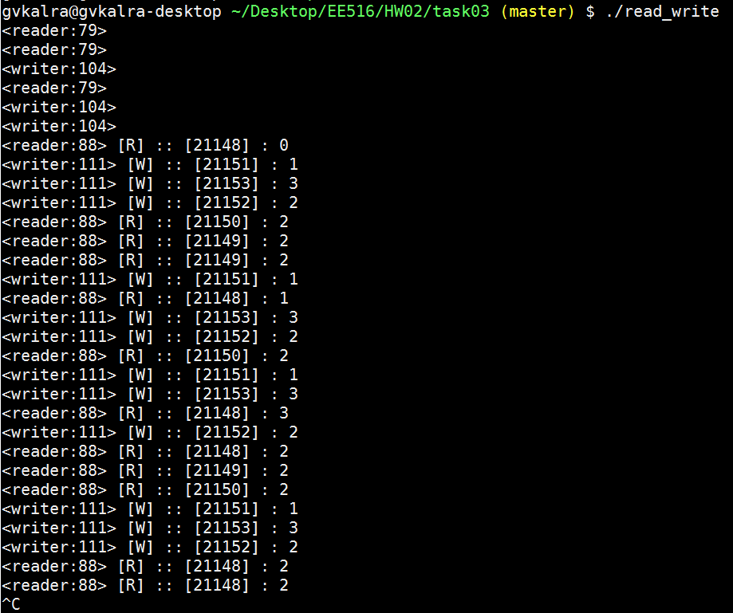
For debugging symbols
Figure 14: Makefile
Figure 15: Verification using “helgrind”
1
It can be easily seen that the last value
written by a writer is the value read by
consequent readers in all 7 blocks.
2
3
Figure 16: Verification using logs
4
5
6
7

