Slide 1
EE516 : Project 2
Gaurav Kalra
(Student ID: 2016 45 93)
gvkalra@kaist.ac.kr

Slide 2
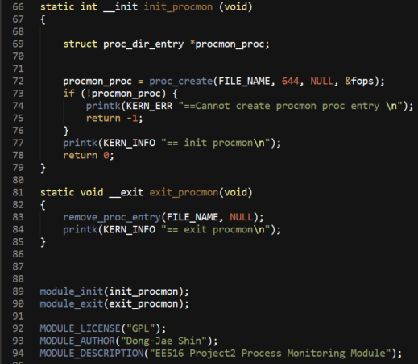
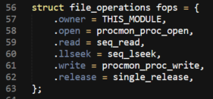
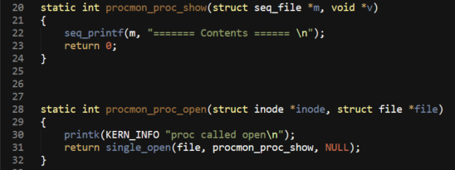
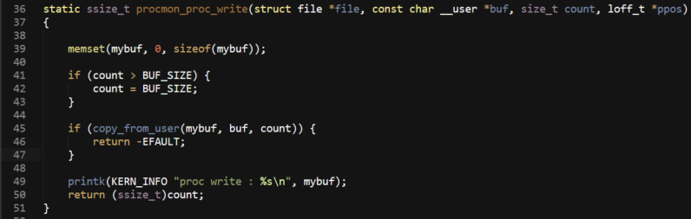
Task 1: Analyze the given skeleton program
Find the functions that you do not know and explain the operations of those functions
proc_create(): creates a file entry in /proc directory
parameters:
name – filename which will show up in proc directory
mode – file creation mode (w,r,x for user,group,others)
parent directory – pointer to parent directory in /proc where this file will be created (we used NULL to indicate /proc/ directory)
file operations – pointer to file operations structure
remove_proc_entry(): remove the file entry from /proc directory
parameters:
name – filename as in /proc
parent – parent dir pointer (same NULL here)
1
2
Figure 1: Creating / Removing a file from procfs
seq_read(): read method for sequential files
seq_lseek(): llseek method for sequential files
single_release(): free the structures associated with sequential files
The parameters for these APIs are compatible with respective VFS file operations. And thus can be used as drop-in replacement so that we do not need to write our own implementation.
1
2
Figure 2: Sequence File APIs for VFS file operations
seq_printf(): It works like printk() for proc files.
The first argument must be the sequence file.
single_open(): It creates and opens a new file
descriptor for sequence files.
parameters:
file – The file structure from VFS
show – Call-back for printing data in proc filesystem
data – Call-back data (NULL in our case)
1
2
Figure 3: Using Sequence Files for displaying contents of procfs

Slide 3
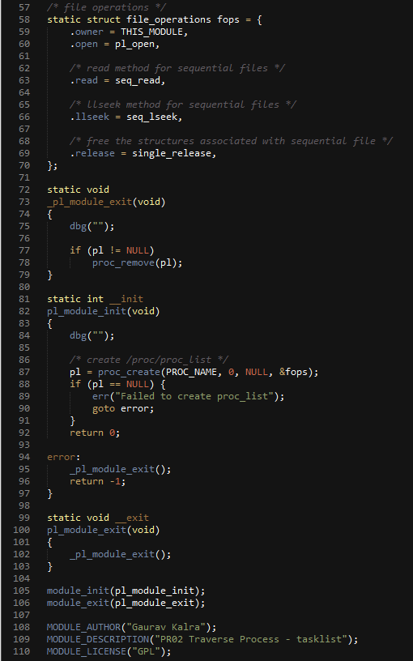
Task 2: Traverse Process - tasklist
Print every task’s PID and Process Name in your proc file system
1
2
3
Figure 4: Module Initialization / Clean-up (refer task01 for details)

Slide 4
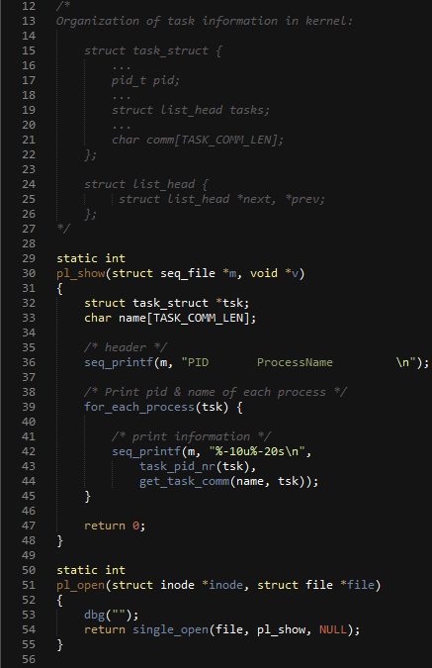
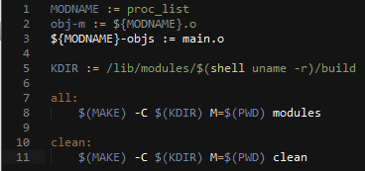
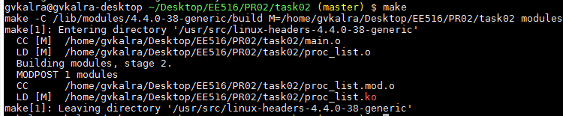
1
Figure 5: Logic for printing PID & Process Name
Figure 6: Makefile (no warnings)
Figure 7: Verification (proc_list & ps -ef both output 290 processes)

Slide 5
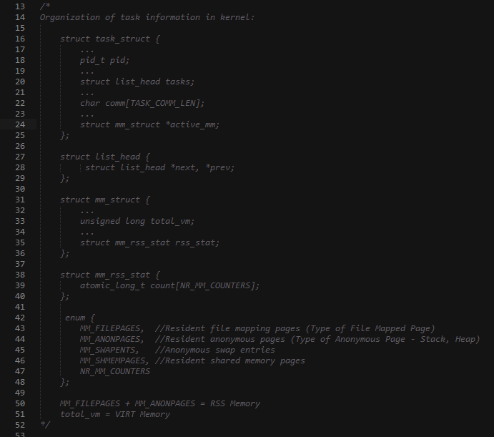
Task 3: per Process Memory Usage
Print every task’s VIRT and RSS Memory Size
Figure 8: Organization of VIRT & RSS in task_struct

Slide 6
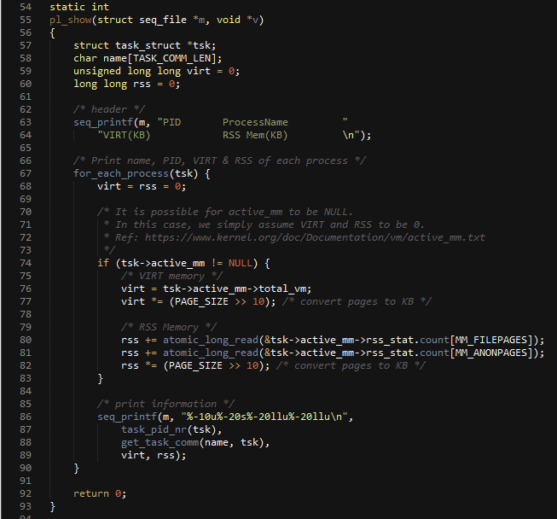
1
2
3
Figure 9: Logic for calculating and printing VIRT, RSS

Slide 7
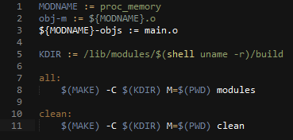
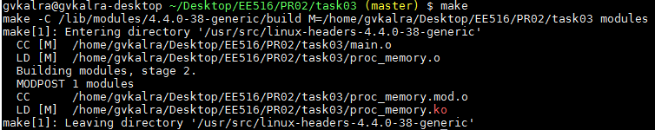
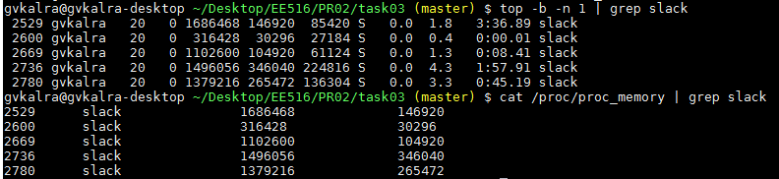
Figure 10: Makefile (no warnings)
2
1
Figure 11: Verification (sublime_text)
1
2
Figure 12: Verification (slack)

Slide 8
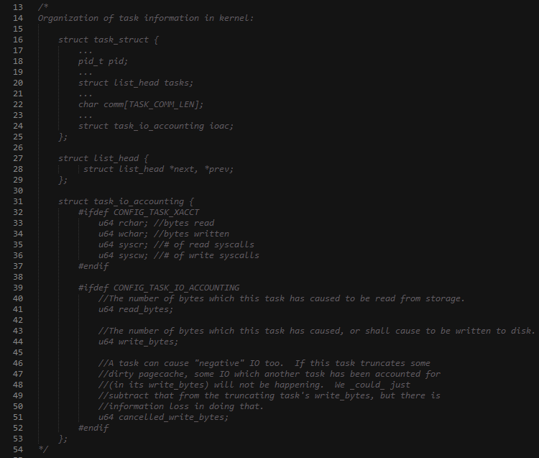
Task 4: per Process I/O Usage
Print every task’s I/O usage
Figure 13: Organization of I/O data in task_struct

Slide 9
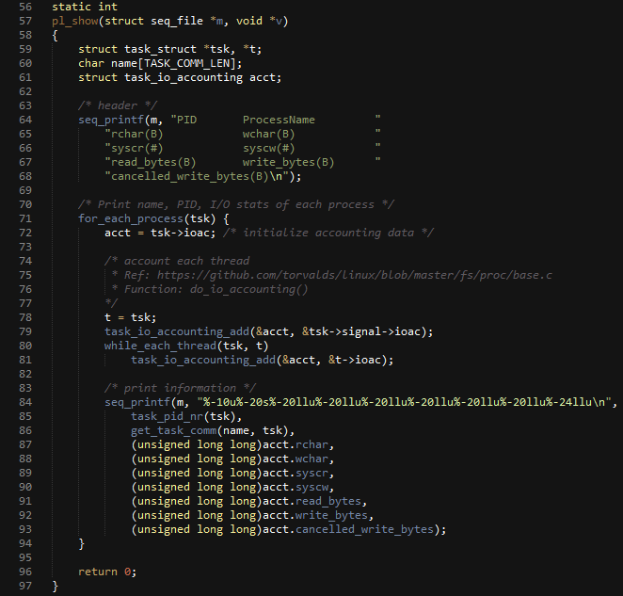
1
2
3
Figure 14: Logic for calculating and printing I/O information

Slide 10
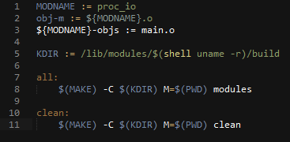
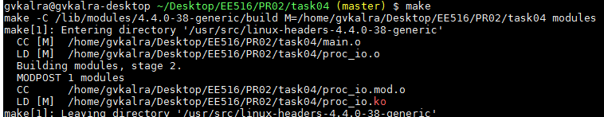
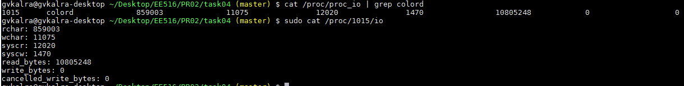
Figure 15: Makefile (no warnings)
Figure 16: Verification (colord)

Slide 11
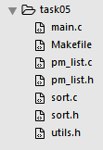
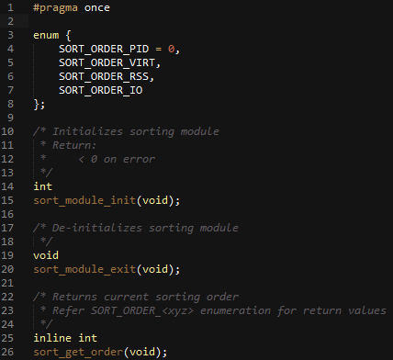
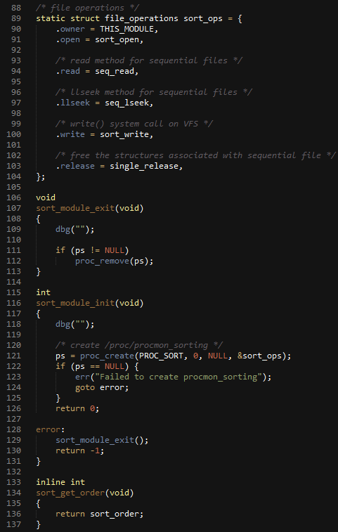
Task 5: Sorting Features
Create a process monitoring tool with sorting feature
The task is divided into 2 modules:
Sorting Module – It is used to view or update current sorting order
PM (procmon) Module – It is used to create process monitoring
1
2
3
Figure 17: Sorting Module APIs exposed to PM module

Slide 12
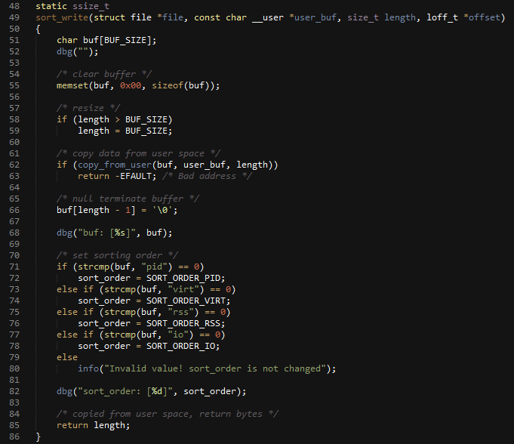
1
2
3
Figure 18: Sorting Module write() file operation to update sort_order

Slide 13
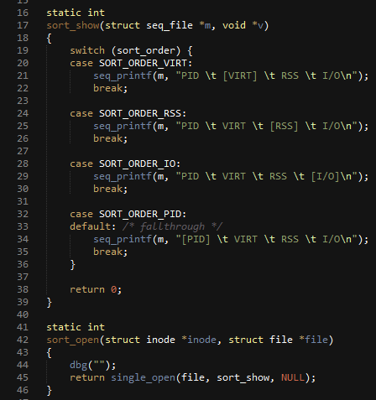
2
1
Figure 19: Sorting Module open() file operation

Slide 14
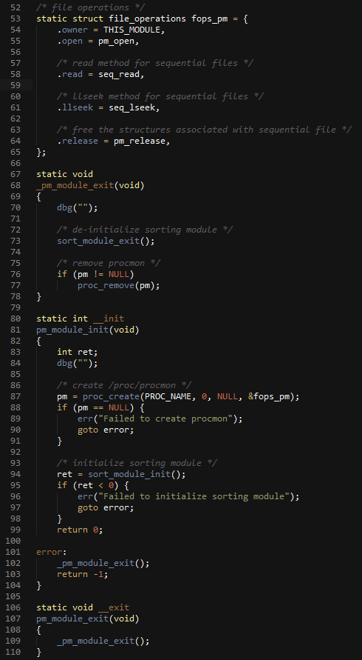
Figure 20: PM Module init / exit
(Sorting module is init/exit by PM module)

Slide 15
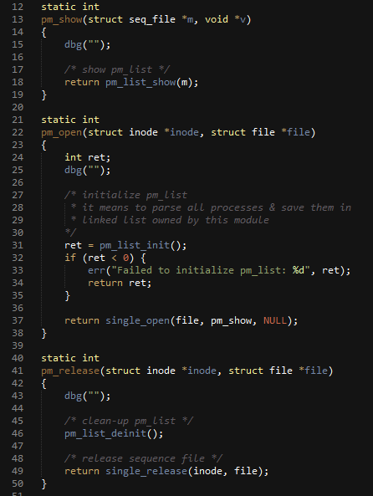
Figure 21: PM Module open() and release()
(pm_list is PM Module’s data structure discussed in next page)

Slide 16
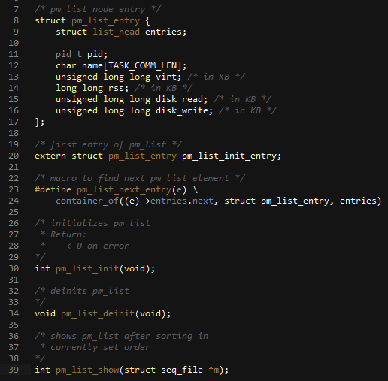
Figure 22: pm_list data structure & APIs.
(Each API is discussed next)
Notes:
1. The design of this data structure closely resembles
task_struct from the Linux Kernel.
2. Reference: https://github.com/torvalds/linux/blob/master/init/init_task.c
3. “struct list_head” is the kernel way of providing linked lists, which has been referred from https://github.com/torvalds/linux/blob/master/include/linux/list.h

Slide 17
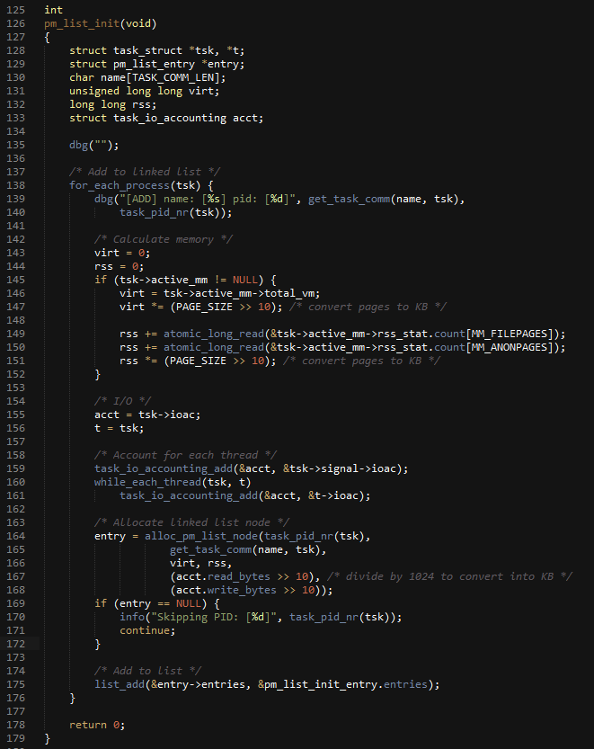
1
2
3
4
5
Figure 23: pm_list_init() – API for creating & initializing a PM list

Slide 18
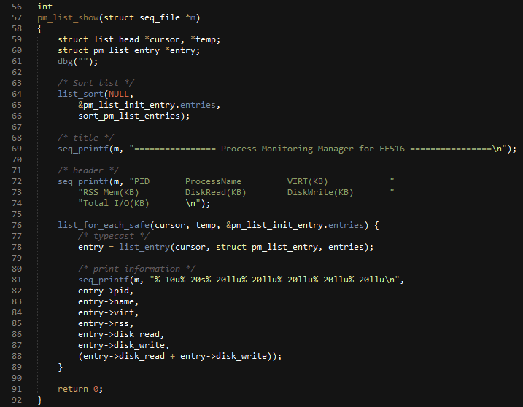
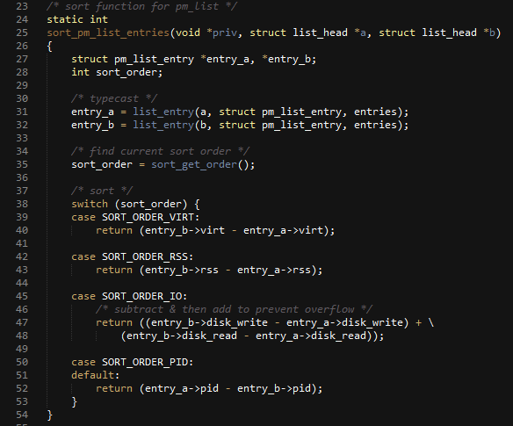
1
2
1
2
Figure 24: pm_list_show() – API for displaying PM list in sorted order

Slide 19
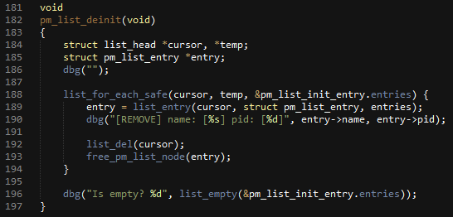
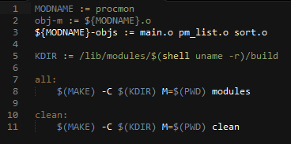
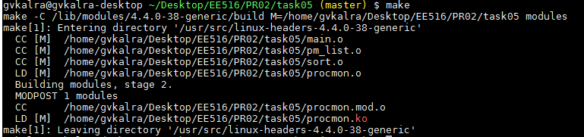
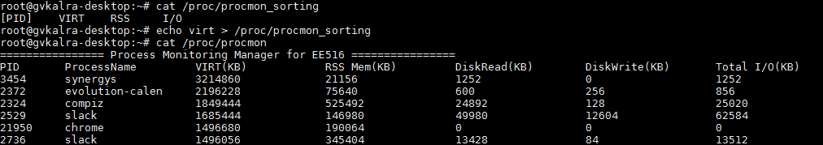
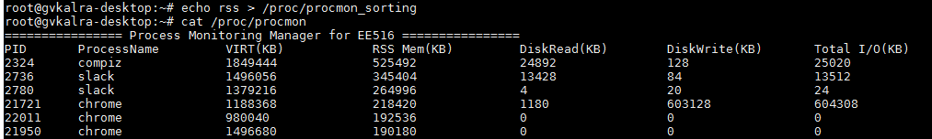
1
2
Figure 25: pm_list_deinit() – API for freeing a PM list
Figure 26: Makefile (no warnings)
Figure 27: Verification (VIRT)
Figure 28: Verification (RSS)

Slide 20

Problem 1
Describe similarity and difference Process (Thread Group) and Thread in the Linux
In Linux, Processes & Threads are all represented by task_struct.
The pid field of task_struct is unique for every process & thread.
However, since POSIX mandates that all threads of a process should have the same ProcessID (as seen by the user), Linux uses “Thread Group ID” (TGID) to satisfy POSIX mandate.
A TGID is the PID of the thread that started the whole process.
Figure 29: pid/tgid in task_struct. Source: https://github.com/torvalds/linux/blob/master/include/linux/sched.h
In Linux, both processes & threads are created using clone() system call. The ‘flags’ passed to clone() specify the degree of data sharing. Threads in Linux have it’s own stack but shares Heap, BSS, Data and Text with other threads having same TGID.
The CFS (Completely Fair Scheduler) as used in Kernel doesn’t discriminate between a thread & a process. It works on “tasks” and is not aware of thread & process abstractions.

Slide 21
Problem 2
Use of copy_to_user / copy_from_user functions in proc filesystem
In Linux, user-space is separated from kernel-space in all aspects.
To arbitrate data between user / kernel space, Linux provides two functions:
copy_to_user: Copy data from kernel space to user space
copy_from_user: Copy data from user space to kernel space
A proc file system (procfs) is just another type of file system on top of Virtual File System (VFS) & thus applies the same rule of data exchange between user & kernel space.

