Slide 1
EE516 : Homework 3
Gaurav Kalra
(Student ID: 2016 45 93)
gvkalra@kaist.ac.kr

Slide 2
Problem 1: Explain the following functions
lseek(), unlink(), fchmod(), fchown(), link(), symlink(), readlink(), fstat(), readdir(), getcwd()
[1] lseek()
Reposition read/write file offset
[2] unlink()
delete a name and possibly the file it refers to
[3] fchmod()
change permissions of a file
[4] fchown()
change ownership of a file
[5] link()
make a new name for a file (hard link)
[6] symlink()
make a new name for a file (soft link)
[7] readlink()
read value of a symbolic link
[8] fstat()
get file status
[9] readdir()
read a directory
[10] getcwd()
get current working directory

Slide 3
References:
[1] http://man7.org/linux/man-pages/man2/lseek.2.html
[2] http://man7.org/linux/man-pages/man2/unlink.2.html
[3] http://man7.org/linux/man-pages/man2/fchmodat.2.html
[4] http://man7.org/linux/man-pages/man2/lchown.2.html
[5] http://man7.org/linux/man-pages/man2/link.2.html
[6] http://man7.org/linux/man-pages/man2/symlink.2.html
[7] http://man7.org/linux/man-pages/man2/readlink.2.html
[8] http://man7.org/linux/man-pages/man3/fstat.3p.html
[9] http://man7.org/linux/man-pages/man3/readdir.3.html
[10] http://man7.org/linux/man-pages/man2/getcwd.2.html

Slide 4

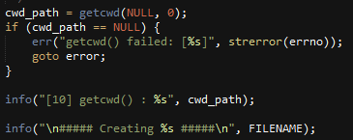
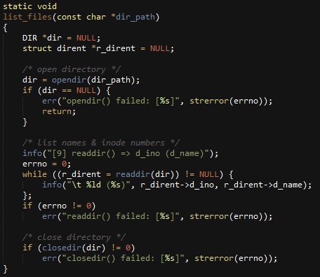
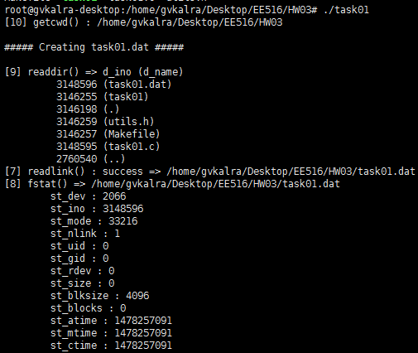
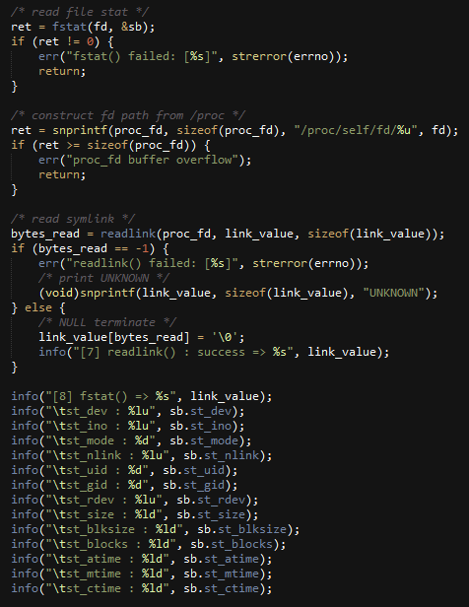
Problem 2: Make your own program using each red coloured functions
task01.dat is newly created.
Notice the following:
st_mode = 33216
inode = 3148596

Slide 5
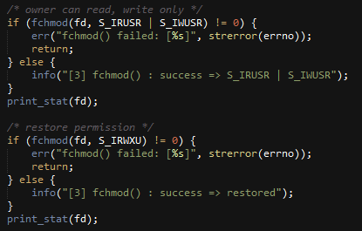
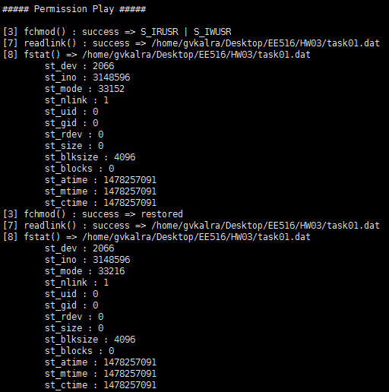
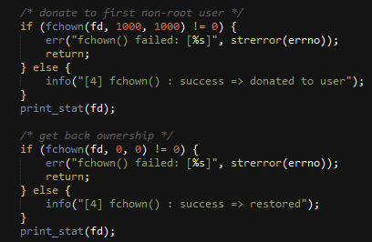
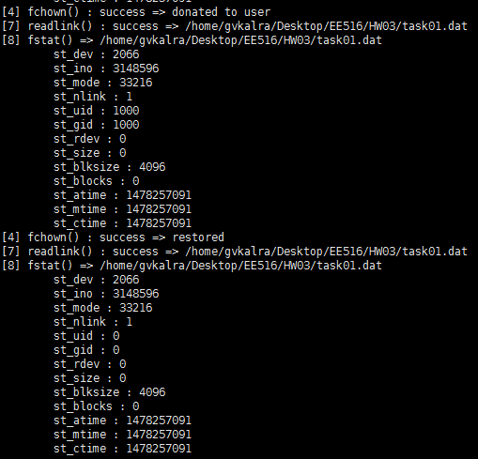
Notice the change in st_mode by using fchmod(). It changes from 33216 to 33152.
Notice the change in st_uid and st_gid by using fchown(). It changes from 0:0 (root:root) to 1000:1000 (user:user)
Note:
1000 is the first non-root user created in ubuntu

Slide 6
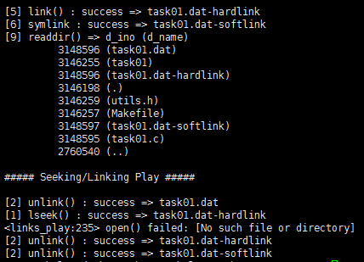
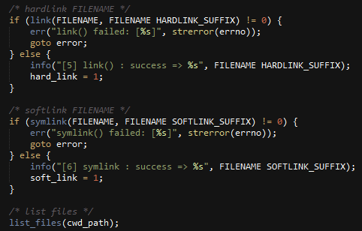
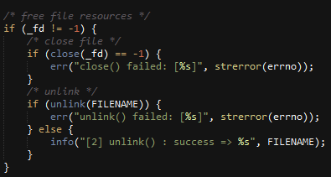
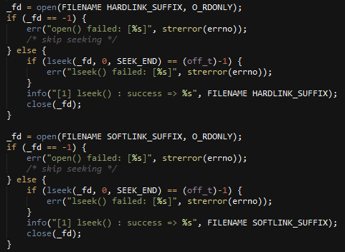
Notice the inode number for task01.dat and it’s soft (different) & hard links (same).
Notice that it is not possible to open() or lseek() softlink if task01.dat is removed.
However, hardlink is not affected by removal of task01.dat

Slide 7
Problem 3: Explain the following functions
malloc(), calloc(), realloc(), free()
[1] malloc()
Allocates un-initialized memory for given number of bytes
[2] calloc()
Allocates initialized (set to zero) memory for given number of elements of specified bytes each
[3] realloc()
Changes size of memory block for given pointer to specified bytes
[4] free()
Frees memory allocated by [1], [2] or [3]
References:
http://man7.org/linux/man-pages/man3/malloc.3.html

Slide 8
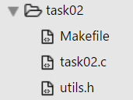
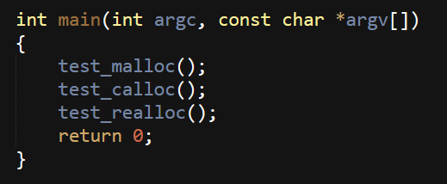
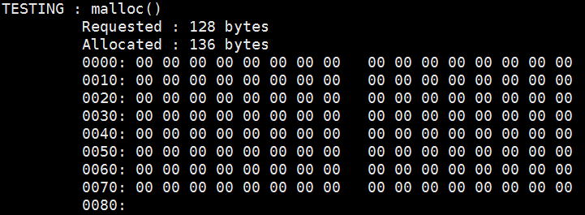
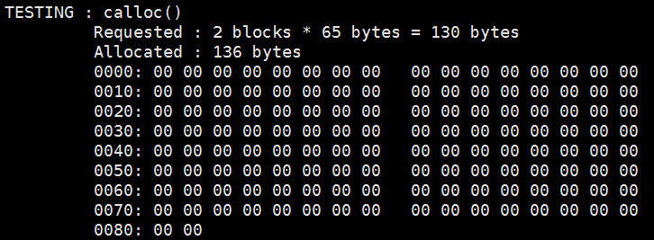
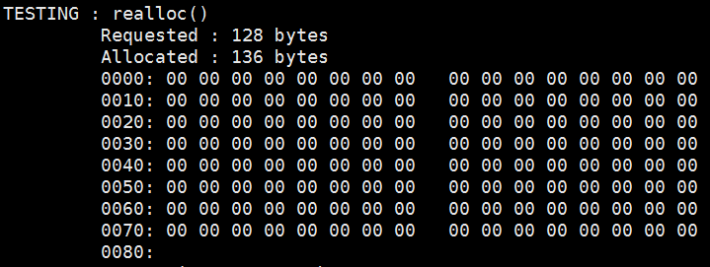
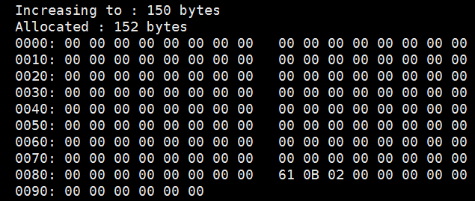
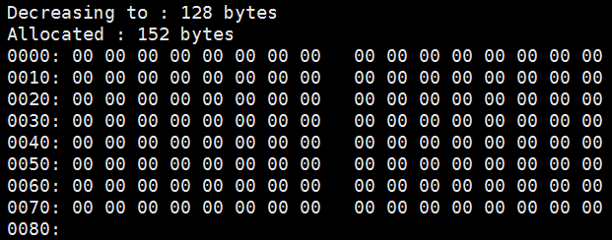
Problem 4: Make your own program using malloc(), calloc(), realloc() & free()
Notice that allocated size is > requested size. This depends on implementation of malloc() or any other memory allocator. However, as a programmer, we should only utilize requested size of memory. Also observe that although hex dump of allocated memory is initialized to ‘zero’ in this case, it may not hold true always. Reference: http://stackoverflow.com/a/8029624
In case of calloc(), allocated memory is always initialized to ‘zero’.
Notice that realloc() doesn’t initialize memory. It simply increases or decreases an already allocated memory.

