Slide 1
EE516 : Homework 1
Gaurav Kalra
(Student ID: 2016 45 93)
gvkalra@kaist.ac.kr

Slide 2
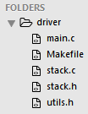
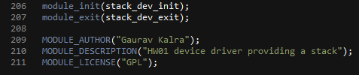
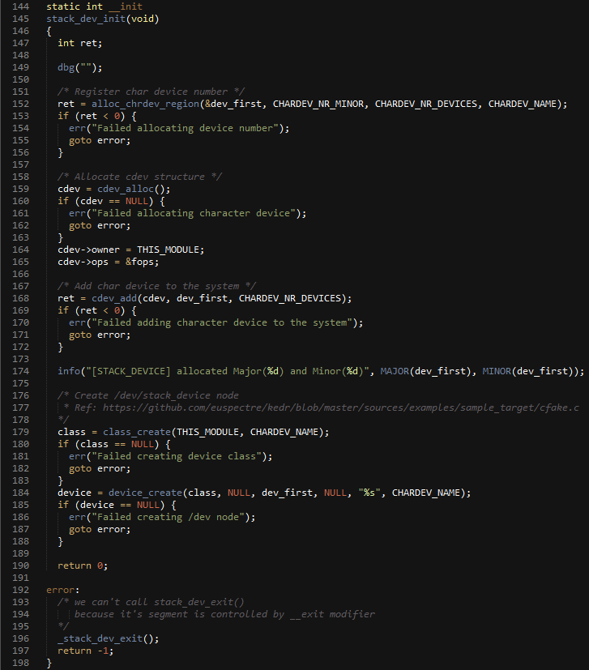

Problem 1: Device Driver
Make your device driver with a Stack and its application program to prove the correctness.
1
2
3
4
5
6
Figure 1: Kernel Module initialization / de-initialization in main.c

Slide 3
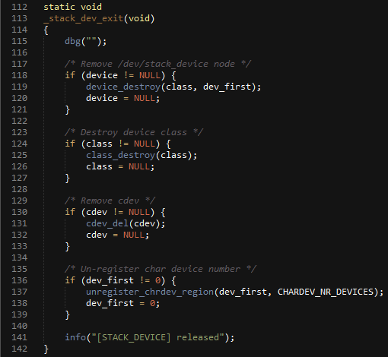
1
2
3
4
Figure 1.1: Kernel Module initialization / de-initialization in main.c
A separate function _stack_dev_exit() is reused in stack_dev_init() and
stack_dev_exit() because of different lifetimes provided by __init and
__exit modifiers.
Major & Minor numbers are dynamically allocated by the Kernel using
the new way of device allocation.
References:
http://stackoverflow.com/questions/8563978/what-is-kernel-section-mismatch
https://github.com/euspectre/kedr/blob/master/sources/examples/sample_target/cfake.c

Slide 4
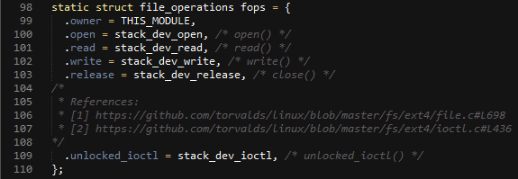


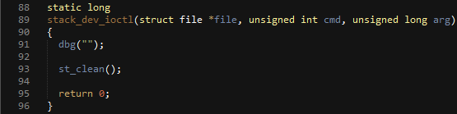
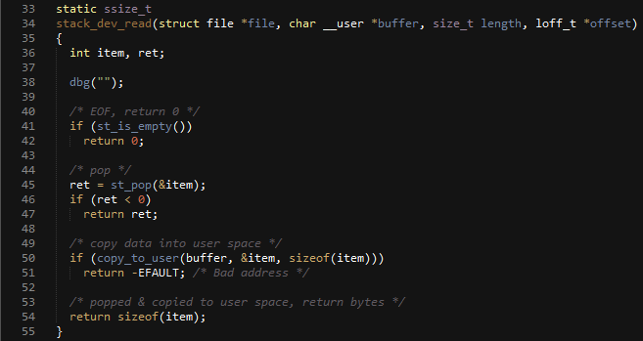
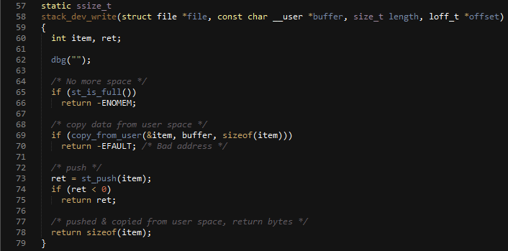
1
2
3
4
5
6
7
8
9
Figure 2: VFS operations implemented by Stack device in main.c

Slide 5
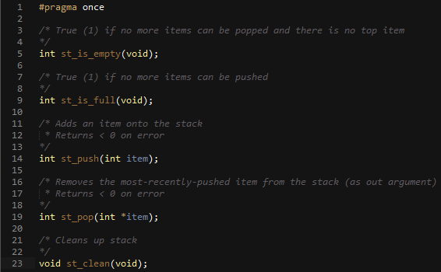
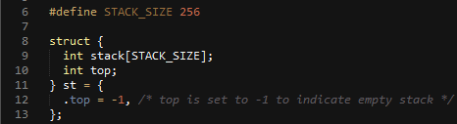
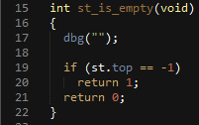
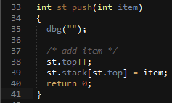
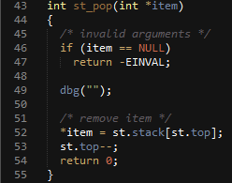
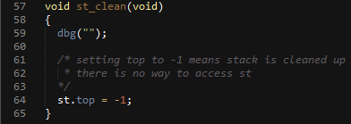
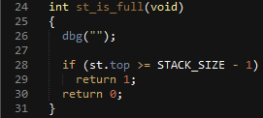
Figure 3: APIs exposed by Stack abstraction in stack.h
Figure 4: Implementation of Stack abstraction in stack.c

Slide 6
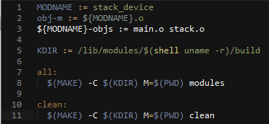
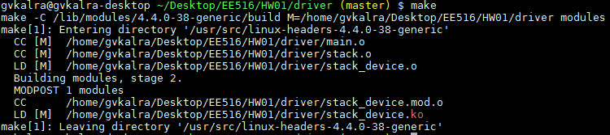

Figure 5: Makefile for Kernel Module
Figure 6: Generating Kernel Module (stack_device.ko)
Figure 7: Inserting Kernel Module using insmod
Figure 8: Verifying module insertion using lsmod, /proc/devices and creation of /dev/stack_device character device. Note that Major(244) and Minor(0) have been assigned by the kernel at runtime.

Slide 7
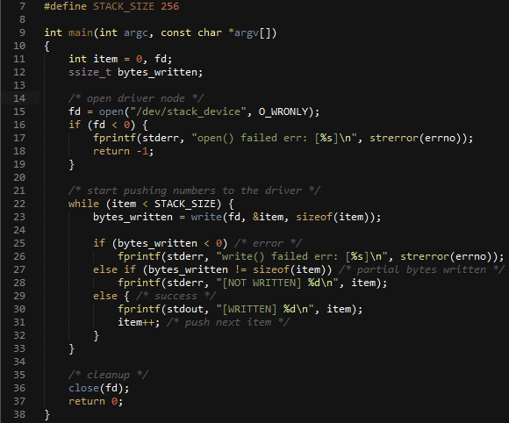
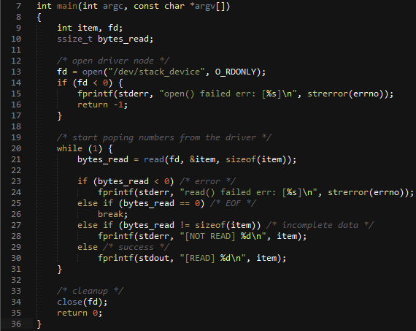
1
2
Figure 9: app1 writing 256 items (0 – 255) on stack_device
1
2
Figure 10: app2 reading items until EOF from stack_device

Slide 8
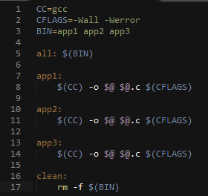


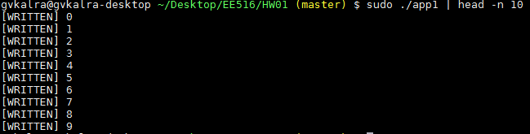
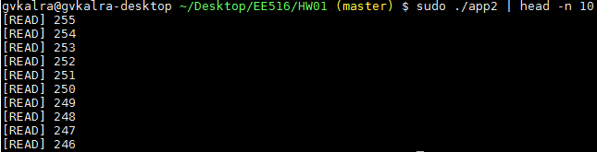
Figure 11: Makefile & folder structure of applications
Figure 12: Output of ./app1 (write) stripped to 10 lines
Figure 13: Output of ./app2 (read) stripped to 10 lines
The read data sequence is opposite of write data sequence because
the read() & write() system calls on /dev/stack_device are implemented
as a stack data structure (first-in last-out, last-in first-out) in our driver.

Slide 9
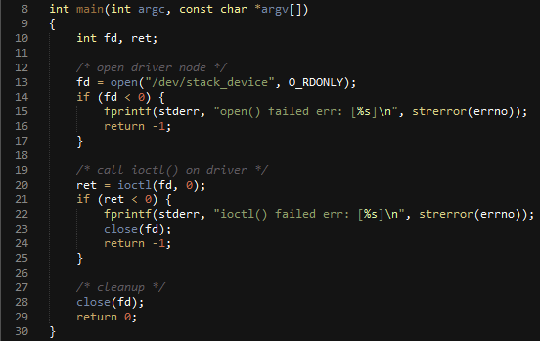
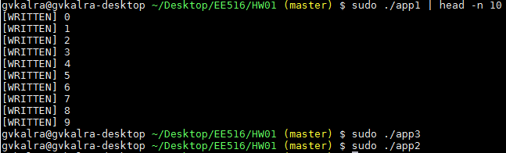
Problem 2: Clean Function
Make your own “clean function” that makes the stack empty.
1
2
Figure 14: app3 cleans stack_device by invoking ioctl()
The structure file_operations provides an extension point for custom
commands using ioctl (I/O control). I have implemented the operation
of “stack clean” in Linux using unlocked_ioctl() [Refer Figure 2].
It can be invoked by an application using ioctl() system call.
Reference:
https://github.com/torvalds/linux/blob/master/include/linux/fs.h#L1679
Figure 15: app1 writes 256 items (0 – 255) on stack_device, app3 cleans stack_device, app2 has no remaining data to read.

