Slide 1
Data Formats
(and beyondish)
Shannon EK Joslin
03 May 2020

Slide 2
Overview
data formats
a few (more) notes about files
software
a note about data
does this all make sense?

Slide 3
FASTA
“2” lines per sequence entry…kind of
>m64069_200211_020731/0/0_7511 RQ=0.800
ttaagcagagccagtacagacatggtgacctggctggtgatccccaggatggcgggggggatccggtgcctgtcgacact
ccagatagggcggagaggaggtgttgctcgagggcaagatgtttttattctctggccgcagtataaggctattagggcac
ggaaggtctttttgacaatgctttccttttcctgatcaattgctaaatgtgaggattggcttcagcataattccatacac
ttgtgtagcacattttggggcgctttgaggctgagaggtgggtggaatgtctgaatagactgtcgtttggaagggtggtc
ctcacccttgaaaagtcaaggaggtgatccagagaggctgagatgatgtggcctagcctgaaccatttctccagatcctg
gggaaagcctctagcagtgctagacctttcaacatctgcccagagtgttgaagtaccaggtcttcagcagaaaggtatgg
aggagaagcttgcccgatggtctgatctaaaatccagcaagtagggagccagggtcccatctgctcaggtccgcaccggt
gttgagaaggtggccgatgatagcagtgaaactttaggagcaacatctgtgacctccacaggttctcagacaagatgttg

Slide 4
FASTA
2 lines per sequence entry…kind of
>m64069_200211_020731/0/0_7511 RQ=0.800
ttaagcagagccagtacagacatggtgacctggctggtgatccccaggatggcgggggggatccggtgcctgtcgacact
ccagatagggcggagaggaggtgttgctcgagggcaagatgtttttattctctggccgcagtataaggctattagggcac
ggaaggtctttttgacaatgctttccttttcctgatcaattgctaaatgtgaggattggcttcagcataattccatacac
ttgtgtagcacattttggggcgctttgaggctgagaggtgggtggaatgtctgaatagactgtcgtttggaagggtggtc
ctcacccttgaaaagtcaaggaggtgatccagagaggctgagatgatgtggcctagcctgaaccatttctccagatcctg
gggaaagcctctagcagtgctagacctttcaacatctgcccagagtgttgaagtaccaggtcttcagcagaaaggtatgg
aggagaagcttgcccgatggtctgatctaaaatccagcaagtagggagccagggtcccatctgctcaggtccgcaccggt
gttgagaaggtggccgatgatagcagtgaaactttaggagcaacatctgtgacctccacaggttctcagacaagatgttg
description line
Nowadays description line always begins with >

Slide 5
FASTA
2 lines per sequence entry…kind of
>m64069_200211_020731/0/0_7511 RQ=0.800
ttaagcagagccagtacagacatggtgacctggctggtgatccccaggatggcgggggggatccggtgcctgtcgacact
ccagatagggcggagaggaggtgttgctcgagggcaagatgtttttattctctggccgcagtataaggctattagggcac
ggaaggtctttttgacaatgctttccttttcctgatcaattgctaaatgtgaggattggcttcagcataattccatacac
ttgtgtagcacattttggggcgctttgaggctgagaggtgggtggaatgtctgaatagactgtcgtttggaagggtggtc
ctcacccttgaaaagtcaaggaggtgatccagagaggctgagatgatgtggcctagcctgaaccatttctccagatcctg
gggaaagcctctagcagtgctagacctttcaacatctgcccagagtgttgaagtaccaggtcttcagcagaaaggtatgg
aggagaagcttgcccgatggtctgatctaaaatccagcaagtagggagccagggtcccatctgctcaggtccgcaccggt
gttgagaaggtggccgatgatagcagtgaaactttaggagcaacatctgtgacctccacaggttctcagacaagatgttg
|
|
80-120 characters

Slide 6
FASTQ
4 lines per sequence entry
@A00351:291:HVMC5DSXX:4:1101:1307:1000 2:N:0:CAGCATAC+CGTATCTC
NCTGTGTGTCTGATGTGTGTCTGCTGTGTGTCTGCTGTGTCTGCTGTGTGTCTGCTGTGTGTCTGTAG
+
#:FF:F,:!''*((((***+))%%%%).1***-+*''))**55CCF>>>>>>CCCC65FF,,,,:FF,

Slide 7
FASTQ
Line 1 = begins with @ followed by a sequence ID, then optional additional information
@A00351:291:HVMC5DSXX:4:1101:1307:1000 2:N:0:CAGCATAC+CGTATCTC
NCTGTGTGTCTGATGTGTGTCTGCTGTGTGTCTGCTGTGTCTGCTGTGTGTCTGCTGTGTGTCTGTAG
+
#:FF:F,:!''*((((***+))%%%%).1***-+*''))**55CCF>>>>>>CCCC65FF,,,,:FF,

Slide 8
FASTQ
Line 2 = the sequence read by the sequencer
@A00351:291:HVMC5DSXX:4:1101:1307:1000 2:N:0:CAGCATAC+CGTATCTC
NCTGTGTGTCTGATGTGTGTCTGCTGTGTGTCTGCTGTGTCTGCTGTGTGTCTGCTGTGTGTCTGTAG
+
#:FF:F,:!''*((((***+))%%%%).1***-+*''))**55CCF>>>>>>CCCC65FF,,,,:FF,

Slide 9
FASTQ
Line 3 = begins with + and optional information (artifact line)
@A00351:291:HVMC5DSXX:4:1101:1307:1000 2:N:0:CAGCATAC+CGTATCTC
NCTGTGTGTCTGATGTGTGTCTGCTGTGTGTCTGCTGTGTCTGCTGTGTGTCTGCTGTGTGTCTGTAG
+
#:FF:F,:!''*((((***+))%%%%).1***-+*''))**55CCF>>>>>>CCCC65FF,,,,:FF,

Slide 10
FASTQ
Line 4 = quality scores for the sequencing read (contains the same number of characters as line 2)
@A00351:291:HVMC5DSXX:4:1101:1307:1000 2:N:0:CAGCATAC+CGTATCTC
NCTGTGTGTCTGATGTGTGTCTGCTGTGTGTCTGCTGTGTCTGCTGTGTGTCTGCTGTGTGTCTGTAG
+
#:FF:F,:!''*((((***+))%%%%).1***-+*''))**55CCF>>>>>>CCCC65FF,,,,:FF,

Slide 11
BAM
Binary alignment/map file
Binary version of a SAM file
samtools view <file>
Column 1 = QNAME
J00113:228:HFWFMBBXX:6:2227:2239:7122 147 R000001 1 60 2S88M = 1 -88 TTCGATGCAGGCCTGTCAGGTTCAGAATGCACAAGGCGTAGATAAAT FFJJFJAAJJAJJJJJJJJJJJJJJJJJJJJJJJJJJJJJJFJJJJJJJJJJFFFAA NM:i:0 MD:Z:88 AS:i:88 XS:i:0
J00113:228:HFWFMBBXX:6:2211:3397:6396 99 R000001 1 60 1S83M = 82 181 CCTGTCAGGTTCAGAAATGCACAAGGCGTAGATAAATTAGGTCTCAGT JJJJFJFJFFJF<-A7AJFFJJFF-F7FJFFFJA7F-77FAF---F< NM:i:1 MD:Z:72C10 AS:i:78 XS:i:0
query template name
a name pertaining to a sequence
m64069_200220_045555/0/23286_23333 4 * 0 255 * * 0 0 ATCTCCAACAGAGAGAGACGAT !$%!!6(?)55CCF>>>>>
m64069_200220_045555/0/34143_37185 4 * 0 255 * * 0 0 CGCGACCGCCCCACCCATCAGC FF:F,:!''*(((*+)&%%

Slide 12
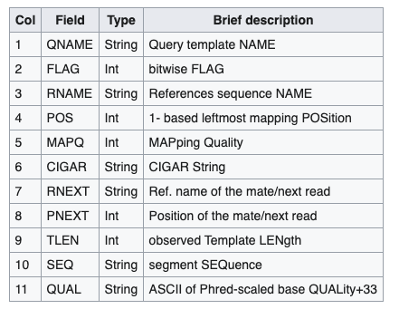
BAM
Binary alignment/map file
Binary version of a SAM file
samtools view <file>
Column 2 = FLAG
J00113:228:HFWFMBBXX:6:2227:2239:7122 147 R000001 1 60 2S88M = 1 -88 TTCGATGCAGGCCTGTCAGGTTCAGAATGCACAAGGCGTAGATAAAT FFJJFJAAJJAJJJJJJJJJJJJJJJJJJJJJJJJJJJJJJFJJJJJJJJJJFFFAA NM:i:0 MD:Z:88 AS:i:88 XS:i:0
J00113:228:HFWFMBBXX:6:2211:3397:6396 99 R000001 1 60 1S83M = 82 181 CCTGTCAGGTTCAGAAATGCACAAGGCGTAGATAAATTAGGTCTCAGT JJJJFJFJFFJF<-A7AJFFJJFF-F7FJFFFJA7F-77FAF---F< NM:i:1 MD:Z:72C10 AS:i:78 XS:i:0
bitwise flag
m64069_200220_045555/0/23286_23333 4 * 0 255 * * 0 0 ATCTCCAACAGAGAGAGACGAT !$%!!6(?)55CCF>>>>>
m64069_200220_045555/0/34143_37185 4 * 0 255 * * 0 0 CGCGACCGCCCCACCCATCAGC FF:F,:!''*(((*+)&%%

Slide 13
BAM
Binary alignment/map file
Binary version of a SAM file
samtools view <file>
Column 3 = RNAME
J00113:228:HFWFMBBXX:6:2227:2239:7122 147 R000001 1 60 2S88M = 1 -88 TTCGATGCAGGCCTGTCAGGTTCAGAATGCACAAGGCGTAGATAAAT FFJJFJAAJJAJJJJJJJJJJJJJJJJJJJJJJJJJJJJJJFJJJJJJJJJJFFFAA NM:i:0 MD:Z:88 AS:i:88 XS:i:0
J00113:228:HFWFMBBXX:6:2211:3397:6396 99 R000001 1 60 1S83M = 82 181 CCTGTCAGGTTCAGAAATGCACAAGGCGTAGATAAATTAGGTCTCAGT JJJJFJFJFFJF<-A7AJFFJJFF-F7FJFFFJA7F-77FAF---F< NM:i:1 MD:Z:72C10 AS:i:78 XS:i:0
reference sequence name
refers to contig
m64069_200220_045555/0/23286_23333 4 * 0 255 * * 0 0 ATCTCCAACAGAGAGAGACGAT !$%!!6(?)55CCF>>>>>
m64069_200220_045555/0/34143_37185 4 * 0 255 * * 0 0 CGCGACCGCCCCACCCATCAGC FF:F,:!''*(((*+)&%%

Slide 14
BAM
Binary alignment/map file
Binary version of a SAM file
samtools view <file>
Column 4 = POS
J00113:228:HFWFMBBXX:6:2227:2239:7122 147 R000001 1 60 2S88M = 1 -88 TTCGATGCAGGCCTGTCAGGTTCAGAATGCACAAGGCGTAGATAAAT FFJJFJAAJJAJJJJJJJJJJJJJJJJJJJJJJJJJJJJJJFJJJJJJJJJJFFFAA NM:i:0 MD:Z:88 AS:i:88 XS:i:0
J00113:228:HFWFMBBXX:6:2211:3397:6396 99 R000001 1 60 1S83M = 82 181 CCTGTCAGGTTCAGAAATGCACAAGGCGTAGATAAATTAGGTCTCAGT JJJJFJFJFFJF<-A7AJFFJJFF-F7FJFFFJA7F-77FAF---F< NM:i:1 MD:Z:72C10 AS:i:78 XS:i:0
leftmost position the QNAME aligns to
0 means unaligned
m64069_200220_045555/0/23286_23333 4 * 0 255 * * 0 0 ATCTCCAACAGAGAGAGACGAT !$%!!6(?)55CCF>>>>>
m64069_200220_045555/0/34143_37185 4 * 0 255 * * 0 0 CGCGACCGCCCCACCCATCAGC FF:F,:!''*(((*+)&%%

Slide 15
BAM
Binary alignment/map file
Binary version of a SAM file
samtools view <file>
Column 5 = MAPQ
J00113:228:HFWFMBBXX:6:2227:2239:7122 147 R000001 1 60 2S88M = 1 -88 TTCGATGCAGGCCTGTCAGGTTCAGAATGCACAAGGCGTAGATAAAT FFJJFJAAJJAJJJJJJJJJJJJJJJJJJJJJJJJJJJJJJFJJJJJJJJJJFFFAA NM:i:0 MD:Z:88 AS:i:88 XS:i:0
J00113:228:HFWFMBBXX:6:2211:3397:6396 99 R000001 1 60 1S83M = 82 181 CCTGTCAGGTTCAGAAATGCACAAGGCGTAGATAAATTAGGTCTCAGT JJJJFJFJFFJF<-A7AJFFJJFF-F7FJFFFJA7F-77FAF---F< NM:i:1 MD:Z:72C10 AS:i:78 XS:i:0
mapping quality
m64069_200220_045555/0/23286_23333 4 * 0 255 * * 0 0 ATCTCCAACAGAGAGAGACGAT !$%!!6(?)55CCF>>>>>
m64069_200220_045555/0/34143_37185 4 * 0 255 * * 0 0 CGCGACCGCCCCACCCATCAGC FF:F,:!''*(((*+)&%%

Slide 16
BAM
Binary alignment/map file
Binary version of a SAM file
samtools view <file>
Column 7 = RNEXT
J00113:228:HFWFMBBXX:6:2227:2239:7122 147 R000001 1 60 2S88M = 1 -88 TTCGATGCAGGCCTGTCAGGTTCAGAATGCACAAGGCGTAGATAAAT FFJJFJAAJJAJJJJJJJJJJJJJJJJJJJJJJJJJJJJJJFJJJJJJJJJJFFFAA NM:i:0 MD:Z:88 AS:i:88 XS:i:0
J00113:228:HFWFMBBXX:6:2211:3397:6396 99 R000001 1 60 1S83M = 82 181 CCTGTCAGGTTCAGAAATGCACAAGGCGTAGATAAATTAGGTCTCAGT JJJJFJFJFFJF<-A7AJFFJJFF-F7FJFFFJA7F-77FAF---F< NM:i:1 MD:Z:72C10 AS:i:78 XS:i:0
reference sequence name of the next read in the template
“=“ means RNAME = RNEXT
“*” meands unavailable
m64069_200220_045555/0/23286_23333 4 * 0 255 * * 0 0 ATCTCCAACAGAGAGAGACGAT !$%!!6(?)55CCF>>>>>
m64069_200220_045555/0/34143_37185 4 * 0 255 * * 0 0 CGCGACCGCCCCACCCATCAGC FF:F,:!''*(((*+)&%%

Slide 17
BAM
Binary alignment/map file
Binary version of a SAM file
samtools view <file>
Column 8 = PNEXT
J00113:228:HFWFMBBXX:6:2227:2239:7122 147 R000001 1 60 2S88M = 1 -88 TTCGATGCAGGCCTGTCAGGTTCAGAATGCACAAGGCGTAGATAAAT FFJJFJAAJJAJJJJJJJJJJJJJJJJJJJJJJJJJJJJJJFJJJJJJJJJJFFFAA NM:i:0 MD:Z:88 AS:i:88 XS:i:0
J00113:228:HFWFMBBXX:6:2211:3397:6396 99 R000001 1 60 1S83M = 82 181 CCTGTCAGGTTCAGAAATGCACAAGGCGTAGATAAATTAGGTCTCAGT JJJJFJFJFFJF<-A7AJFFJJFF-F7FJFFFJA7F-77FAF---F< NM:i:1 MD:Z:72C10 AS:i:78 XS:i:0
position of the primary alignment of the next read in the template
m64069_200220_045555/0/23286_23333 4 * 0 255 * * 0 0 ATCTCCAACAGAGAGAGACGAT !$%!!6(?)55CCF>>>>>
m64069_200220_045555/0/34143_37185 4 * 0 255 * * 0 0 CGCGACCGCCCCACCCATCAGC FF:F,:!''*(((*+)&%%

Slide 18
BAM
Binary alignment/map file
Binary version of a SAM file
samtools view <file>
Column 9 = TLEN
J00113:228:HFWFMBBXX:6:2227:2239:7122 147 R000001 1 60 2S88M = 1 -88 TTCGATGCAGGCCTGTCAGGTTCAGAATGCACAAGGCGTAGATAAAT FFJJFJAAJJAJJJJJJJJJJJJJJJJJJJJJJJJJJJJJJFJJJJJJJJJJFFFAA NM:i:0 MD:Z:88 AS:i:88 XS:i:0
J00113:228:HFWFMBBXX:6:2211:3397:6396 99 R000001 1 60 1S83M = 82 181 CCTGTCAGGTTCAGAAATGCACAAGGCGTAGATAAATTAGGTCTCAGT JJJJFJFJFFJF<-A7AJFFJJFF-F7FJFFFJA7F-77FAF---F< NM:i:1 MD:Z:72C10 AS:i:78 XS:i:0
observed length of template
minus sign corresponds to the rightmost
m64069_200220_045555/0/23286_23333 4 * 0 255 * * 0 0 ATCTCCAACAGAGAGAGACGAT !$%!!6(?)55CCF>>>>>
m64069_200220_045555/0/34143_37185 4 * 0 255 * * 0 0 CGCGACCGCCCCACCCATCAGC FF:F,:!''*(((*+)&%%

Slide 19
BAM
Binary alignment/map file
Binary version of a SAM file
samtools view <file>
Column 10 = SEQ
J00113:228:HFWFMBBXX:6:2227:2239:7122 147 R000001 1 60 2S88M = 1 -88 TTCGATGCAGGCCTGTCAGGTTCAGAATGCACAAGGCGTAGATAAAT FFJJFJAAJJAJJJJJJJJJJJJJJJJJJJJJJJJJJJJJJFJJJJJJJJJJFFFAA NM:i:0 MD:Z:88 AS:i:88 XS:i:0
J00113:228:HFWFMBBXX:6:2211:3397:6396 99 R000001 1 60 1S83M = 82 181 CCTGTCAGGTTCAGAAATGCACAAGGCGTAGATAAATTAGGTCTCAGT JJJJFJFJFFJF<-A7AJFFJJFF-F7FJFFFJA7F-77FAF---F< NM:i:1 MD:Z:72C10 AS:i:78 XS:i:0
DNA/RNA sequence
m64069_200220_045555/0/23286_23333 4 * 0 255 * * 0 0 ATCTCCAACAGAGAGAGACGAT !$%!!6(?)55CCF>>>>>
m64069_200220_045555/0/34143_37185 4 * 0 255 * * 0 0 CGCGACCGCCCCACCCATCAGC FF:F,:!''*(((*+)&%%

Slide 20
BAM
Binary alignment/map file
Binary version of a SAM file
samtools view <file>
Column 11 = QUAL
J00113:228:HFWFMBBXX:6:2227:2239:7122 147 R000001 1 60 2S88M = 1 -88 TTCGATGCAGGCCTGTCAGGTTCAGAATGCACAAGGCGTAGATAAAT FFJJFJAAJJAJJJJJJJJJJJJJJJJJJJJJJJJJJJJJJFJJJJJJJJJJFFFAA NM:i:0 MD:Z:88 AS:i:88 XS:i:0
J00113:228:HFWFMBBXX:6:2211:3397:6396 99 R000001 1 60 1S83M = 82 181 CCTGTCAGGTTCAGAAATGCACAAGGCGTAGATAAATTAGGTCTCAGT JJJJFJFJFFJF<-A7AJFFJJFF-F7FJFFFJA7F-77FAF---F< NM:i:1 MD:Z:72C10 AS:i:78 XS:i:0
base quality scores
ASCII of Phred-scaled base quality+33
−10 log10 Pr{base is wrong}
m64069_200220_045555/0/23286_23333 4 * 0 255 * * 0 0 ATCTCCAACAGAGAGAGACGAT !$%!!6(?)55CCF>>>>>
m64069_200220_045555/0/34143_37185 4 * 0 255 * * 0 0 CGCGACCGCCCCACCCATCAGC FF:F,:!''*(((*+)&%%

Slide 21
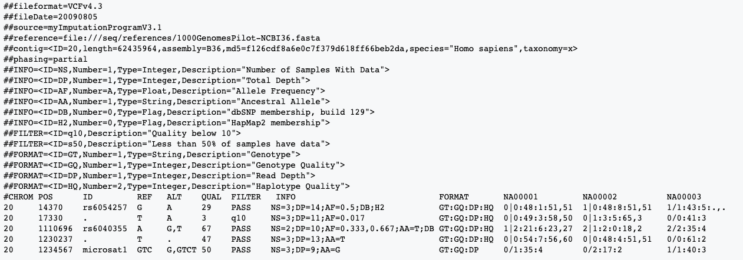
VCF
variant call format –– there are different versions!
Notes:
stores gene sequence variations

Slide 22
VCF
header (denoted by ##) has metadata –– watch out there are different versions
Notes:
stores gene sequence variations

Slide 23
VCF
columns of a VCF file
chromosome/contig number/name
position on chromosome/contig
SNP reference ID (dpSNP or rs)
reference base(s)
alternate base(s)
quality score associated with inferring given alleles
filter status (if the locus passes given quality filters)
information to describe observed variation (e.g. allele freq)
format for describing samples (e.g. genotype, genotype likelihood)
individual sample values listed as per the FORMAT column
Notes:
stores gene sequence variations

Slide 24
gVCF
genomic VCF
similar to VCF but contains information about blocks that match (or don’t match) the reference

Slide 25
BED
one feature per line
minimum of 3 columns
chr1 29320 29370
chr1 135124 135563
chr1 327790 328229
chr1 327790 328229
chr1 327790 328229
chromosome or scaffold
name/number
starting
coordinate
ending
coordinate

Slide 26
BED
can have up to nine more columns (12 in total)
line | title | description
1 | chromosome | chromosome or scaffold name
2 | chromStart | starting coordinate for the line’s sequence (the first base on the chromosome/scaffold = 0)
3 | chromEnd | ending coordinate for the line’s sequence
4 | name | name of the line in the BED file
5 | score | score between 0 and 1000
6 | strand | DNA strand orientation (positive = "+" or negative = "-")
7 | thickStart | starting coordinate from which the annotation is displayed thicker on a graphical representation (e.g.: the start codon of a gene)
8 | thickEnd | end coordinates from which the annotation is no longer displayed in a thicker way on a graphical representation (e.g.: the stop codon of a gene)
9 | itemRgb | color value in R,G,B format (e.g. 255,0,0) used to determine display color of the annotation contained in the BED file
10 | blockCount | number of blocks (e.g. exons) on the line of the BED file
11 | blockSizes | comma separated list of values corresponding to the size of blocks (# of values must match "blockCount")
12 | blockStarts | commas separated list of values corresponding to starting coordinates of blocks, coordinates calculated relative to those present in the chromStart column ((# of values must match "blockCount")

Slide 27
GFF3
general feature format
one feature line per feature
less common

Slide 28
A few more notes about files
bioinformatics generates a lot of intermediate files
always gzip fasta and fastq files
look at the head of a gzipped file with:
bam files are usually smaller…but it depends on what they contain
zcat <file> | head
127M RX73_1_F_H09_GACAGTGC_R1.fastq
140M RX73_1_F_H09_GACAGTGC_R2.fastq
67M RX73_1_F_H09_GACAGTGC.sort.bam
447G m64069_200211_020731.subreads.bam

Slide 29
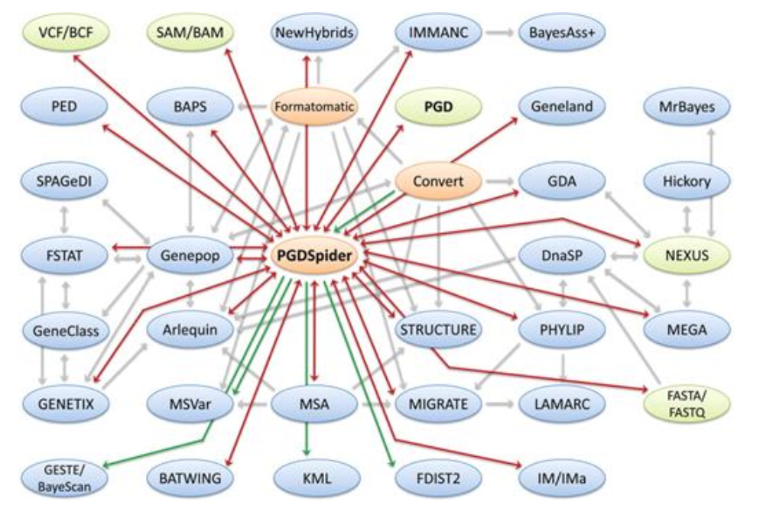
software to convert between file formats
fcGENE (https://bioinformaticshome.com/tools/descriptions/fcGENE.html)
PLINK MACH, IMPUTE, BEAGLE, BIMBBAM, HAPLOVIEW, EIGENSOFT, and SNPTEST
PGDSpider (http://www.cmpg.unibe.ch/software/PGDSpider/)
36 difference file formats
limitation: GUI does not handle big data well
khmer (https://khmer.readthedocs.io/en/latest/user/scripts.html#)
read handling
bam2fastx (https://github.com/PacificBiosciences/bam2fastx)
converts bam to fasta/q
snpR (https://rdrr.io/github/hemstrow/snpR/)
r package that can create and convert into pop gen formats

Slide 30
Getting to know your data
look at data after every step so you become familiar with what to expect
samtools view
zcat <file> | less -S
samtools tview

Slide 31
Does what you see make sense?
aligning
GC content
number of reads
depth
BEDtools: https://bedtools.readthedocs.io/en/latest/
Notes:
aligning depends on reference genome
don’t expect very skewed GC content

